Slide 1
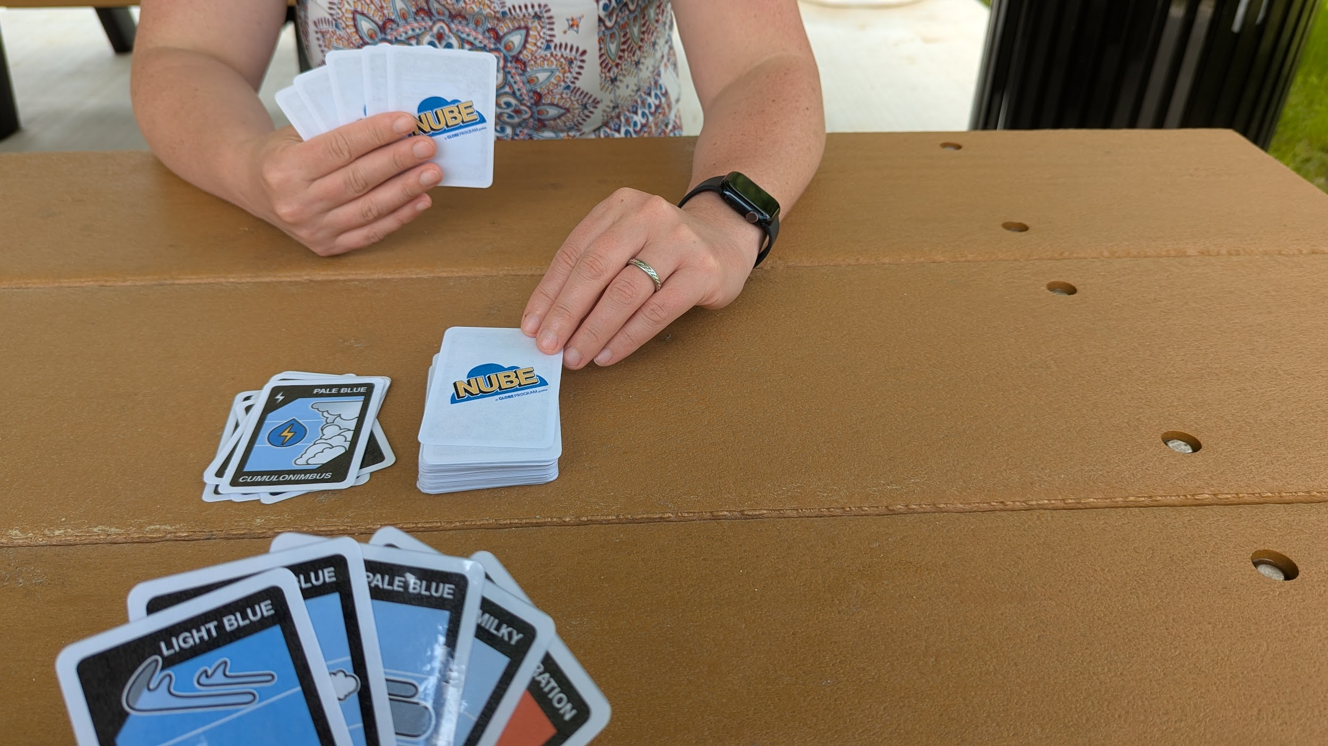


NUBE, a GLOBE Clouds game

Slide 2

How to play NUBE Card game Video

Slide 3
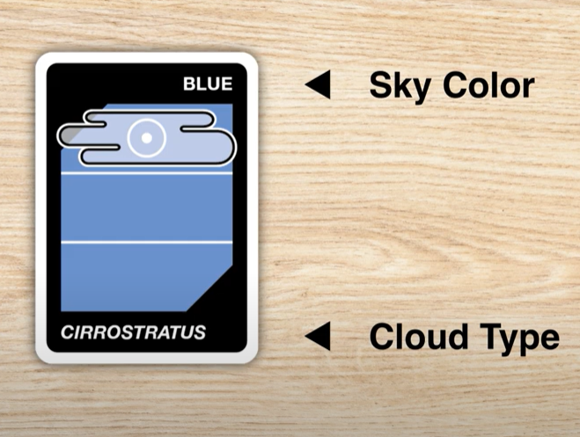
How to Play
Each cloud card has a sky color and a cloud type. There are 5 different sky colors and 11 cloud types.
You play by either matching the cloud type or sky color.

Slide 4
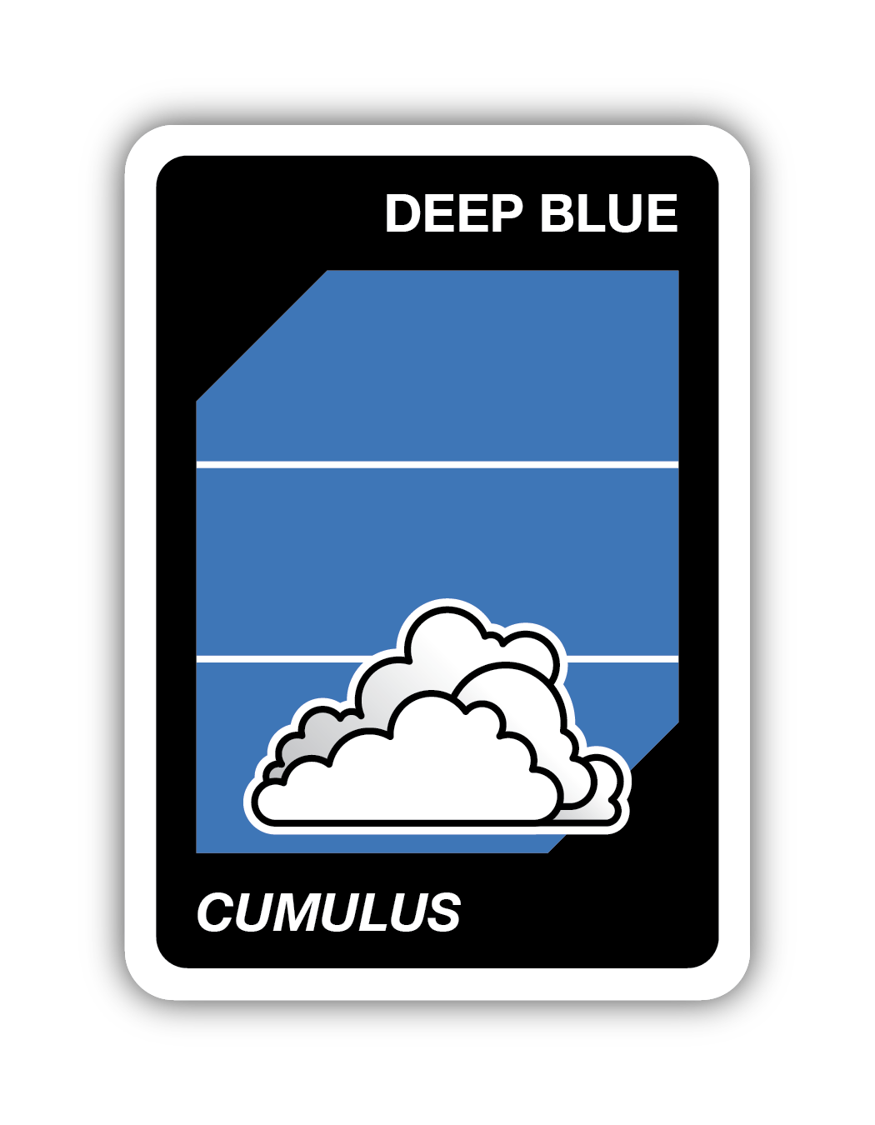
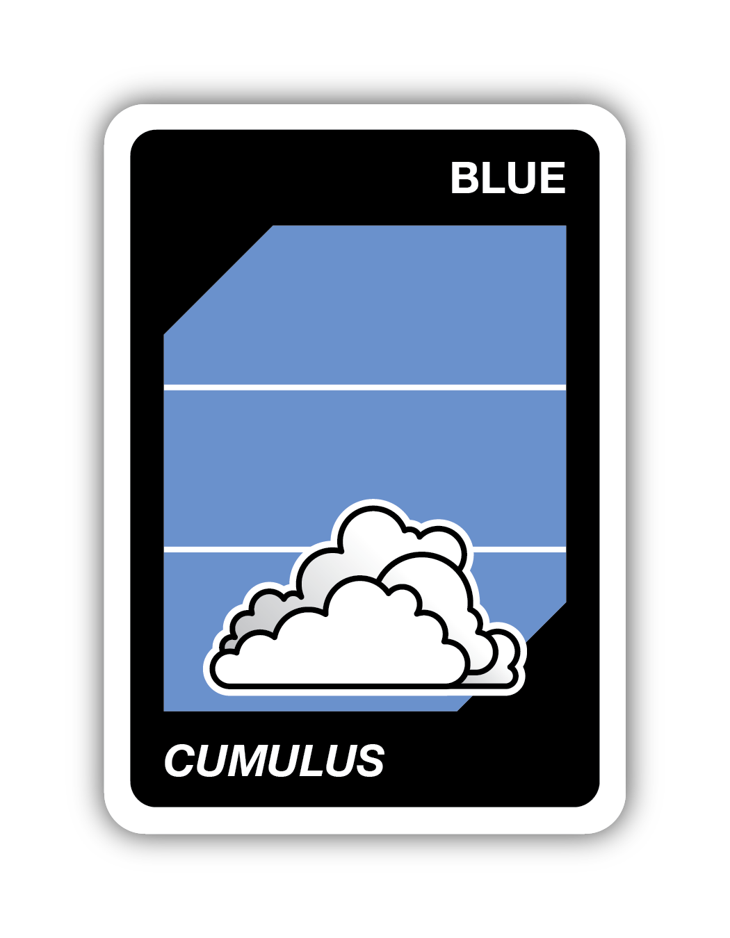
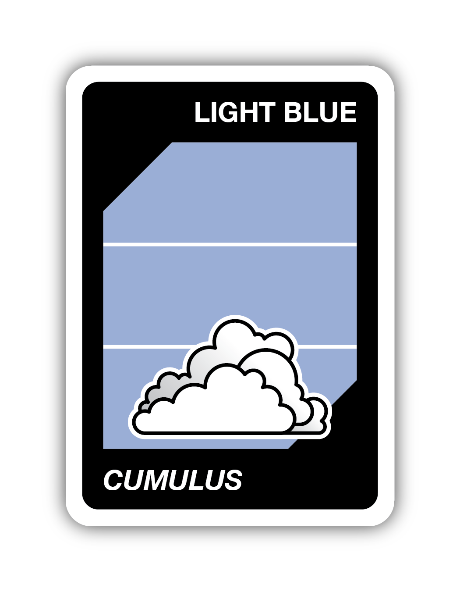
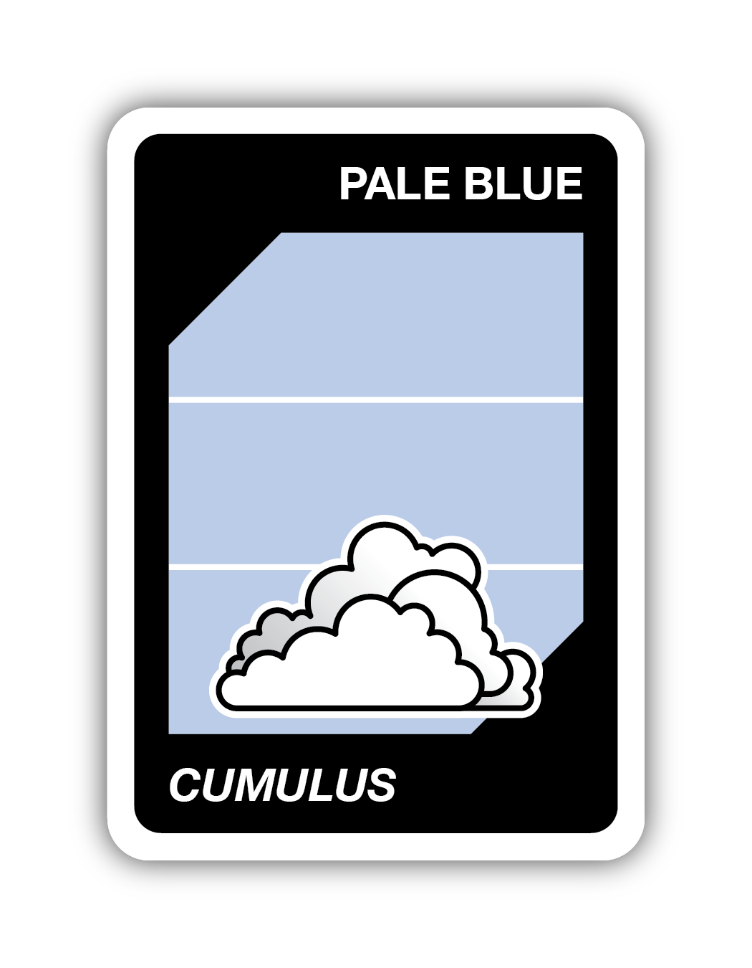
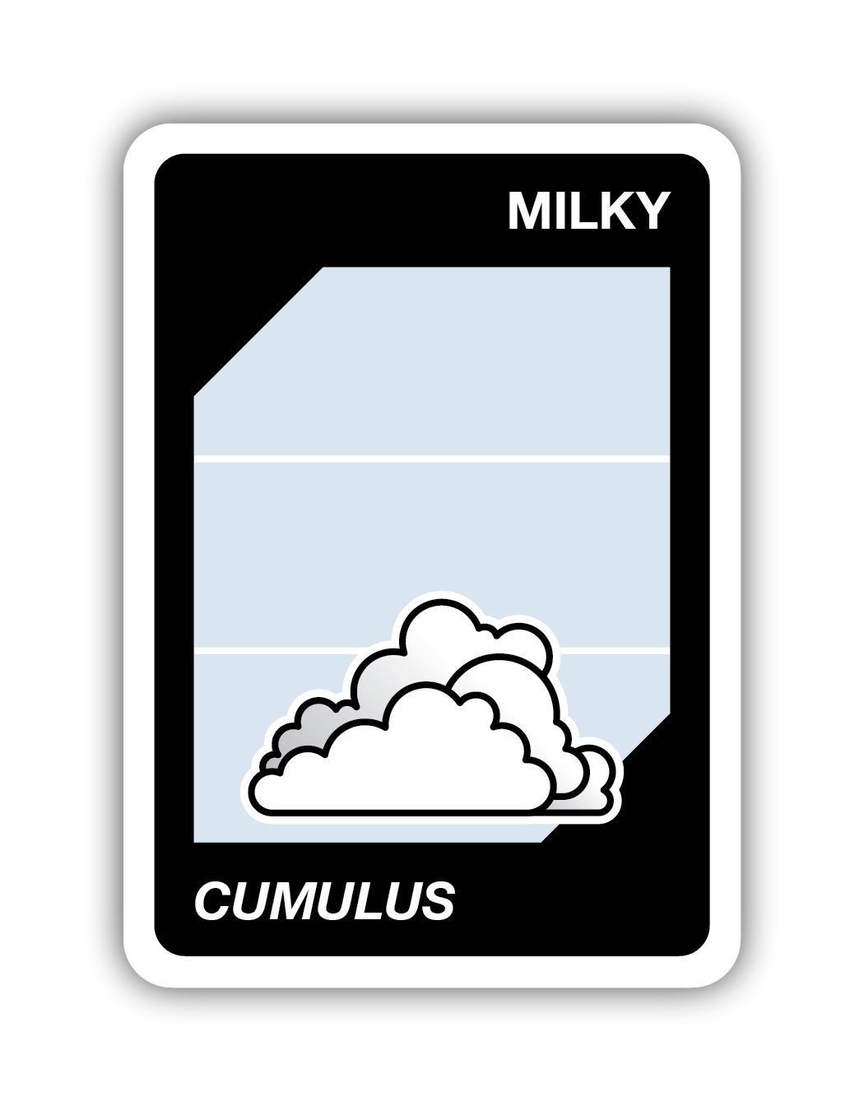
Sky Color - 5 Different Sky Colors
Sky color gives you an idea of how many aerosols are in the sky. The more aerosols, the milkier the sky will look.
You play by either matching the cloud type or sky color.

Slide 5
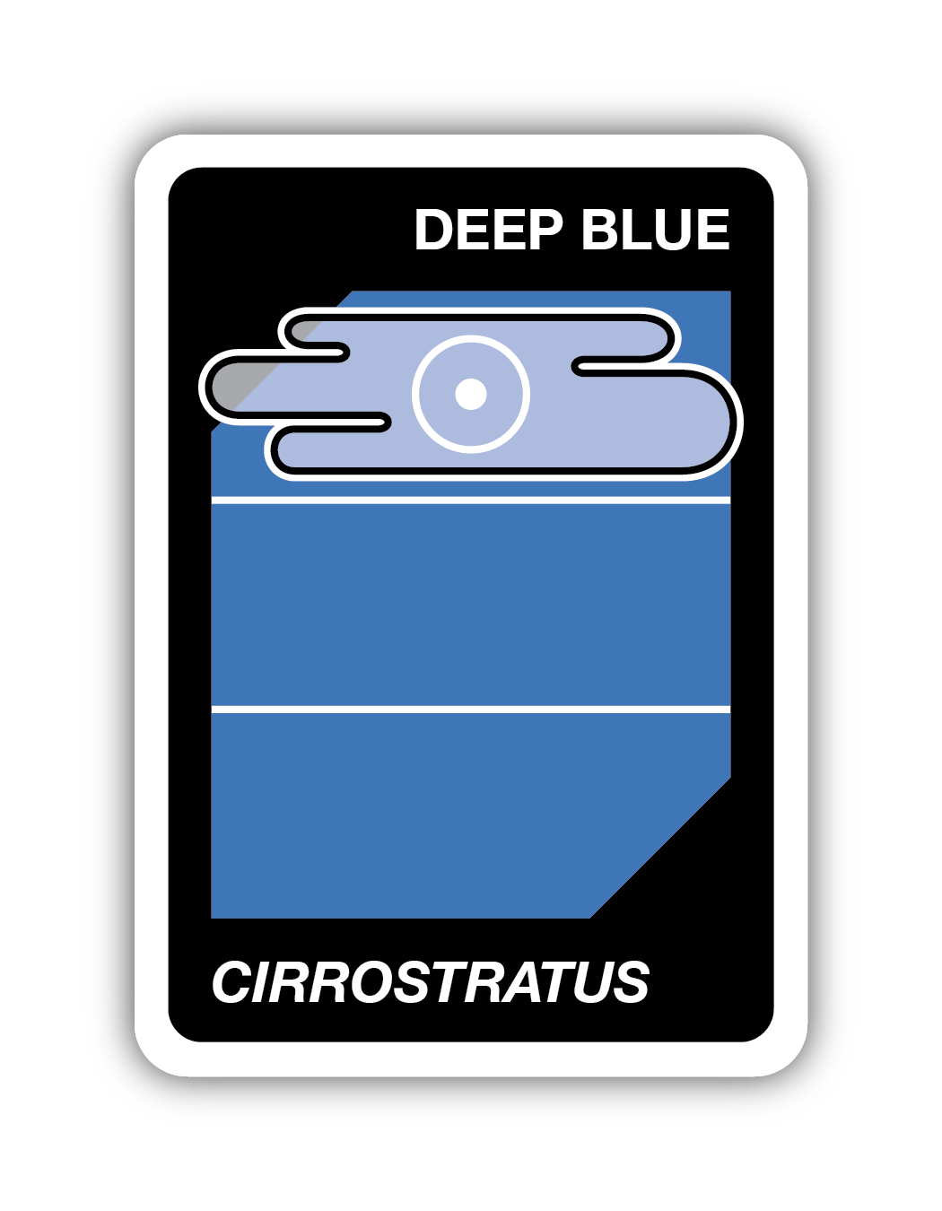
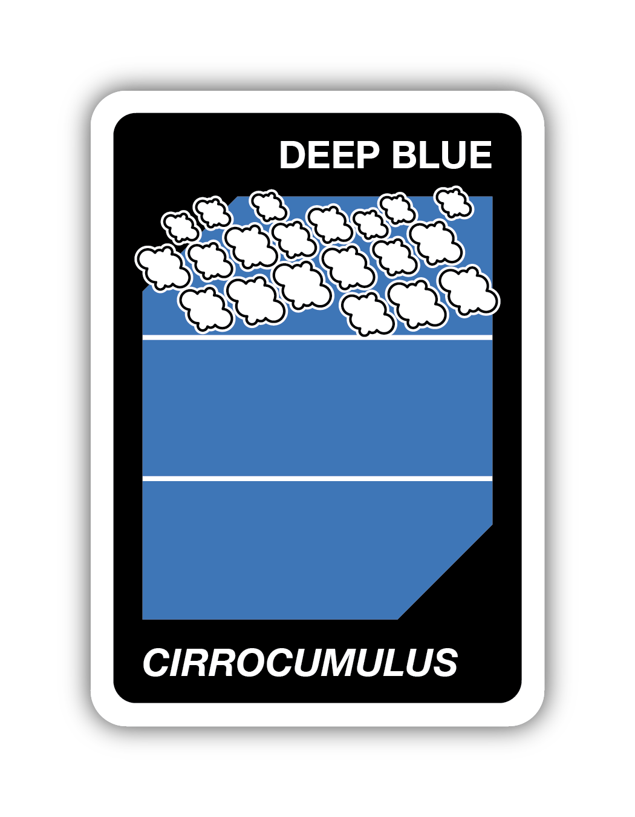
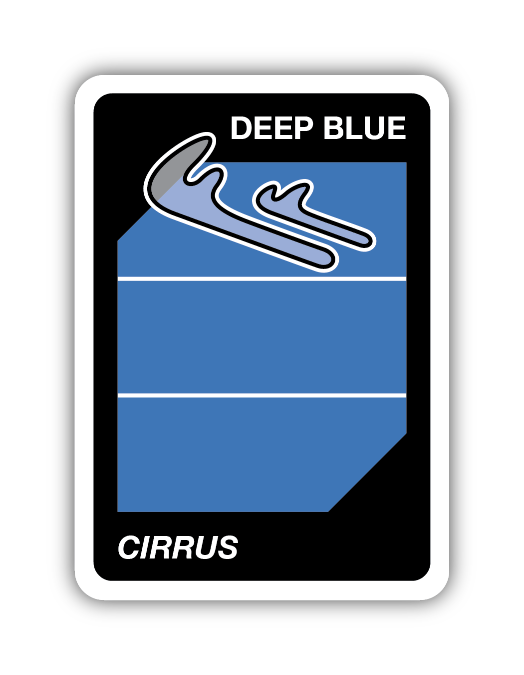
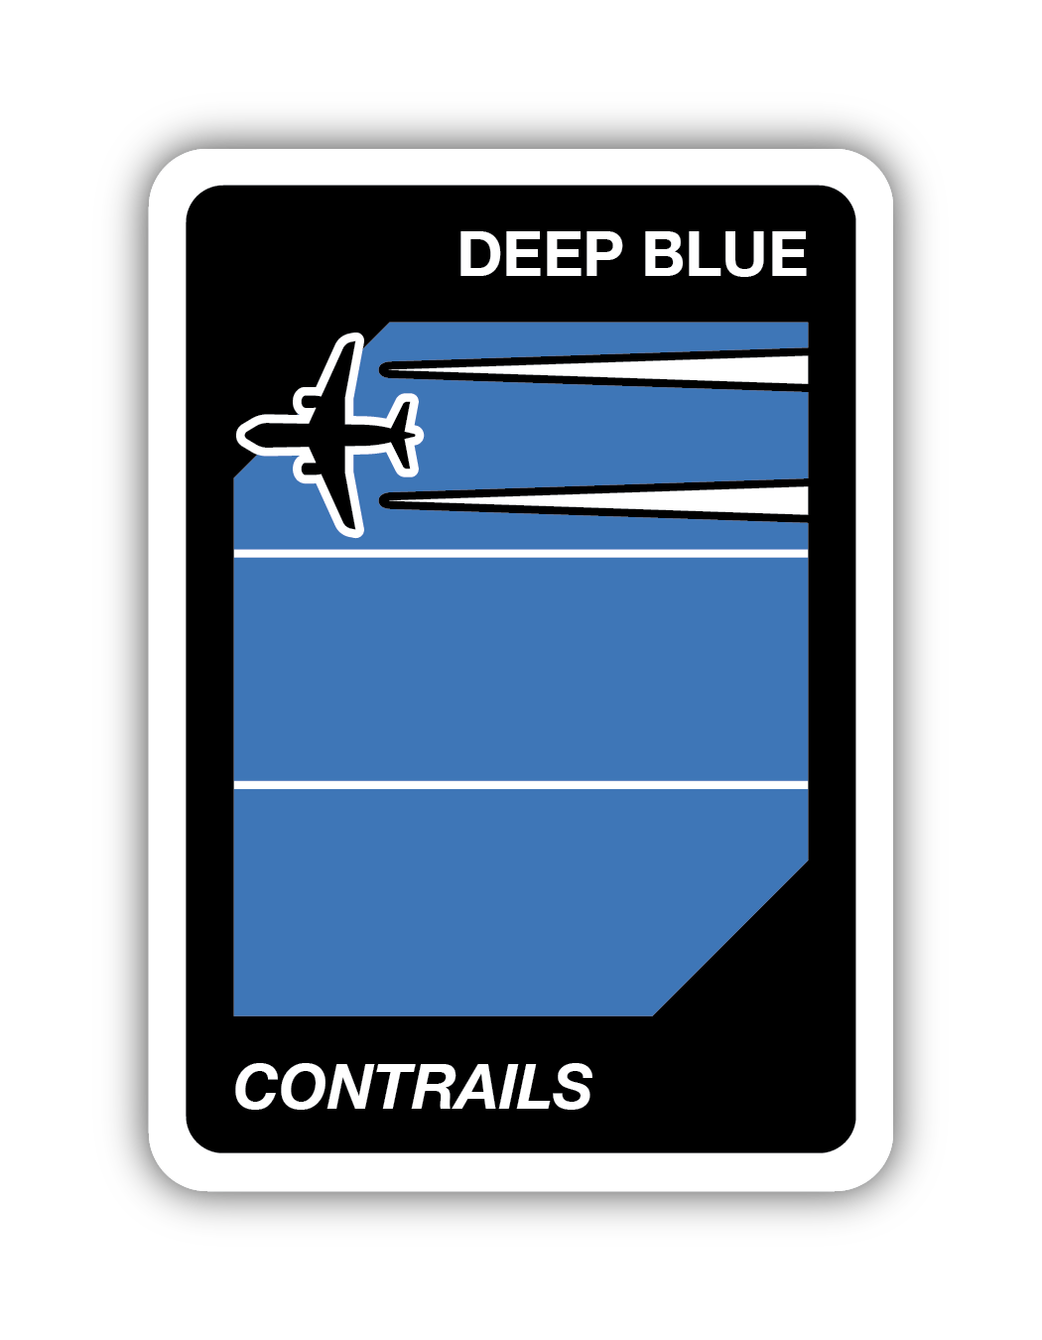
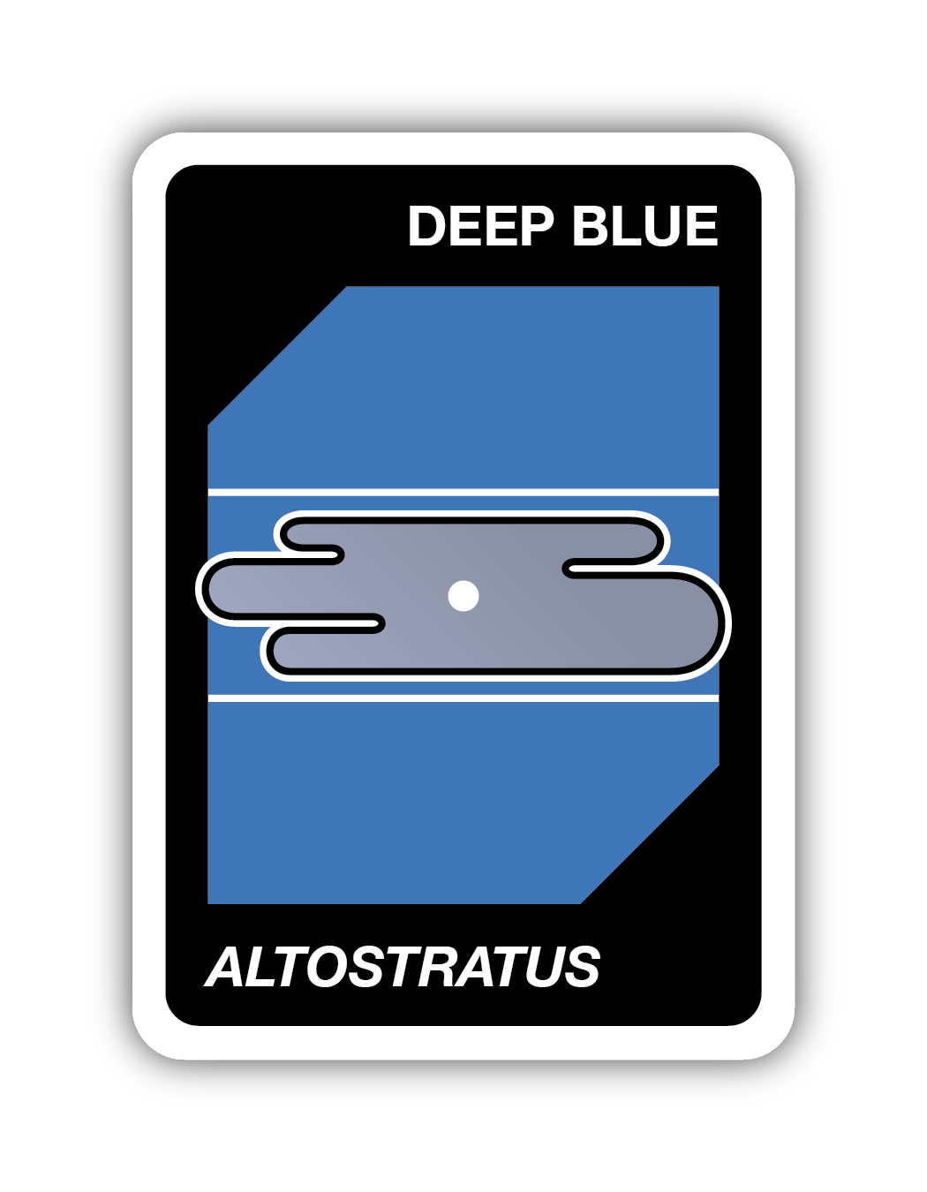
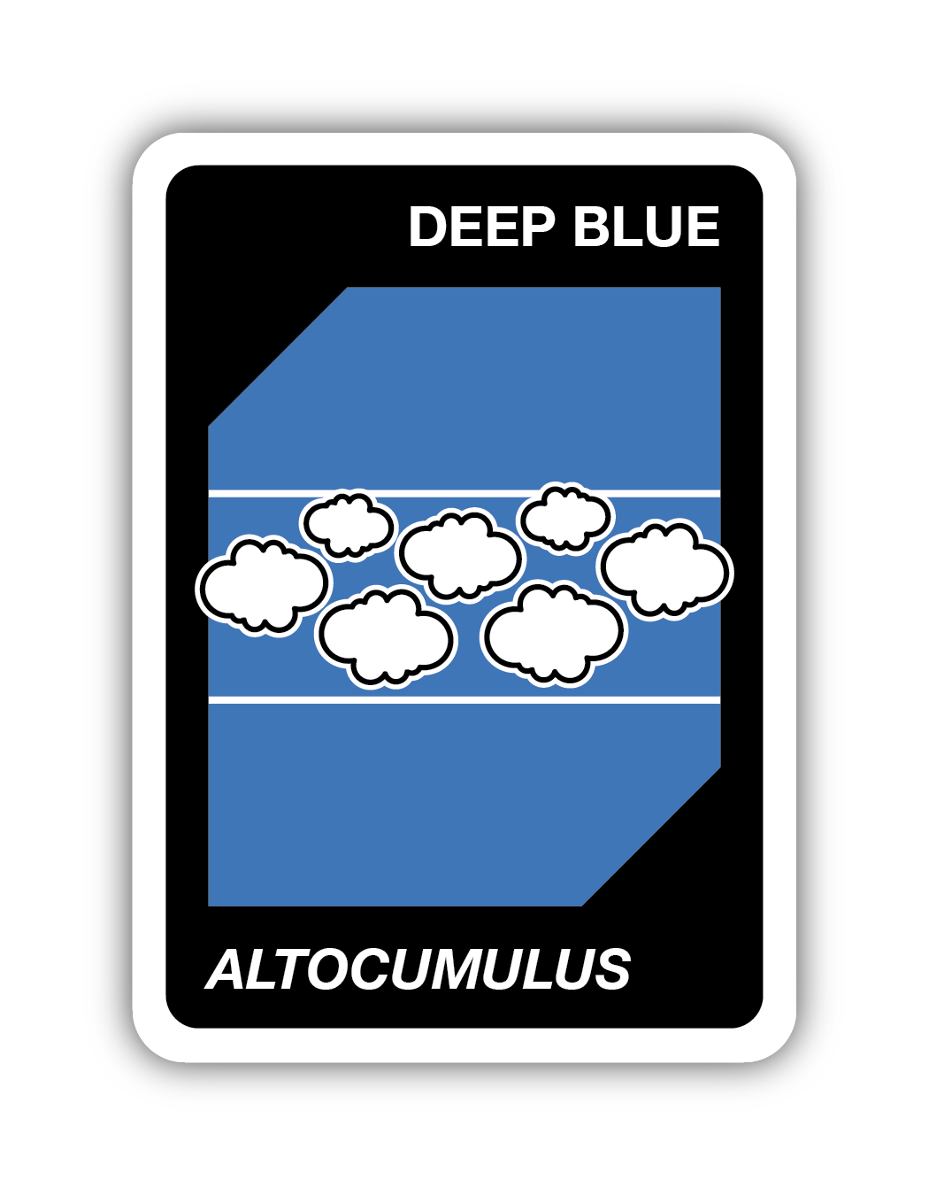
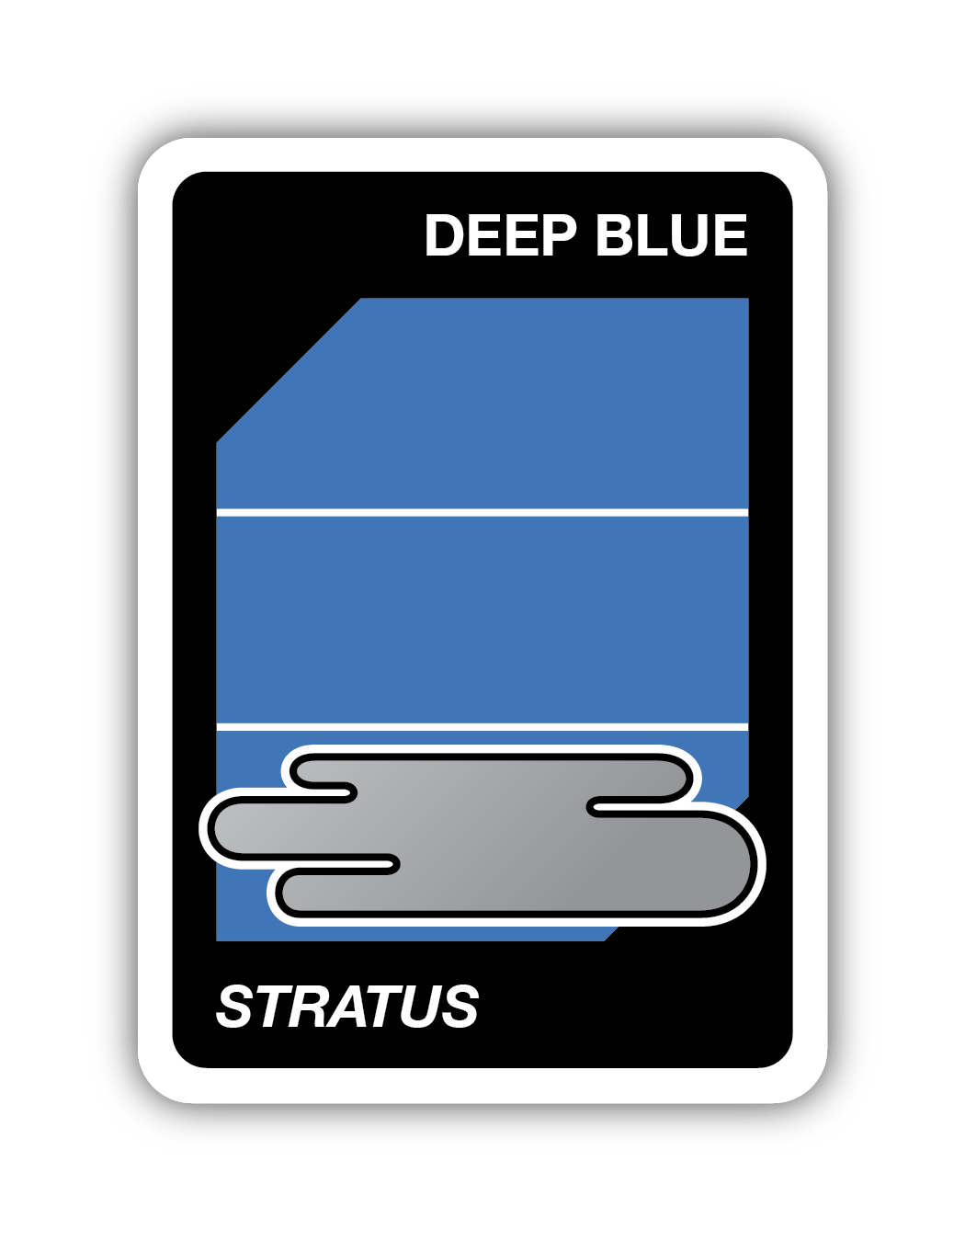
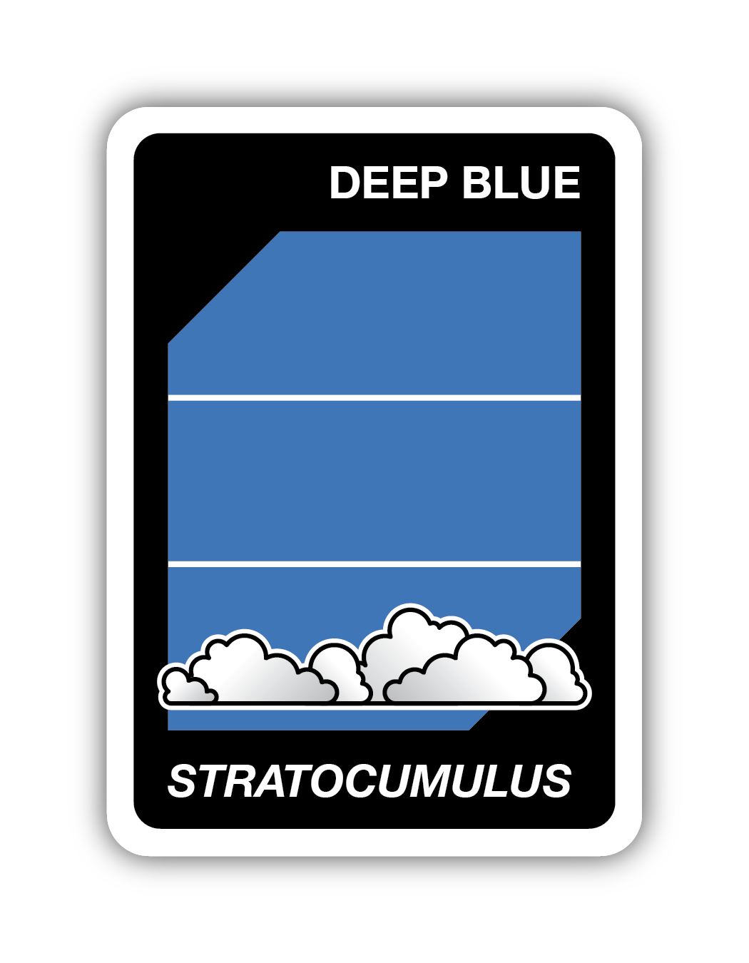
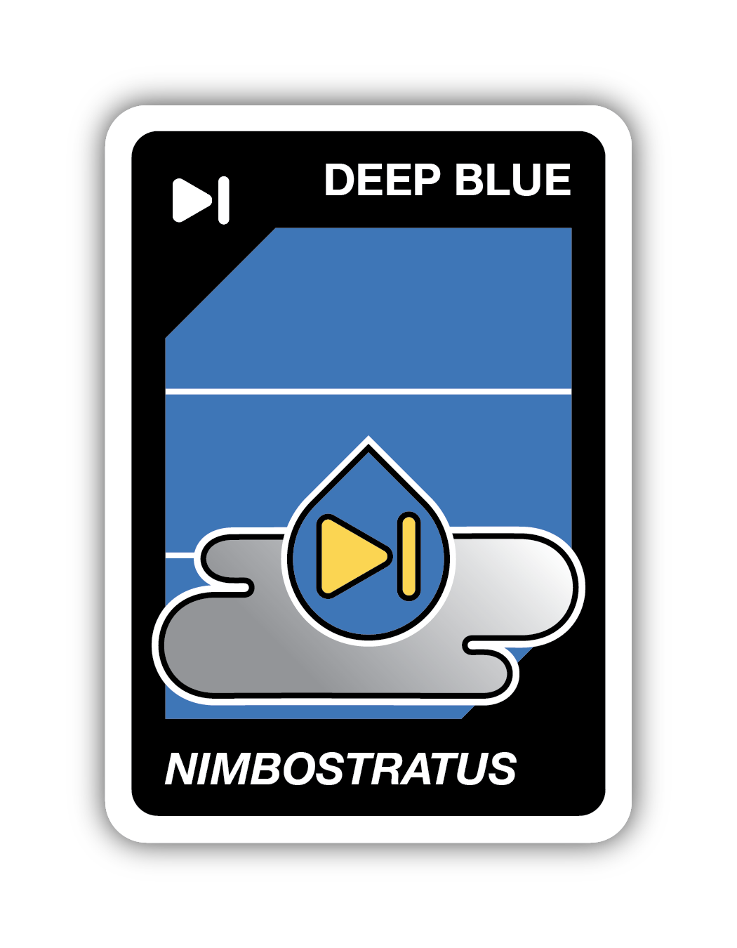
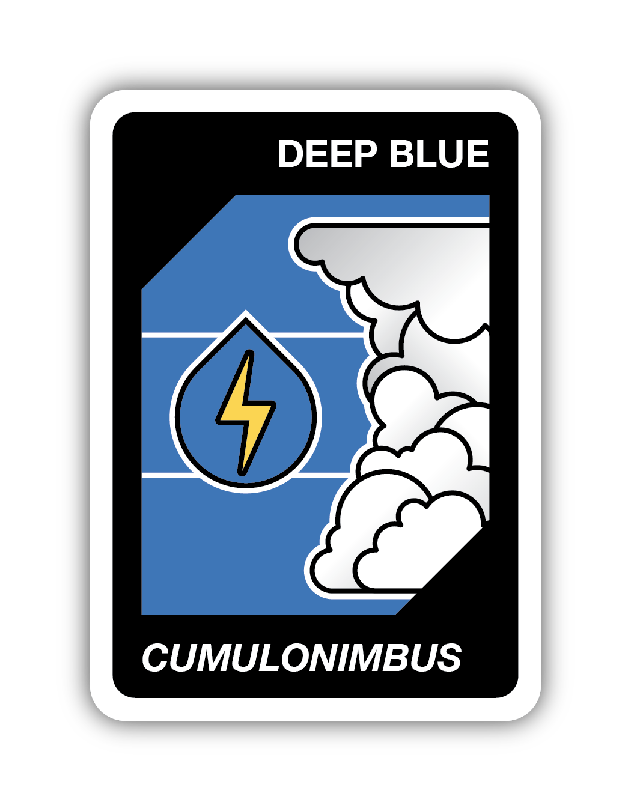
Cloud Types - 11 Different Cloud Types

Slide 6
Low Level Clouds (cloud base height)

Slide 7
Mid-Level Clouds

Slide 8
High Level Clouds

Slide 9
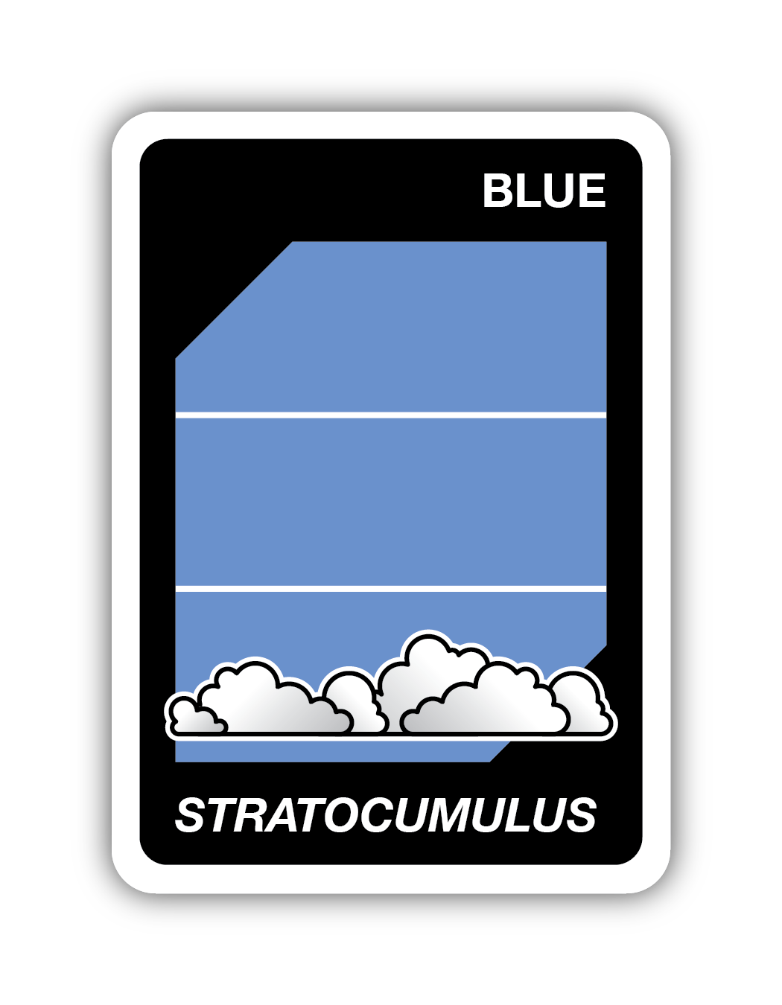
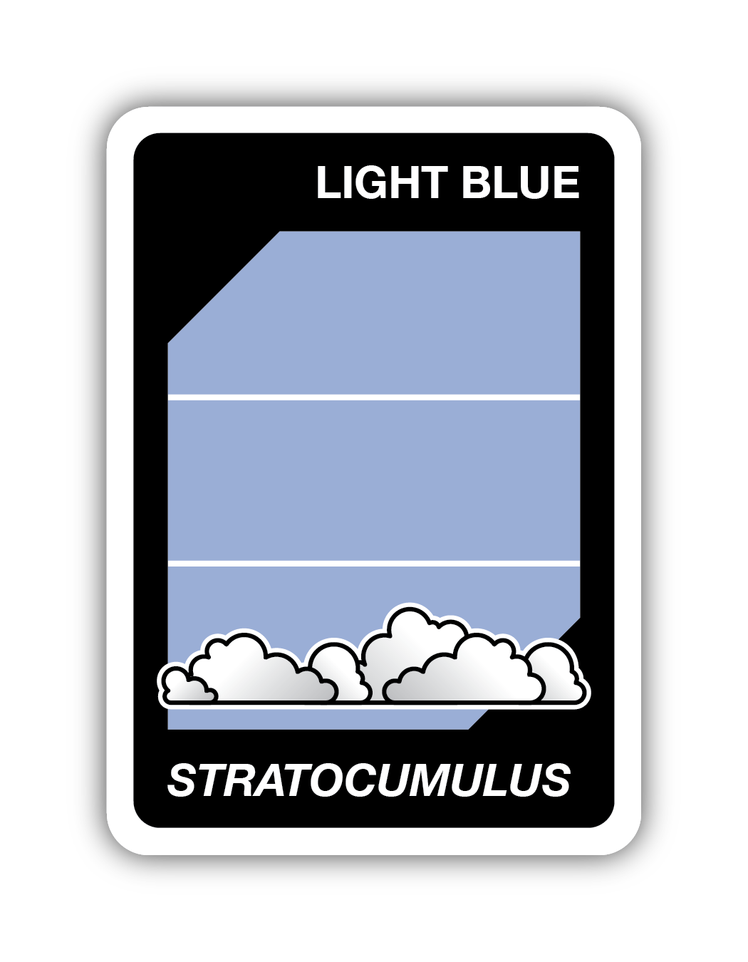
Let’s Practice
You play by either matching the cloud type or sky color. Is this a match?
Yes!
No!

Slide 10
Let’s Practice 2
You play by either matching the cloud type or sky color. Is this a match?
Yes!
The cloud types match!

Slide 11
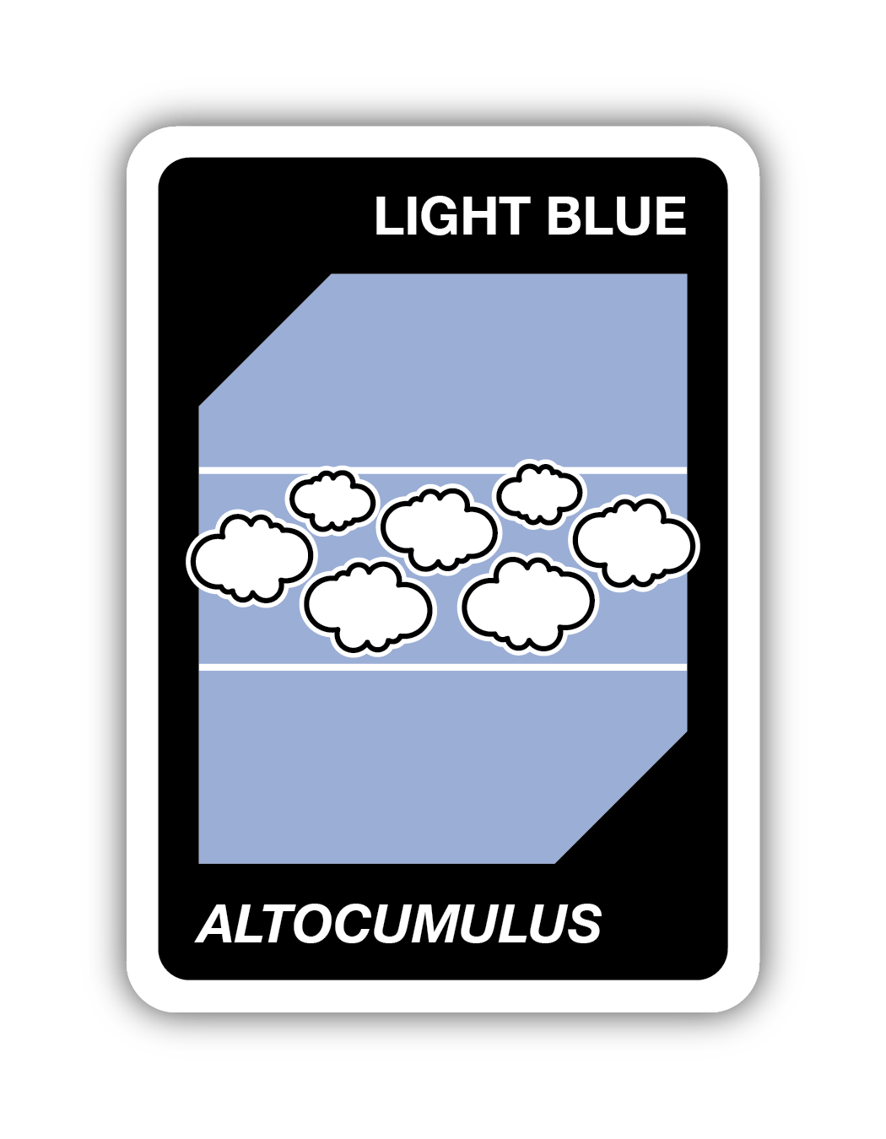
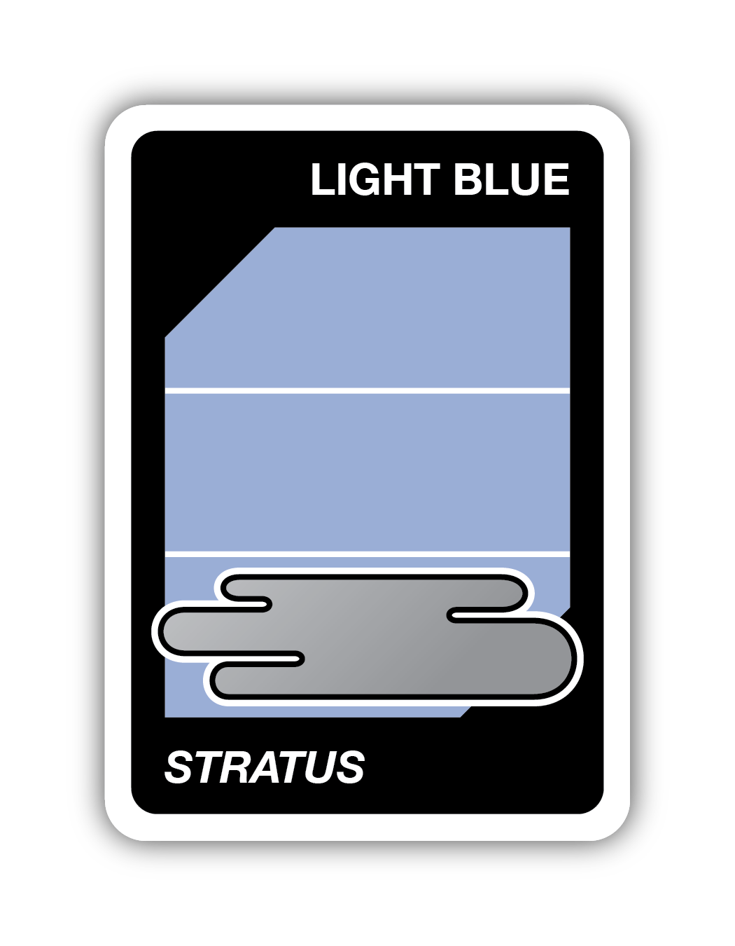
Let’s Practice 3
You play by either matching the cloud type or sky color. Is this a match?
Yes!
No!

Slide 12
Let’s Practice 4
You play by either matching the cloud type or sky color. Is this a match?
Yes!
The sky colors match!

Slide 13
Let’s Practice 5
You play by either matching the cloud type or sky color. Is this a match?
Yes!
No!

Slide 14
Let’s Practice 6
You play by either matching the cloud type or sky color. Is this a match?
Neither the sky color nor the cloud type match.
No!

Slide 15
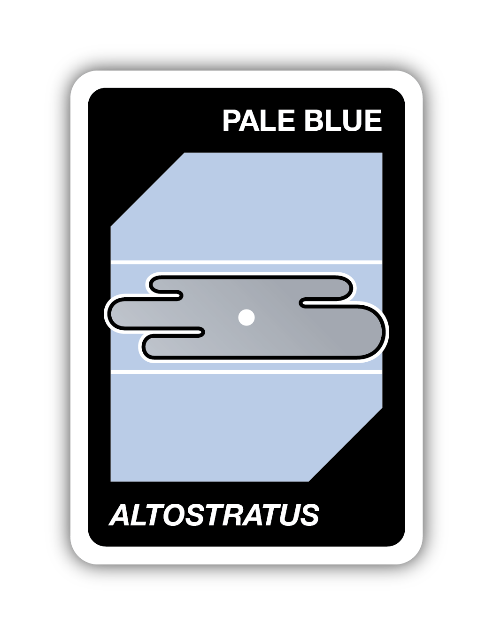
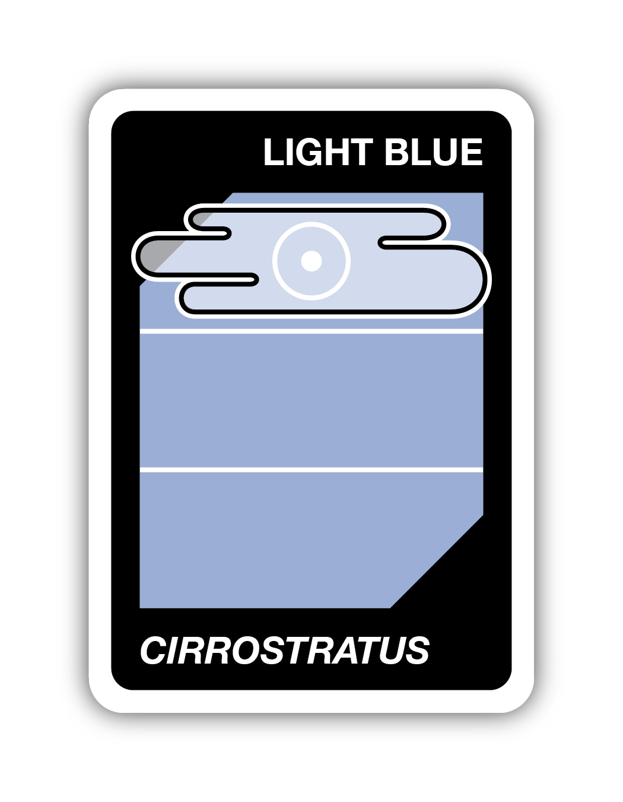
Let’s Practice 7
You play by either matching the cloud type or sky color. Is this a match?
Yes!
No!

Slide 16
Let’s Practice 8
You play by either matching the cloud type or sky color. Is this a match?
Neither the sky color nor the cloud type match.
No!

Slide 17
Let’s Play

Slide 18
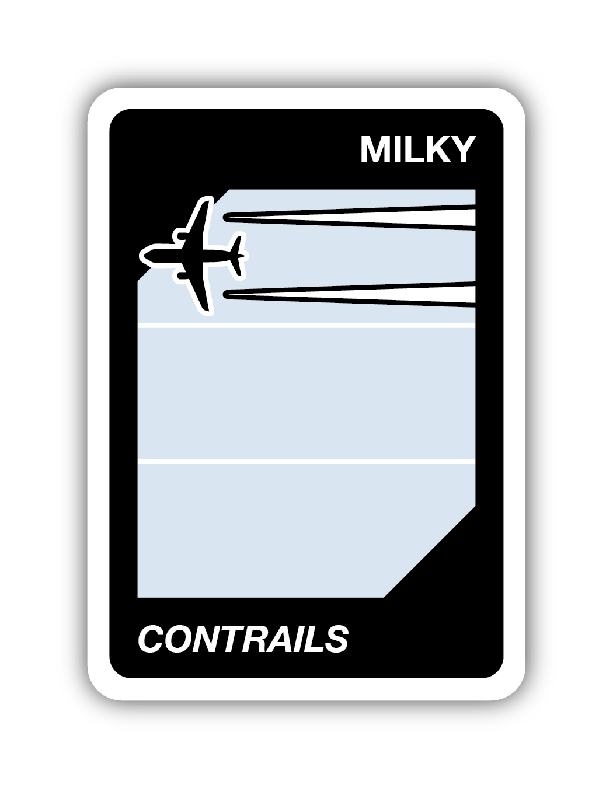
What card would you play next? Match the sky color or cloud type.
Discard Pile
B
A
C
Your Cards

Slide 19
What card would you play next? Match the sky color or cloud type. 2
Discard Pile
B
Your Cards

Slide 20
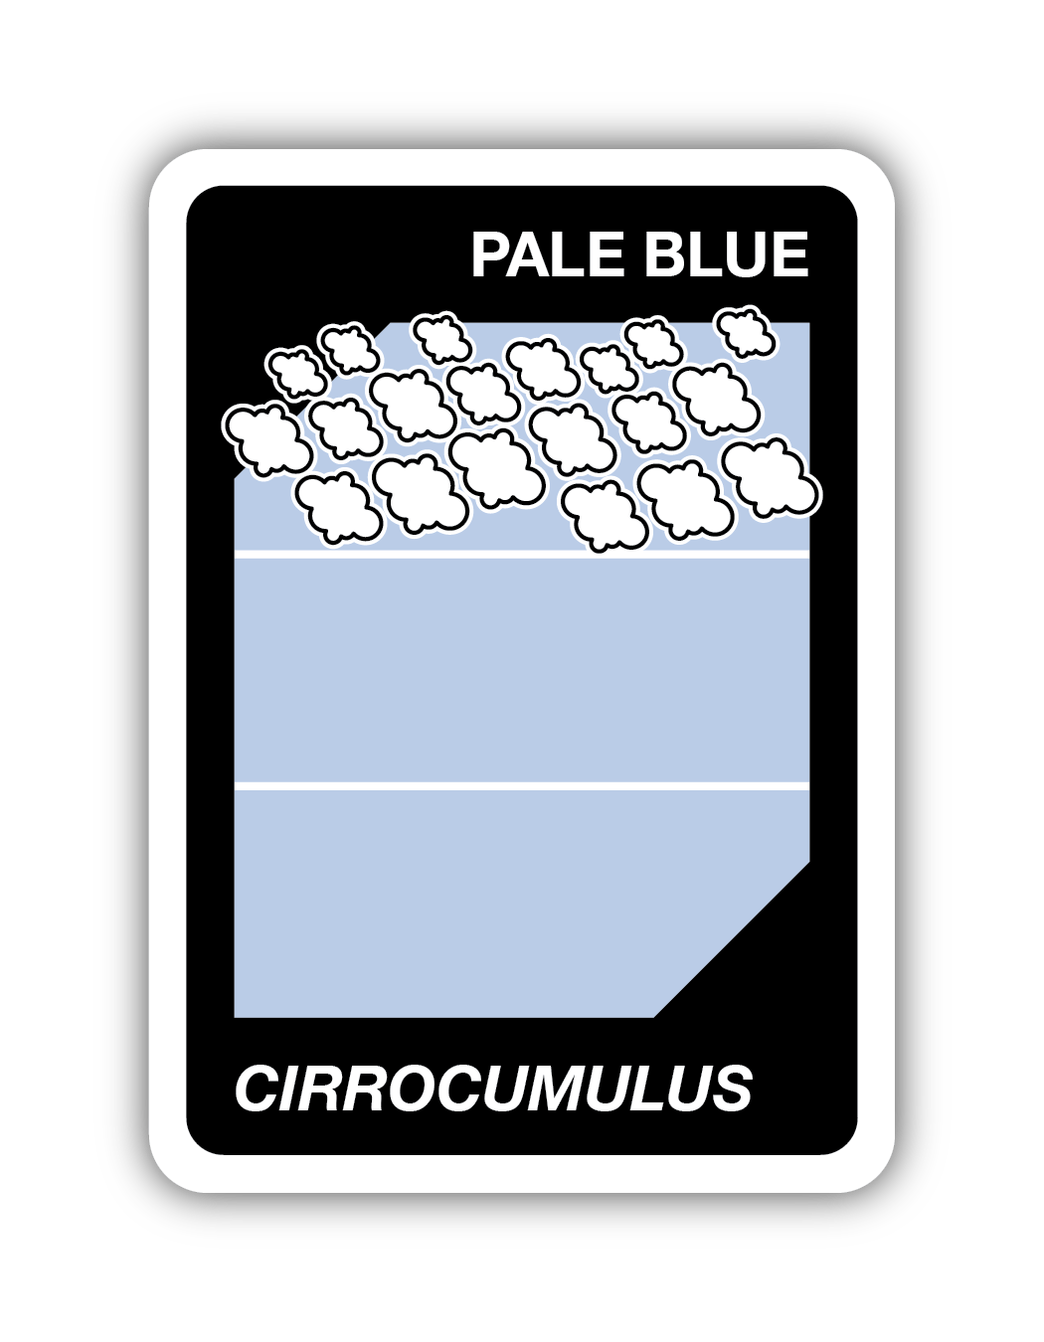
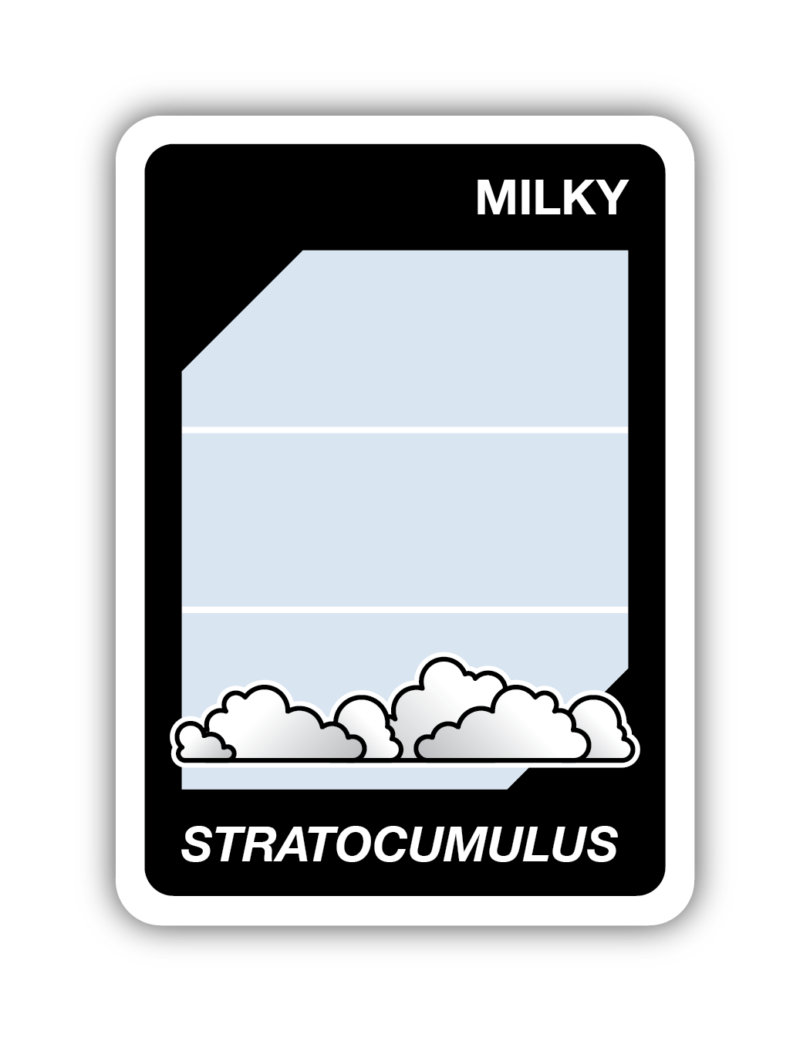
What card would you play next? Match the sky color or cloud type. 3
Discard Pile
B
A
C
Your Cards

Slide 21
What card would you play next? Match the sky color or cloud type. 4
Discard Pile
A
Your Cards

Slide 22
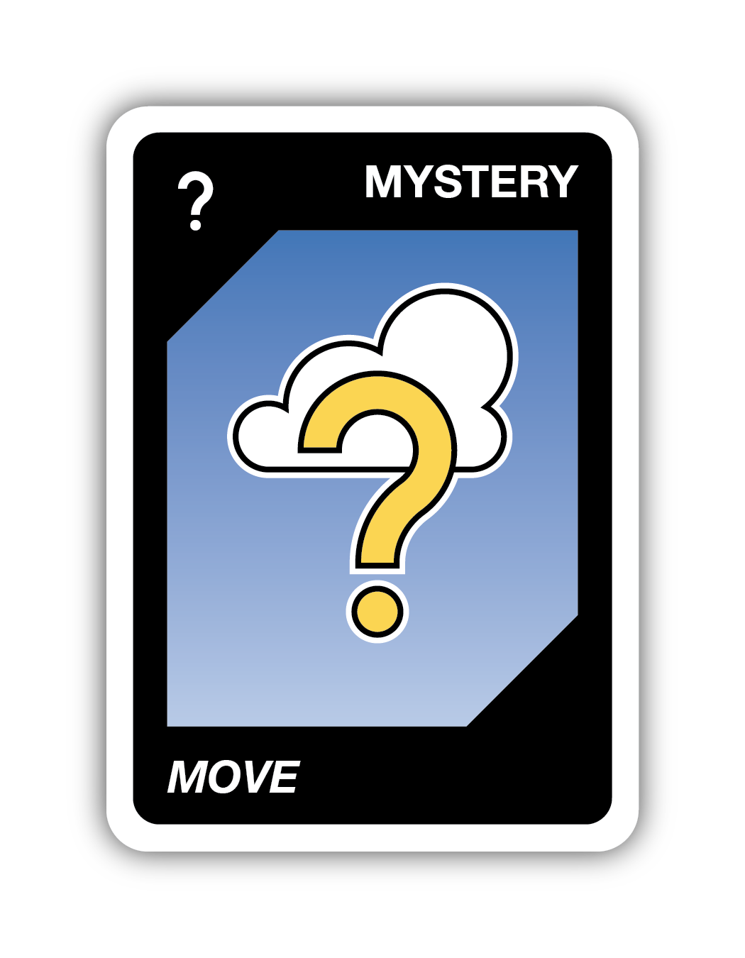
Mystery Move
Do the correct cloud dance based on type and altitude of clouds.
A
B
C

Slide 23
Mystery Move 2
Do the correct cloud dance based on type and altitude of clouds.
A
Cirro is used for high clouds.
Cumulus is used for puffy clouds.
Cirro cumulus are high puffy clouds.

Slide 24
Mystery Move 3
Do the correct cloud dance based on type and altitude of clouds.
B
Stratus is used for flat clouds. It is also used to talk about low flat clouds.
Stratus are low flat clouds.

Slide 25
Mystery Move 4
Do the correct cloud dance based on type and altitude of clouds.
C
Cumulus is used for puffy clouds.
Nimbus is used when a cloud is raining or snowing (precipitation).
Cumulo nimbus are thunderstorms.

Slide 26
Quick Review:
Rainmaker and Obscuration Cards

Slide 27
Review: Rainmaker Cards
Cumulonimbus clouds are thunderstorms. If you are outside during one, you may want to go back indoors.
This card reverses the direction of play.

Slide 28
Review: Rainmaker Cards 2
Nimbostratus clouds produce more of a persistent drizzle that can last all day. If you don’t like going out in the rain, are outside during one, you might not go outside at all when a nimbostratus cloud is around.
This card skips the next player’s turn.

Slide 29
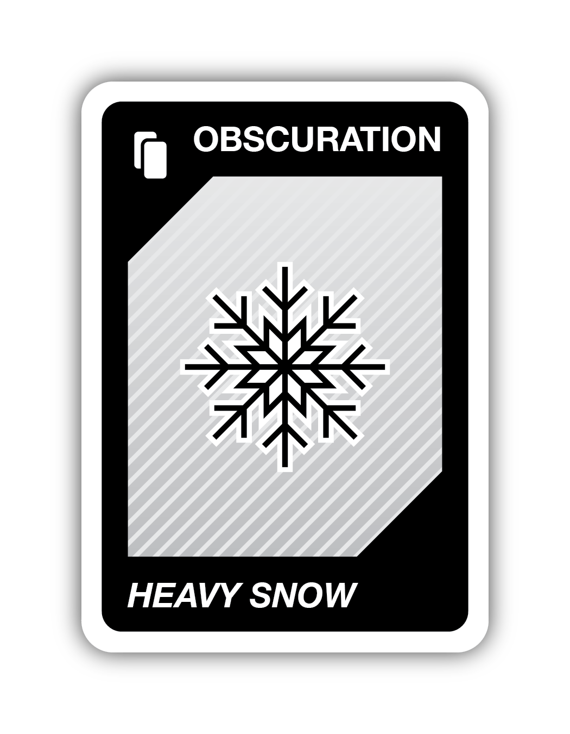
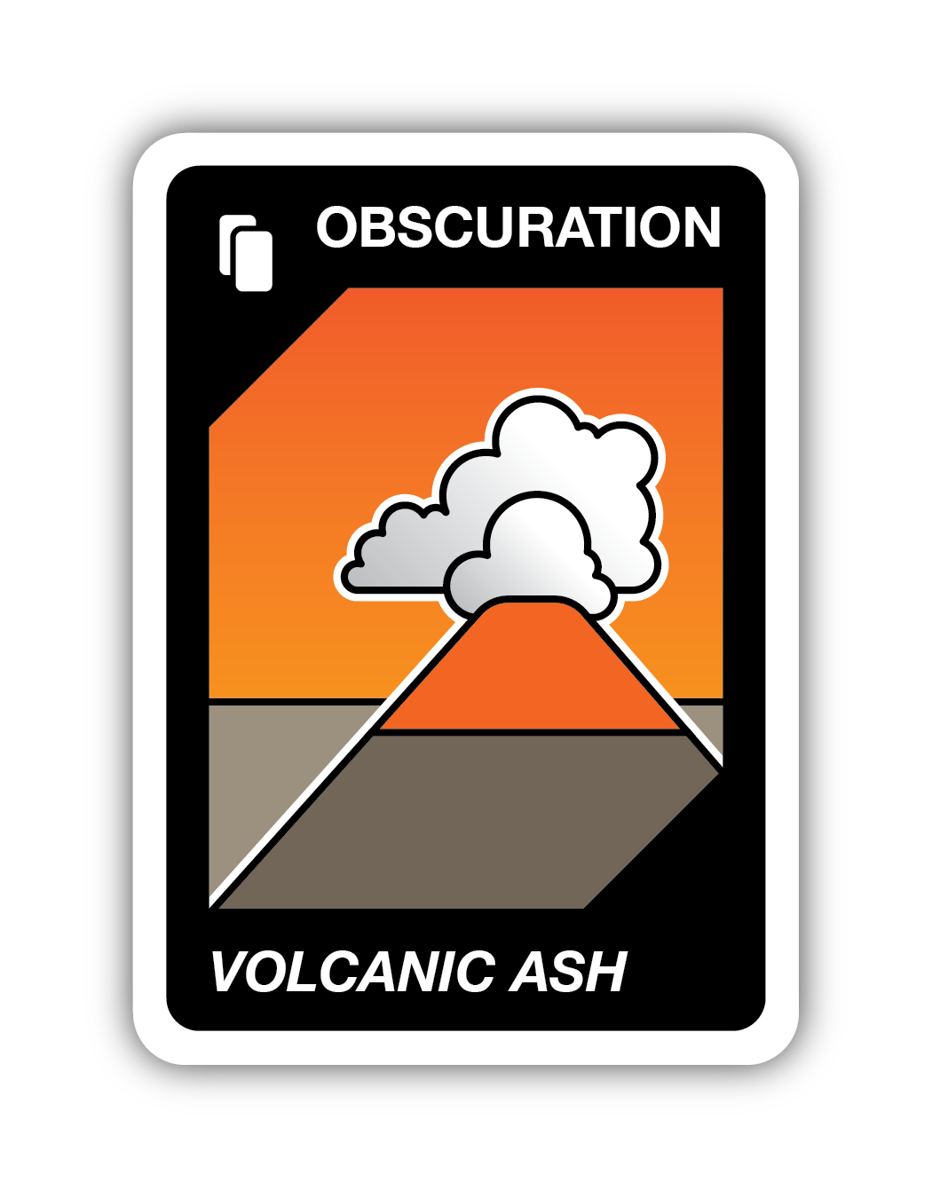
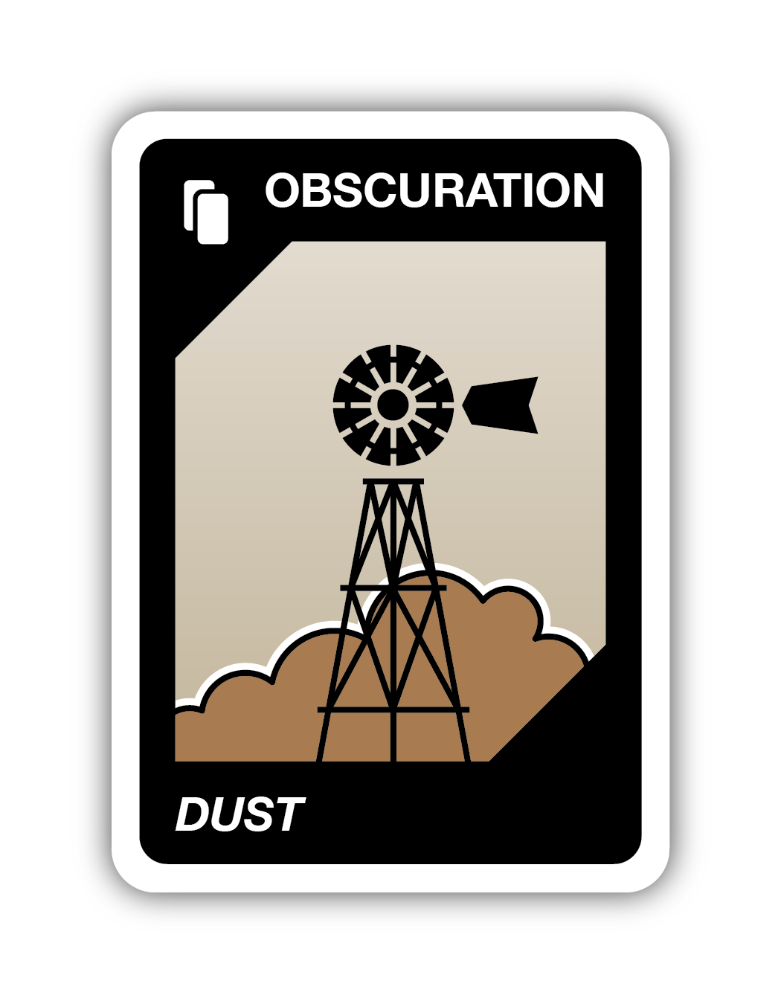
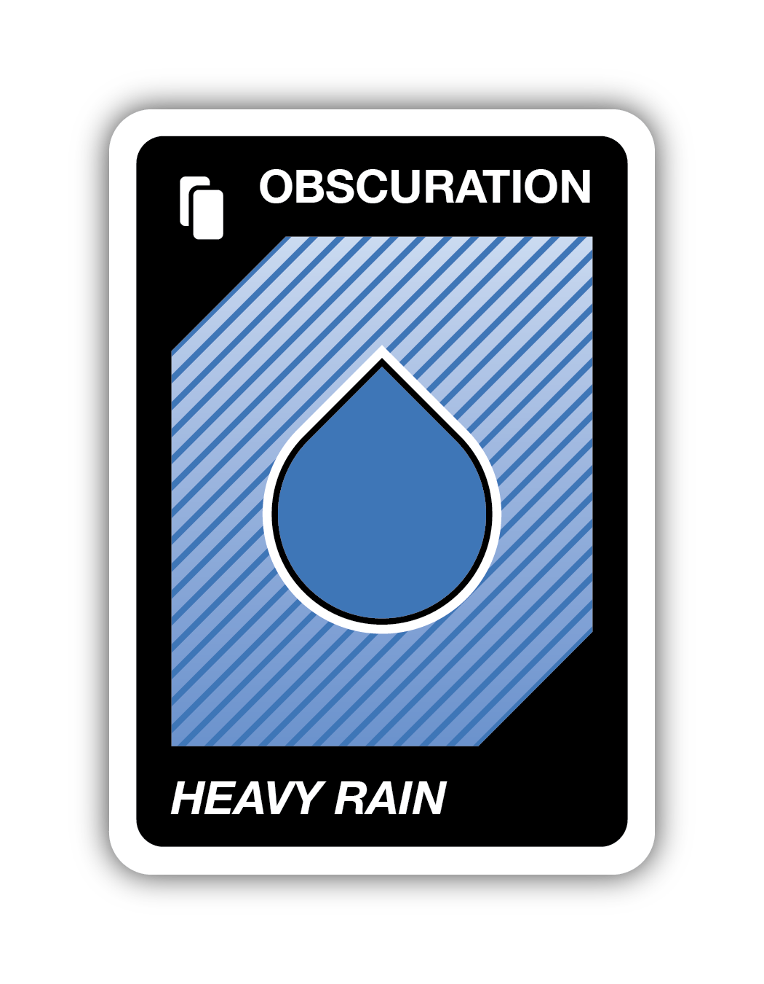
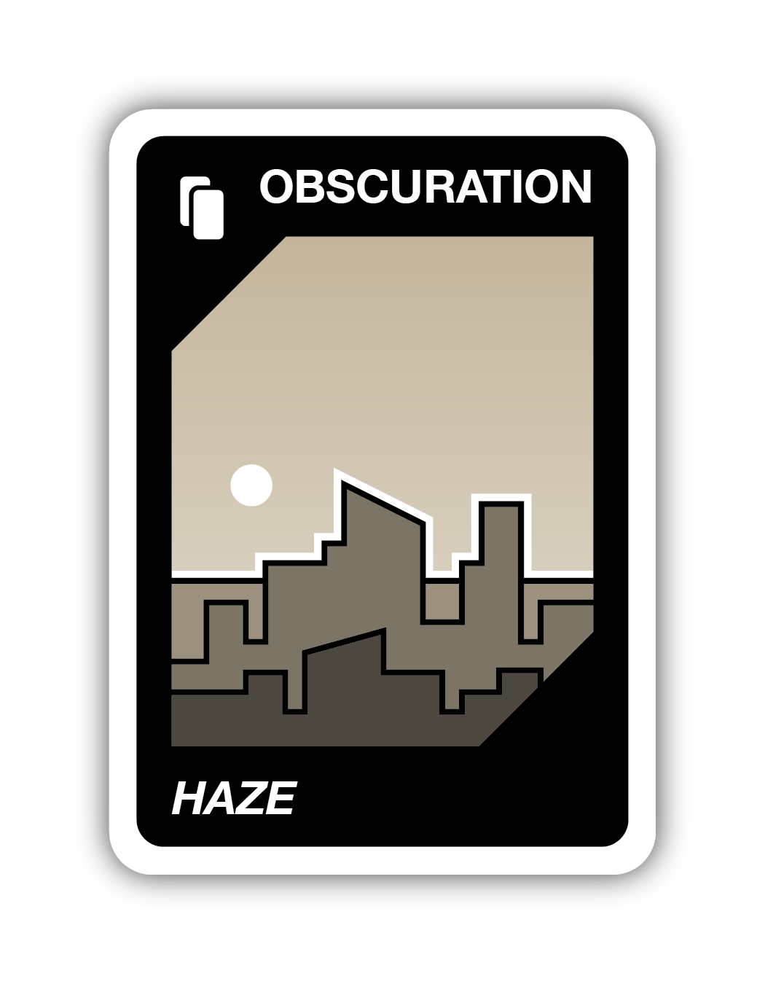
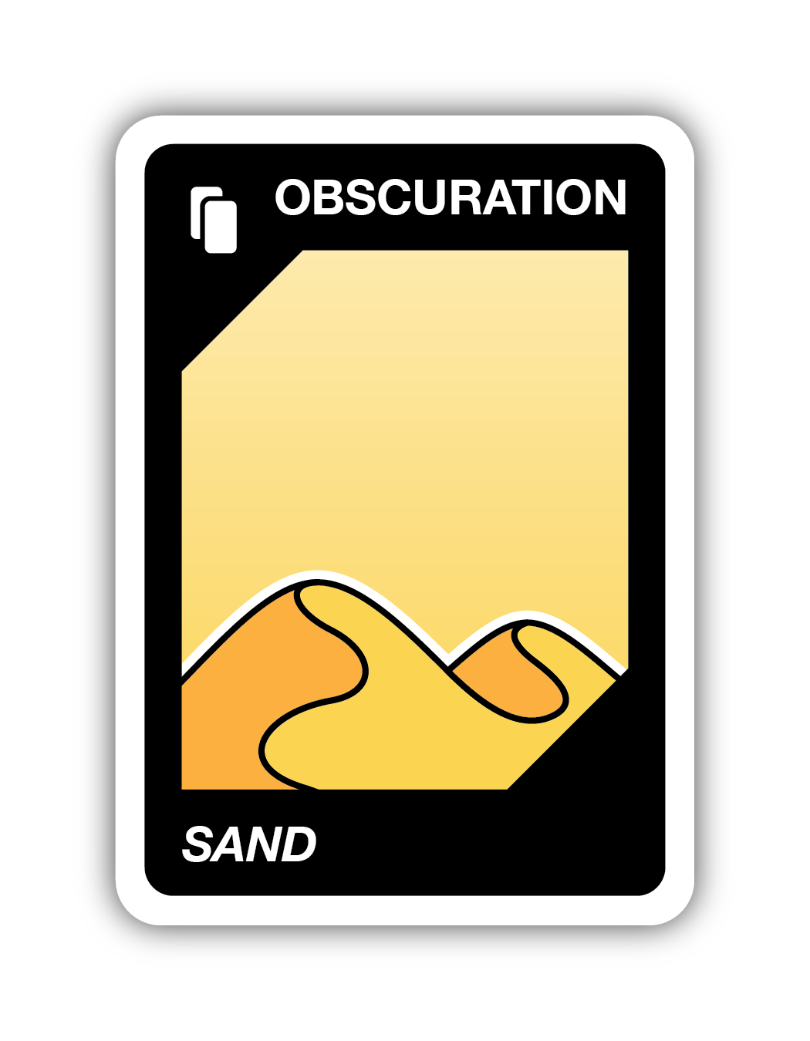
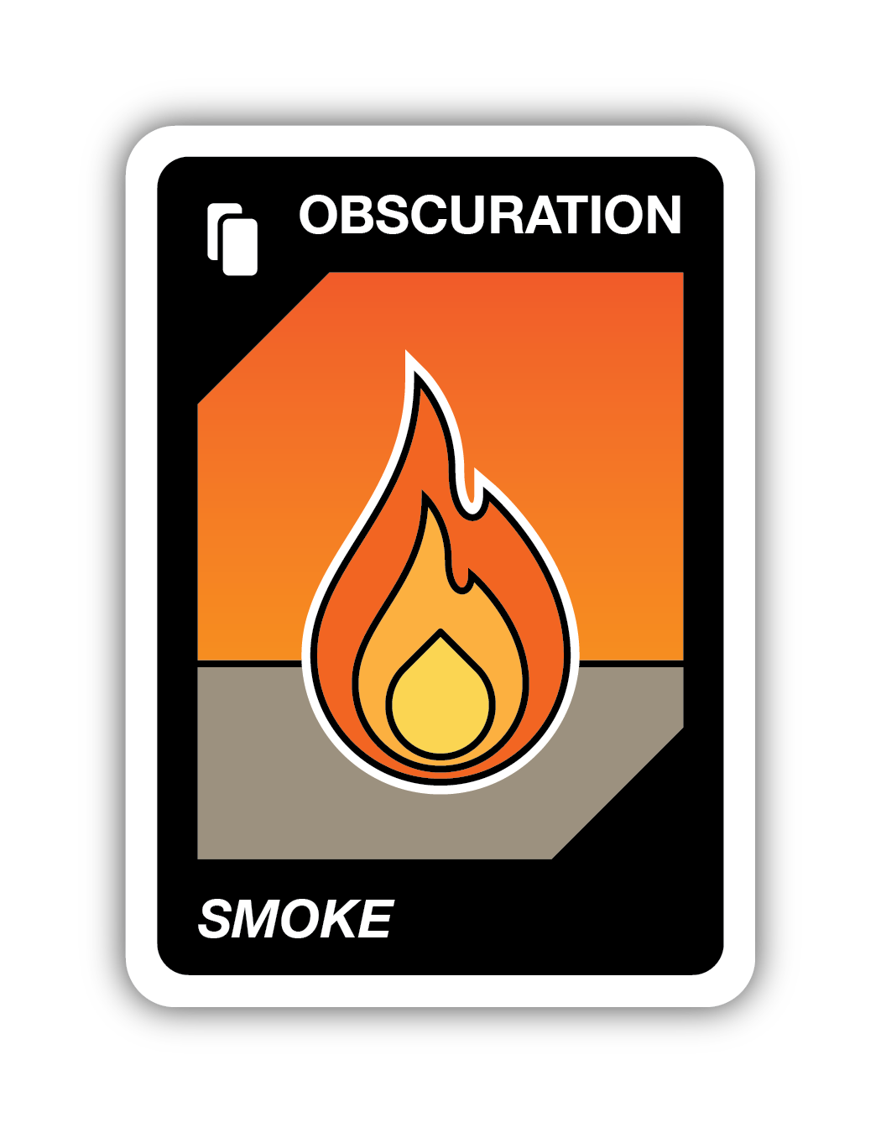
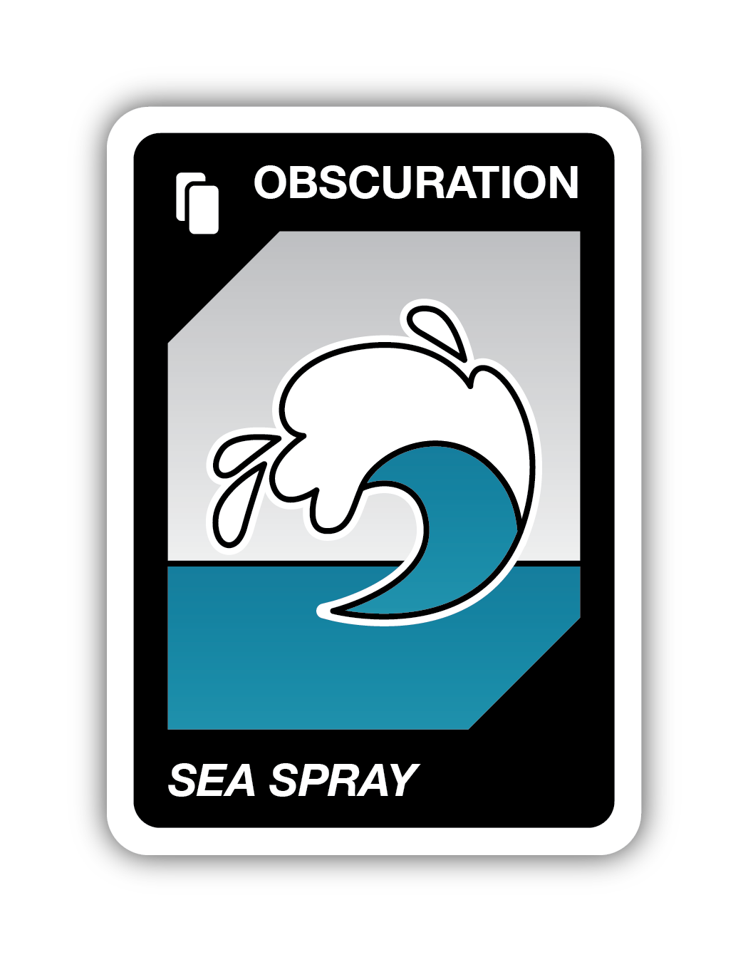
Review: Obscuration Cards
In real life, an obscuration is something blocking your view of the sky, like dust or smoke. When someone plays an obscuration card, the next player draws two cards at the start of their turn. Then, they may play any card from their hand.

Slide 30
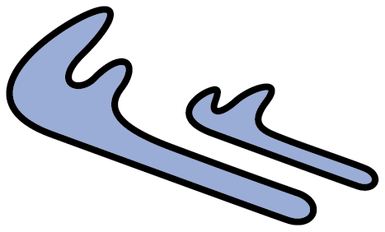
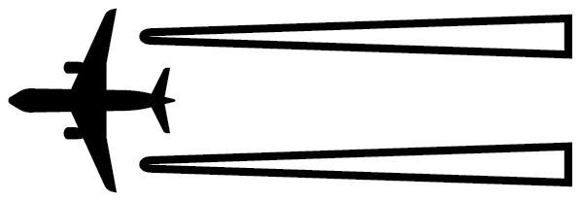


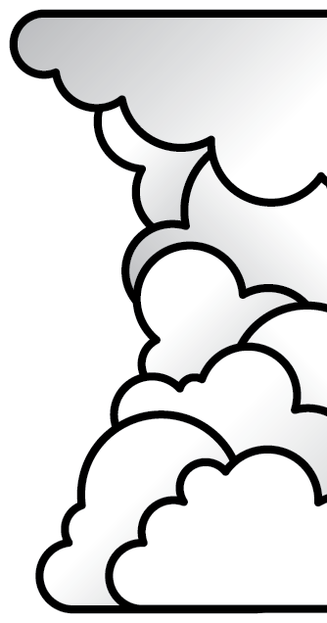






Cloud Pronunciation Guide
Cirrostratus sear-oh-STRAT-us
Cirrus SEAR-us
Cirrocumulus sear-oh-CUE-mew-luss
Contrails CON-trails
Altostratus all-toe-STRAT-us
Altocumulus all-toe-CUE-mew-luss
Nimbostratus nim-bo-STRAT-us
Cumulus
CUE-mew-luss
Stratus STRAT-us
Stratocumulus strat-oh-CUE-mew-luss
Cumulonimbus cue-mew-low-NIM-bus

Slide 31
Tips for Educators

Slide 32
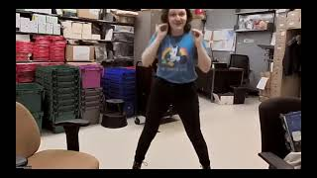
Tip: Representing Clouds With Movement
Watch Rose Kelly-Lyons, Children’s Librarian at Queens Public Library - Baisley Park, in Queens, NY.
She uses movement to represent different types of clouds!
Alternative video with captions

Slide 33
Tip: Cloud Height
Notice the lines on each card indicating if a cloud is at low, mid, or high level.
HIGH
MID
LOW
This can help you when you play a mystery card and need to sketch, describe, or represent a cloud type with movement.

Slide 34
Tip: Student-selected Words to Describe Clouds
Fluffy
Puffy
Cotton candy
Horizontal
Flat
Stretchy
Mustache
Feathery
Waves crashing
The “Dab”

Slide 35
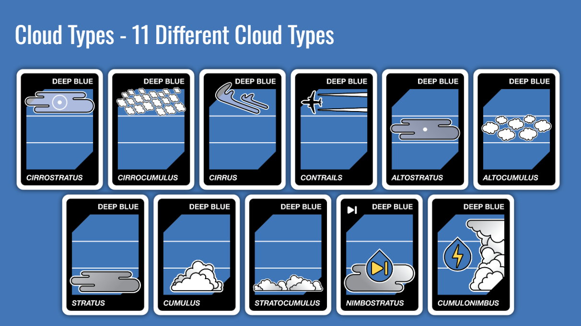
Tip: Identifying Cloud Types
While students play, it may be helpful to leave visible the slide with all 11 types of clouds. This can make students feel more secure and engage better with the game. It also helps figure out which cloud type their teammate is drawing/imitating/describing.

Slide 36
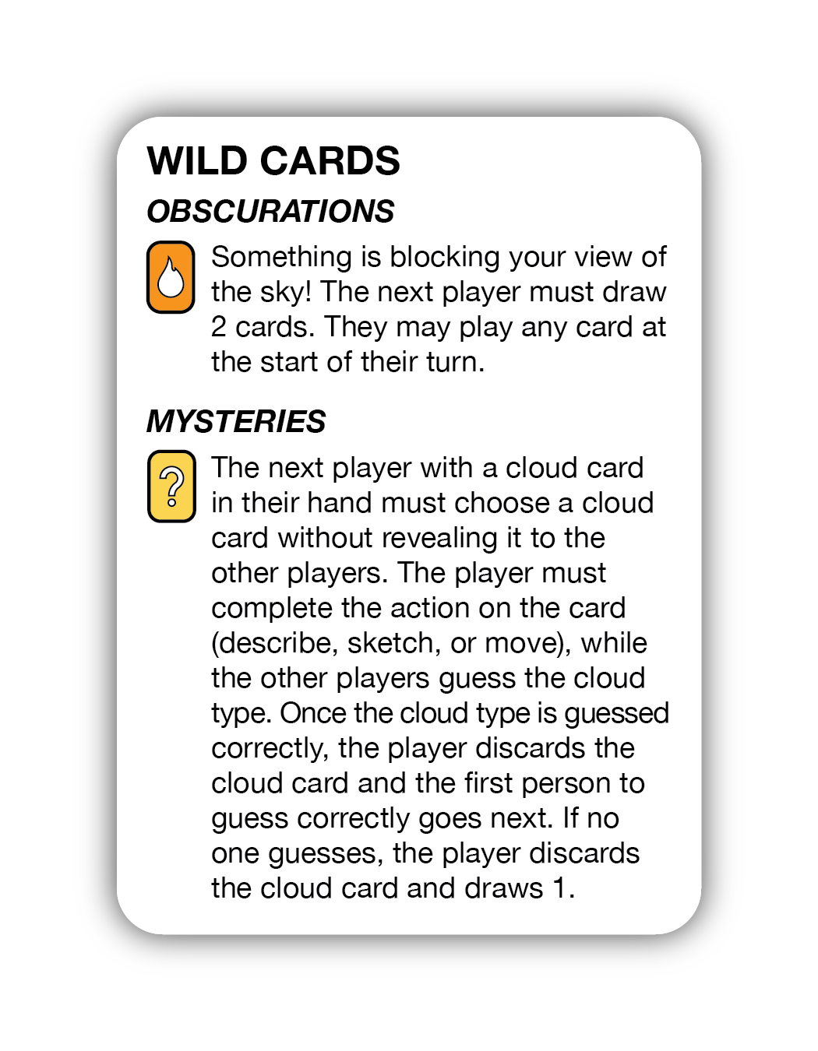
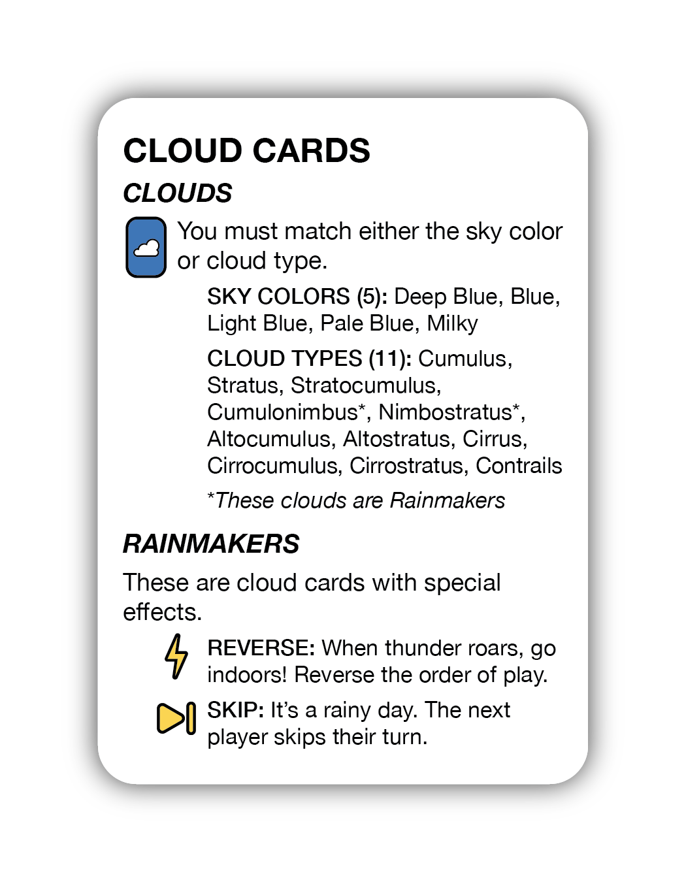
Additional Resources
For more information go to https://observer.globe.gov/nubegame
Read the complete instructions or watch the how-to-play video. You can also print a NUBE Cloud Chart for reference while you play.
Download the DIY files for the card deck and tuck box. Print additional copies of the quick reference cards to provide to players.

