Slide 1
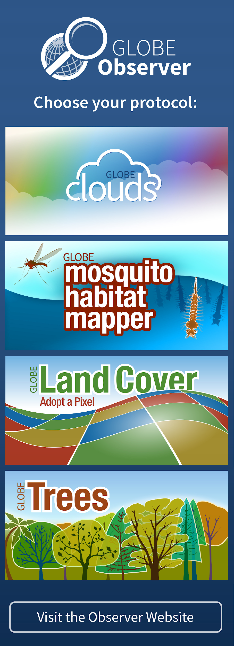
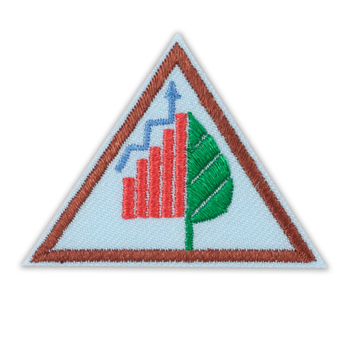
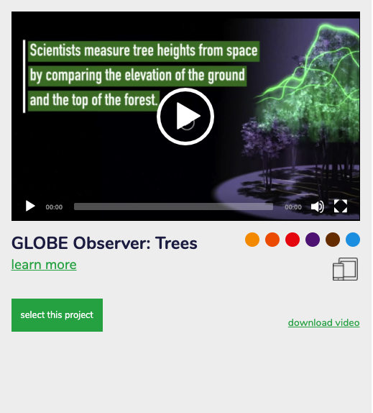
Girl Scouts and GLOBE Observer
&
Notes:
Welcome to the first step in being a critical part of a growing citizen science project. Today you will learn about what it means to Think Like a Citizen Scientist, learn about the Trees Tool on the GLOBE Observer app and make your own paper clinometer.

Slide 2
NASA GLOBE and Girl Scouts
The Global Learning and Observations to Benefit the Environment (GLOBE) Program is an international science and education program that provides students and the public worldwide with the opportunity to participate in data collection and the scientific process and contribute meaningfully to our understanding of the Earth system and global environment.
The GLOBE Observer app is a GLOBE’s data entry tool that allows an international network of citizen scientists to work together to learn more about our shared environment and changing climate. GLOBE Observer currently accepts observations of Clouds, Mosquito Habitats, Land Cover and Trees.
GLOBE Observer Trees Tool: Think Like a Citizen Scientist
Notes:
But first let me tell you about GLOBE and GLOBE Observer
GLOBE is an international science and education program that provides students and the public worldwide with the opportunity to participate in data collection and the scientific process and contribute meaningfully to our understanding of the Earth system and global environment.
GLOBE Observer app is the data entry tool that allows citizen scientists to enter their data and share observations.
GLOBE Observer is part of GLOBE.

Slide 3
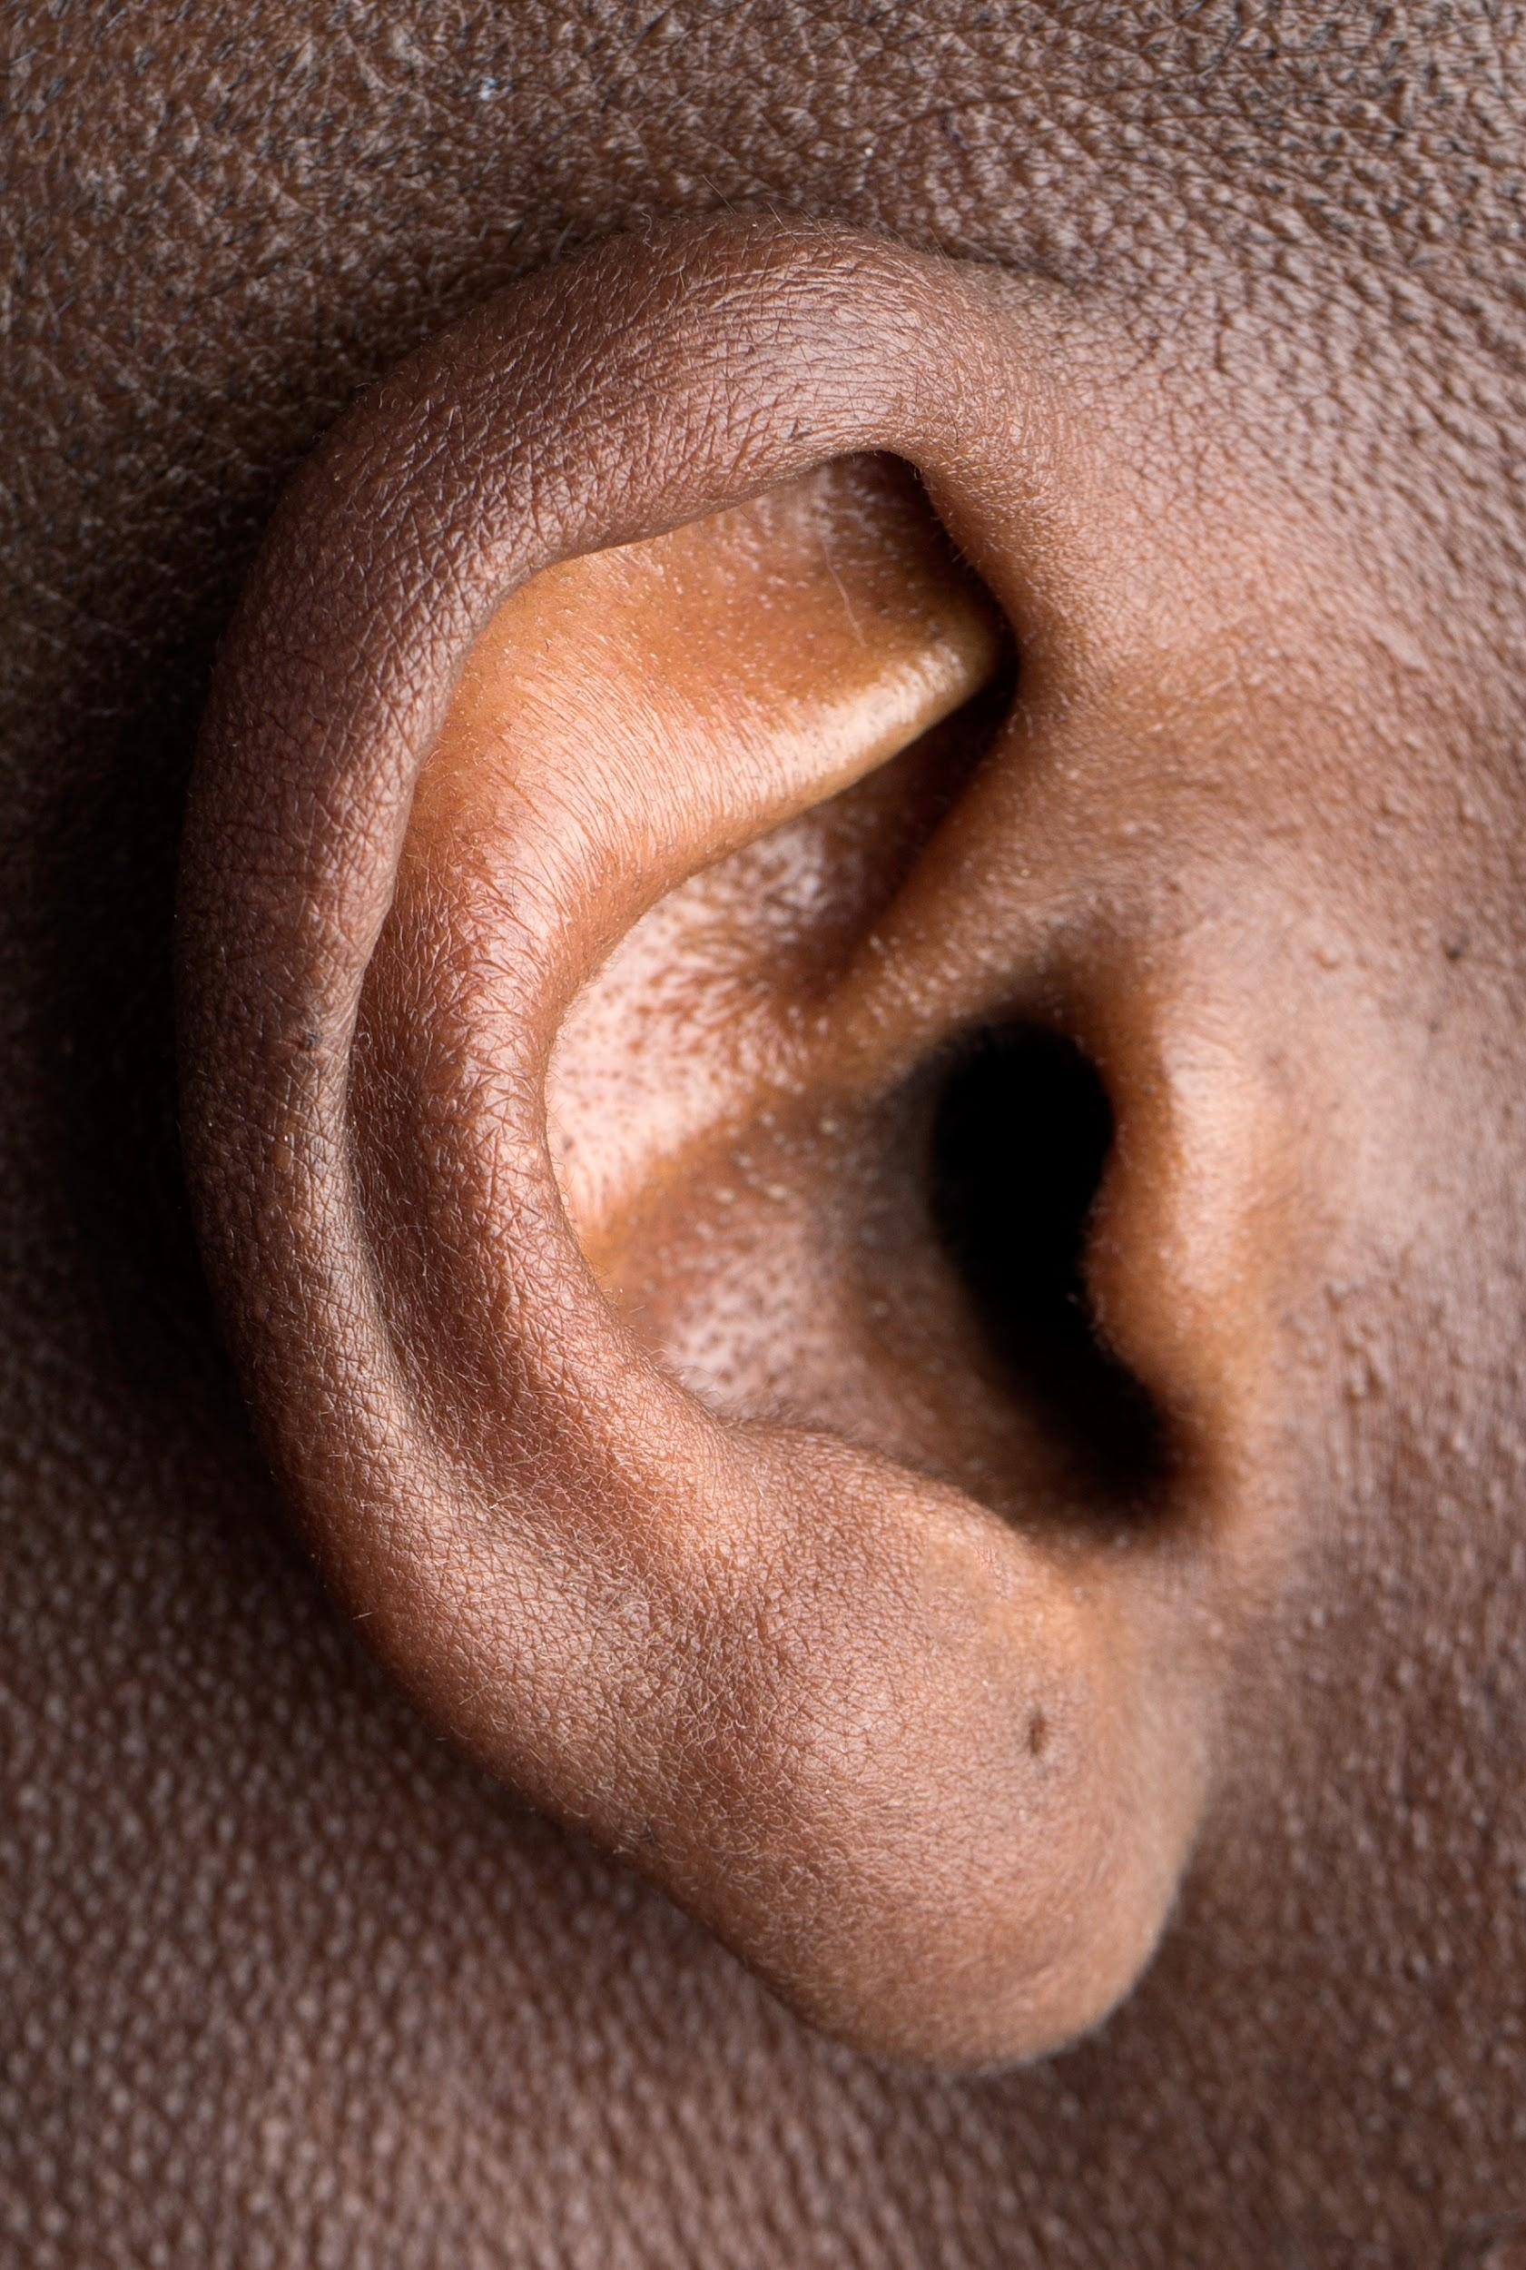
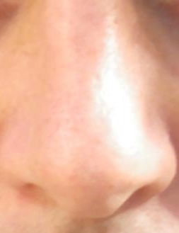
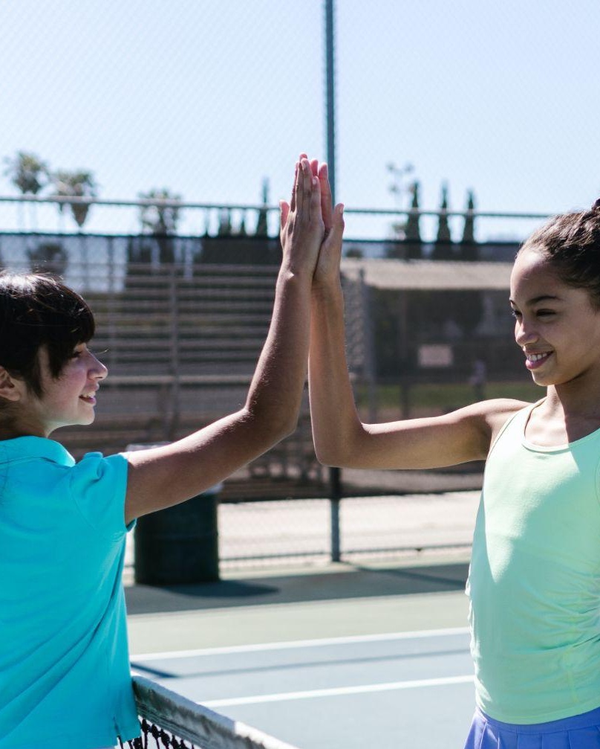
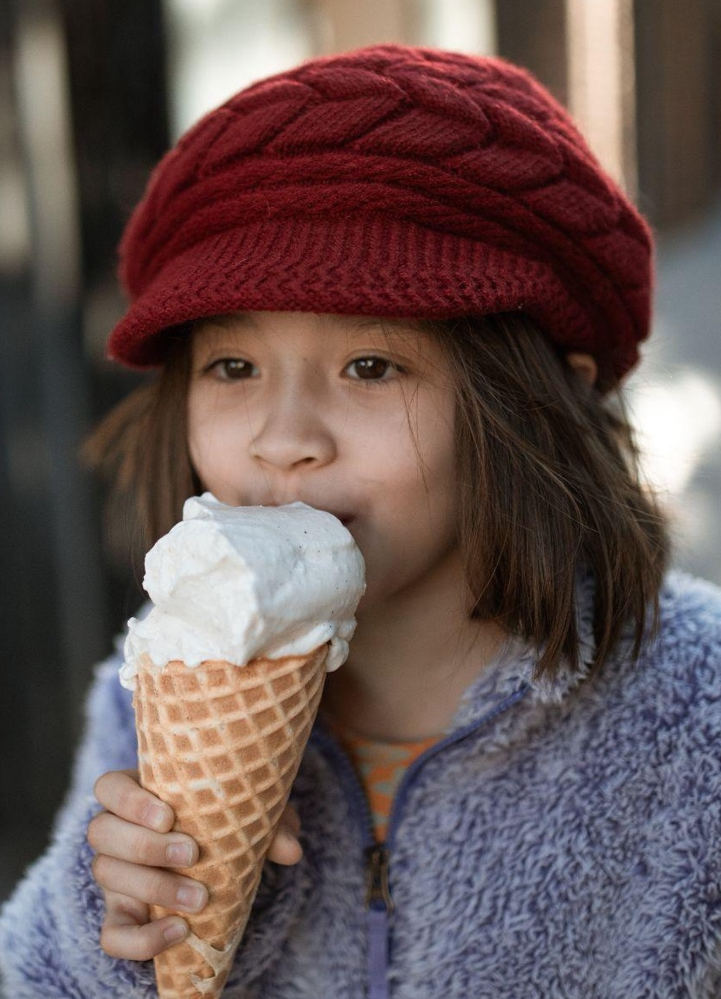
What’s an Observation?
Hear
Smell
Touch
See
Taste
Notes:
Okay, speaking of the Think Like a Citizen Scientist Journey, learning about what it means to observe is the first step in thinking like a citizen scientist. Let’s get started by practicing our observation skills.
When we observe, we use our senses (taste, smell, touch, hearing, and sight). Since we can’t really taste, smell, hear, or touch these pictures, we are going to use our sense of sight.

Slide 4
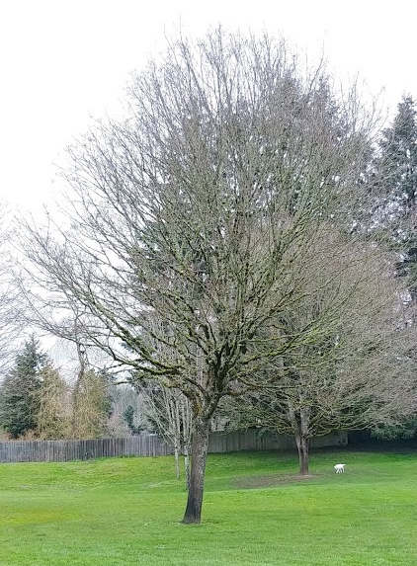
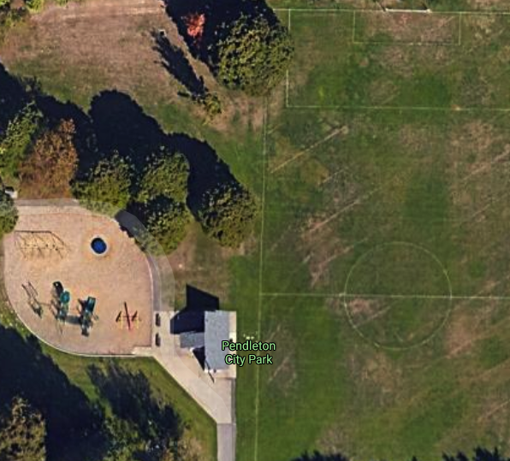
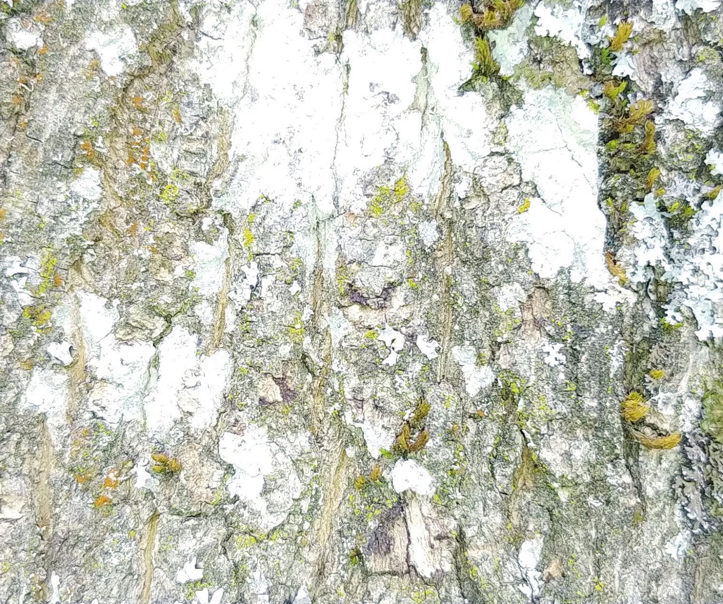
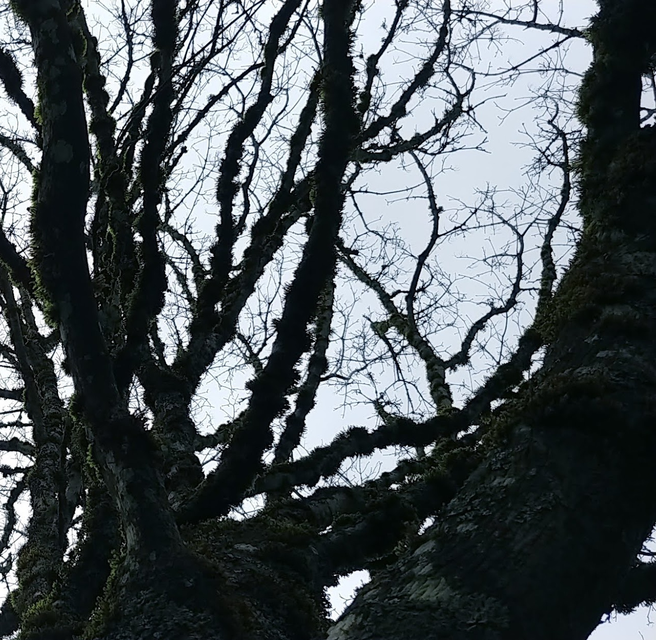
Observations: 1
Zoomed out
Zoomed in
View up
View above
What you notice?
Needles or leaves?
Time of year?
Height?
Colors, shapes or patterns?
What do you think makes your tree unique or special?
What was different about the tree from a distance and “zoomed in”?
Did you see any insects, plants, animals, lichen or fungi on your tree?
Notes:
Here are pictures of a tree to observe from a distance and then up-close.
Some possible questions to help you with your observations could be:
Do trees have needles or leaves?
When was this image taken?
How tall is that tree?
What did you notice about your tree?
What was different about looking at a tree from a distance and then “zoomed in”?
What colors did you see?
What shapes or patterns did you see?
Did you see any insects, plants, animals, lichen or fungi on your tree?
What do you think makes your tree unique or special?
You can write down any observations you made in the chat, your science journal, or on a piece of scratch paper. If you can, you can do this same activity with any tree, not just with the photographs. This could be a great activity for a nature walk, hike, playground meeting, or even something to do in your own yard. So don’t feel limited to just using these pictures. Leaders, once your Girl Scouts have finished noting their observations, ask them to share. I’m going to ask your leaders to pause the video so you have some time to finish your observations and discuss.
The Zoom in on a Tree guide (go.usa.gov/xtpBa) can be used as a basis for this activity.

Slide 5
Observations: 2
Zoomed out
Zoomed in
View up
View above
II
Press Pause while you make your observations and discuss.
What you notice?
Needles or leaves?
Time of year?
Height?
Colors, shapes or patterns?
What do you think makes your tree unique or special?
What was different about the tree from a distance and “zoomed in”?
Did you see any insects, plants, animals, lichen or fungi on your tree?
Notes:
Welcome back! I bet you made some really great observations. Some things I noted about this tree is that the photo was taken when the leaves had fallen from the tree (either fall, spring, or winter), the tree is deciduous and not an evergreen because it lost its leaves, the tree provides habitat for lichen and moss, the tree is in a park near a playground and soccer field, and the tree is moderately tall, but not as tall as some of the evergreens in the background. Observations can tell us a lot about something and scientists use observations in their work.

Slide 6
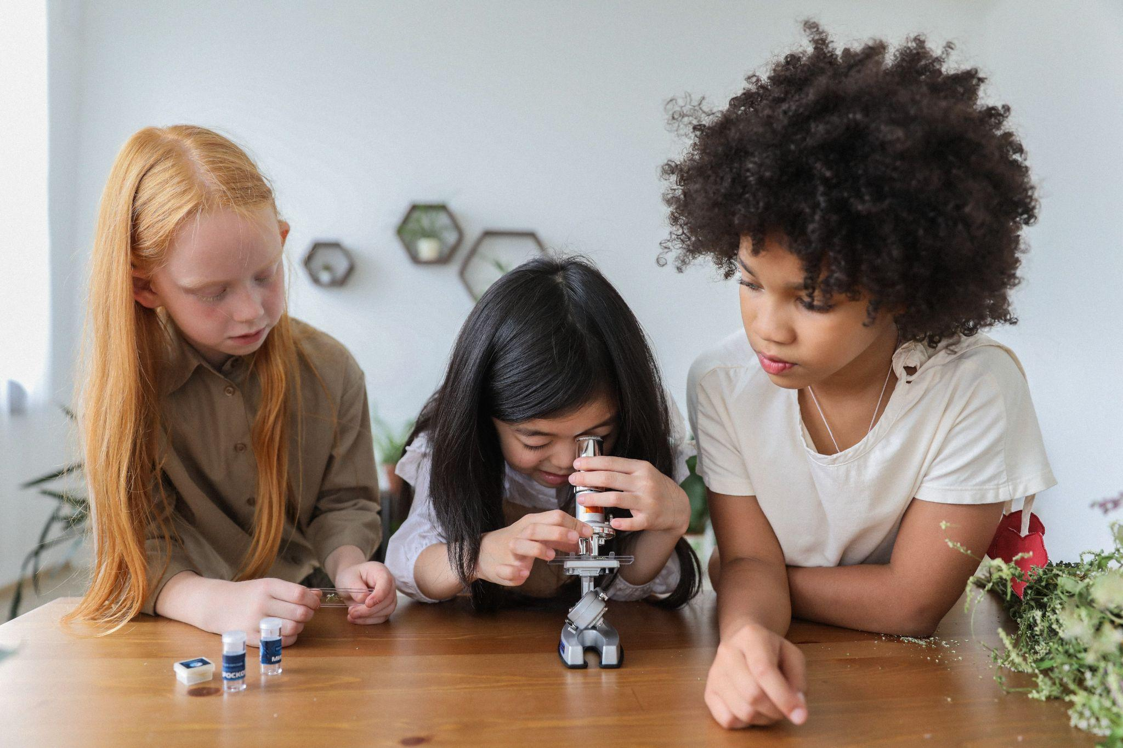
What does a Scientist Do? 1
Notes:
What do scientists do?

Slide 7
What does a Scientist Do? 2
II
Press Pause while you discuss.
Notes:
Pause the video and discuss what a scientist does.
I bet you had a great discussion on what it means to be a scientist. There are lots of different types of scientists out there, but one thing they all have in common in their research is that scientists rely on the scientific method to learn new things.
You are going to be citizen scientists, where you use the scientific method to help gather data for NASA scientists and other researchers including students or scouts like you.

Slide 8
What does a Scientist Do? 3
Observe
Ask a Question
Make a Hypothesis
Notes:
The first part of the scientific method is to observe. You all did a great job of observing the Tree pictures. You can do that with any tree and if you do it in-person, you can touch and smell the tree (as long as it’s safe to do so – beware of poison oak!).
The next part of the scientific method is to create a question and make a hypothesis (i.e. your best guess at the answer to your question based on your observations).

Slide 9
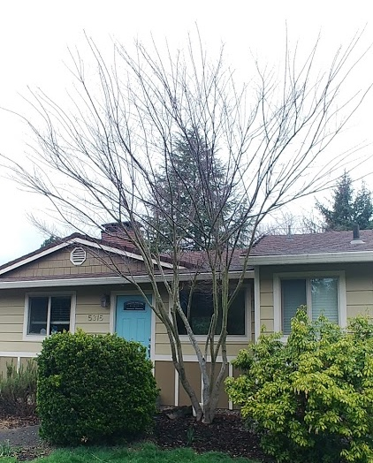
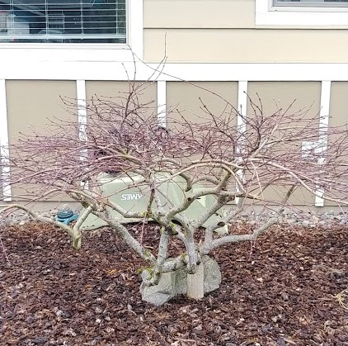
Observations 1
Tall Tree
Short Tree
What differences do you notice between these trees?
What similarities?
Notes:
Let’s look at these two trees.
Let’s make some observations and then form a question based on those observations.
What differences do you notice between these trees?
What similarities?
What do you want to know? What is your question?

Slide 10
Observations 2
II
Press Pause while you discuss.
Tall Tree
Short Tree
What differences do you notice between these trees?
What similarities?
Notes:
Pause the video and discuss. You can come up with your own question or you can use the one that I’ll provide.

Slide 11
Formulate a Question
?
Can tree height tell you which tree is older?
Notes:
Our question could be, “Can tree height tell you which tree is older?”

Slide 12
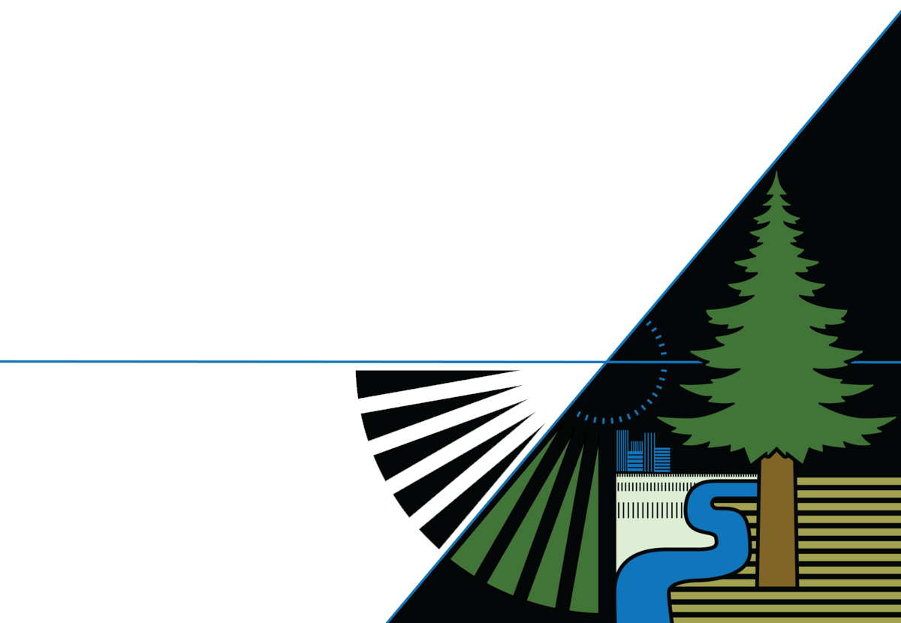
Make a Hypothesis 1
Can tree height tell you which tree is older?
1. Yes.
2. No.
Answer your question based on observations
Notes:
The hypothesis is your answer to that question. So let’s make a hypothesis.
We have a few options:
Yes
No
What do you think?

Slide 13
Make a Hypothesis 2
Can tree height tell you which tree is older?
1. Yes.
2. No.
II
Press Pause while you discuss.
Answer your question based on observations
Notes:
Leaders, please pause the video while you discuss with your troop.

Slide 14
Make a Hypothesis 3
Can tree height tell you which tree is older?
1. Yes.
2. No.
Answer your question based on observations
Notes:
I made the hypothesis that no, tree height can’t tell me which tree is older.

Slide 15
Was our hypothesis correct?
I needed more information.
Can tree height tell you which tree is older?
Notes:
I need more information. For example, I would want to know when these trees were planted? Which one is older? How tall are they? Are there other trees that are short and old and some that are tall and young?

Slide 16
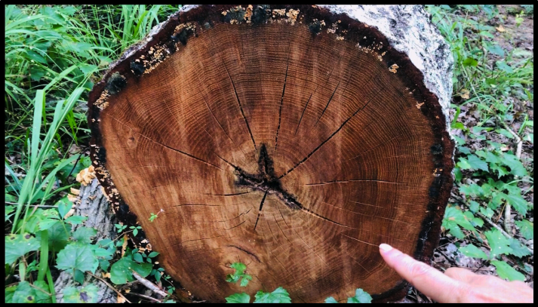
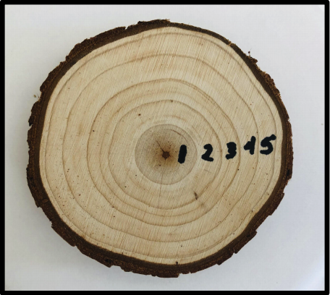
How can you tell how old a tree is?
Tree rings. Trees gain rings every year.
Notes:
One thing I do know is that tree age can be determined by the number of tree rings. For each year of growth cycle a tree gets a ring. So without cutting down these trees, I may not be able to get an precise age of these trees. Also, as you can see by these photos, the width of the rings can vary depending on the type of tree and the conditions in which it is growing. But how could I collect data to answer my hypothesis? I would have to measure a lot of tree heights of known ages and then look at all that data and look for patterns or trends.

Slide 17
How do scientists know if their hypothesis is correct?
Collect and Analyze Data
Notes:
So, how do scientists know if their hypothesis is correct? They have to collect and analyze data. The more data they have the better their results will be because it helps filter out some of the outliers (the mistakes, errors, or oddball data – kind of like if I was measuring Favorite girl scout cookies. The more people I sell cookies to, the better my data.

Slide 18
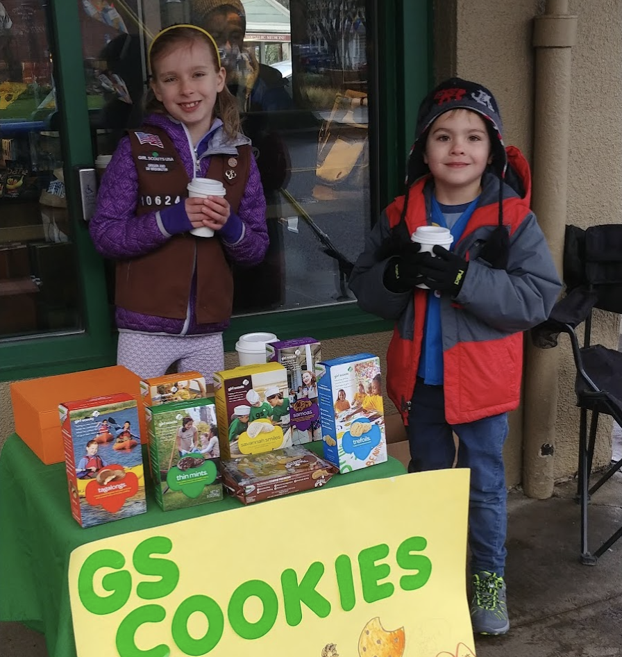
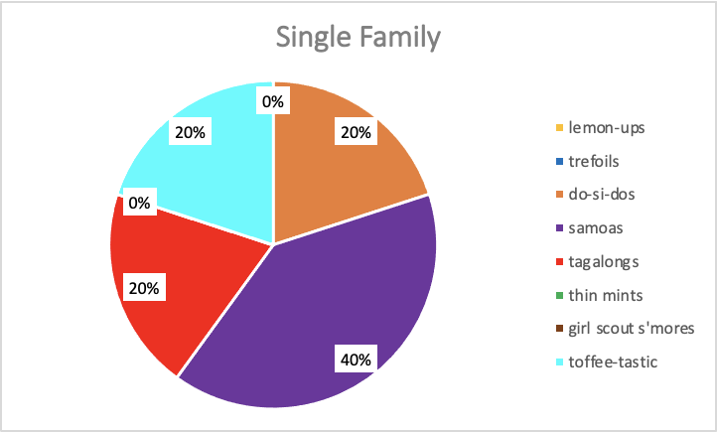
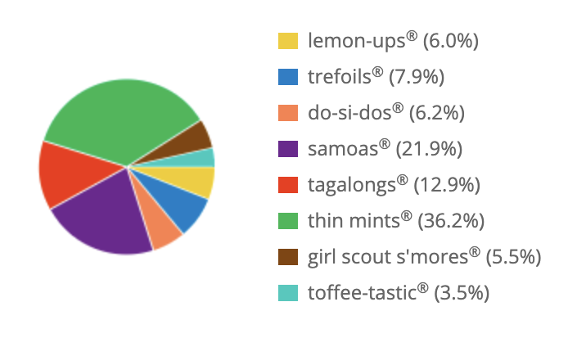
Collect and Analyze Data
Girl Scout Cookie Sales
Single Sale
Troop Sales
Total packages sold: 5
Total packages sold: 1,559
Notes:
For example, here is a pie chart showing real data from my troop sales. This Girl Scout made a single sale to one family (who love Samoas and don't like Thin Mints). But are Samoas the most popular cookie sold by Girl Scouts nationwide? With this data my hypothesis should be yes! But is it? How could I get a better data set?
I could collect more data. The pie chart on the right is the data for my entire troop’s sales. This is a much better data set because it has 1,559 packages of cookies sold – 1,554 more boxes than my single sale. With this much data, I could look at which ones I sold the most of and be able to make a better conclusion to my hypothesis than if I’d only sold 1 or 2 boxes. The more data that is collected, the better. So are Samoas the most popular according to this data? No. Thin mints are. Your troop can do this same exercise with your troop sales! If you added your data to this data, we’d have an even better data set!
In the pictures of the two trees, we only have these two data points, so we can’t make a conclusion about all trees, we can only make a conclusion about the two trees. And we’d need a method to see how old the trees are.

Slide 19
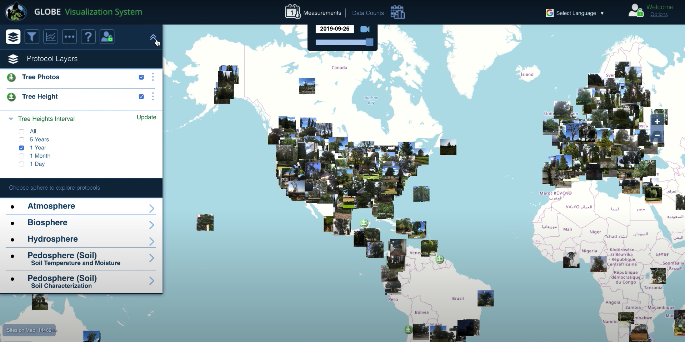
Tree Height Data
https://vis.globe.gov/trees
Notes:
So, to make the hypothesis of tall trees are older than short trees, I’d have to have measured a LOT of tree heights, and been able to count their tree rings (or at least measure their circumference – that’s the length around the tree – like your arms hugging a tree. For NASA scientists, we rely on a lot of data. And this is where you can come in. You can be citizen scientists – measuring both tree height and trunk circumference. All these pictures on this map are data points where citizen scientists have taken observations of tree heights around the world. You can also take these observations and add to this robust data set.

Slide 20
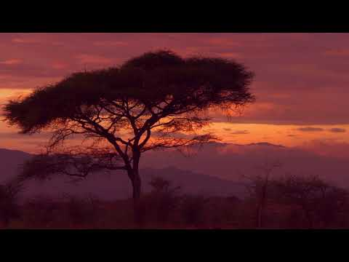
GLOBE Observer: Tree Height
https://youtu.be/pMV9COMYtSg
Notes:
Let me introduce to you the GLOBE Observer Trees tool.
GLOBE Observer: Tree Height video [1:20] (youtu.be/pMV9COMYtSg)

Slide 21
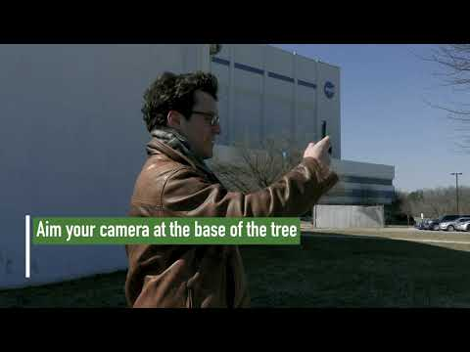
GLOBE Observer Trees Tool
https://youtu.be/_pE26h4xlui
Notes:
This next video will show you how the tree height tool works and what satellite data your measurements are compared to.
GLOBE Observer: Trees Promo video [1:06] (youtu.be/_pE26h4xlui)

Slide 22
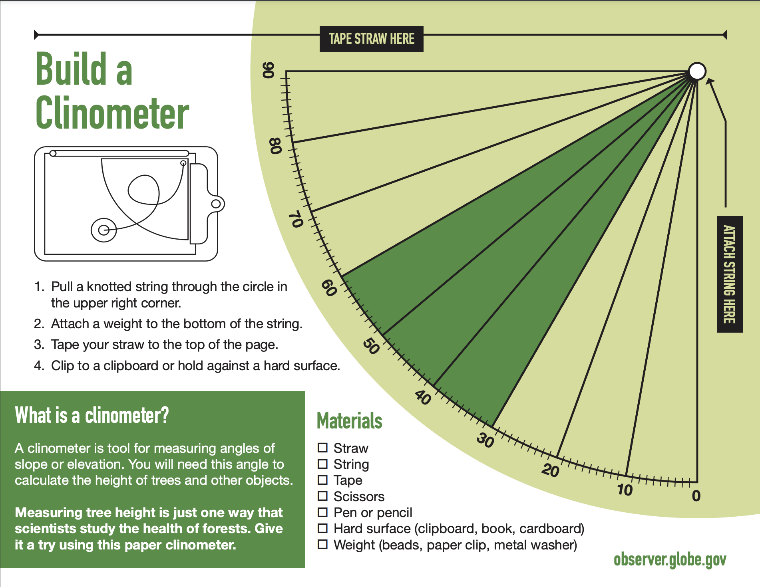
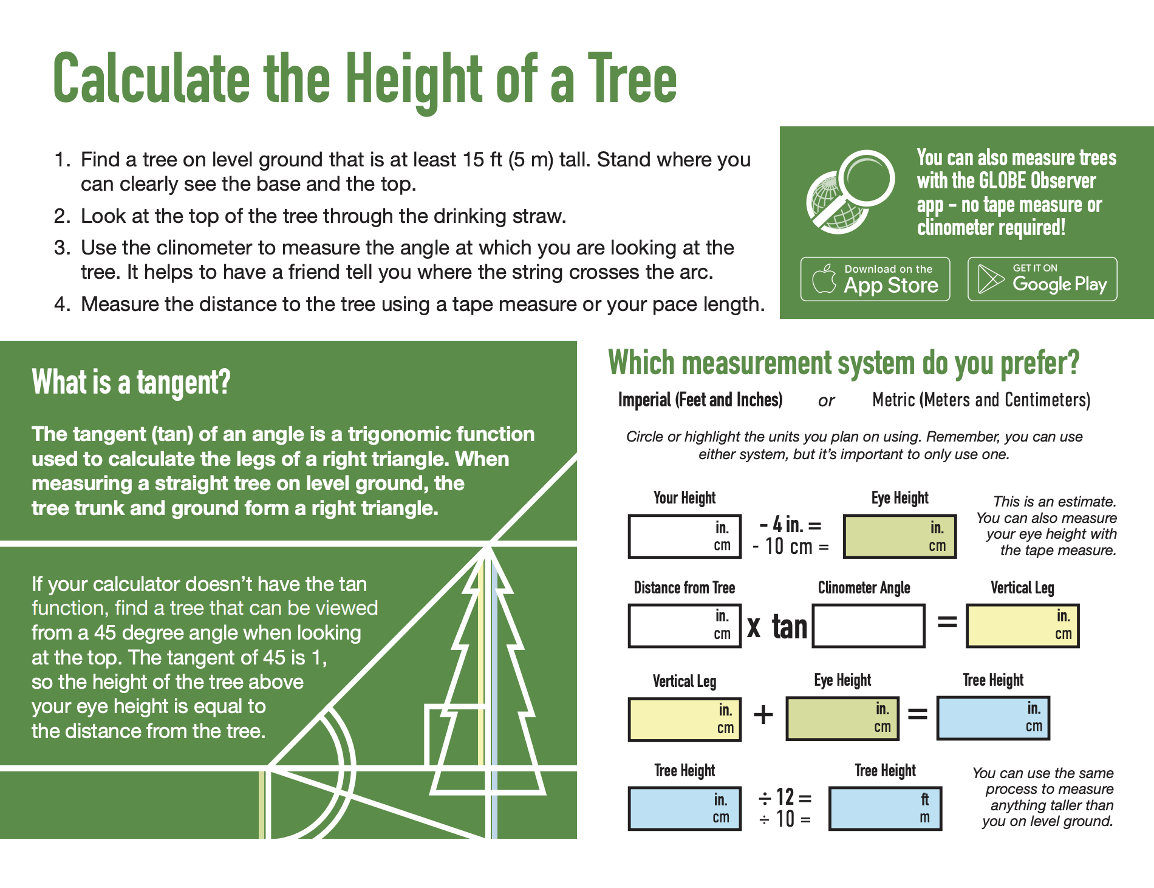
The Hand-Held Clinometer for Measuring Tree Height
Clinometer: an instrument used for measuring the angle of elevation of slopes. A clinometer can be used to measure the heights of trees, poles, towers, and buildings.
https://go.usa.gov/xtE7w
Notes:
Now, I know I just showed you how to use the app, but scientists also use another method to measure tree height and we are going to make our own tree measuring device – a clinometer.

Slide 23
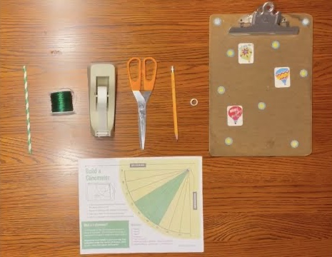
Build a Clinometer
Straw
Pencil
String
Washer
Tape
Scissors
Clipboard
https://youtu.be/AdcU4O1Hwh0
Notes:
Here is a list of the materials you need. If you have them now, you can build it with us, if not, you can easily make your own later. Pause the video if you need to collect the materials and want to build along with us.
Brian Campbell from NASA GLOBE Observer and his son will walk you through how to build the clinometer and use it to measure tree heights. This is one method of measuring trees. A clinometer measures angles that can be used to calculate tree height! The GLOBE Observer app uses your phone as a clinometer, and it uses the internal algorithm in the app to calculate the height. No math required.
Build a Clinometer Instructions (go.usa.gov/xtE7w)
Paper Clinometer Activity video [12:29] (youtu.be/Ky6KhGLw1AU)

Slide 24
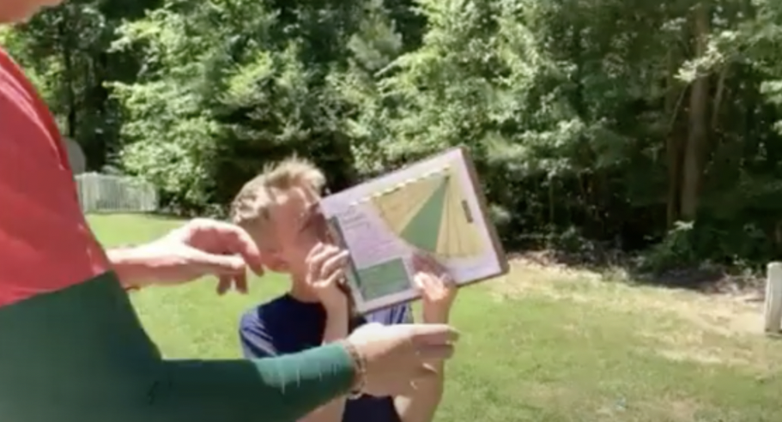
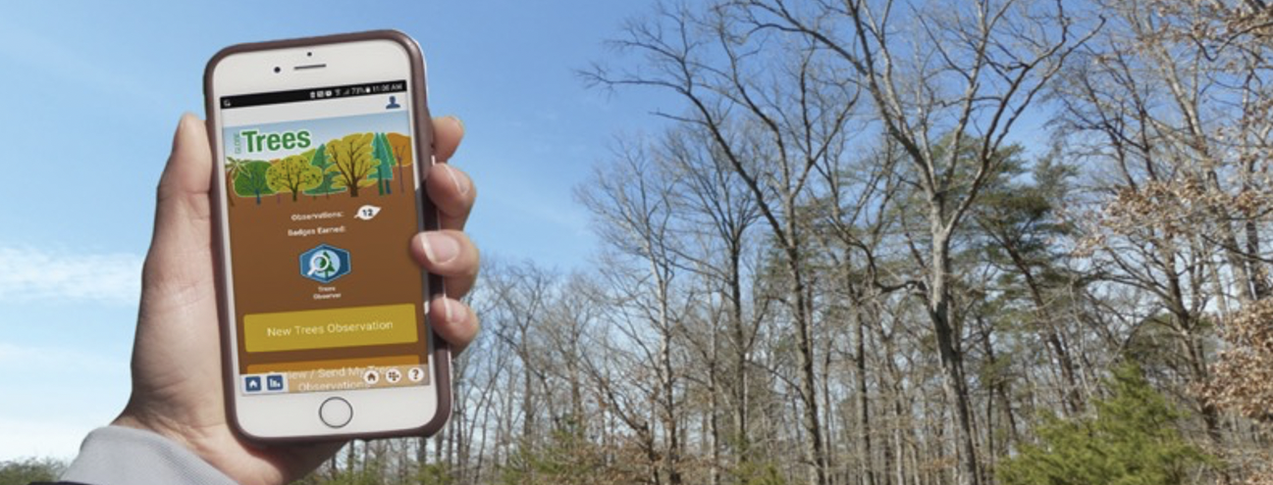
Compare the App and a Clinometer
https://youtu.be/Ky6KhGLw1AU
One way to maximize accuracy of the the GLOBE tree height data is to take tree height observations with a hand-held clinometer and the GLOBE Observer Trees tool, then compare the measurements and repeat!
Notes:
A clinometer is helpful for measuring trees, but the GLOBE Observer Trees tool has a clinometer built in. You can use your paper clinometer to compare your results from the app! This helps make your data even stronger, since you are validating that your instruments are working (if they get the same result).

Slide 25
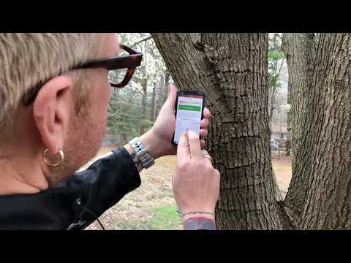
How to use the app to measure tree height
https://youtu.be/ZaUxc-AaI4Y
Notes:
Now that you have a paper clinometer, lets learn how to use the app so you can compare your results from your tree height measurements. This video will show you how to take an observation with GLOBE Observer when you download the app.
How to Take a Trees Observation video [8:21] (youtu.be/ZaUxc-AaI4Y)

Slide 26
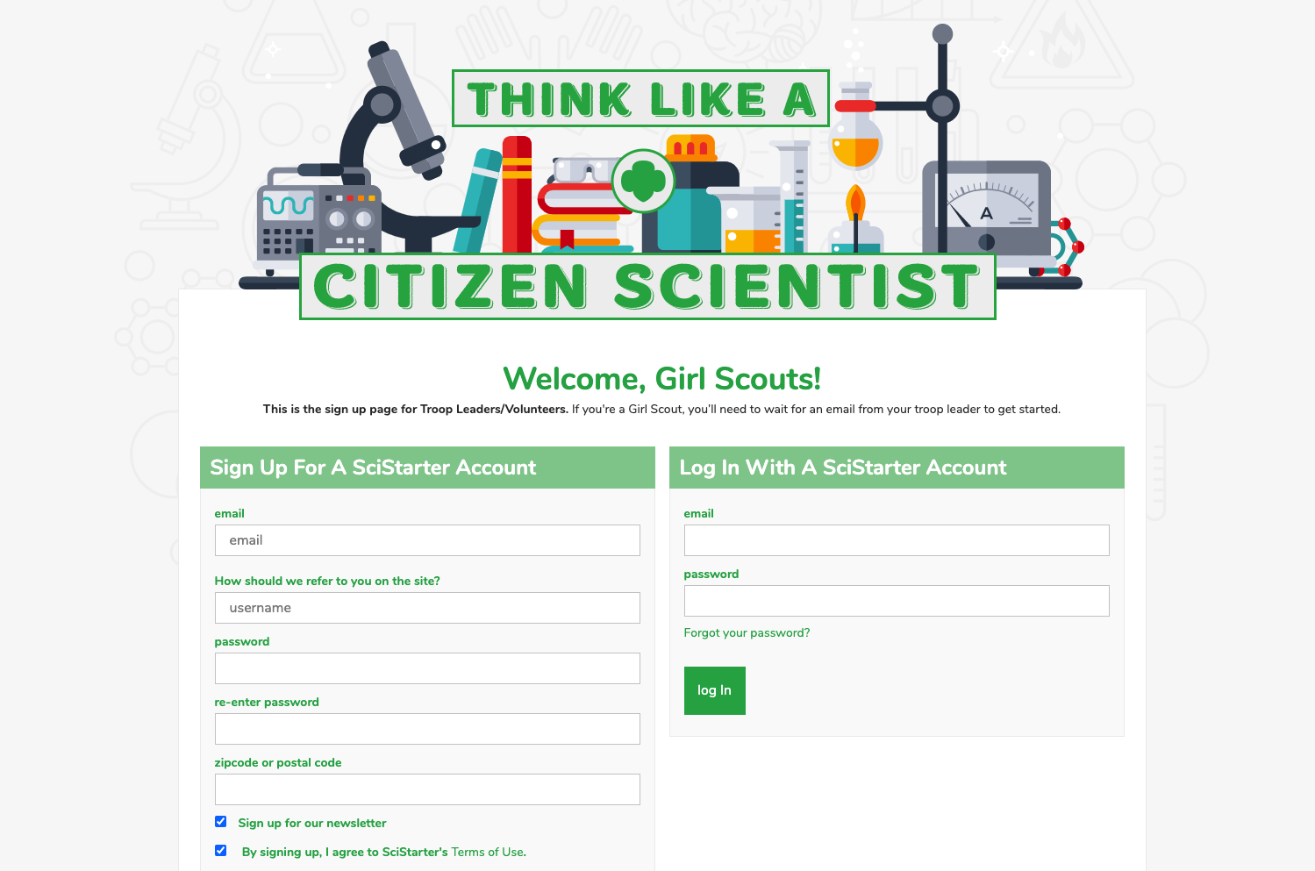
Register your Troop on SciStarter
https://scistarter.com/girlscouts/volunteer/landing
Notes:
If you want to get started as a GLOBE Observer, ask your troop leader to register your troop through SciStarter, then send you the link to set up your accounts.
URL to set up a SciStarter account (scistarter.com/girlscouts/volunteer/landing)

Slide 27
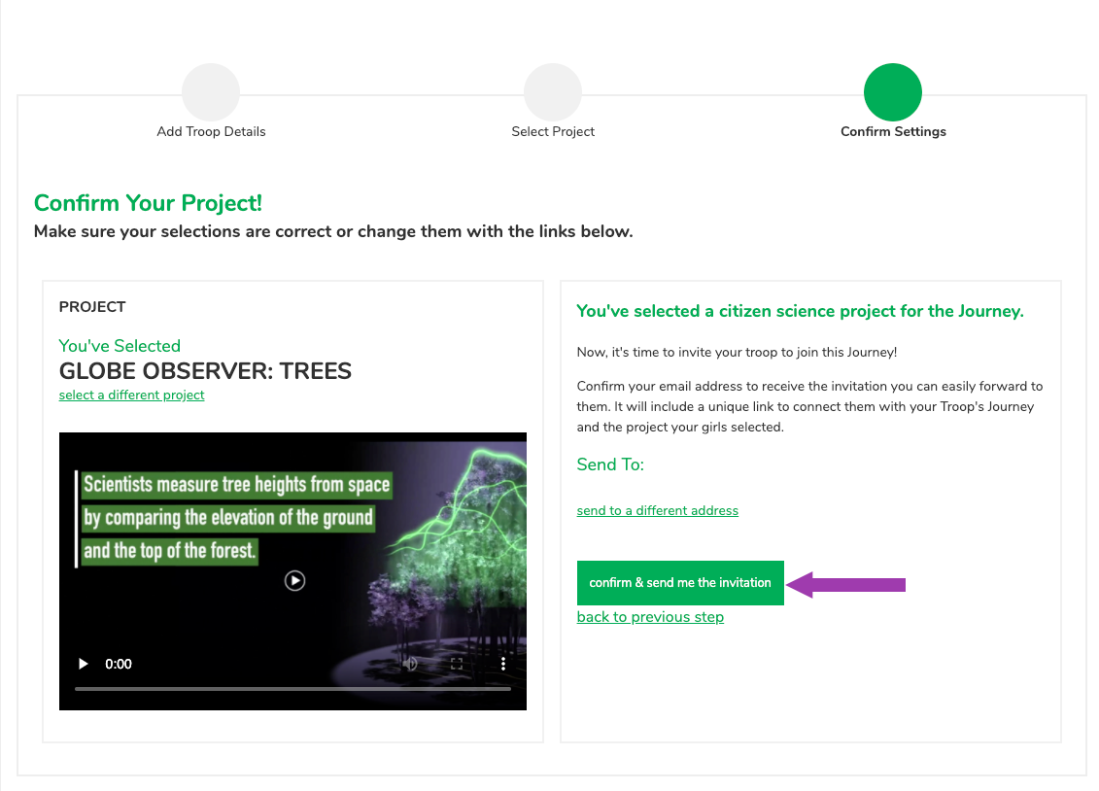
Choose GLOBE Observer: Trees
Notes:
Once you have a troop SciStarter account, you will choose which citizen science opportunity interests you – If you want to use the GLOBE Observer app to measure trees, choose “GLOBE Observer Trees.” There are a lot of different citizen science projects (including others with NASA) and others with GLOBE Observer: Trees, Land Cover, Clouds, and Mosquito Habitat Mapper, that you may be interested in contributing data to as well.

Slide 28
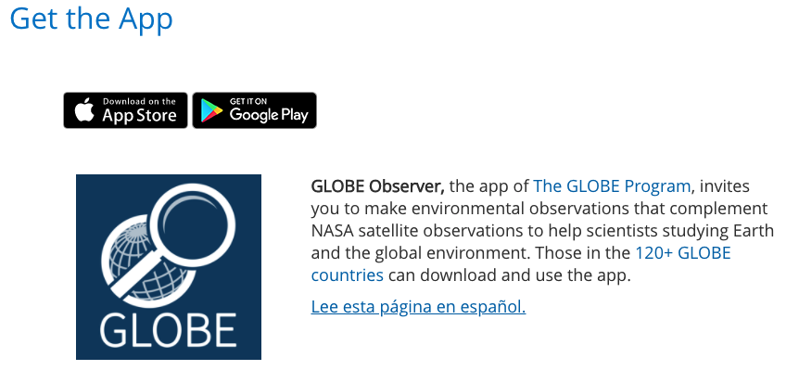
Download the App
Notes:
Once you’ve chosen your project, then you need to download the app. It’s available on Google Play or at the App Store.
Download the app (observer.globe.gov/get-the-app) and register as a GLOBE observer. Then collect your data.
So now you’ve learned to Think Like a Citizen Scientist by observing, collecting and analyzing data. The next step is to collect and analyze your own data by using the app.

Slide 29
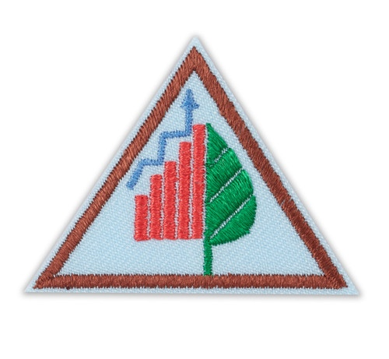
Take Action
What can you do?
Plant a tree and track its growth
Create a program to teach other Girl Scouts about a trees
Start a hiking group and take tree height observations
On a road trip take tree height observations of trees at your stops along the way.
Take tree height and land cover observations from the same place in different seasons, then compare the changes to the tree height from year to year and look for differences between the images.
Create a GLOBE team for your troop, council, or service unit (www.globe.gov/globe-community/globe-teams) and take observations.
Notes:
Then, as you work toward completing your Think Like a Citizen Scientist Journey, consider how you might use your data to take action.
What kind of take action projects could you think of doing?

Slide 30
Questions? Share your projects.
@TheGLOBEProgram
@GLOBEProgram
Notes:
We would also love for you to share your Take Action projects inspired by GLOBE Observer. Please share on social media or email us at GLOBE Observer.

Slide 31
Links for more information
GLOBE Observer app link or download from the App Store or Google Play.
GLOBE Visualization System to see other citizen science data from GLOBE observers around the world. You can look for trees pictures or check out data from the other GLOBE tools.
NASA Worldview to explore current and past satellite data (yes, you can view data as early as today in near real time.)
Girl Scout Tree Promise
Video about how to take a tree height observation
GLOBE Teams
Thanks!
Notes:
What I love about Girl Scouts is that you all leave the world a better place. I for one am really excited that you are leading the future for us. Thanks for joining the NASA GLOBE Observer and Girl Scouts Think Like a Citizen Scientist Journey!
https://observer.globe.gov/about/get-the-app
https://vis.globe.gov
https://worldview.earthdata.nasa.gov/
https://www.girlscouts.org/en/girl-scouts-at-home/activities-for-girls/for-every-girl/tree-promise.html
https://www.globe.gov/globe-community/globe-teams

