Slide 1
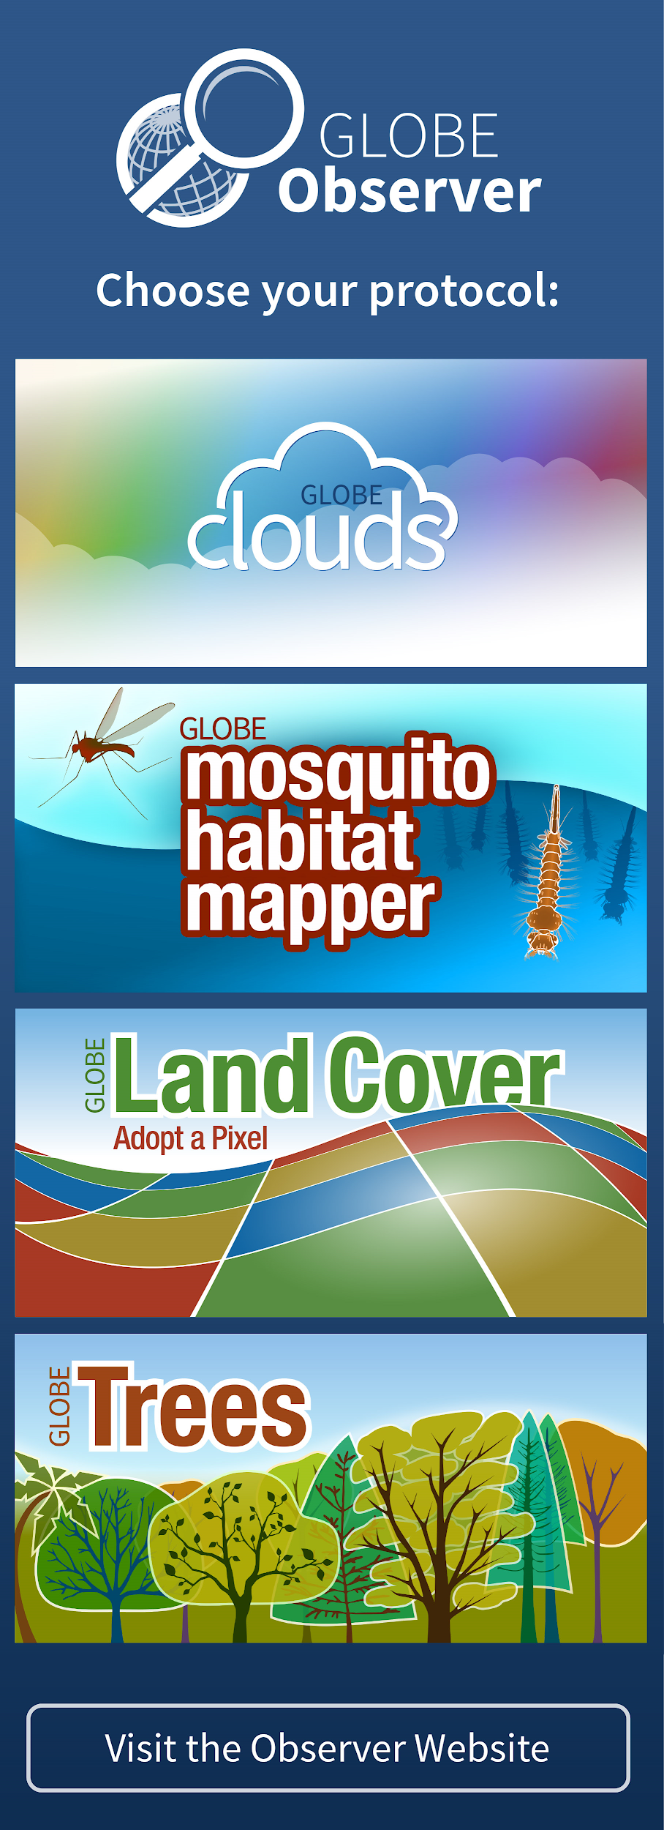
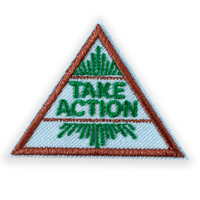
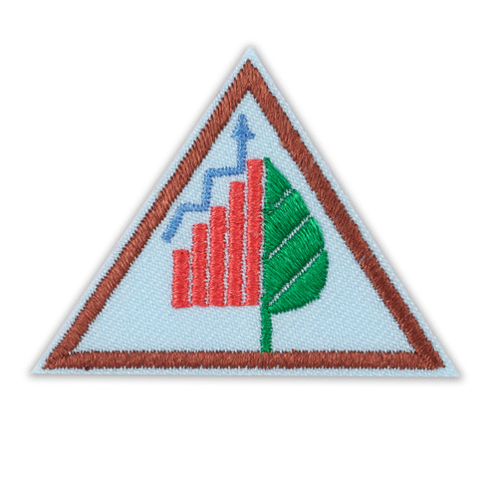
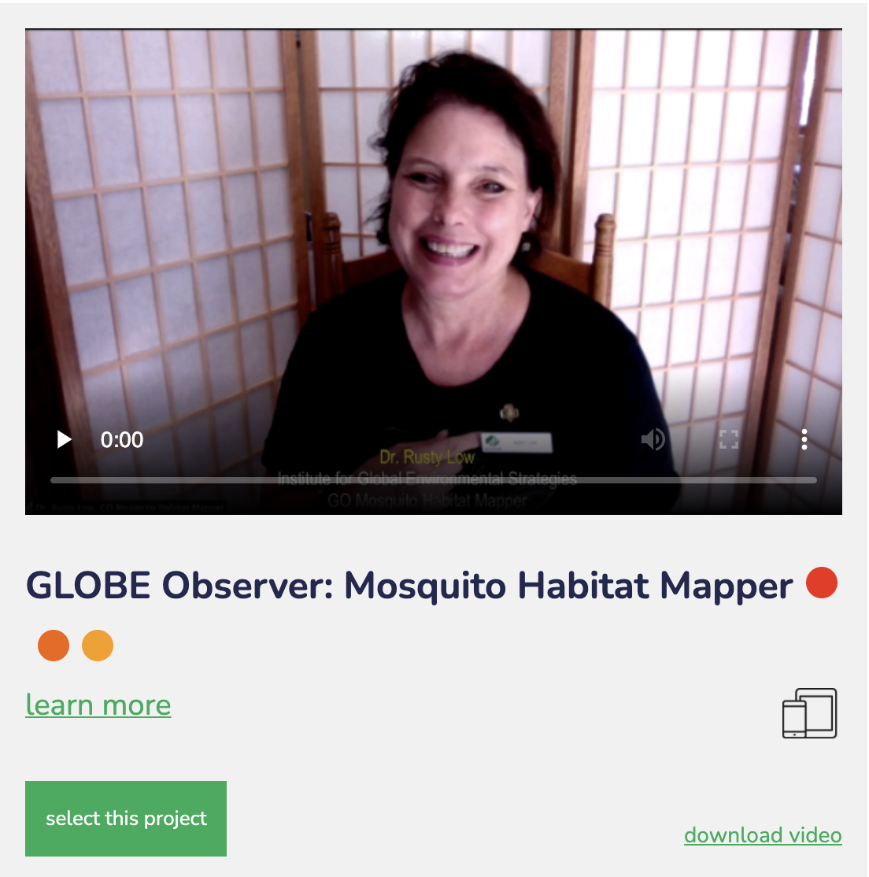
Girl Scouts and GLOBE Observer
&
Notes:
Welcome to the first step in being a critical part of a growing citizen science project. Today you will learn about what it means to Think Like a Citizen Scientist, learn about the Mosquito Habitat Mapper Tool on the GLOBE Observer app and make your own mosquito trap to catch and observe mosquito larvae. Your observations play an important role in identifying mosquitoes that carry disease, which could help prevent mosquito-borne illnesses.

Slide 2
NASA GLOBE and Girl Scouts
The Global Learning and Observations to Benefit the Environment (GLOBE) Program is an international science and education program that provides students and the public worldwide with the opportunity to participate in data collection and the scientific process and contribute meaningfully to our understanding of the Earth system and global environment.
The GLOBE Observer app is a GLOBE’s data entry tool that allows an international network of citizen scientists to work together to learn more about our shared environment and changing climate. GLOBE Observer currently accepts observations of Clouds, Mosquito Habitats, Land Cover and Trees.
GLOBE Observer Mosquito Habitat Mapper: Think Like a Citizen Scientist
Notes:
But first let me tell you about GLOBE and GLOBE Observer.
GLOBE is an international science and education program that provides students and the public worldwide with the opportunity to participate in data collection and the scientific process and contribute meaningfully to our understanding of the Earth system and global environment.
GLOBE Observer app is the data entry tool that allows citizen scientists to enter their data and share observations.
GLOBE Observer is part of GLOBE.

Slide 3
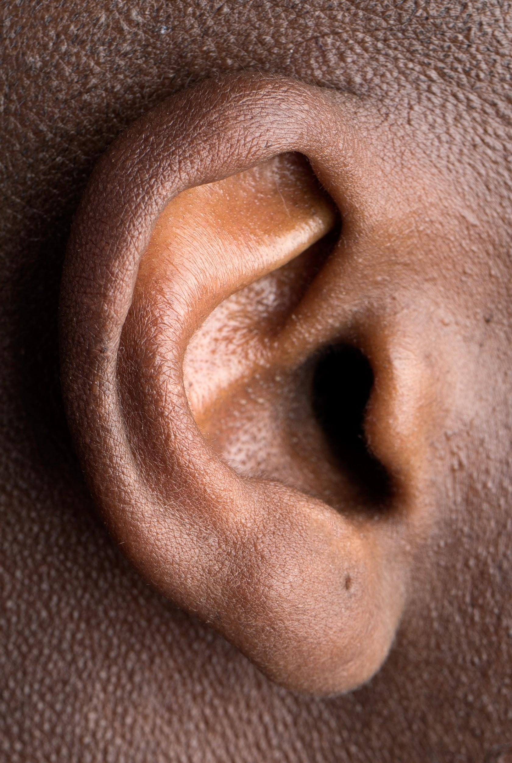
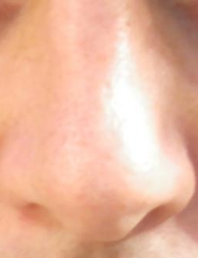
What’s an Observation?
Hear
Smell
Touch
See
Taste
Notes:
Let’s get started on our Think Like a Citizen Scientist Journey, by practicing our observation skills.
When we observe, we use our senses (taste, smell, touch, hearing, and sight). Since we can’t really taste, smell, hear, or touch these pictures, we are going to use our sense of sight. We are going to be observing places where mosquitoes might breed (where mosquito larvae hatch and grow into adult mosquitos), so we need a little prior knowledge. So let’s learn a little bit about mosquitoes.

Slide 4
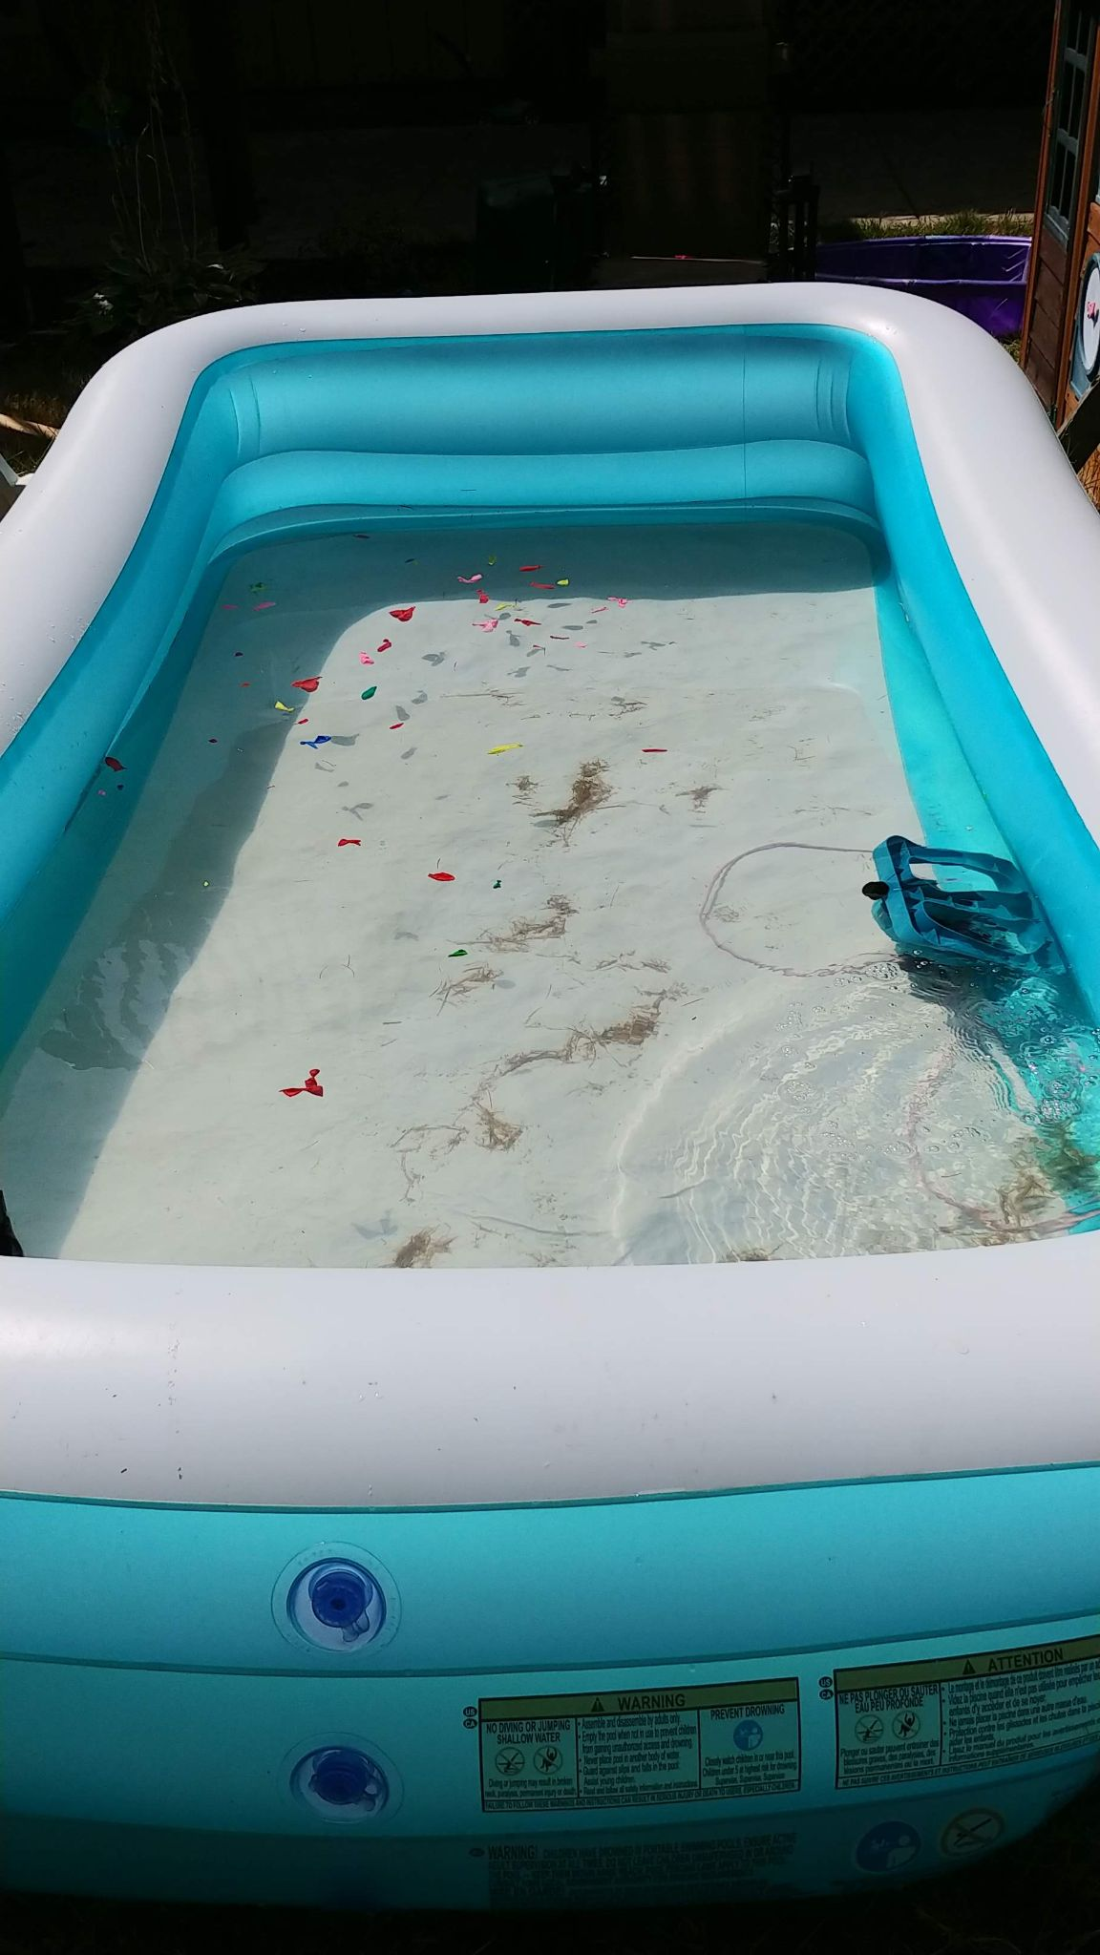
Observation
Mosquitoes need a source of water to breed. Anything that collects water could become a mosquito habitat.
Let’s look at a few pictures and use our sense of sight to make observations about where we might find breeding grounds for mosquitos.
Mosquito City!
Notes:
Mosquitoes need water to breed. So anything that holds water (like this inflatable pool – with bits of water balloon) would be a great mosquito habitat. Fun fact: the mosquitoes that bite are female mosquitoes. Females need the proteins in blood from animals … or humans… to develop eggs. The female mosquitoes lay their eggs above the water line on the inner, wet walls of water-filled containers.

Slide 5
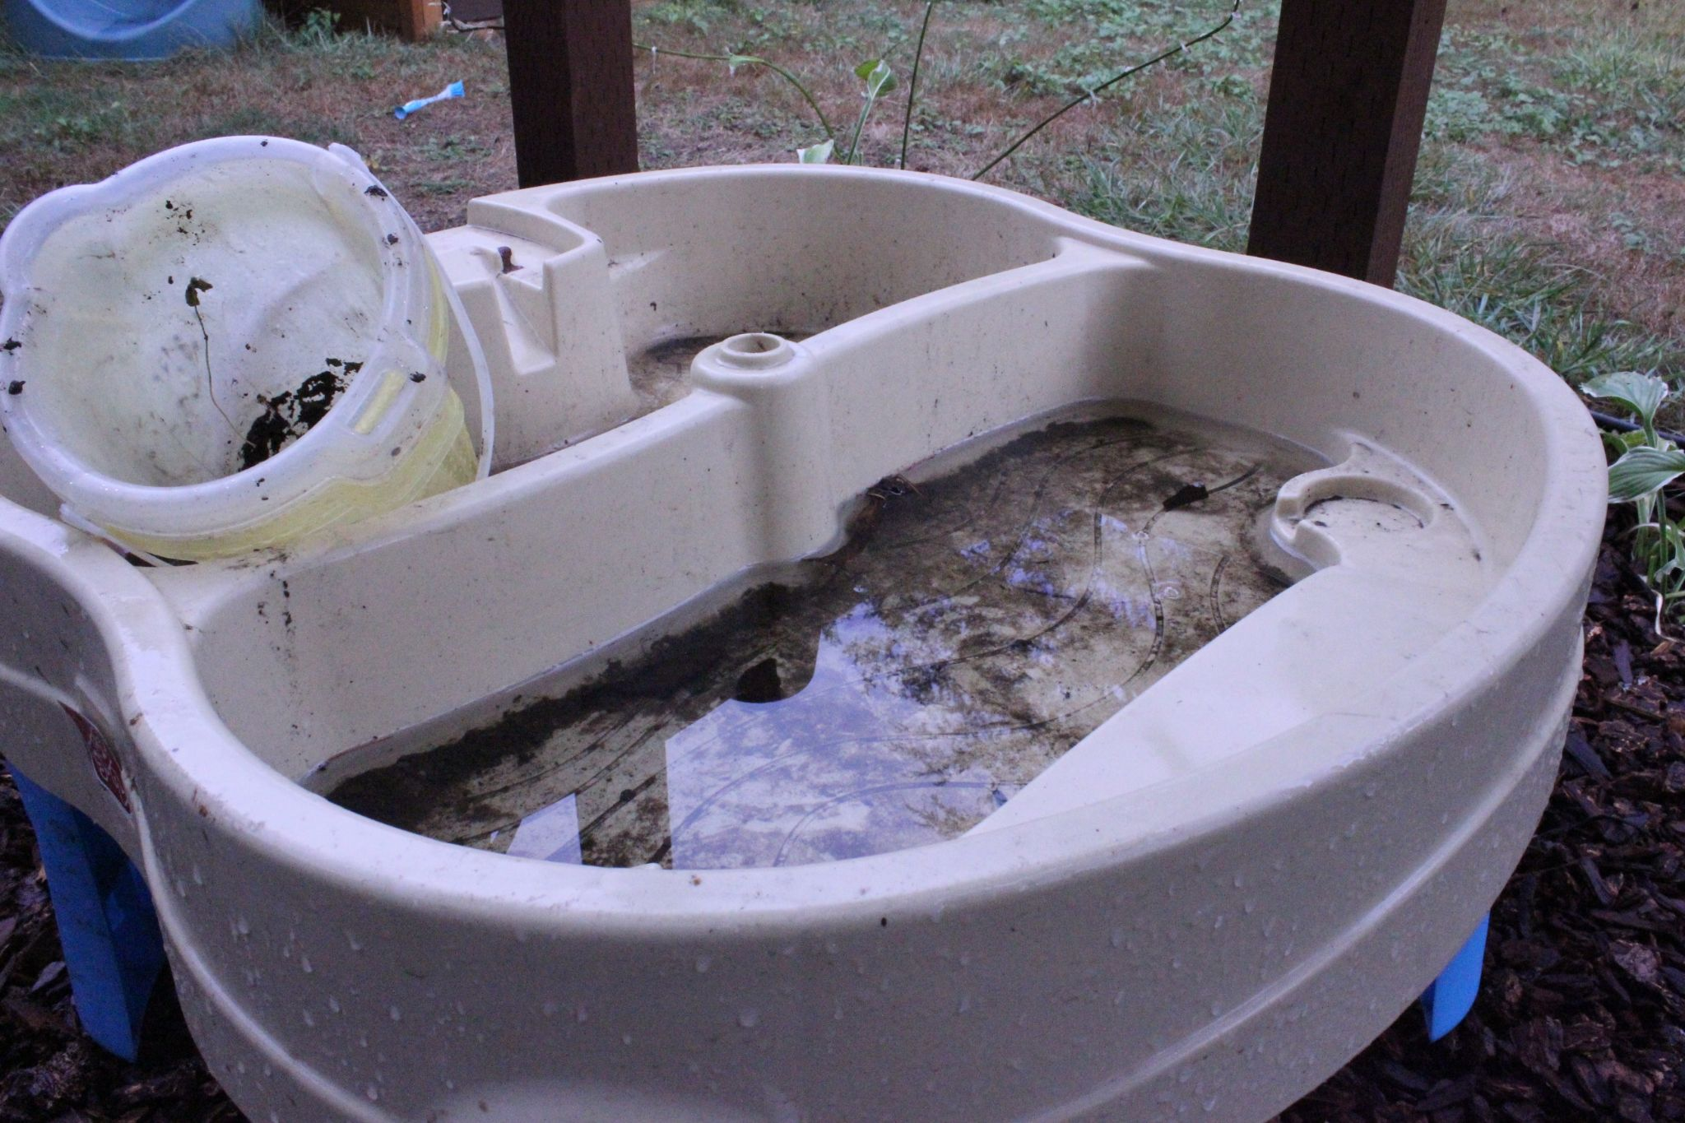
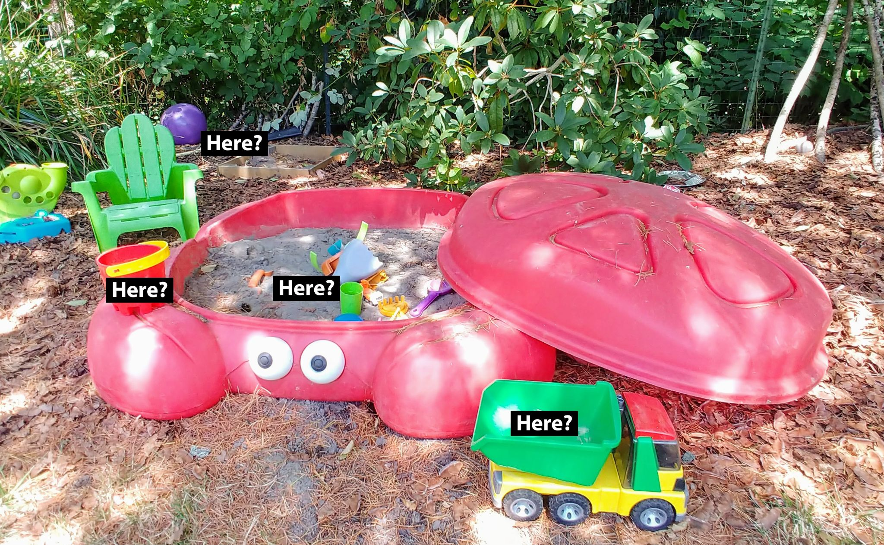
Go on a Mosquito Habitat Hunt
Where do mosquito larvae live? I Spy...
Notes:
Let’s use our prior knowledge about mosquitoes and these pictures to identify places where mosquitoes might be breeding. Let’s go on a mosquito habitat hunt and observe some potential mosquito habitats.

Slide 6
Observations 2
Conditions (temperature, precipitation, etc.)?
Where were larvae present?
Notes:
Some observations might be about where there could be standing water in any of the objects in the pictures.
Other observations could be about the seasons or conditions under which these pictures were taken:
Is there snow on the ground?
Is the sun shining?
Is the water standing still or is it flowing?
What condition is the water in (clean, dirty, fresh, or old)?
Are the water sources in the images artificial (man-made) or naturally occurring?
Grab a sheet of paper, a science journal, or discuss with your troop any observations of these places in the photographs. If you are watching this video with your troop, briefly …

Slide 7
Observations 3
II
Press Pause while you discuss.
Conditions (temperature, precipitation, etc.)?
Where were larvae present?
Notes:
… pause the video, give the scouts a few moments to write down some observations and then discuss what was observed with your troop. Once you’ve shared your observations with each other, resume the video.
Great observing Girl Scouts! There were lots of potential mosquito habitats in those photos. The water play table was full of old filthy water, but this photo was taken when it was winter, so there weren’t any mosquito larvae in the water! It was just too cold, but you probably couldn’t observe that from the photo! In the photo of the backyard toys, taken in the summer, mosquito larvae were found in almost any standing water, like in the buckets, or in the back of the toy dump truck. The photo of the Girl Scouts with umbrellas was taken at a Girl Scout property in the spring and the giant puddle was full of little larvae like these …

Slide 8
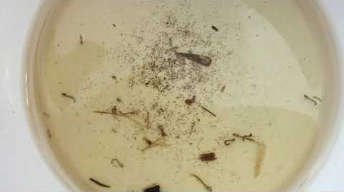
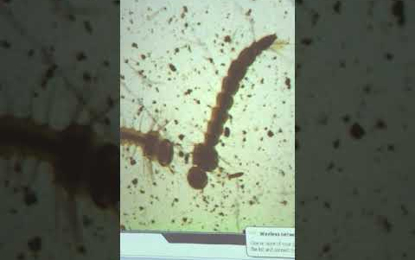
Observation:
Mosquito Larvae up close!
Notes:
… wiggling around.

Slide 9
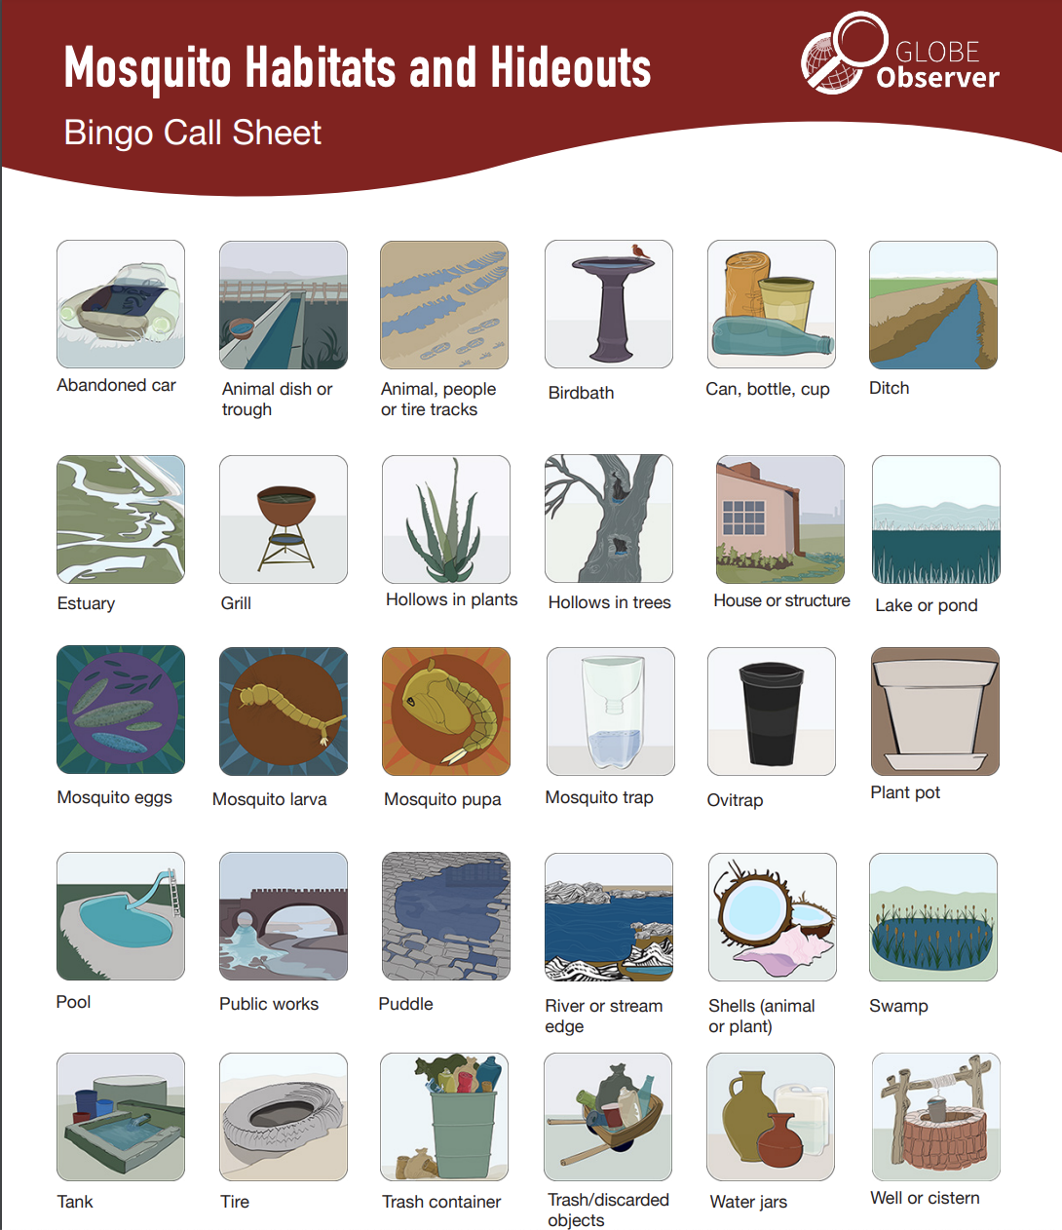
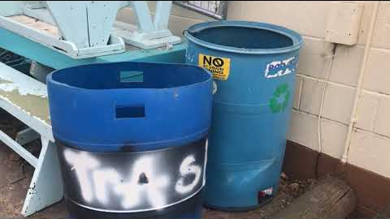
Observation:
Virtual Mosquito Habitat Audit
Check off on your bingo card
Notes:
Next you will practice your observations skills by checking off mosquito habitats on the Mosquito Habitat Bingo Card.
You can download these cards in the Mosquito Habitats Resource Library. Go to observer.globe.gov, then go to “Do GLOBE Observer,” mouse over “Mosquito Habitats,” then select “Resource Library.”
Here you can find lots of different activities, including the “Conducting a Mosquito Habitat Survey” and the “Bingo Boards” from the “Mosquito Habitats and Hideouts Activity.”

Slide 10
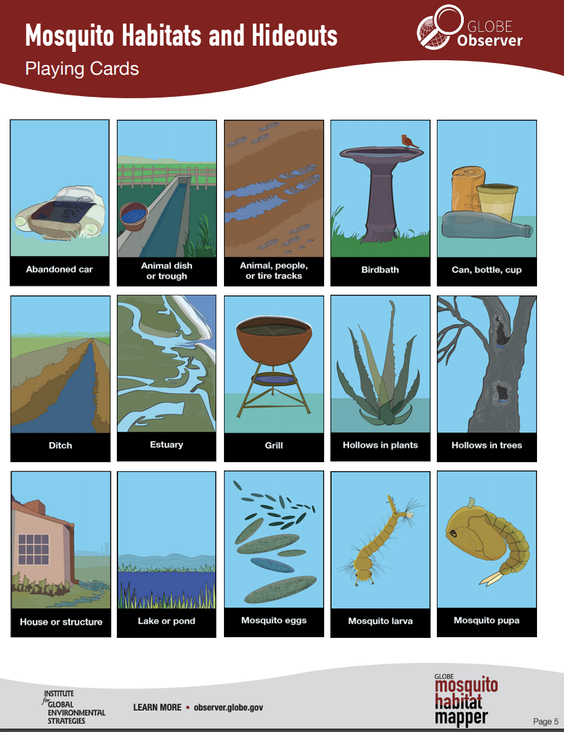
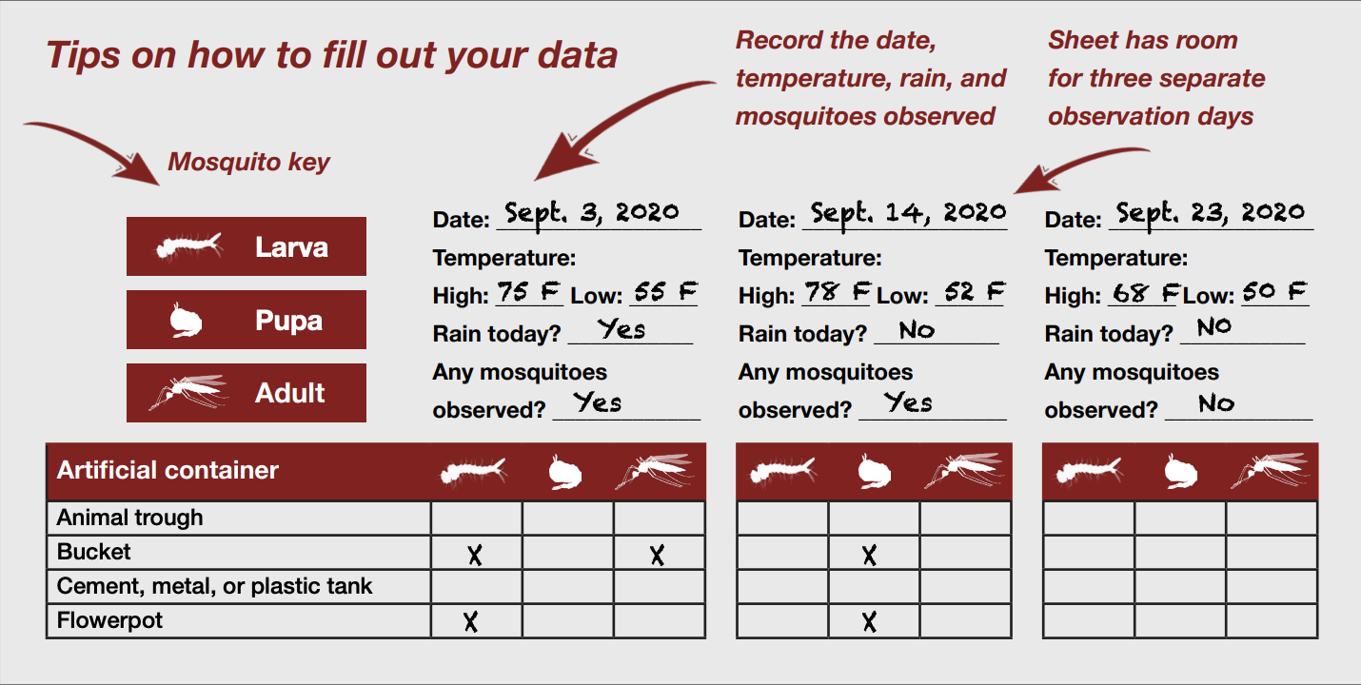
Observation: Mosquito Habitats and Hideouts (Your turn!)
You can do this on your own if you can go outside with an adult.
Bingo card Mosquito Habitats and Hideouts scavenger hunt: check off any mosquito habitats when you find them.
Mosquito Habitat Survey: identify any larvae, pupa, or mosquitos that are present.
Notes:
The bingo cards can be used like a scavenger hunt sheet to observe mosquito habitats around you while on a hike, while meeting outside, while camping, or even as a scavenger hunt to look for mosquito habitats in your own yards or nearby parks. Alternatively, if you are unable to look for mosquito habitats where you are located, you can watch this next video where Tassia Owen takes you on a virtual hike through the Marquam Trail in southwest Portland, Oregon. If you plan to take your troop out to do this activity, skip ahead past the virtual hike. On a side note, more advanced troops can use the Mosquito Habitat Survey to collect data about mosquito larvae in addition to the bingo card.
Mosquito Habitat Virtual Hike video segment (youtu.be/YobgJJmN7YA?t=334) [3:10]

Slide 11
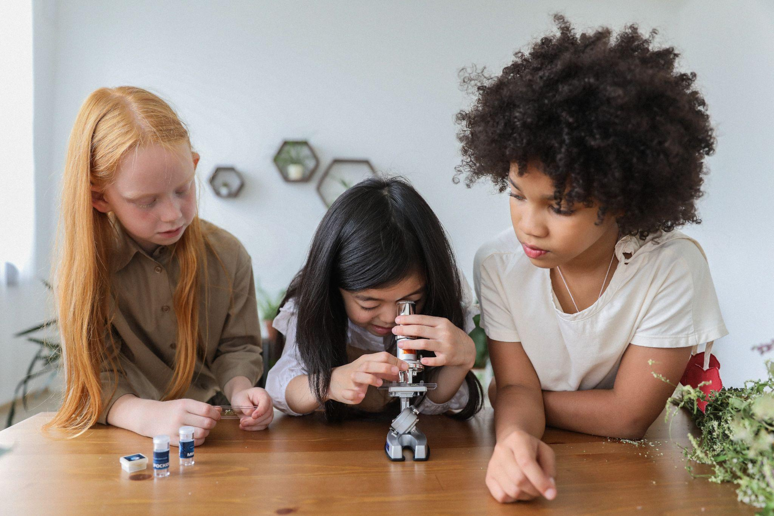
What does a Scientist Do? 1
Notes:
Congrats! You are taking the first step to become scientists!
Okay, now let’s talk about scientists. What do scientists do?

Slide 12
What does a Scientist Do? 2
II
Press Pause while you discuss.
Notes:
Pause the video and discuss what you think a scientist does.
(Return to Slide 11, if desired)
I bet you had a great discussion on what it means to be a scientist. There are lots of different types of scientists out there, but one thing they all have in common in their research is that scientists rely on the scientific method to learn new things. You are going to be citizen scientists, where you use the scientific method to help gather data for NASA scientists and other researchers including students or scouts like you.

Slide 13
What does a Scientist Do? 3
Observe
Ask a Question
Make a Hypothesis
Notes:
The first part of the scientific method is to observe.

Slide 14
What does a Scientist Do? 4
Observe ✓
Ask a Question
Make a Hypothesis
Notes:
You all did a great job of observing the mosquito habitat hunt pictures and using the bingo cards or habitat survey sheets to record your observations.
The next part of the scientific method is to create a question and make a hypothesis (i.e. your best guess at the answer to your question based on your observations).

Slide 15
Formulate a Question 1
?
Did you know:
Vector borne illness mosquitoes usually prefer breeding in artificial containers.
Create a question based on your observations
Notes:
Okay, now that we’ve observed a few different mosquito habitats, either in person or by watching the video, let’s form a question based on our observations. What could be a good question?

Slide 16
Formulate a Question 2
?
Did you know:
Vector borne illness mosquitoes usually prefer breeding in artificial containers.
II
Press Pause while you discuss.
Create a question based on your observations
Notes:
Pause this video and discuss with your troop.

Slide 17
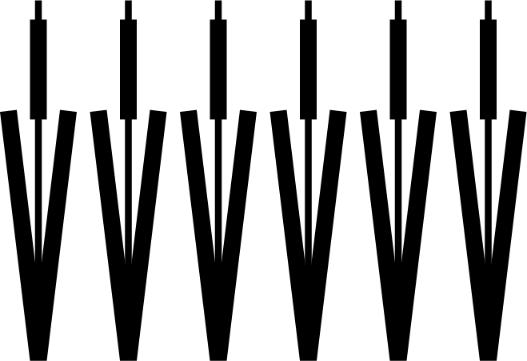
Formulate a Question 3
?
Near where you live, are there more artificial or natural habitats for mosquitoes?
Create a question based on your observations
Notes:
I bet you came up with some great questions! I’m going to give you a question to discuss. Our question could be, “Are there more artificial containers or natural water sources where I live?” This is a question that you could answer by collecting data or inventorying the types of potential mosquito habitats in your area.

Slide 18
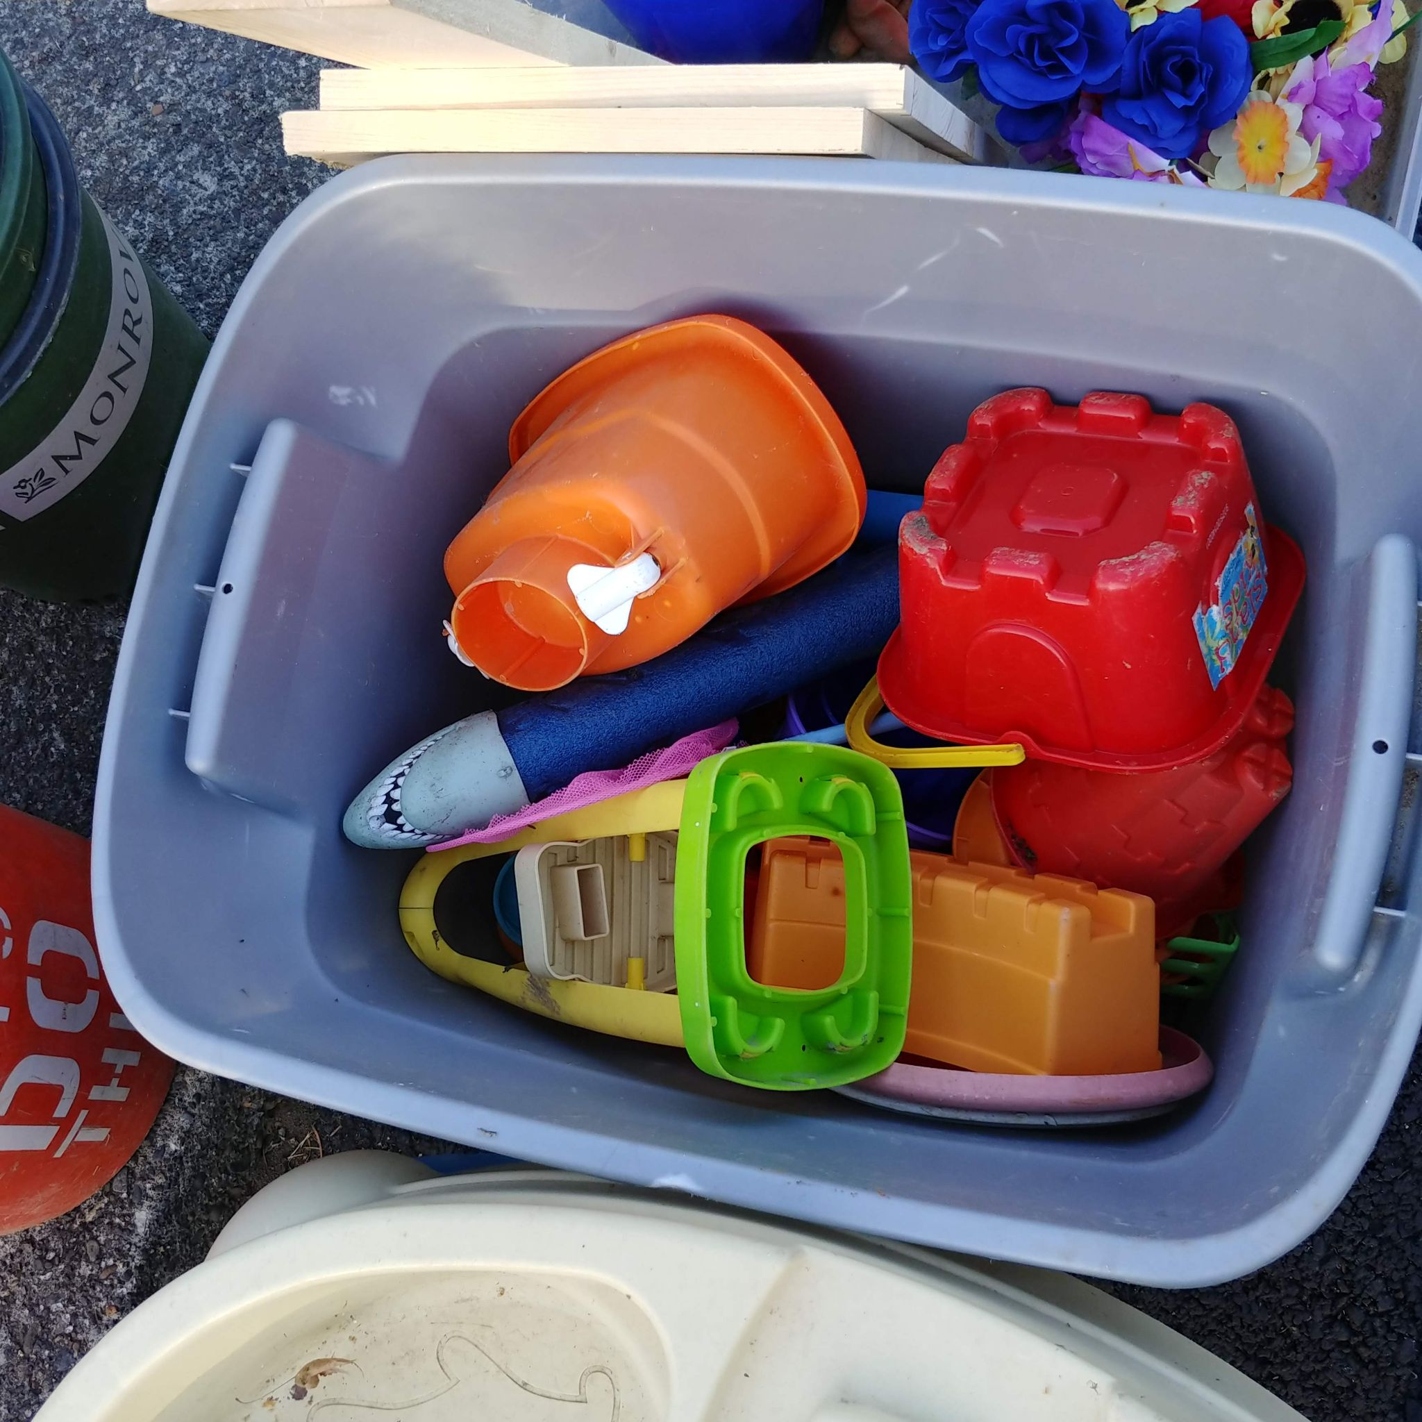
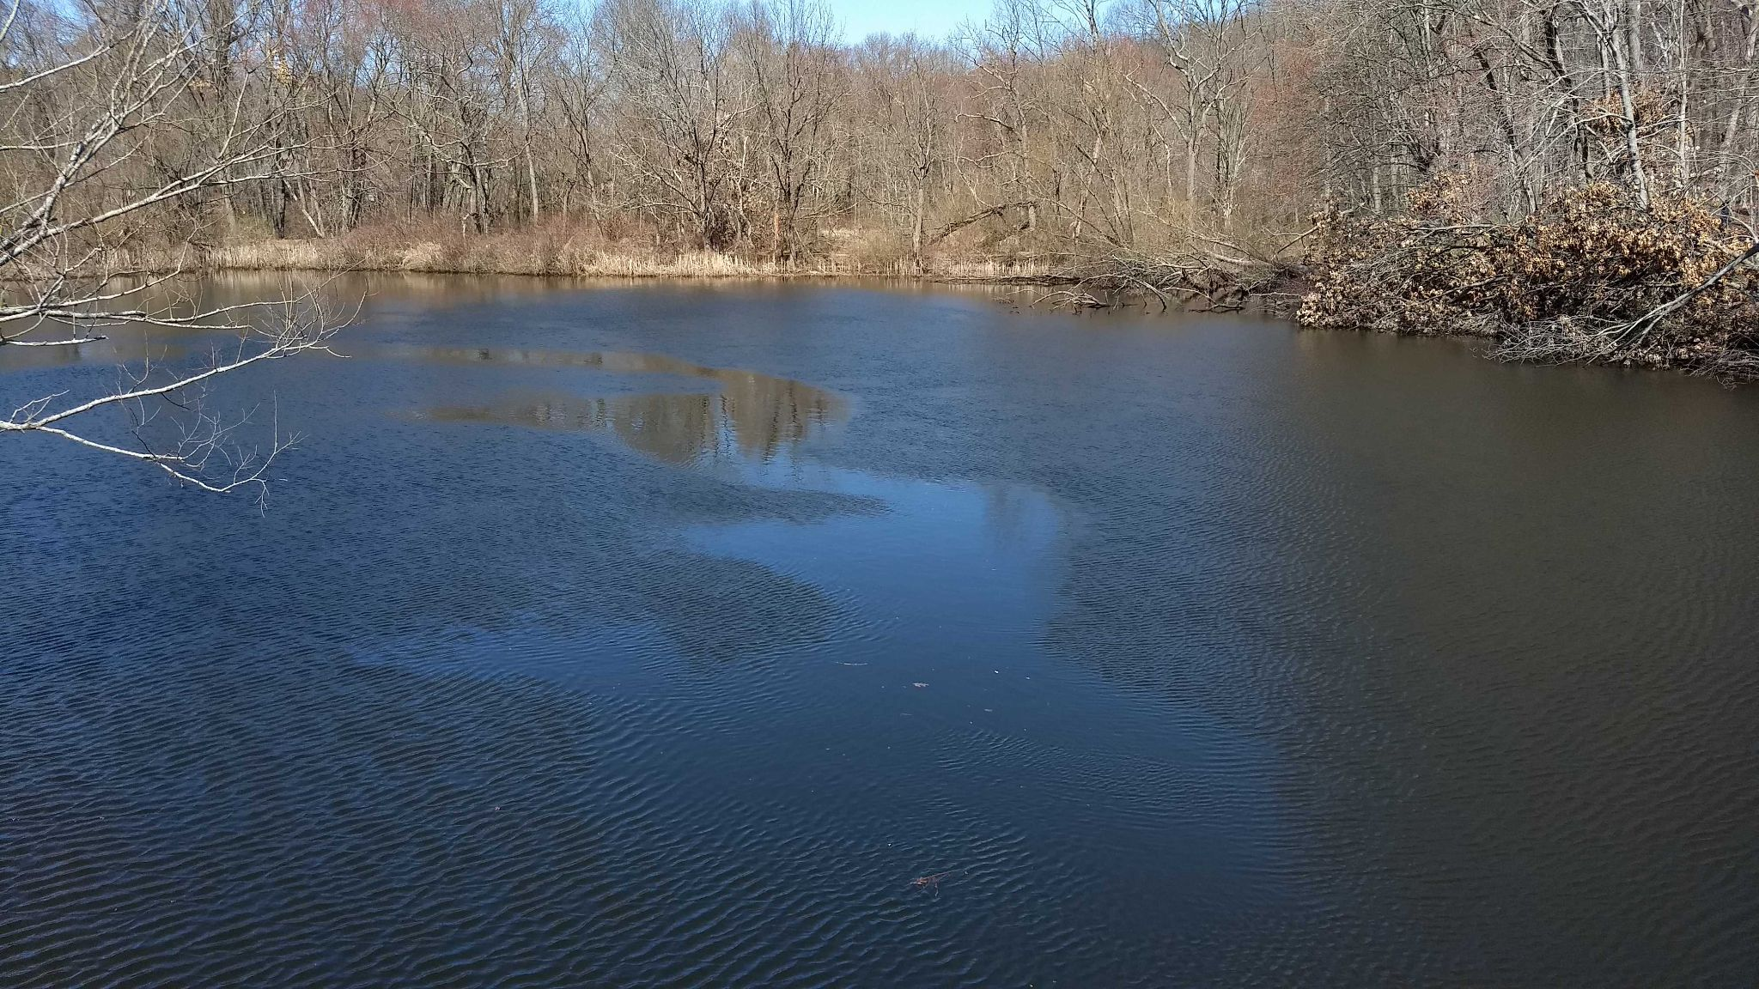
Make a Hypothesis 1
Answer your question based on observations.
There are more artificial containers near me.
There are more natural water sources near me.
Notes:
What do you think? Are there more artificial containers near you or more natural water sources that could be potential mosquito habitats? Make a hypothesis.
The hypothesis is your answer to that question.
We have a few options:
I think there are more artificial containers
I think there are more natural water sources for mosquitoes to breed in.
Which one do you think?

Slide 19
Make a Hypothesis, then Collect Data
Answer your question based on observations.
Collect data to see if your hypothesis is correct.
Artificial
Natural
Notes:
At this point, you can pause the video and take an inventory of the number of artificial or natural potential mosquito habitats in your area (which could be your yard, your schoolyard, local park, or another area that your troop defines) or you can continue watching the video and do this activity later.

Slide 20
Make a Hypothesis 2
Answer your question based on observations.
There are more artificial containers near me.
There are more natural water sources near me.
Notes:
I observed my yard and decided that I have more artificial containers in my backyard than natural containers. There’s a sandbox, sand toys, inflatable pool, wagon, dog bowl, tire swing. There are a lot of containers back there. So I chose “There are more artificial containers near me,” as my hypothesis. Your observations may have led you to choose “There are more natural water sources near me.” That would depend on what is in your surroundings.

Slide 21
How do scientists know if their hypothesis is correct?
Collect and Analyze Data
Notes:
So, how do scientists know if their hypothesis is correct? They have to collect and analyze data. The more data they have, the better their results will be, because it helps filter out some of the outliers (the mistakes, errors, or oddball data – kind of like if I was measuring favorite Girl Scout cookies. The more people I sell cookies to, the better my data.

Slide 22
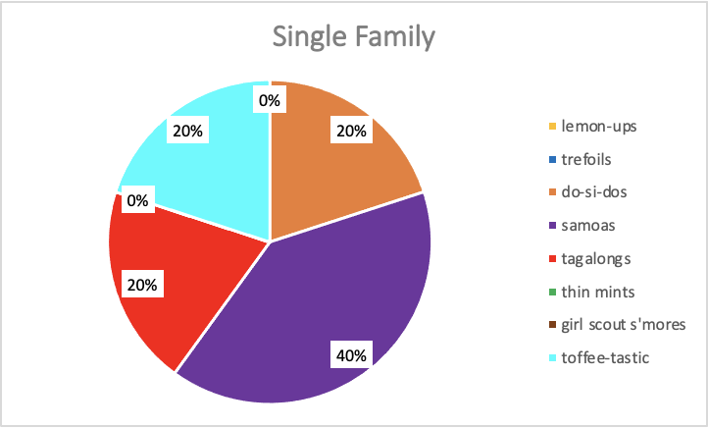
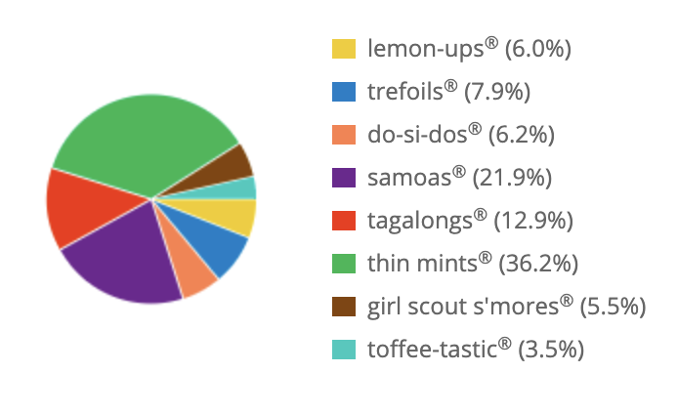
Collect and Analyze Data
Girl Scout Cookie Sales
Single Sale
Troop Sales
Total packages sold: 5
Total packages sold: 1,559
Notes:
For example, here is a pie chart showing real data from my troops sales. This Girl Scout made a single sale to one family (who love Samoas and doesn’t like Thin Mints). But are Samoas the most popular cookie sold by Girl Scouts nationwide? With this data my hypothesis should be yes! But is it? How could I get a better data set?
I could collect more data. The pie chart on the right is the data for my entire troop’s sales. This is a much better data set because it has 1,559 packages of cookies sold – 1,554 more boxes than my single sale. With this much data, I could look at which ones I sold the most of and be able to make a better conclusion to my hypothesis than if I’d only sold 1 or 2 boxes. The more data that is collected, the better. So are Samoas the most popular according to this data? No. Thin mints are. Your troop can do this same exercise with your troop sales! If you added your data to this data, we’d have an even better data set!

Slide 23
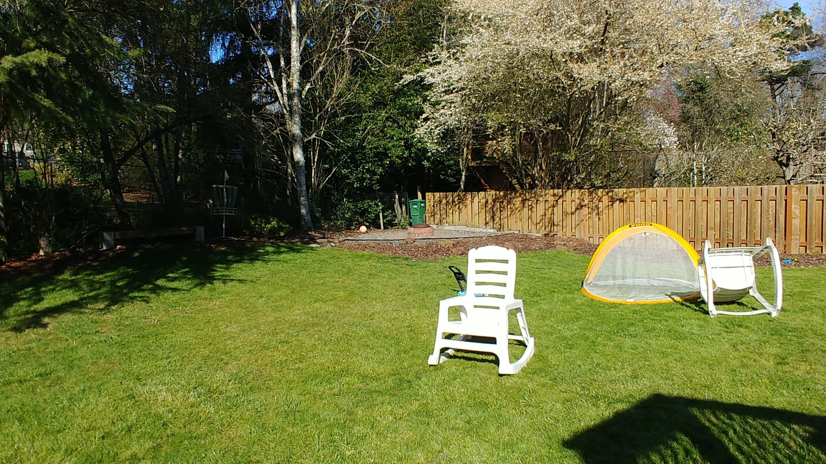
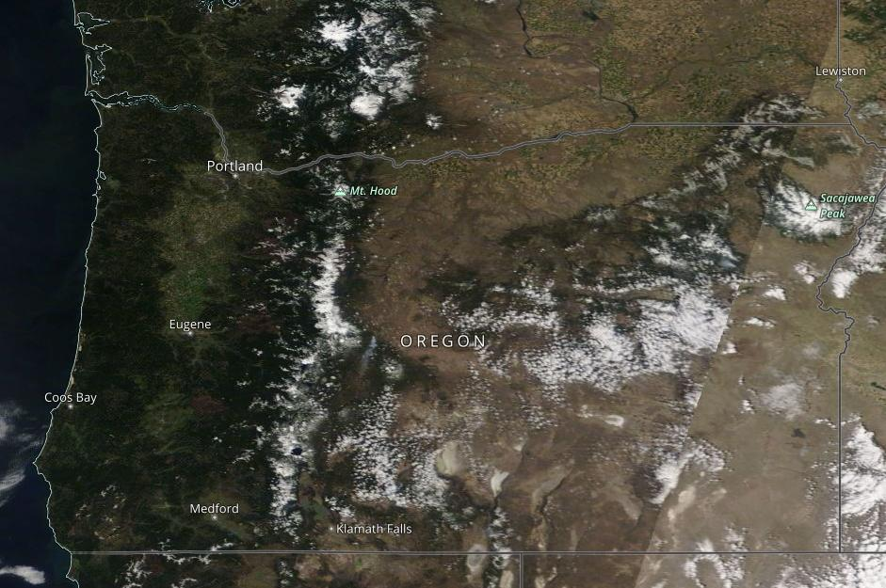
What about around in Oregon and SW Washington?
My yard is not a large data set.
We need MORE data!
Notes:
Like the girl scout cookie example, my yard is not a large data set - it is a snapshot of one location in Portland, Oregon. So, it’s definitely not large enough to make a conclusion about a large area like Oregon and SW Washington. There are a lot of yards in this Girl Scout region and even more yards and open spaces across the United States. So, we need a LOT of data to make stronger scientific discoveries.

Slide 24
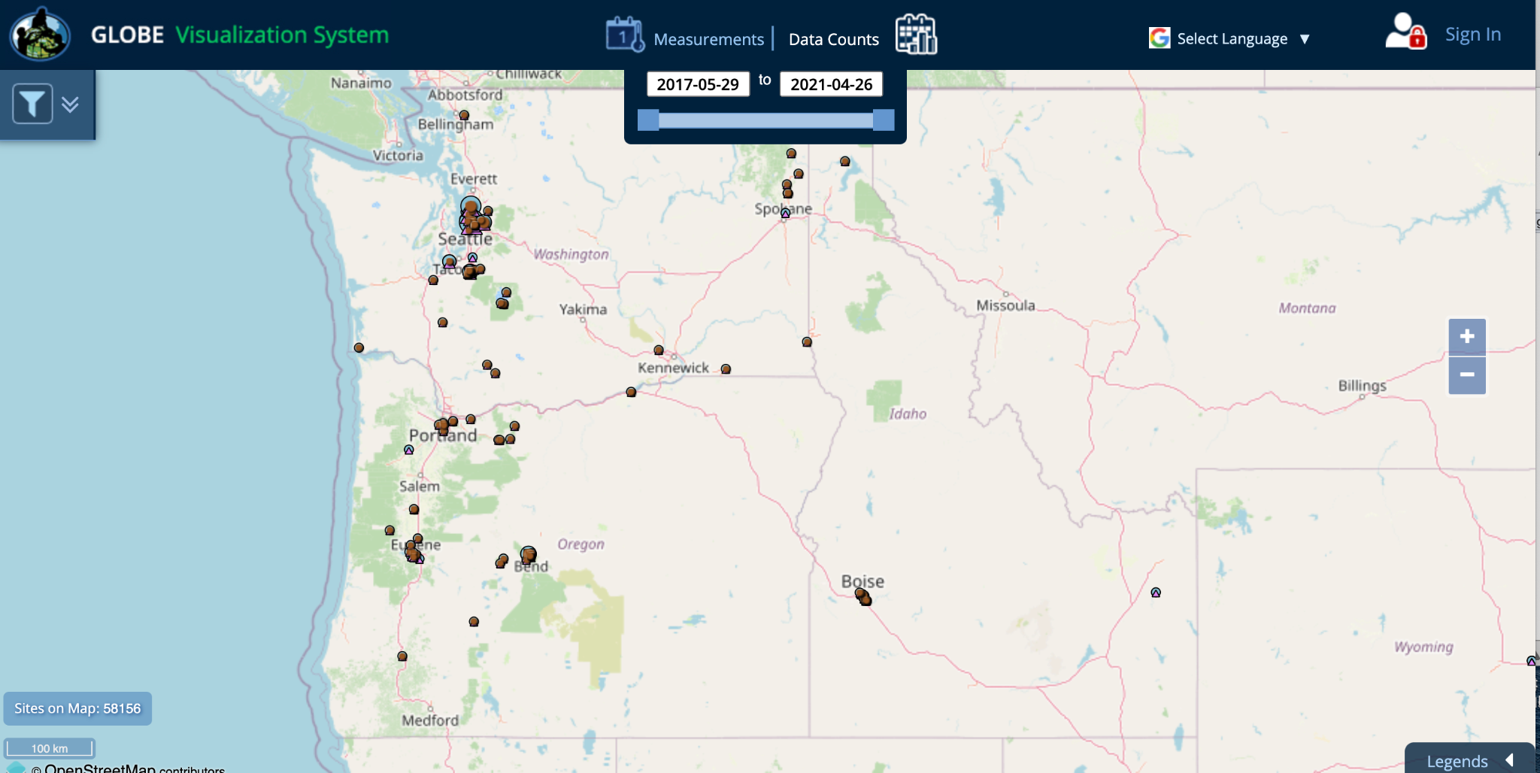
Mosquito Habitat Data
https://vis.globe.gov/mosquitohabitats
Notes:
GLOBE’s network of citizen scientists collect a lot of data. You can see the data on the GLOBE Visualization System (vis.globe.gov/mosquitohabitats). Each dot on the map is a mosquito observation taken by a citizen scientist or school. But we still need more data! We need you, citizen scientists!

Slide 25
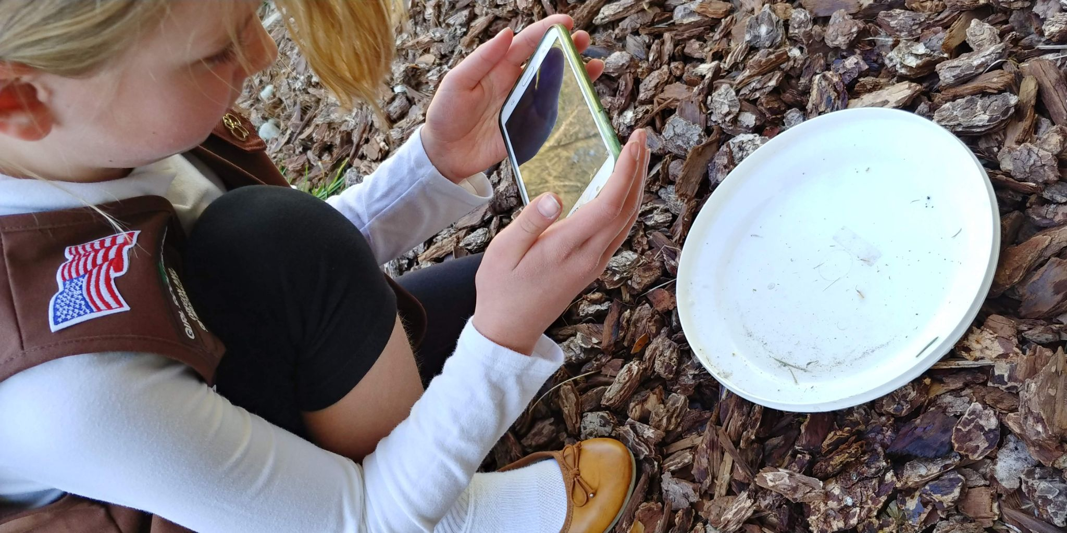
We need your data!
The more data we get, the better the science can be.
And that’s why
NASA GLOBE
needs you!
Join GLOBE Observer: Mosquito Habitat Mapper
Notes:
Girl Scouts are a valuable source of this information. We need you to Think Like a Citizen Scientist!

Slide 26
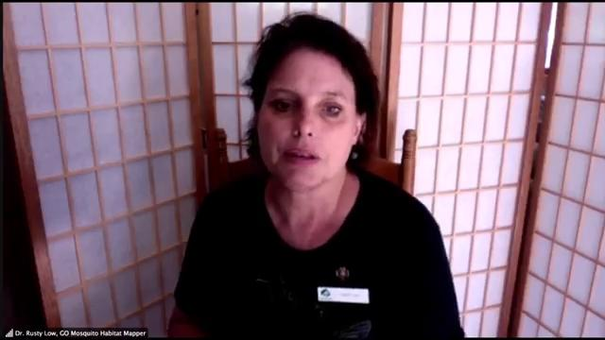
Mosquito Habitats Girl Scout Intro
https://youtu.be/YobgJJmN7YA?t=905
Notes:
Dr. Rusty Low, GLOBE Observer’s Mosquito Habitat Mapper science lead (and life-long Girl Scout) will share with you how Girl Scouts like you can help us collect more data on mosquito habitats and help keep people safe from mosquito-borne illnesses.
Mosquito Habitat Girl Scout Intro video segment [2:20] (youtu.be/YobgJJmN7YA?t=905)

Slide 27
Mosquito Habitat Mapper Intro
https://youtu.be/YobgJJmN7YA?t=1055
Notes:
Now that you know why mosquito observations are important, Kristen Weaver from the GLOBE Observer communications team is going to show you how to take a mosquito observation.
Mosquito Habitat Mapper Intro video segment [2:29] (youtu.be/YobgJJmN7YA?t=1055)

Slide 28
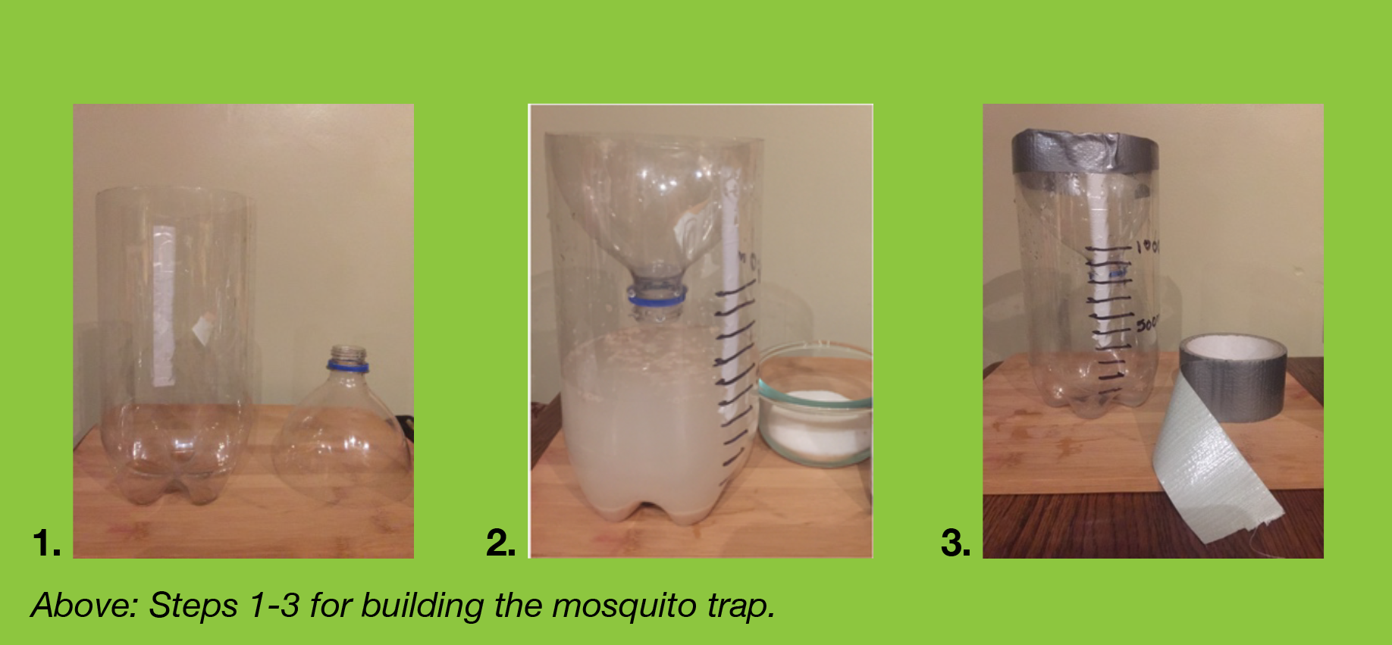
Build a Mosquito Trap
Materials:
clear plastic bottle
netting (like tule)
rubber band
tape
scissors or craft knife
dark paper or fabric
water
Build a Mosquito Trap Activity Instructions
Notes:
Since you now know how to use the app to take observations and collect data, Dr. Low is going to show you how you can make a mosquito trap, to collect larvae that you can safely observe. It’s really easy. If you have the materials on hand, you can create your trap too. Just pause the video while you collect your materials. Then as you watch her demonstrate, pause the video as needed while you build your mosquito trap.
Here is a list of the materials you need. If you have them now, you can build it with us, if not, you can easily make your own later. The link to the printable activity can be found in the resources section we visited earlier in the video.
clear plastic bottle
netting (like tule)
rubber band
tape
scissors or craft knife
dark paper or fabric
water
This is one method for catching larvae so you can count them and identify mosquito species in your region.
Build a Mosquito Trap Activity Instructions (go.usa.gov/xtEPV)

Slide 29
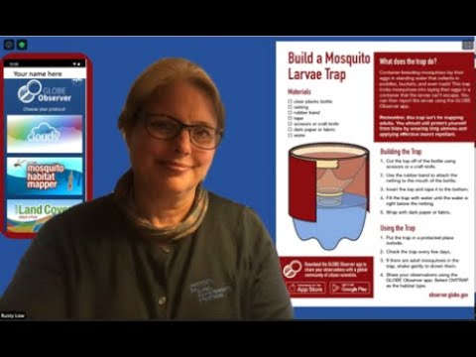
Make Your Own Mosquito Trap
https://go.nasa.gov/3aGgU1S
Notes:
“Build a Mosquito Larvae Trap” video [10:38] (youtu.be/bPBomfbLpWY)

Slide 30
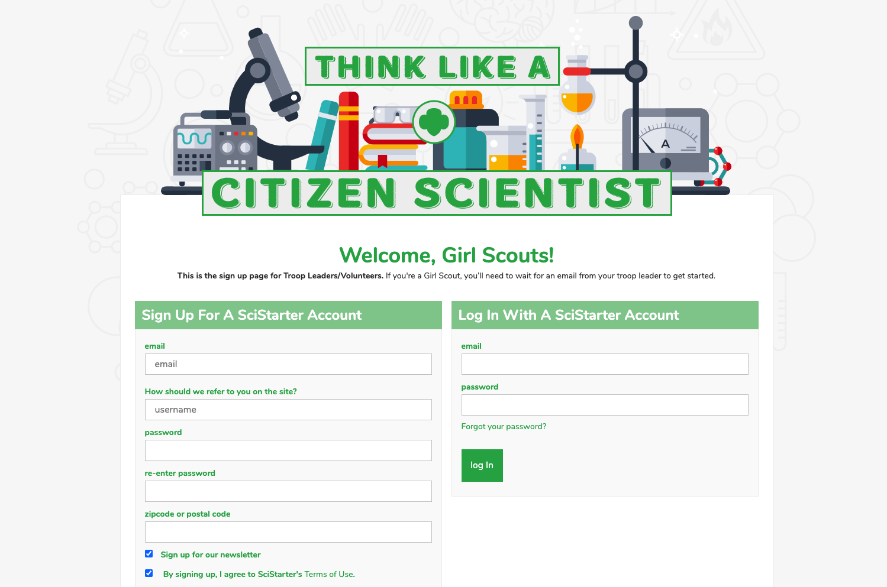
Register your Troop on SciStarter
https://scistarter.com/girlscouts/volunteer/landing
Notes:
If you want to get started as a GLOBE Observer, ask your troop leader to register your troop through SciStarter, then send you the link to set up your accounts.
URL to set up a SciStarter account (scistarter.com/girlscouts/volunteer/landing)

Slide 31
Choose GLOBE Observer: Mosquito Habitat Mapper
Notes:
Once you have a troop SciStarter account, you will choose which citizen science opportunity interests you. Here is where you will choose GLOBE Observer: Mosquito Habitat Mapper. There are a lot of different citizen science projects (including others with NASA) and others with GLOBE Observer: Trees, Land Cover, and Clouds, that you can also participate in.
Then you need to download the app.
Download the app (observer.globe.gov/get-the-app) and register as a GLOBE observer. Then collect your data.
So now you’ve learned to Think Like a Citizen Scientist by observing, collecting and analyzing data. The next step is to collect and analyze your own data by using the app.

Slide 32
Take Action
What can you do?
Find mosquito habitats and dump the standing water if you are able.
Create a program to teach other Girl Scouts about mosquitos
Start a hiking group and take mosquito habitat observations as part of your walk.
Take mosquito habitat and land cover observations from the same place in different seasons, then compare the changes from year to year and look for differences between the images to learn more about seasonal effects on the mosquito habitats and mosquito populations.
Participate in the data challenges when they occur!
Use the “Conducting a Mosquito Habitat Survey” (bit.ly/MosquitoHabitatSurvey) activity and data sheet to survey any mosquito habitats near you!
Notes:
Then, consider how you might use your data to take action.
What kind of take action projects could you think of doing?
Find mosquito habitats and dump the standing water if you are able to. This would eliminate a potential breeding site for mosquitos carrying disease.
Create a program to teach other Girl Scouts about mosquitos
Start a hiking group and take mosquito habitat observations as part of your walk.
Take mosquito habitat and land cover observations from the same place in different seasons, then compare the changes from year to year and look for differences between the images to learn more about seasonal effects on the mosquito habitats and mosquito populations.
Participate in the data challenges when they occur!
Use the “Conducting a Mosquito Habitat Survey” (bit.ly/MosquitoHabitatSurvey) activity and data sheet to survey any mosquito habitats near you!

Slide 33
Questions? Share your projects.
@TheGLOBEProgram
@GLOBEProgram
Notes:
What I love about Girl Scouts is that you all leave the world a better place. I for one am really excited that you are leading the future for us.
We would also love for you to share your Take Action projects inspired by GLOBE Observer. Please share on social media or email us at GLOBE Observer.

Slide 34
Links for more information
GLOBE Observer app link or download from the App Store or Google Play.
GLOBE Visualization System to see other citizen science data from GLOBE observers around the world. You can look for mosquito habitat pictures or check out data from the other GLOBE tools.
NASA Worldview to explore current and past satellite data (yes, you can view data as early as today in near real time.)
Video about how to take a mosquito habitat observation
GLOBE Teams
Thanks!
Notes:
Here is a list of the links that were in the presentation and that you may find useful.
https://observer.globe.gov/about/get-the-app
https://vis.globe.gov
https://worldview.earthdata.nasa.gov/
https://youtu.be/Jh_chDc_HCE
https://www.globe.gov/globe-community/globe-teams

