Slide 1
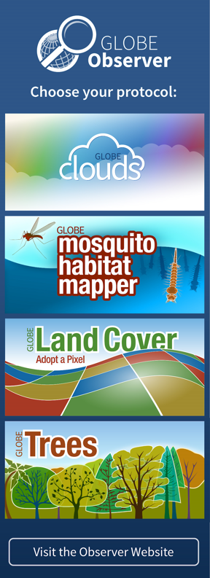
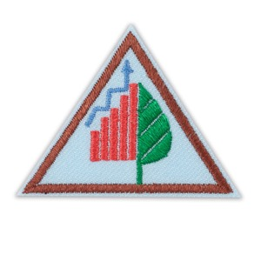
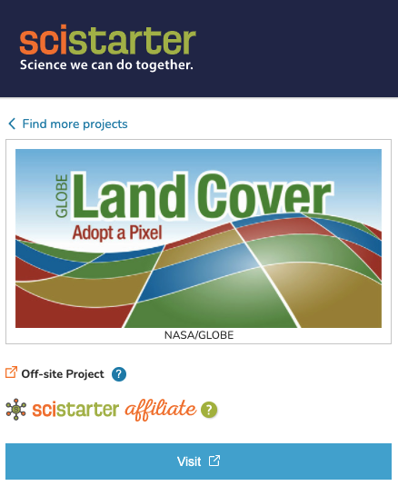
Girl Scouts and GLOBE Observer
&
Notes:
Welcome to the first step in being a critical part of a growing citizen science project. Today you will learn about what it means to Think Like a Citizen Scientist, learn about the Land Cover tool on the GLOBE Observer app and practice identifying different types of Land Cover.

Slide 2
NASA GLOBE and Girl Scouts
The Global Learning and Observations to Benefit the Environment (GLOBE) Program is an international science and education program that provides students and the public worldwide with the opportunity to participate in data collection and the scientific process and contribute meaningfully to our understanding of the Earth system and global environment.
The GLOBE Observer app is a GLOBE’s data entry tool that allows an international network of citizen scientists to work together to learn more about our shared environment and changing climate. GLOBE Observer currently accepts observations of Clouds, Mosquito Habitats, Land Cover and Trees.
GLOBE Observer Trees Tool: Think Like a Citizen Scientist
Notes:
But first let me tell you about GLOBE and GLOBE Observer.
GLOBE is an international science and education program that provides students and the public worldwide with the opportunity to participate in data collection and the scientific process and contribute meaningfully to our understanding of the Earth system and global environment.
GLOBE Observer app is the data entry tool that allows citizen scientists to enter their data and share observations.
GLOBE Observer is part of GLOBE.

Slide 3
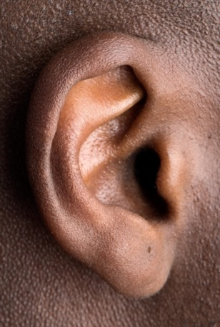
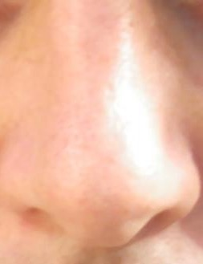
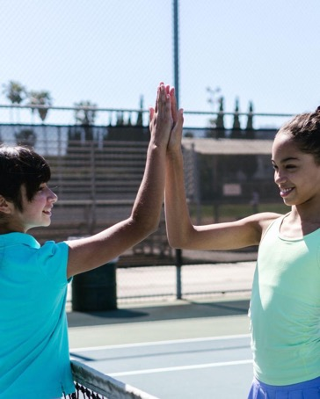
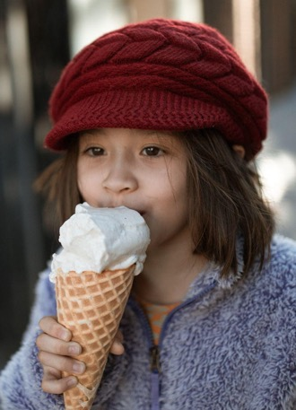
What’s an Observation?
Hear
Smell
Touch
See
Taste
Notes:
Okay, speaking of the Think Like a Citizen Scientist Journey, learning about what it means to observe is the first step in thinking like a citizen scientist. Let’s get started by practicing our observation skills.
I’m going to show you a satellite image and I’m going to ask you to make observations about it. When we observe, we use our senses (hearing, smell, touch, sight, and taste). Since we can’t really taste, smell, hear, or touch this satellite image, we are going to use sight.

Slide 4
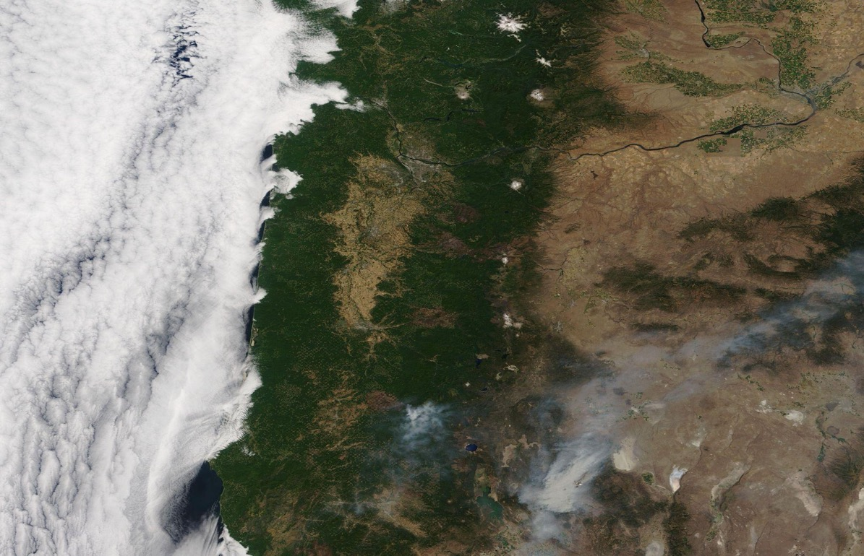
Observations 1
Satellite Image
6 July 2021, Oregon and southwest Washington
What do you notice about the satellite image?
What colors do you see?
What recognizable features do you see?
When was this image taken?
What satellite collected the data?
Notes:
Some possible questions to help you with your observations could be:
What do you notice about the satellite image?
What colors do you see?
What recognizable features do you see?
When was this image taken?
What satellite collected the data?
You can write down any observations you made in your science journal or on a piece of scratch paper. Observations are anything that you notice with your senses, so today, you probably won’t notice any tastes, touches, or smells, but I bet you will be able to see some cool observations.
Do this activity with your Girl Scouts, but make it more personal by using satellite images of your region from a recent time period or a historic time in your area. NASA Worldview allows you to download your own satellite images (worldview.earthdata.nasa.gov.)

Slide 5
Observations 2
What do you notice about the satellite image?
What colors do you see?
What recognizable features do you see?
When was this image taken?
What satellite collected the data?
II
Press pause while you discuss.
Satellite Image
6 July 2021, Oregon and southwest Washington
Notes:
Leaders, once your Girl Scouts have finished examining their satellite images and noting their observations, ask them to share their observations and discuss.
Pause the video and discuss.
Things to point out:
Brown land – not a lot or no living vegetation
White – clouds or snow
Cloud features – cloud streets
Blue – water
Green – vegetation
Bright Green – Salt Lake
Diagonal line in the image (different swaths from different orbits – images were taken 90 minutes apart from each other)
Add place label layer to add observation context

Slide 6
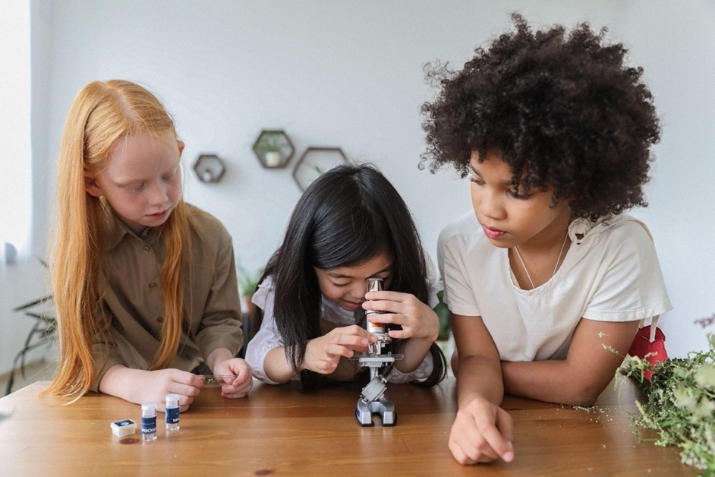
What does a Scientist Do? 1
Notes:
Welcome back! I bet you made some really great observations. But what does this have to do with Thinking Like a Citizen Scientist? Let me ask you, what do scientists do?

Slide 7
What does a Scientist Do? 2
II
Press pause while you discuss.
Notes:
Pause the video and discuss what a scientist does.
I bet you had a great discussion on what it means to be a scientist. There are lots of different types of scientists out there, but one thing they all have in common in their research is that scientists rely on the scientific method to learn new things.
You are going to be citizen scientists, where you use the scientific method to help gather data for NASA scientists and other researchers including students or scouts like you.

Slide 8
What does a Scientist Do? 3
Observe
Ask a Question
Make a Hypothesis
Notes:
The first part of the scientific method is to observe. You all did a great job of observing the satellite image.
The next part of the scientific method is to create a question and make a hypothesis.
Let’s look at this image: and make a question based on our observations.

Slide 9
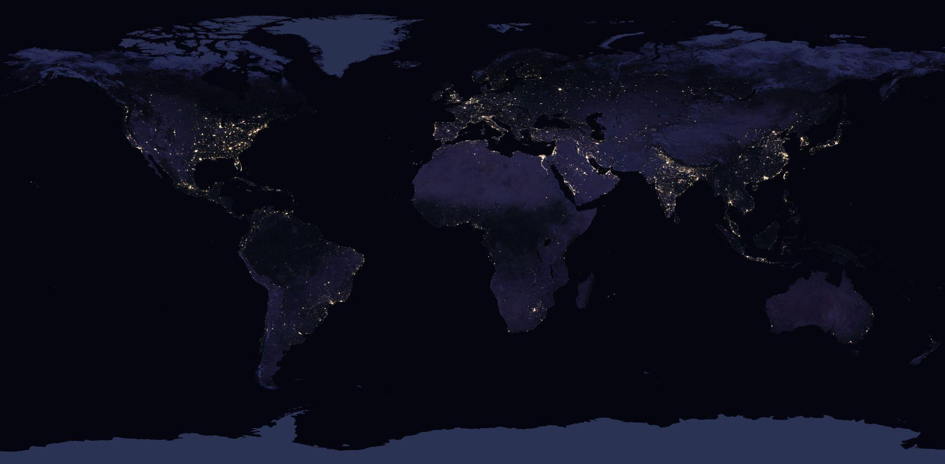
Ask a Question 1
II
Press pause while you discuss.
????????????????????
Notes:
Pause the video and discuss. You can come up with your own question or you can use the one that I’ll provide on the next slide.
In-person option: Show the satellite image from NASA Worldview, a VIIRS image at night (go.nasa.gov/3lJdgdE). Or zoom into the image and use an image from your region.
Possible Observations:
light pixels
dark pixels
location of white pixels
time of day

Slide 10
Ask a Question 2
?
What is located where there are clusters of white pixels?
Notes:
Our question could be, “What is located where there are clusters of white pixels?”

Slide 11
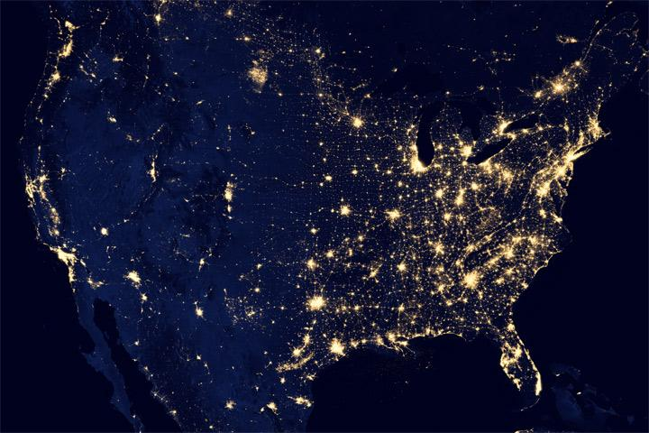
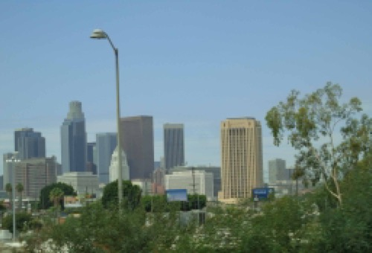
Make a Hypothesis
Question: What is located where there are clusters of white pixels?
Hypothesis: The white pixels indicate that there are a lot of lights, so I think that there are more lights in cities. The clusters of white pixels are where there are cities.
Answer your question based on observations
Notes:
The hypothesis is your answer to that question. The white pixels indicate that there are a lot of lights, so I think that there are more lights in cities. The clusters of white pixels are where there are cities.

Slide 12
How do scientists know if their hypothesis is correct?
Collect and Analyze Data
Notes:
But, how do scientists know if their hypothesis is correct? They have to collect and analyze data. The more data they have the better their results will be because it helps filter out some of the outliers (the mistakes, errors, or oddball data). Kind of like if I was measuring favorite Girl Scout cookies. The more people I sell cookies to, the better my data.

Slide 13
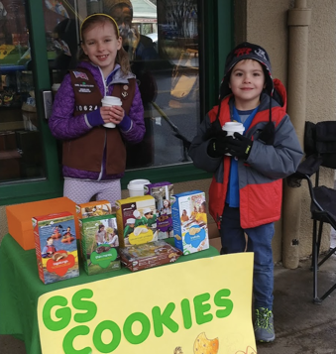
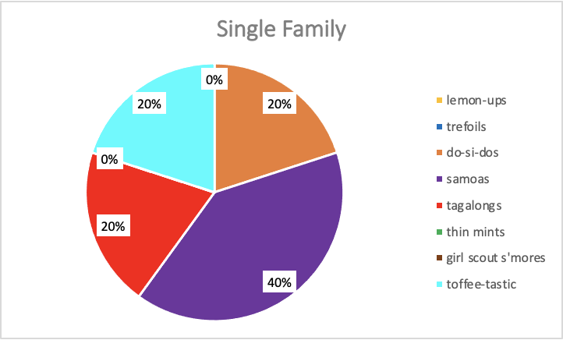
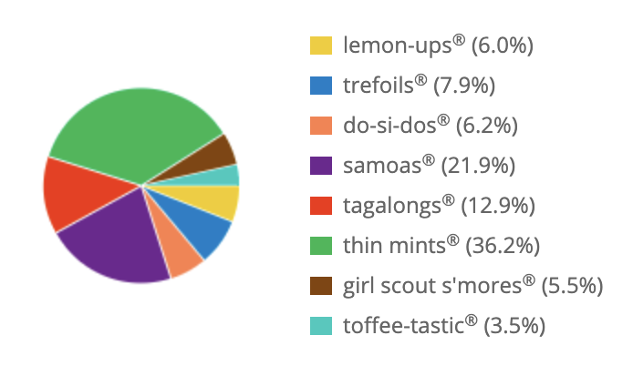
Collect and Analyze Data
Girl Scout Cookie Sales
Single Sale
Troop Sales
Total packages sold: 5
Total packages sold: 1,559
Notes:
For example, here is a pie chart showing real data from my troop sales. This Girl Scout made a single sale to one family (who love Samoas and don't like Thin Mints). But are Samoas the most popular cookie sold by Girl Scouts nationwide? With this data my hypothesis should be yes! But is it? How could I get a better data set?
I could collect more data. The pie chart on the right is the data for my entire troop’s sales. This is a much better data set because it has 1,559 packages of cookies sold – 1,554 more boxes than my single sale. With this much data, I could look at which ones I sold the most of and be able to make a better conclusion to my hypothesis than if I’d only sold 1 or 2 boxes. The more data that is collected, the better. So are Samoas the most popular according to this data? No. Thin mints are. Your troop can do this same exercise with your troop sales! If you added your data to this data, we’d have an even better data set!
Optionally, you could have them conduct this research with your own troops' cookie sales

Slide 14
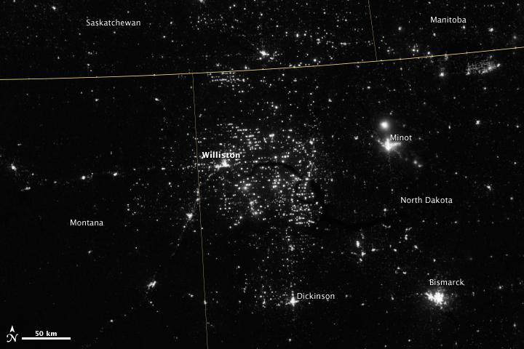
Outliers
Oil Fields
Oddball data that doesn’t match trends or the other data
Notes:
In the nighttime satellite image, we were mostly right, but there are some outliers. For example, in North Dakota, there are bright spots where there are oil fields, but not cities.
For NASA scientists, we rely on a lot of data. And this is where you can come in. You can be citizen scientists.

Slide 15
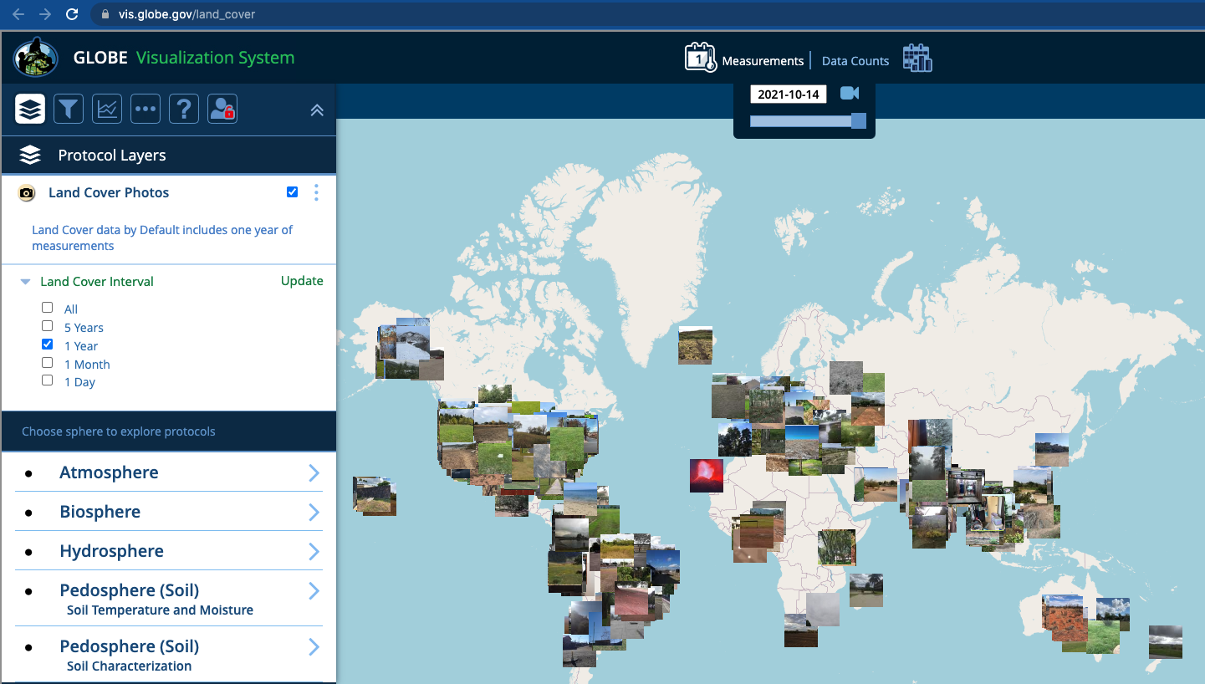
Land Cover Data
https://vis.globe.gov/land_cover
Notes:
These are data points taken by citizen scientists all over the world with GLOBE and GLOBE Observer and you can be part of the network of citizen scientists that are collecting and analyzing this data.
Girl Scouts can interact and explore data in the GLOBE Visualization System (vis.globe.gov). Click around and add layers to explore the data.

Slide 16
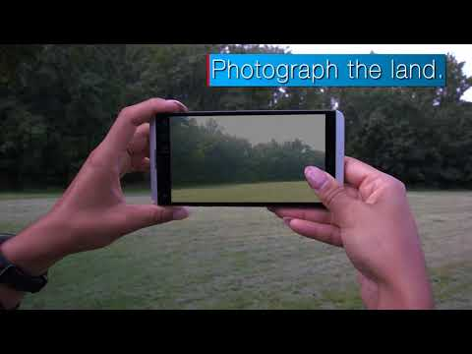
Introducing GLOBE Observer: Land Cover
https://youtu.be/HkXLweBNKd4
Notes:
Let’s learn about GLOBE Observer’s Land Cover tool.
Introducing GLOBE Observer Land Cover video [0:49] (youtu.be/HkXLweBNKd4)

Slide 17
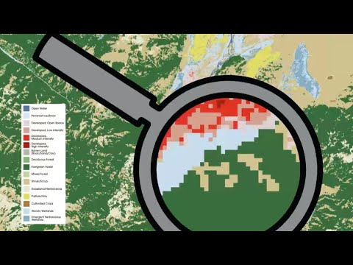
Why Observe: Land Cover
https://youtu.be/vHmwHBFHCQE
Notes:
Next, let’s watch this video to learn about the importance of land cover data and how your citizen science observations contribute to continuing land cover research.
Why Observe: Land Cover video [7:40] (youtu.be/vHmwHBFHCQE)

Slide 18
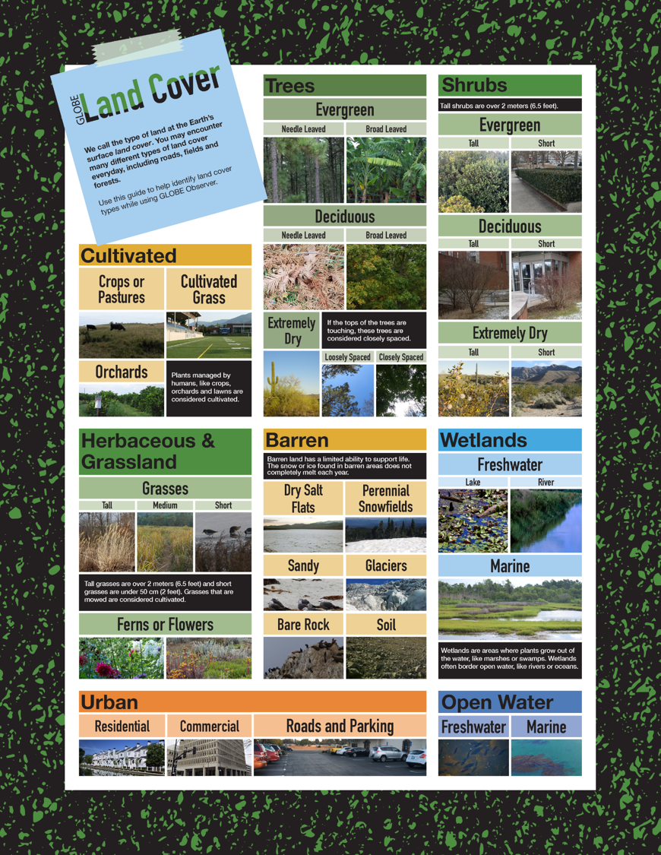
GLOBE Observer Land Cover Classification Challenge
Land Cover Quick Reference Guide
Notes:
Now it’s your turn.
Let’s try analyzing and classifying some land cover data collected by GLOBE Observers. Let’s play the Land Cover Classification Challenge.
We are going to use the Land Cover Quick Reference Guide to identify and classify different types of land cover. You can keep watching the video and go through the Land Cover Classification Presentation or you can do this activity as a troop, logging the different types of Land Cover that you see.

Slide 19
Challenge Instructions
Instructions
Each slide will show you a photo from a GLOBE Observer Land Cover Observation.
Use the Land Cover Type Quick Reference Guide to identify the types of land cover in the photos.
Write down your answers on a piece of paper.
After all 9 photos, continue watching the video to see how many you got right?
Link to helpful tool to identify land cover:
Land Cover Quick Reference Guide
Notes:
Each slide will show you a photo from a GLOBE Observer Land Cover Observation.
Use the Land Cover Type Quick Reference Guide to identify the types of land cover in the photos.
Write down your answers on a piece of paper.
After all 9 photos, continue watching the video to see how many you got right.
The Land Cover Quick Reference Guide can be downloaded and printed in advance, then you can distribute them among your scouts. Alternatively, instead of watching the slides and answering the questions, you can send your Girl Scouts out on a hike, where they would identify land cover types along the way, if it is safe to do so.
Land Cover Quick Reference Guide (go.usa.gov/xtE4N)

Slide 20
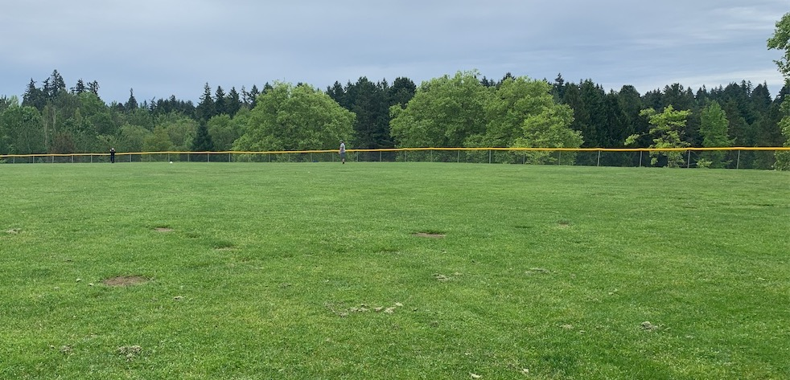
Land Cover Classification
Notes:
Troop Leader Notes
Let these slides (Slides 20 - 29) play through. Then, pause the video and discuss. The answers are in Slides 30 - 39.

Slide 21
Image 1

Slide 22
Image 2

Slide 23
Image 3

Slide 24
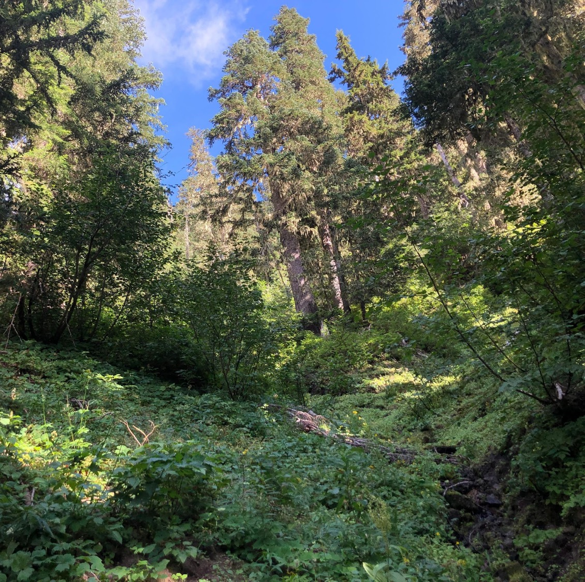
Image 4

Slide 25
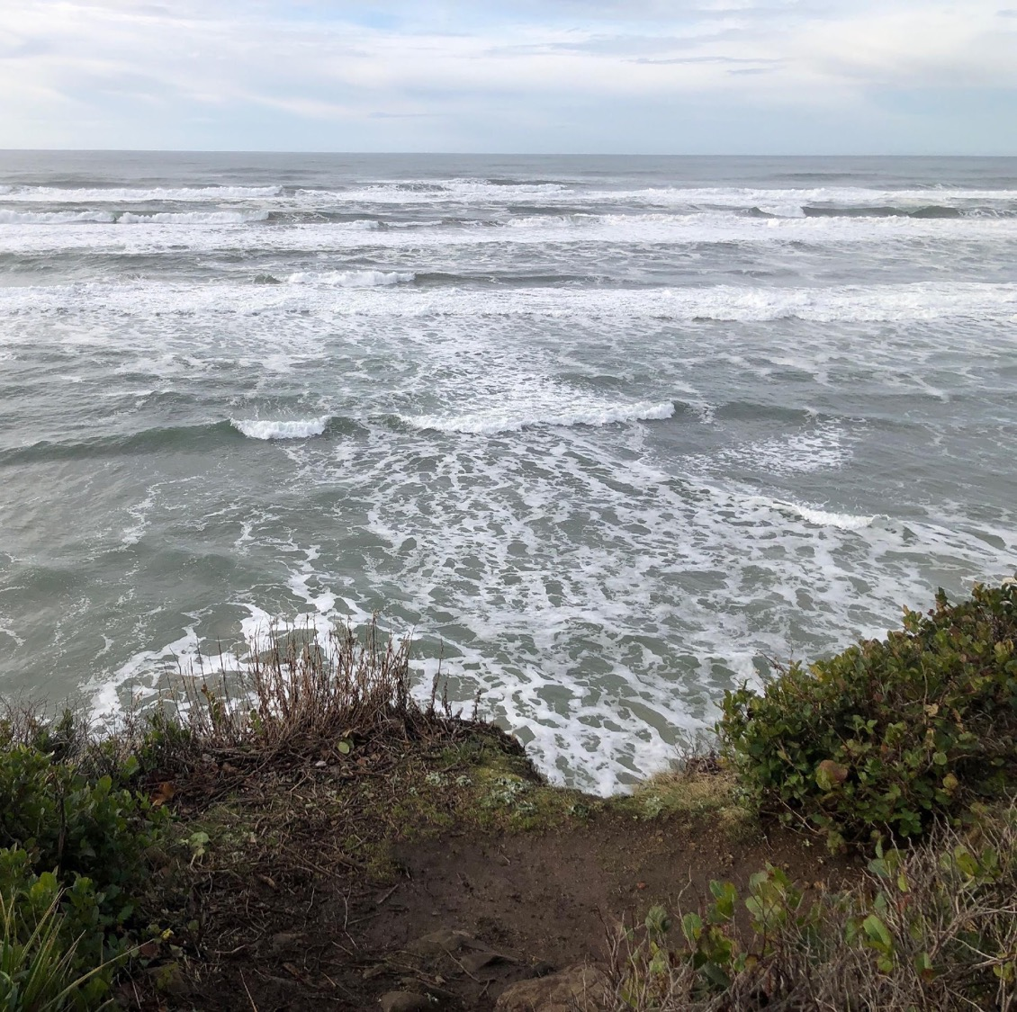
Image 5

Slide 26
Image 6

Slide 27
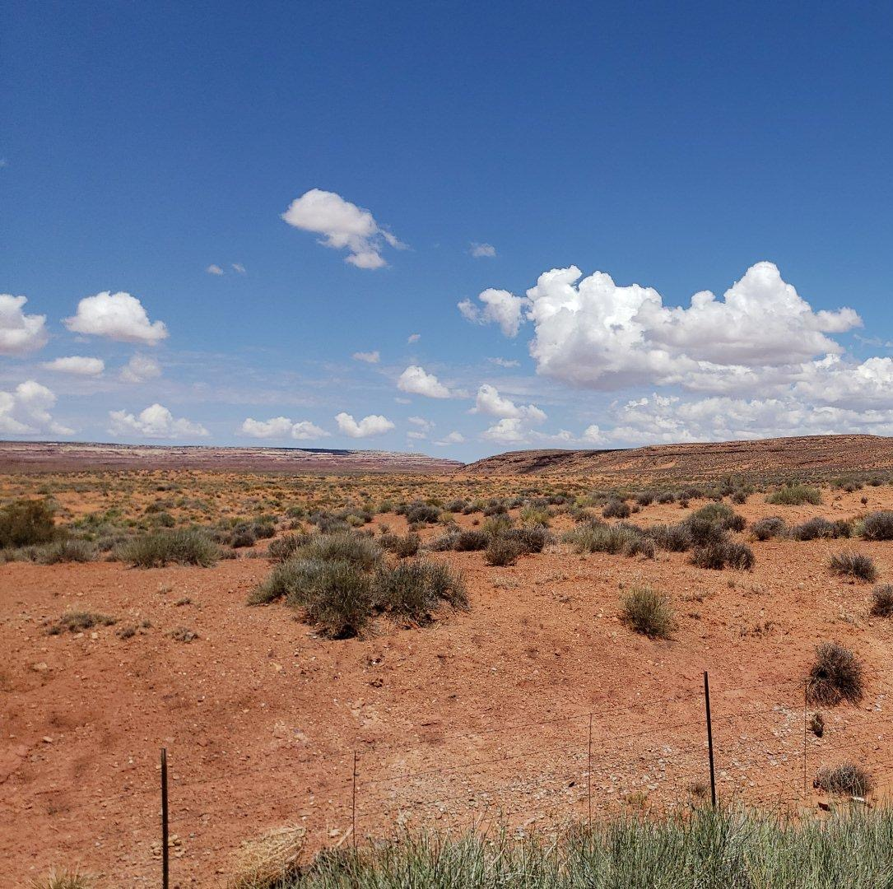
Image 7

Slide 28
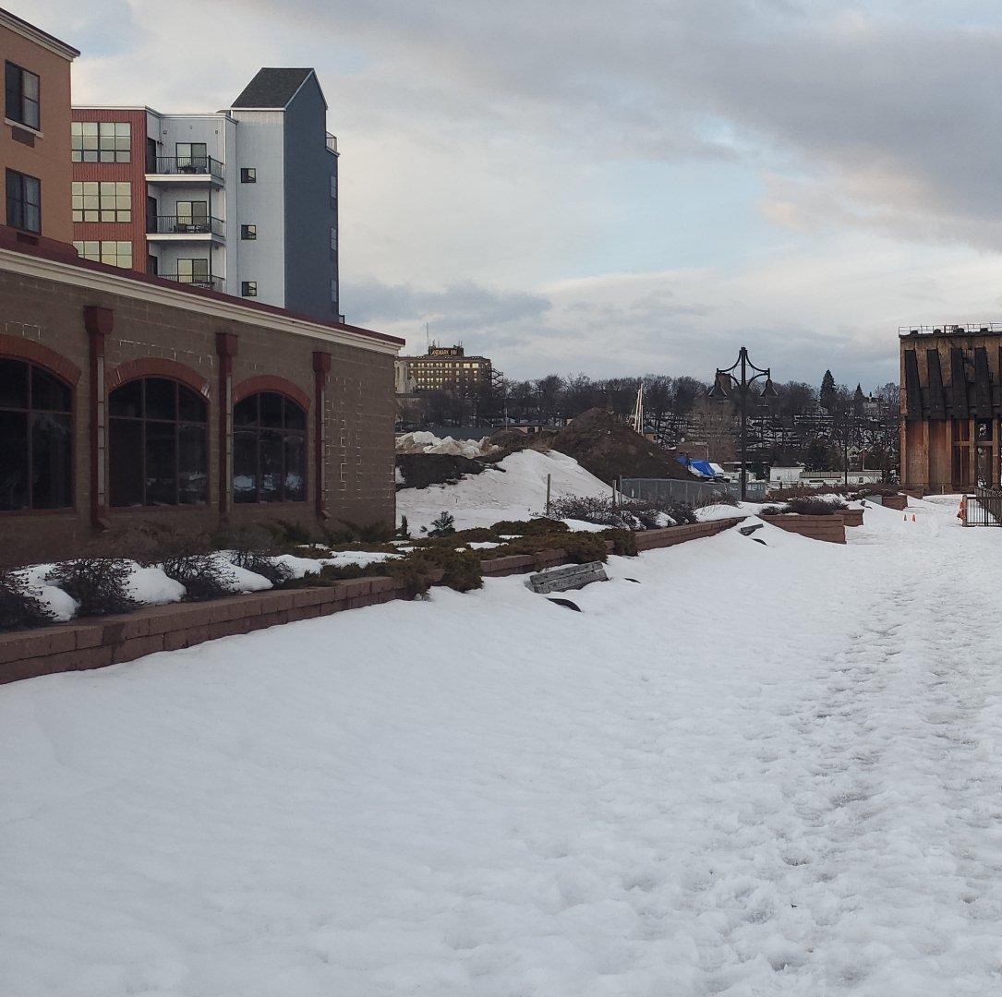
Image 8

Slide 29
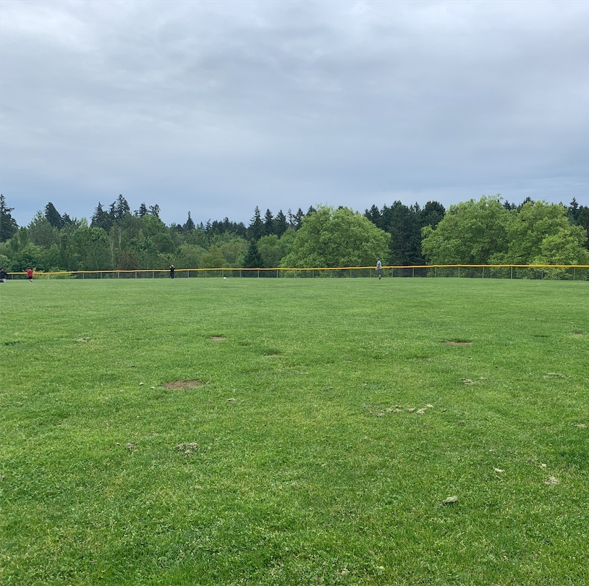
Image 9

Slide 30
Land Cover Classification Challenge Answers
And the ANSWERS are...
Notes:
Thanks for playing! Let’s find out how well you did.

Slide 31
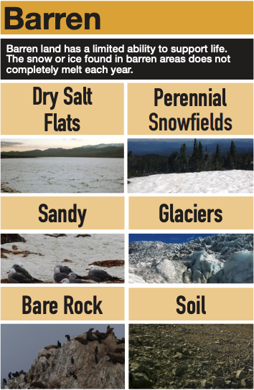
Image 1 Answer
Notes:
This photo is of a barren landscape. Barren means that there isn’t much vegetation. We can see bare rock, glaciers, and soil.

Slide 32
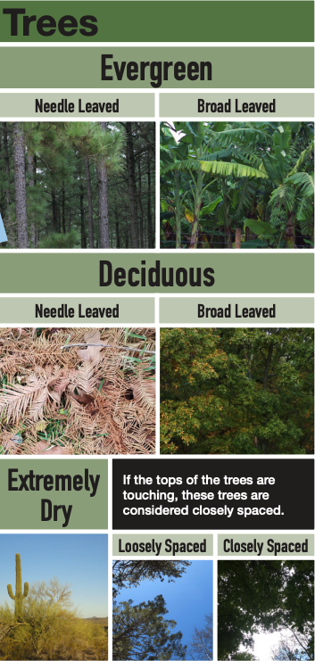
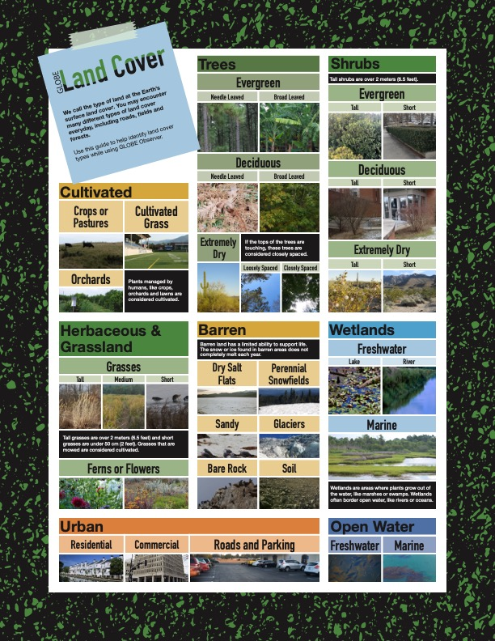
Image 2 Answer
Notes:
In this photo of a road in a forest we have two different types of land cover. Urban and Trees. The trees are tall trees. If you were in this forest, you could use this opportunity to use the GLOBE Observer Trees tool, and measure the tree height of one of these trees. It is also an urban land cover because there is a road that cuts through the forest. The road is an urban land cover, while the forest is a tree land cover.

Slide 33
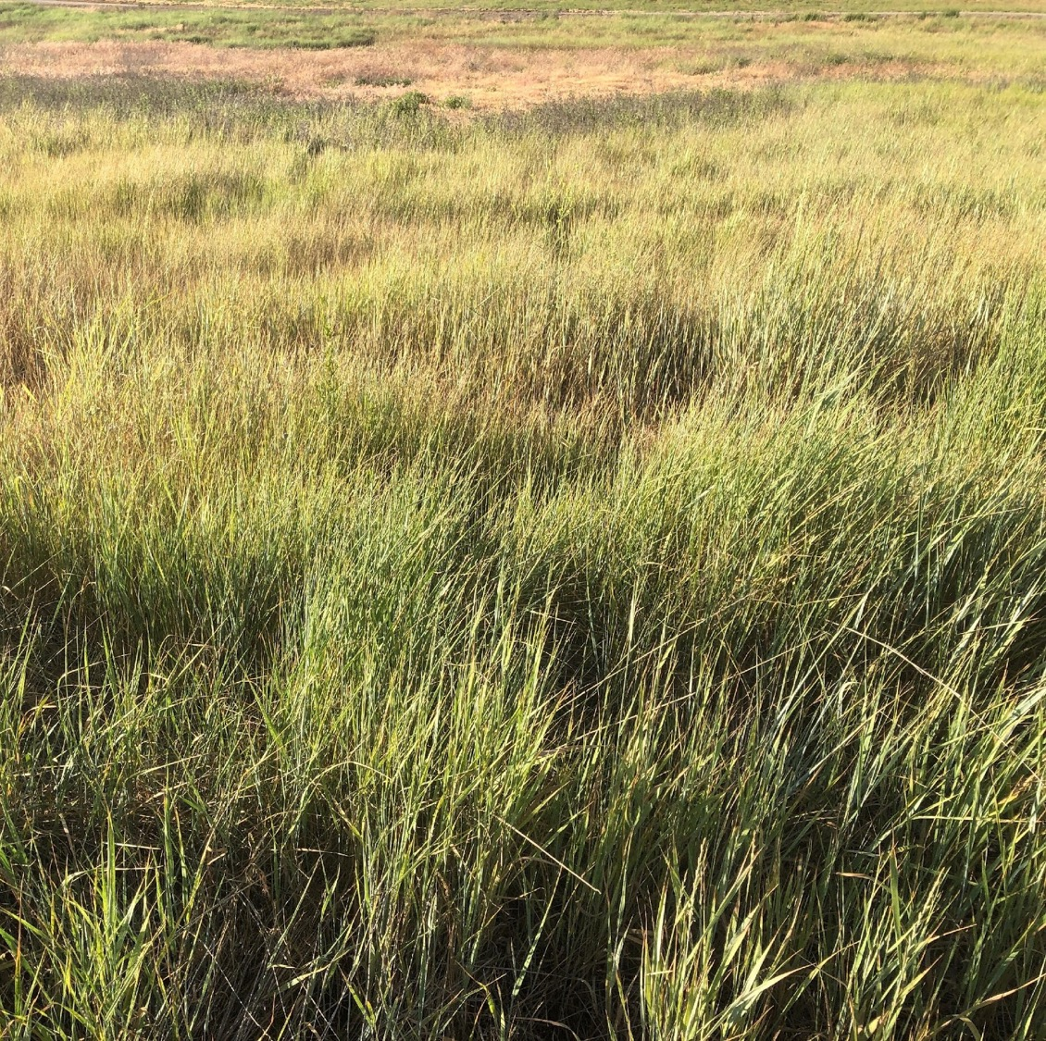
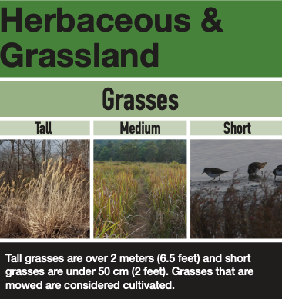
Image 3 Answer
Notes:
Look at all that grass! This is a grassland. And the grass is medium in length. If it was tall the grass would have to be over 6.5 feet high. That’s taller than most people I know!

Slide 34
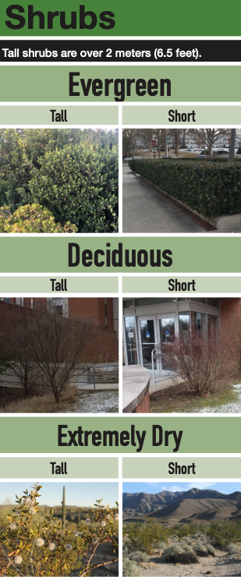
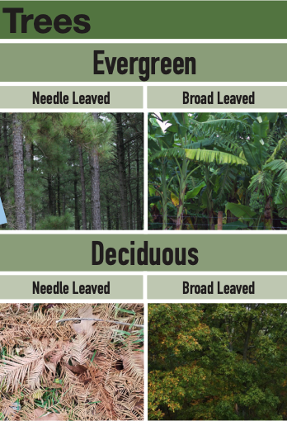
Image 4 Answer
Notes:
This is a picture of a forest with both trees and shrubs. The Trees are primarily needle leaf evergreens and there are both short and tall shrubs.

Slide 35
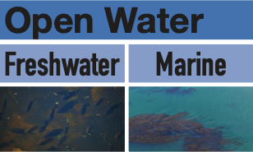
Image 5 Answer
Notes:
This photo was taken from the Pacific Coast. That is open water, since the Pacific Ocean is filled with saltwater, this is a marine open water land cover.

Slide 36
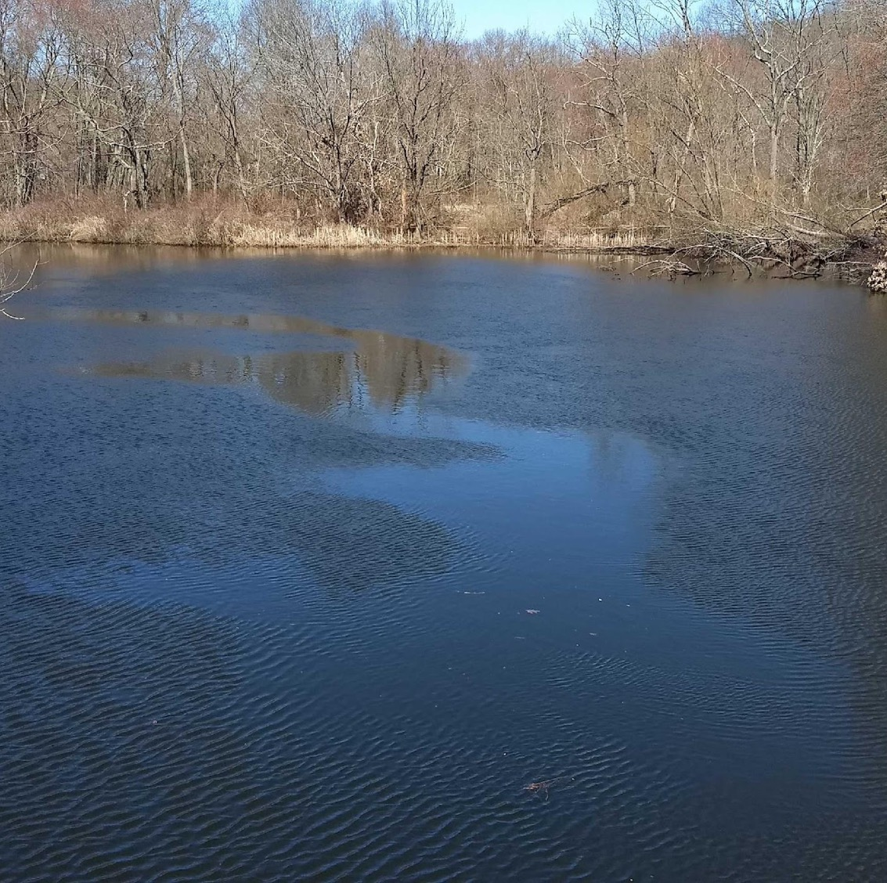
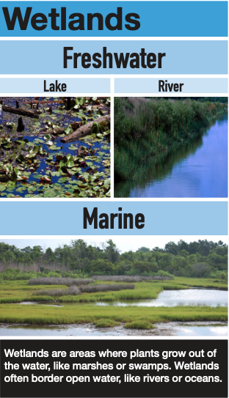
Image 6 Answer
Notes:
This is a photo from a river. This would be a freshwater open water land cover type because the river is filled with freshwater, not saltwater. Also, there are trees in the background, this is a wetland and specifically a river wetland.

Slide 37
Image 7 Answer
Notes:
This is a really dry landscape, but there are a few shrubs scattered among the barren dirt. These shrubs would be classified as short, since they are under 6.5 feet tall.

Slide 38
Image 8 Answer
Notes:
This photo shows a city, or an urban area. We can see that there are apartments (residential), businesses (commercial) and roads. This photo shows all the subcategories in the urban land cover type.

Slide 39
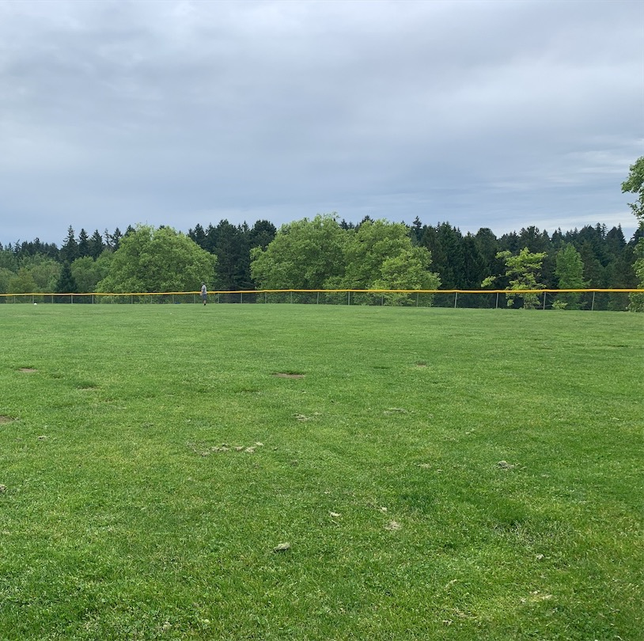
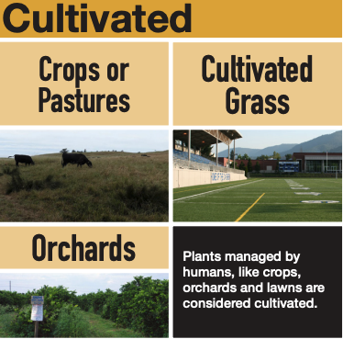
Image 9 Answer
Notes:
This looks like an outfield of a baseball field. The grass has been mowed and cared for. It wouldn’t look like this if people didn’t plant, water and mow this field. Because humans grow the vegetation to look like this, it is considered cultivated. Farms, pastures, or parks are cultivated land cover types. Since the field is covered in grass, it is specifically a cultivated grass land cover type.

Slide 40
GLOBE Observer
CONGRATULATIONS!
Thanks for playing the
Land Cover Classification Challenge!
Land Cover Classification Challenge
Notes:
Congratulations! How many did you get right? You can pause the video and discuss or you can continue on and learn about how to use the Land Cover Tool in the GLOBE Observer app.

Slide 41
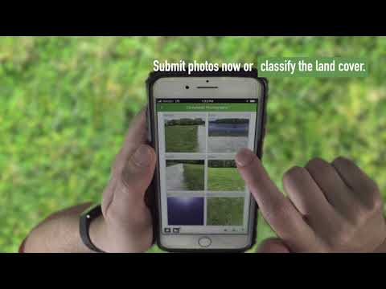
How to use the Land Cover Tool
https://youtu.be/PSCEpPlfGMs
Notes:
… and learn about how to use the Land Cover tool in the GLOBE Observer app.
GLOBE Observer Land Cover: Getting Started video [2:44] (youtu.be/PSCEpPlfGMs)
Alternatively, you can share the Land Cover Introductory Tutorial video [1:26], (youtu.be/Z5tdE12HjpA) and narrate as the video plays.

Slide 42
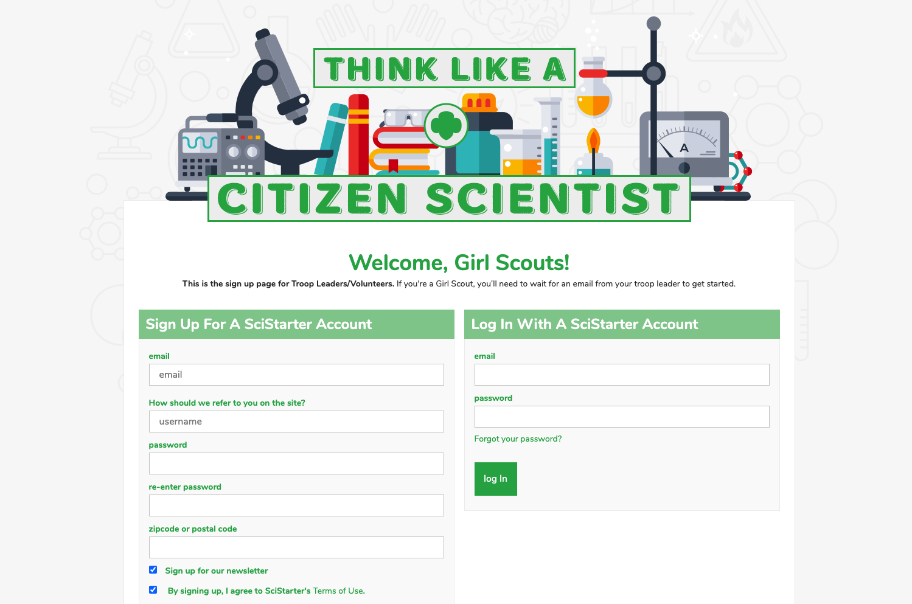
Register your Troop on SciStarter
https://scistarter.com/girlscouts/volunteer/landing
Notes:
If you want to get started as a GLOBE Observer, ask your troop leader to register your troop through SciStarter, then send you the link to set up your accounts.
URL to set up SciStarter account (scistarter.com/girlscouts/volunteer/landing)

Slide 43
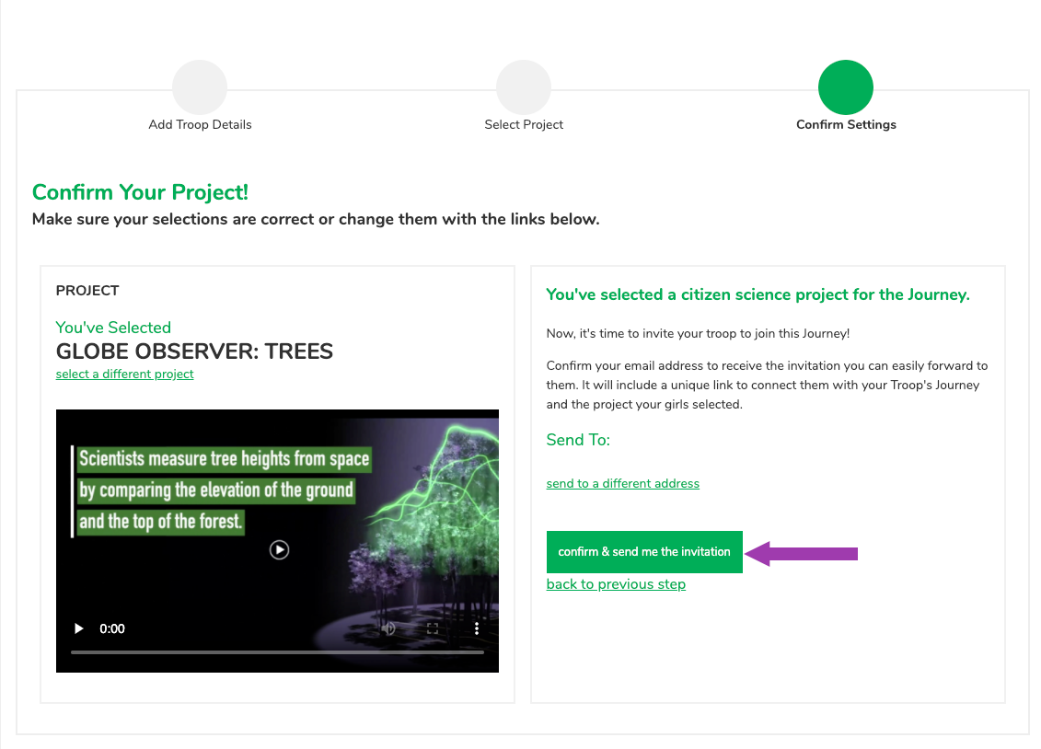
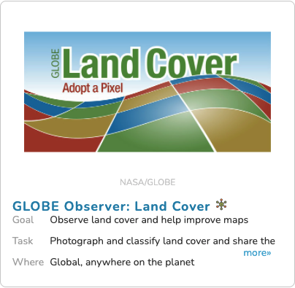
Choose GLOBE Observer: Clouds
Notes:
Once you have a troop scistarter account, you will choose which citizen science opportunity interests you. There are a lot of different citizen science projects (including others with NASA) and others with GLOBE Observer: Trees, Land Cover, Clouds, and Mosquito Habitat Mapper.

Slide 44
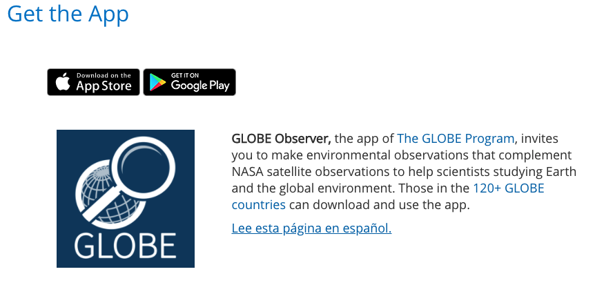
Download the App
https://observer.globe.gov/get-the-app
Notes:
Then you need to download the app. Register as a GLOBE observer. Then collect your data.
Download the app (observer.globe.gov/get-the-app)

Slide 45
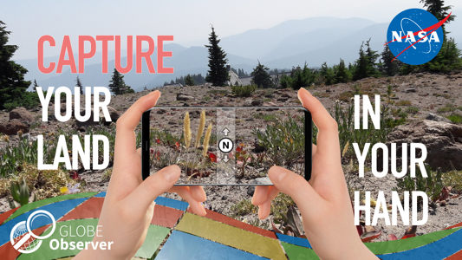
Take Action
Adopt a place to take observations. While you are there, take care of it. Pick up litter, do some gardening.
Create a program to teach other Girl Scouts about a place that is important to you.
Start a hiking group and take observations as part of your walk.
Document changes with scheduled observations.
Create a team of your troop, council, or service unit (www.globe.gov/globe-community/globe-teams) and take observations together.
What can you do?
Notes:
So now you’ve learned to Think Like a Citizen Scientist by observing, collecting and analyzing data. The next step is to collect and analyze your own data by using the app.
Then, consider how you might use your data to take action.
What kind of “take action” projects could you think of doing?
Adopt a place and take observations on a schedule. While you are there, take care of it. Pick up litter, do some gardening.
Create a program to teach other Girl Scouts about a place that is important to you.
Start a hiking group and take observations as part of your walk.
Document changes with scheduled observations. If you know of a place that is undergoing changes (a new building being built, a development, a place where regrowth is happening after a landslide or forest fire – of course only after it is safe to do so) monitor that change with scheduled observations. Or take seasonal observations and compare the changes that take place
What I love about Girl Scouts is that you all leave the world a better place. I for one am really excited that you are leading the future for us.
.

Slide 46
Questions? Share your projects.
@TheGLOBEProgram
@GLOBEProgram
Notes:
We would also love for you to share your Take Action projects inspired by GLOBE Observer. Please share on social media or email us at GLOBE Observer.

