Slide 1
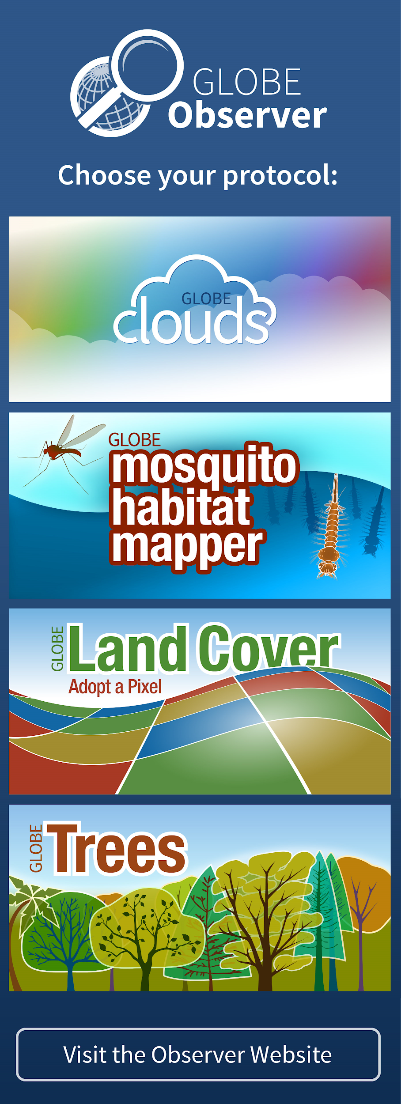
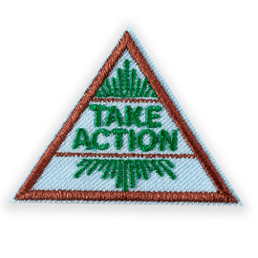
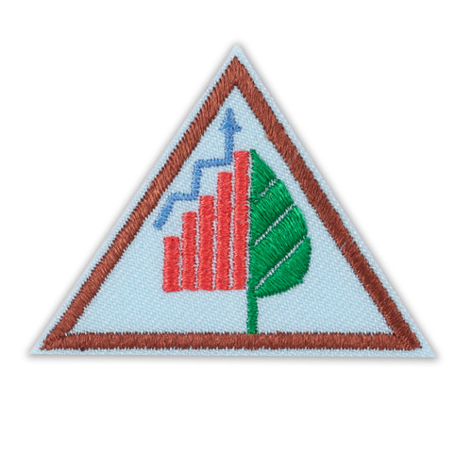
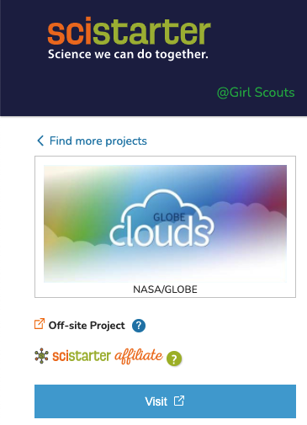
Girl Scouts and GLOBE Observer
&
Notes:
Welcome to the first step in being a critical part of a growing citizen science project. Today you will learn about what it means to Think Like a Citizen Scientist, learn about the Clouds Tool on the GLOBE Observer app and practice identifying different types of clouds.

Slide 2
NASA GLOBE and Girl Scouts
The Global Learning and Observations to Benefit the Environment (GLOBE) Program is an international science and education program that provides students and the public worldwide with the opportunity to participate in data collection and the scientific process and contribute meaningfully to our understanding of the Earth system and global environment.
The GLOBE Observer app is a GLOBE’s data entry tool that allows an international network of citizen scientists to work together to learn more about our shared environment and changing climate. GLOBE Observer currently accepts observations of Clouds, Mosquito Habitats, Land Cover and Trees.
GLOBE Observer Trees Tool: Think Like a Citizen Scientist
Notes:
But first let me tell you about GLOBE and GLOBE Observer.
GLOBE is an international science and education program that provides students and the public worldwide with the opportunity to participate in data collection and the scientific process and contribute meaningfully to our understanding of the Earth system and global environment.
GLOBE Observer app is the data entry tool that allows citizen scientists to enter their data and share observations.
GLOBE Observer is part of GLOBE.

Slide 3
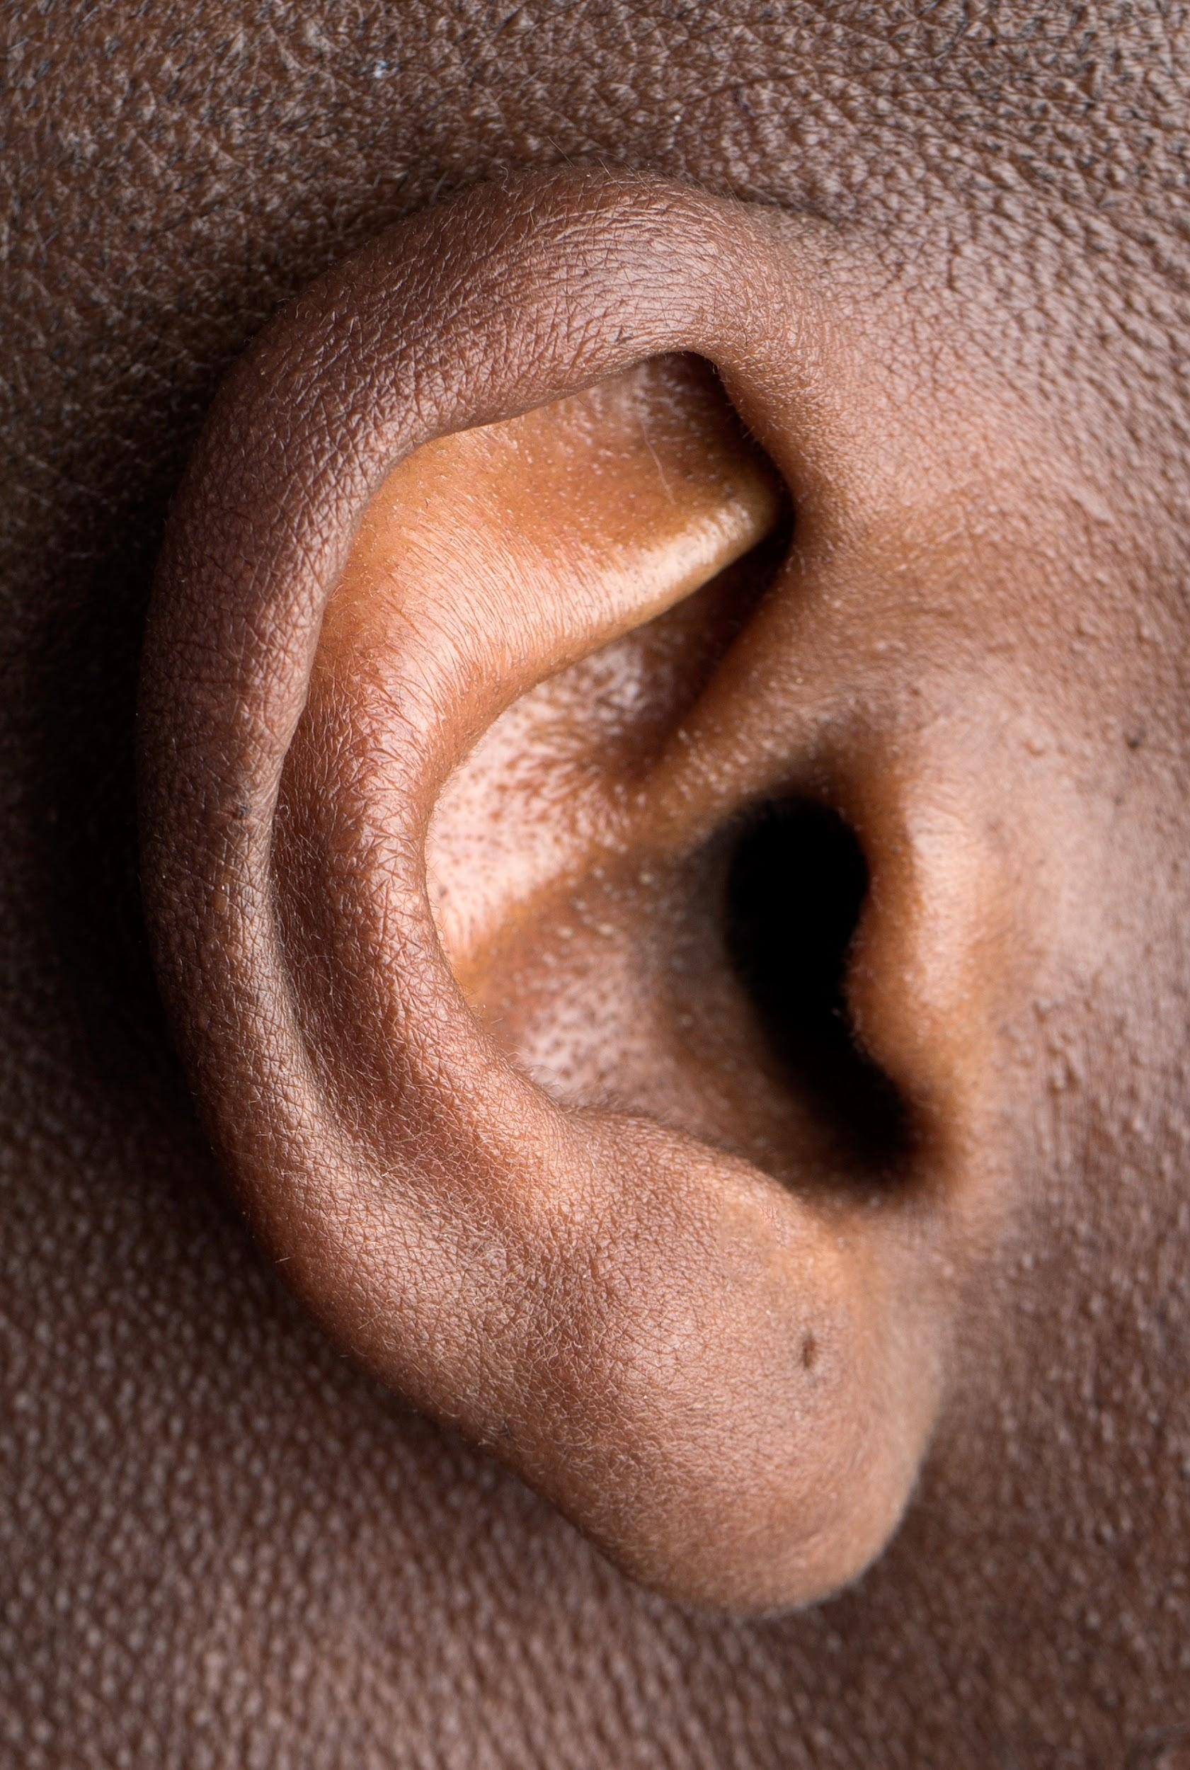
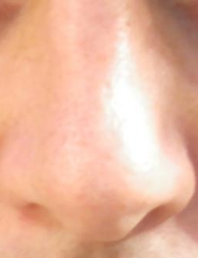
What’s an Observation?
Hear
Smell
Touch
See
Taste
Notes:
Okay, speaking of the Think Like a Citizen Scientist Journey, learning about what it means to observe is the first step in thinking like a citizen scientist. Let’s get started by practicing our observation skills.
When we observe, we use our senses (taste, smell, touch, hearing, and sight). Since we can’t really taste, smell, hear, or touch these pictures, we are going to use our sense of sight. If you decide to do this experiment on your own, you can use some of your other senses.

Slide 4
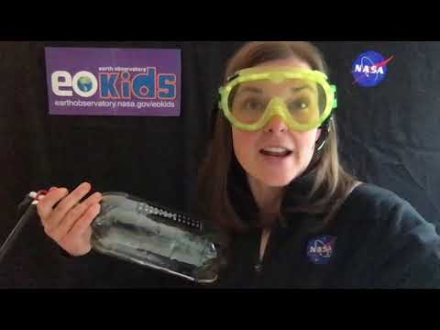
Observations:
Demo Time! Cloud in a Bottle
What you notice?
Could you see anything change?
Did you hear anything?
Did you feel anything?
Did you smell anything?
https://youtu.be/5kjrPUP9X1g
Notes:
Today we are going to practice your observation skills.
I’m going to show you a science demo (cloud in a bottle) and I’m going to ask you to observe what happens. You can write down any observations you made in your science journal or on a piece of scratch paper. Observations are anything that you notice with your senses, so today, you probably won’t notice any tastes, touches, or smells, but I bet you will see something change.
Leaders, once your Girl Scouts have finished watching the demonstration and noting their observations, ask them to share their observations and discuss.
Play the video or do this experiment with your troop:
“Make your Own Cloud (in a Bottle)” video: youtu.be/5kjrPUP9X1g [5:01]
Instructions: www.nisenet.org/catalog/exploring-earth-investigating-clouds

Slide 5
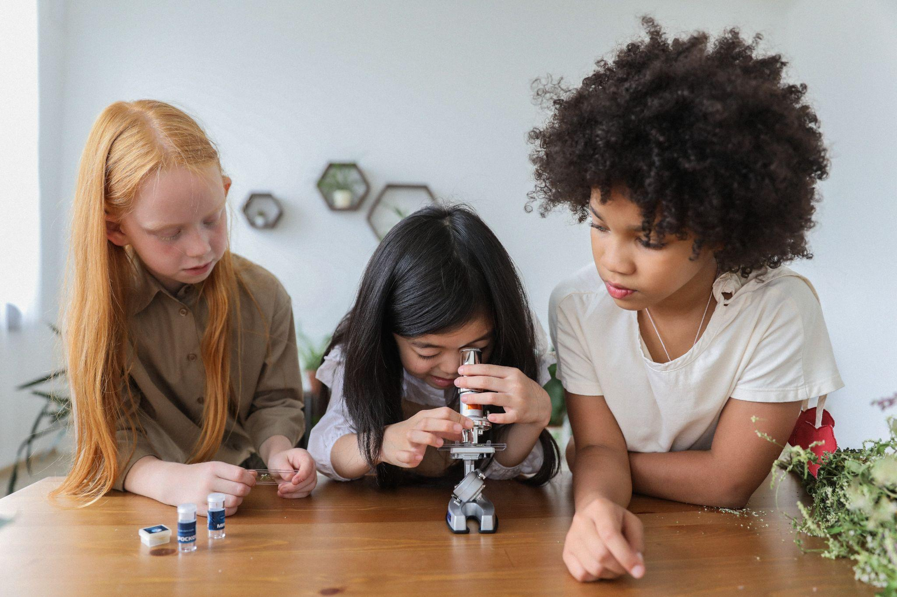
What does a Scientist Do? 1
Notes:
Welcome back! I bet you made some really great observations. But what does this have to do with Thinking Like a Citizen Scientist? Let me ask you, what do scientists do?
Pause the video and discuss what a scientist does.

Slide 6
What does a Scientist Do? 2
II
Press Pause while you discuss.
Notes:
I bet you had a great discussion on what it means to be a scientist. There are lots of different types of scientists out there, but one thing they all have in common in their research is that scientists rely on the scientific method to learn new things.
You are going to be citizen scientists, where you use the scientific method to help gather data for NASA scientists and other researchers including students or scouts like you.

Slide 7
What does a Scientist Do? 3
Observe
Ask a Question
Make a Hypothesis
Notes:
The first part of the scientific method is to observe. You all did a great job of observing the cloud appear in a bottle.
The next part of the scientific method is to create a question and make a hypothesis (i.e. your best guess at the answer to your question based on your observations).

Slide 8
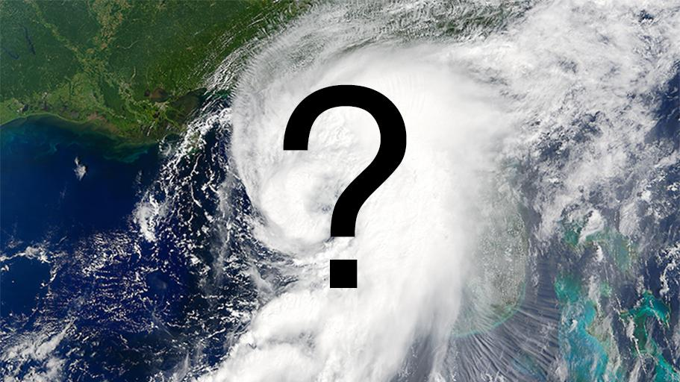
Ask a Question 1
II
Press Pause while you discuss.
Pause
????????????????????
Notes:
Pause the video and discuss. You can come up with your own question or you can use the one that I’ll provide on the next slide.

Slide 9
Ask a Question 2
What happens when pressure decreases abruptly inside a closed container with water vapor?
Notes:
The question for the cloud in a bottle could have been: What happens when pressure decreases abruptly inside a closed container with water vapor?

Slide 10
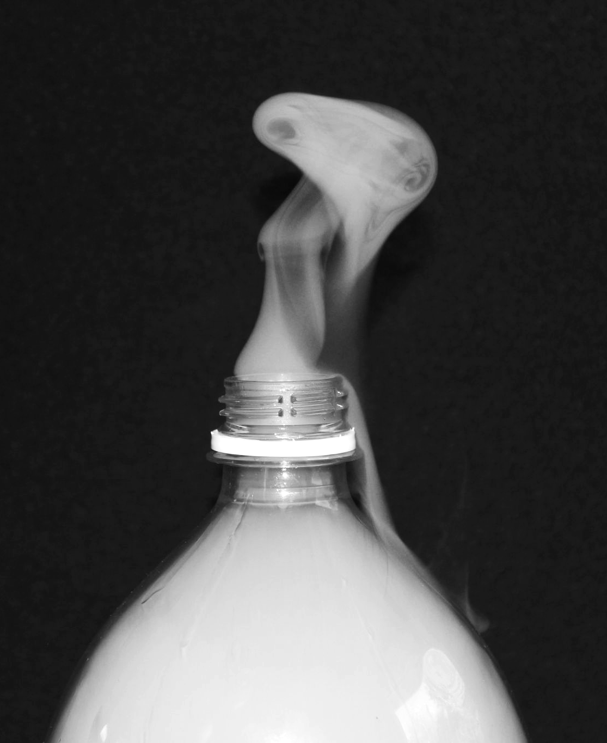
Make a Hypothesis
Question: What happens when pressure decreases abruptly inside a closed container with water vapor?
Hypothesis: When pressure decreases, the temperature decreases and a cloud will form.
Answer your question based on observations
Notes:
The hypothesis is your answer to that question. My hypothesis was that when pressure decreases, the temperature decreases, and a cloud will form. – and I was right.
We could see from the thermometer that the temperature actually went down. While the pressure inside the bottle went down as well. And when that happened the cloud formed.

Slide 11
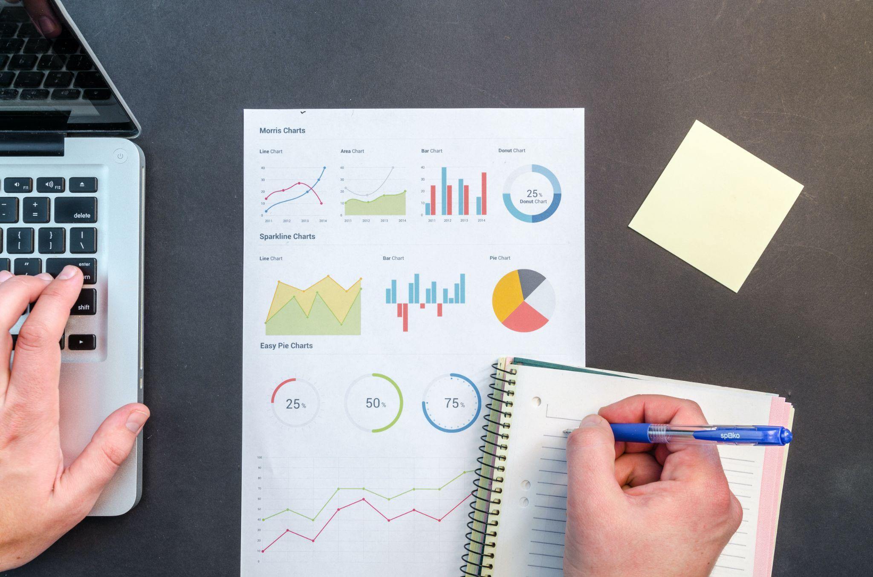
How do scientists know if their hypothesis is correct?
Collect and Analyze Data
Notes:
But, how do scientists know if their hypothesis is correct?
They have to collect and analyze data. The more data they have the better their results will be because it helps filter out some of the outliers (the mistakes, errors, or oddball data). Kind of like if I was measuring Favorite girl scout cookies. The more people I sell cookies to, the better my data.

Slide 12
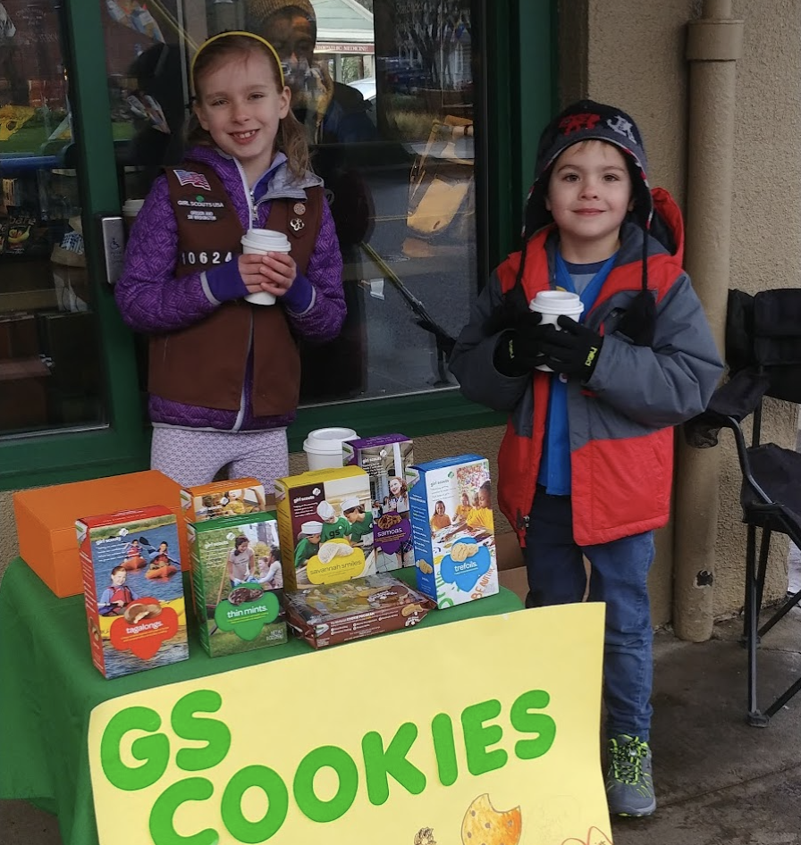
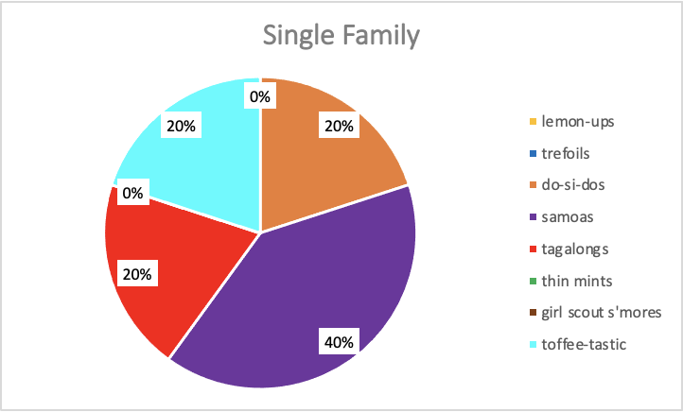
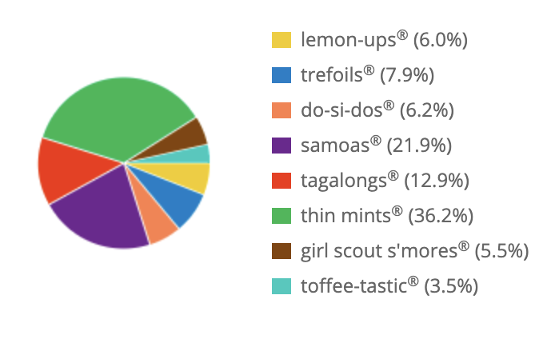
Collect and Analyze Data
Girl Scout Cookie Sales
Single Sale
Troop Sales
Total packages sold: 5
Total packages sold: 1,559
Notes:
For example, here is a pie chart showing real data from my troop sales. This Girl Scout made a single sale to one family (who love Samoas and don't like Thin Mints). But are Samoas the most popular cookie sold by Girl Scouts nationwide? With this data my hypothesis should be yes! But is it? How could I get a better data set?
I could collect more data. The pie chart on the right is the data for my entire troop’s sales. This is a much better data set because it has 1,559 packages of cookies sold – 1,554 more boxes than my single sale. With this much data, I could look at which ones I sold the most of and be able to make a better conclusion to my hypothesis than if I’d only sold 1 or 2 boxes. The more data that is collected, the better. So are Samoas the most popular according to this data? No. Thin mints are. Your troop can do this same exercise with your troop sales! If you added your data to this data, we’d have an even better data set!
Optionally, you could have them conduct this research with your own troop’s cookie sales.

Slide 13
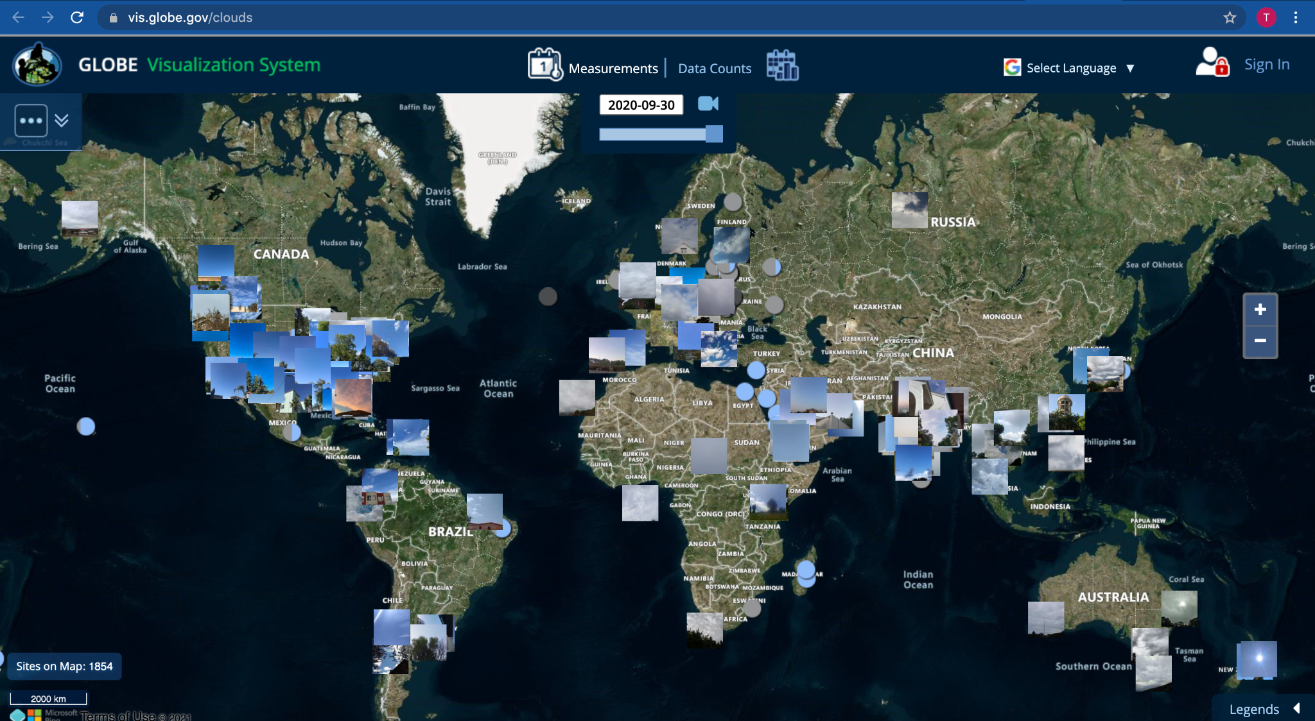
Clouds Data
https://vis.globe.gov/clouds
Notes:
NASA scientists rely on a lot of data. And this is where you can come in.
You can be Citizen Scientists. All these pictures and circles on this map are data points where citizen scientists have taken observations of clouds around the world. You can also take these observations and add to this robust data set.

Slide 14
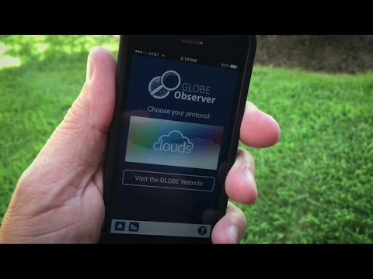
Introducing GLOBE Observer
https://youtu.be/DQ58q-5yUGw
Notes:
Let’s watch this video and learn about how GLOBE Observer contributes.
“Introducing GLOBE Observer” video: youtu.be/DQ58q-5yUGw [0:41]

Slide 15
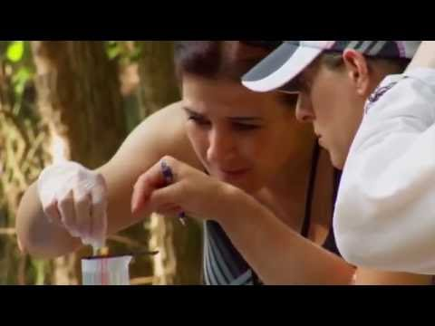
GLOBE Observer Cloud Science
https://youtu.be/TNc5qjj8ZZE
Notes:
Before we dive into collecting observations as citizen scientists, let’s watch this video where Jessica Taylor, cloud scientist and education specialist at NASA, explains a little more about the science behind and the different types of clouds that are in our sky. You’ll be using this information to classify clouds in the next activity, so pay close attention.
“GLOBE Cloud Science” video: youtu.be/TNc5louqjj8ZZE [2:45]

Slide 16
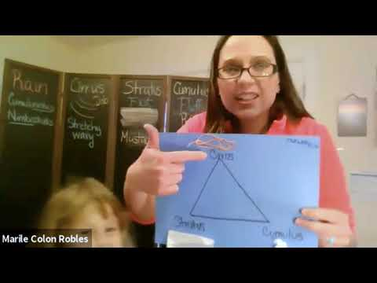
GLOBE Observer Cloud Activities
https://youtu.be/vpYXh3xHoS4
Notes:
Okay, so now troop leaders, you have a choice to make. You can keep watching this video and try the cloud classification challenge or you can join Marilé Colón-Robles and her girls and do the cloud dance and a few other fun activities. Just watch the video and dance along or use the video to lead your own cloud dance and activities.
“Do You Know that Clouds Have Names?” video: youtu.be/vpYXh3xHoS4 [6:50]

Slide 17
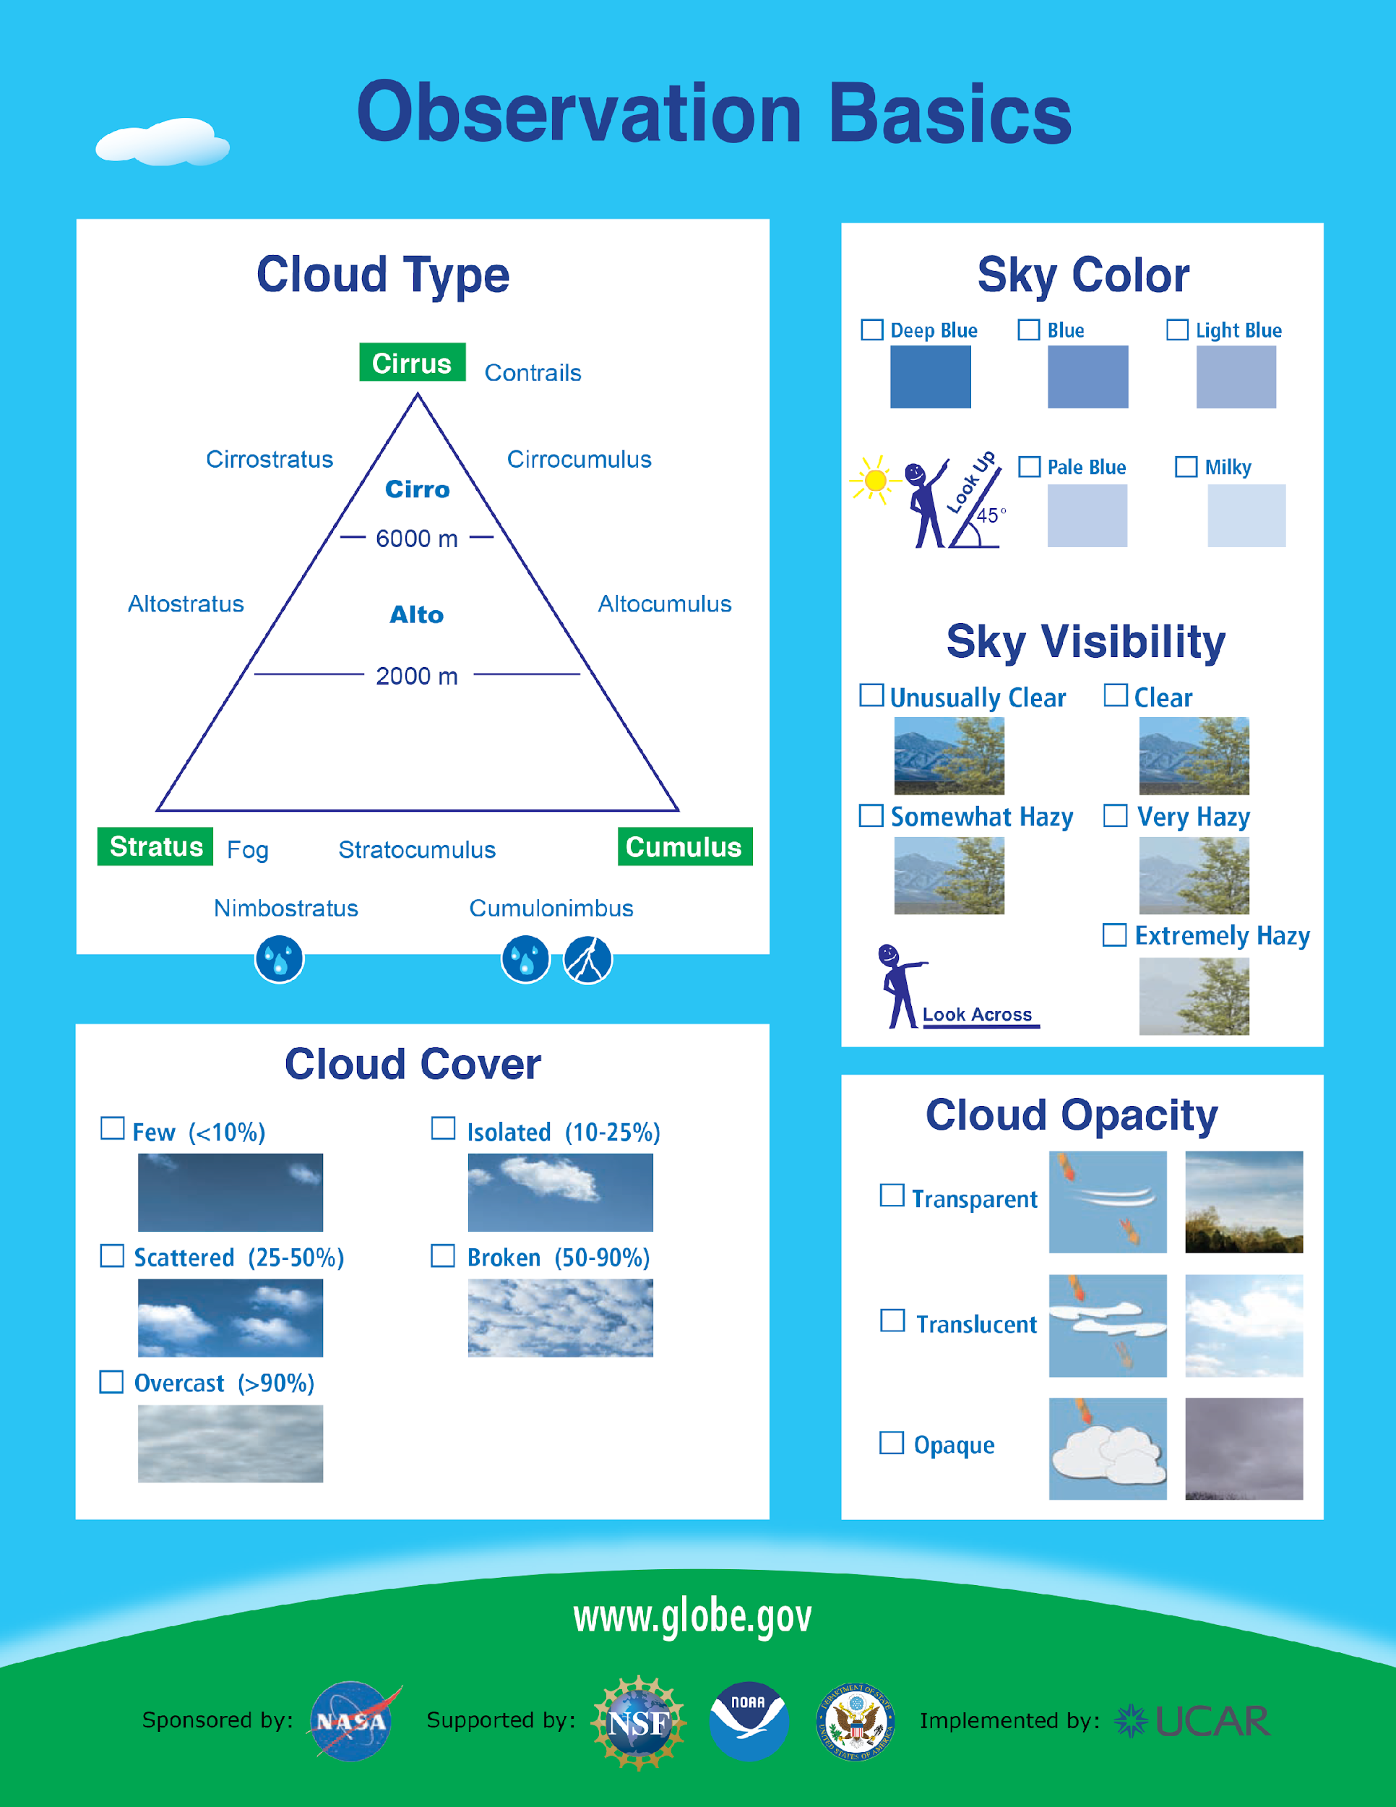
GLOBE Observer Cloud Classification Challenge 1
Notes:
Now it’s your turn to analyze some data collected by GLOBE Observers.
We are going to use the Cloud Identification Chart and the Cloud Window Viewer to identify and classify different types of clouds. You can keep watching the video and go through the Cloud Classification presentation or you can do this activity as a troop, logging the different types of clouds that you see. Troops can keep a weekly log or log conditions on days when you have troop meetings throughout the year.
Cloud Classification Challenge presentation - use slides 18 - 36 of the Clouds presentation (available at observer.globe.gov/toolkit/guides/girl-scouts)
Links to downloadable/printable tools to identify clouds:
Cloud Window Viewer – go.usa.gov/xtRyB
Cloud identification Chart - go.usa.gov/xtRy8

Slide 18
GLOBE Observer Cloud Classification Challenge 2
Instructions
Each slide will show you a picture in the “window” of the Cloud Window Viewer.
Use the viewer to identify which type of cloud is in the window.
Write down your answers on a piece of paper.
After all 8 photos, continue watching the video to see how many you got right?
Links to helpful tools to identify clouds:
Cloud Window Viewer
Cloud identification Chart
Notes:
Instructions
Each slide will show you a picture in the “window” of the Cloud Window Viewer.
Use the viewer to identify which type of cloud is in the window.
Write down your answers on a piece of paper.
After all 8 photos, continue watching the video to see how many you got right!

Slide 19
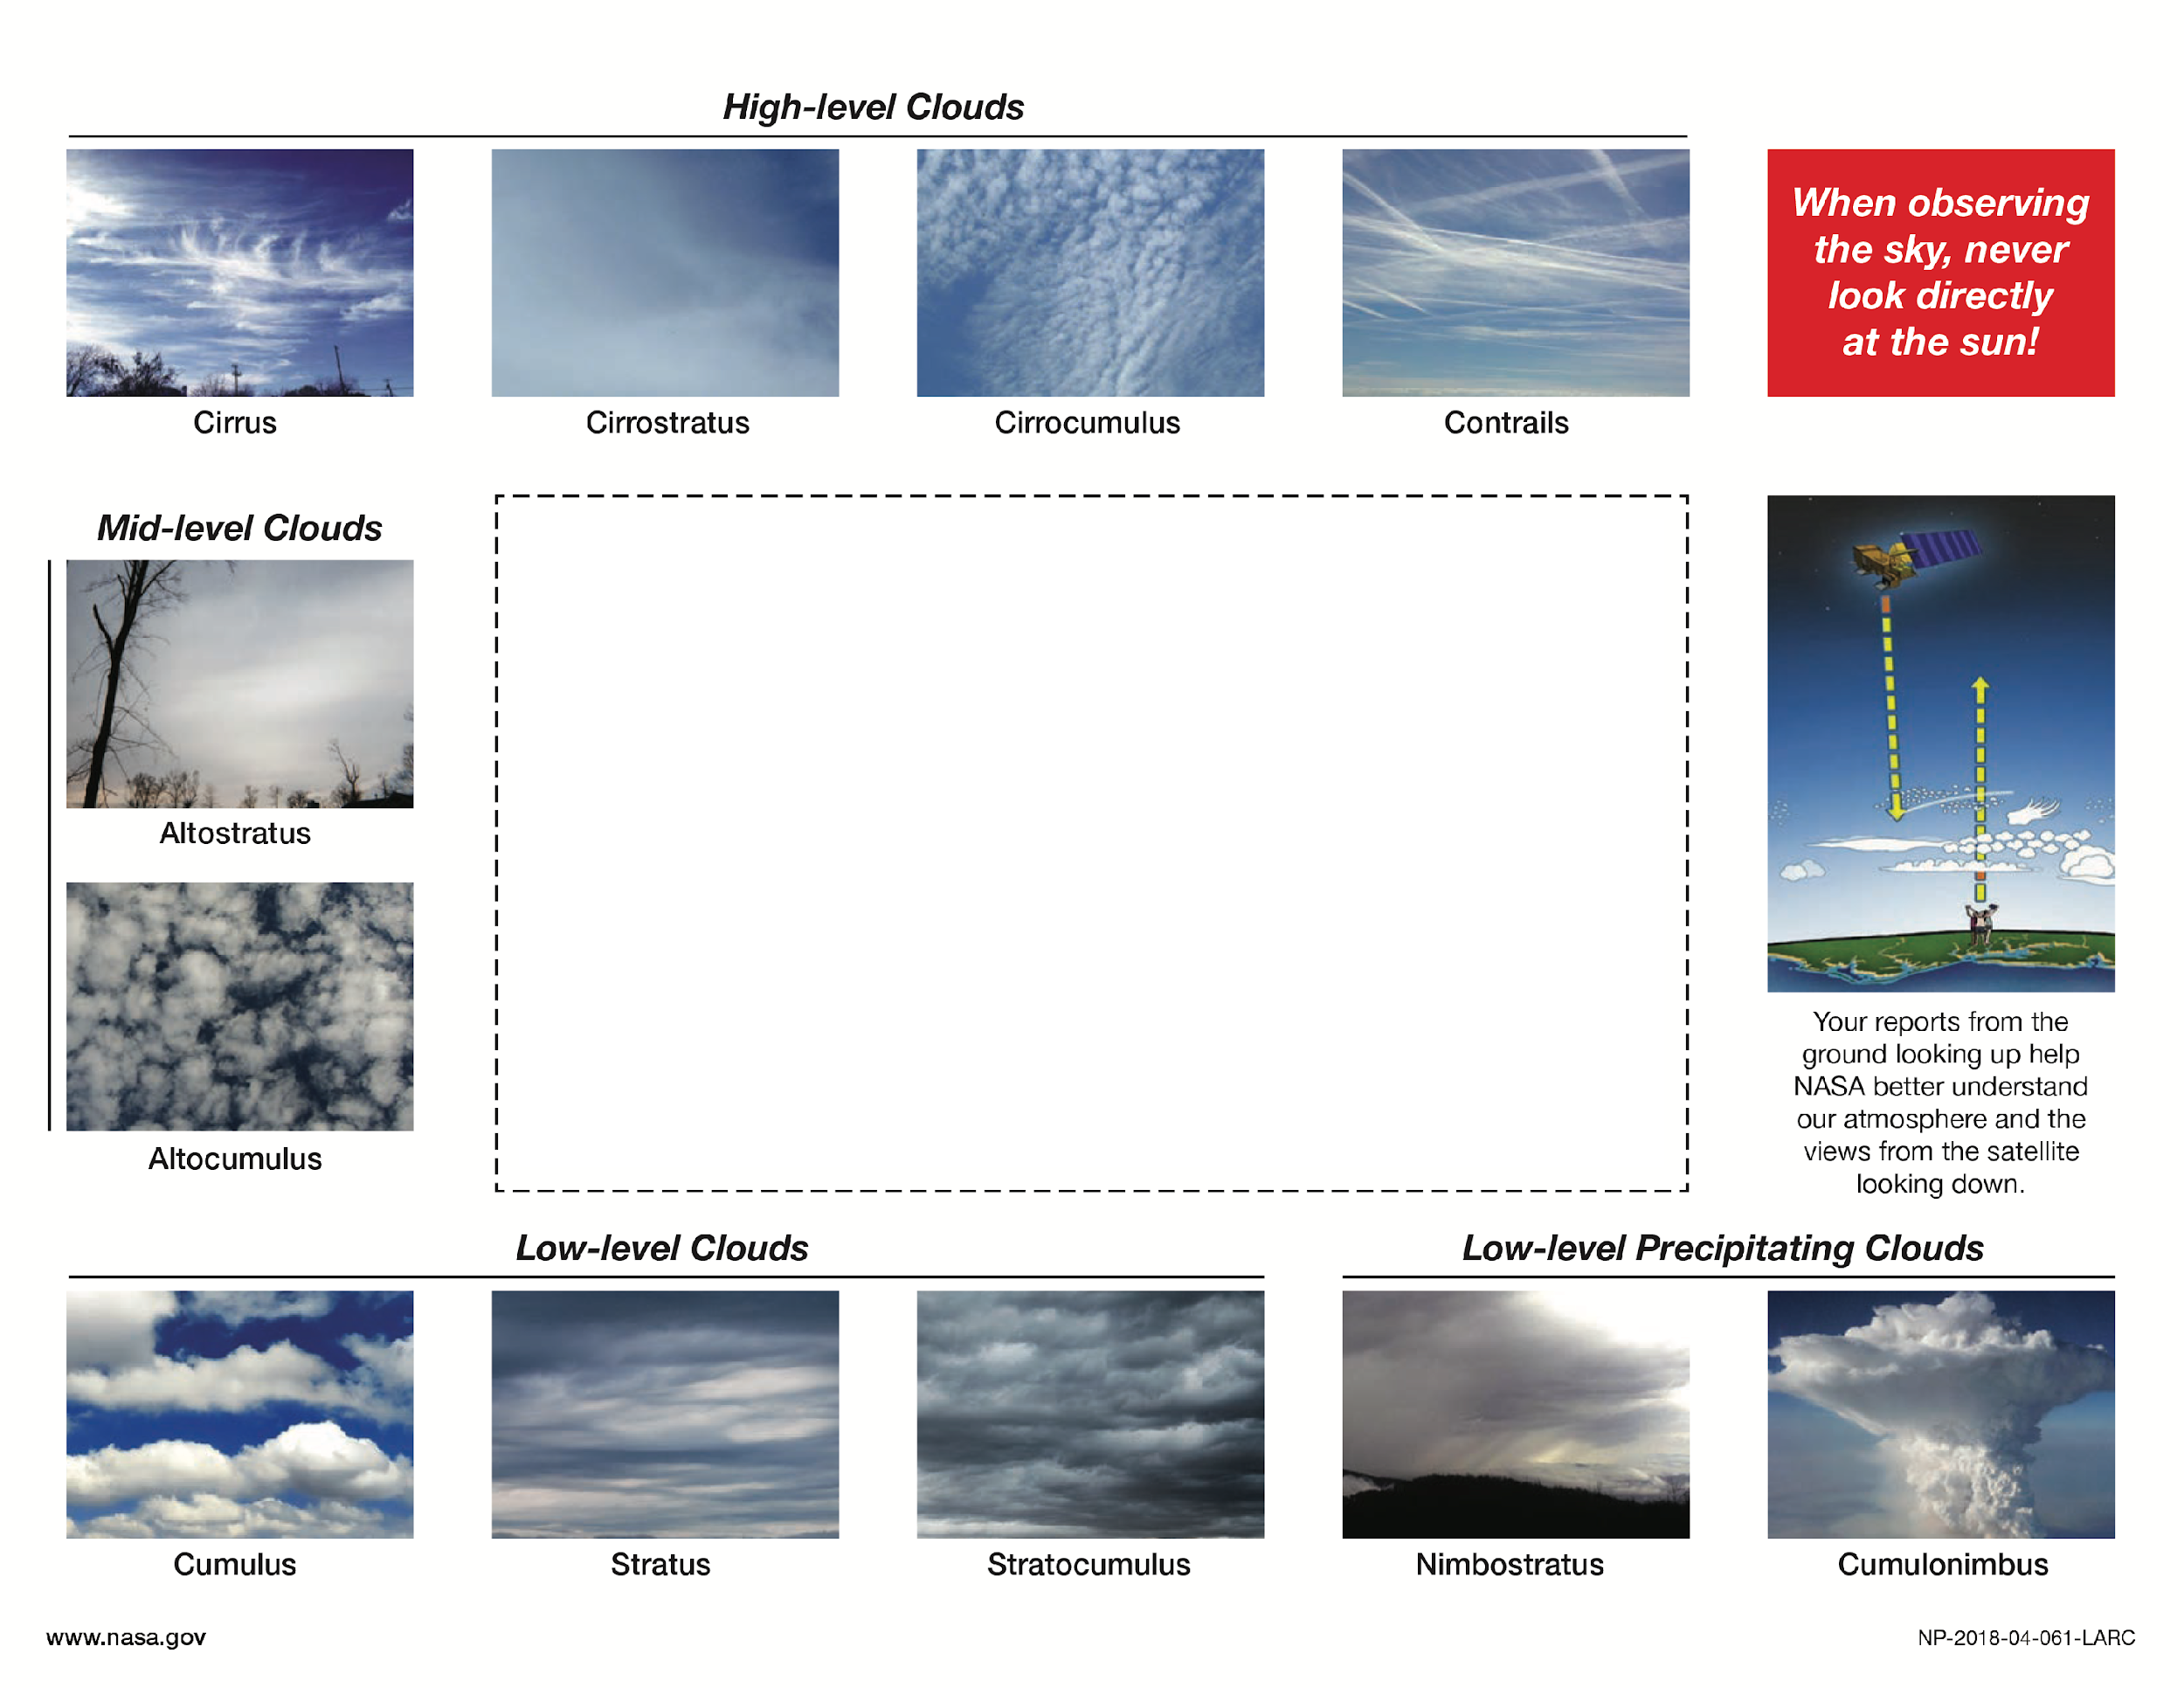
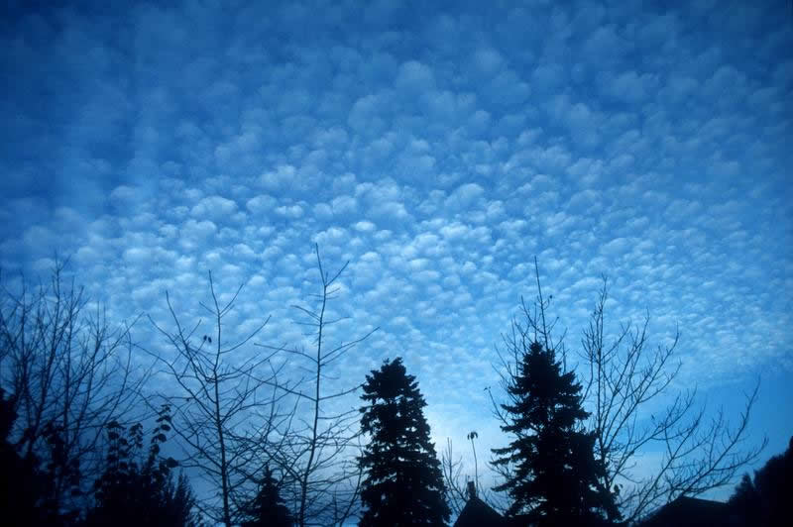
1.

Slide 20
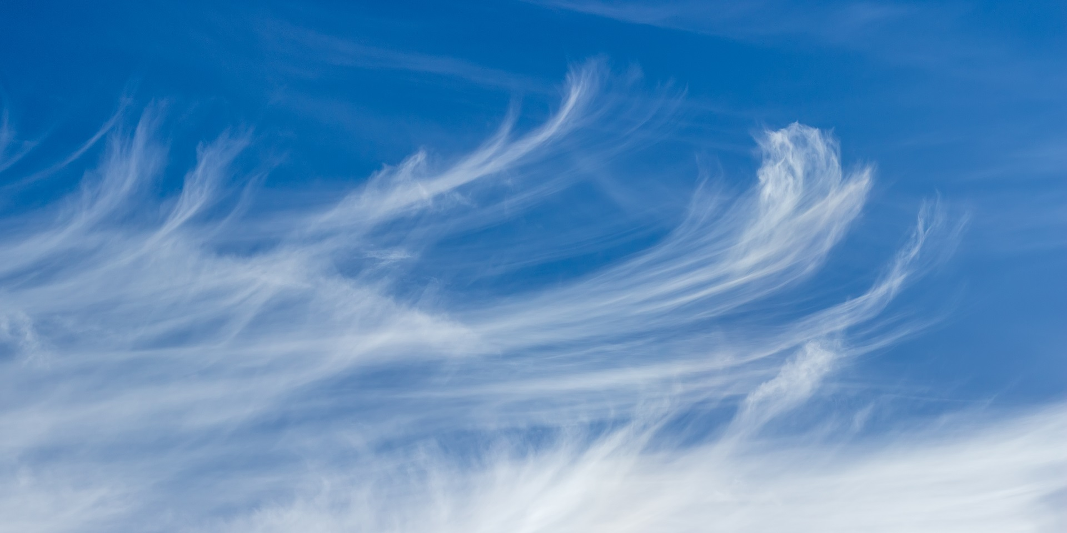
2.

Slide 21
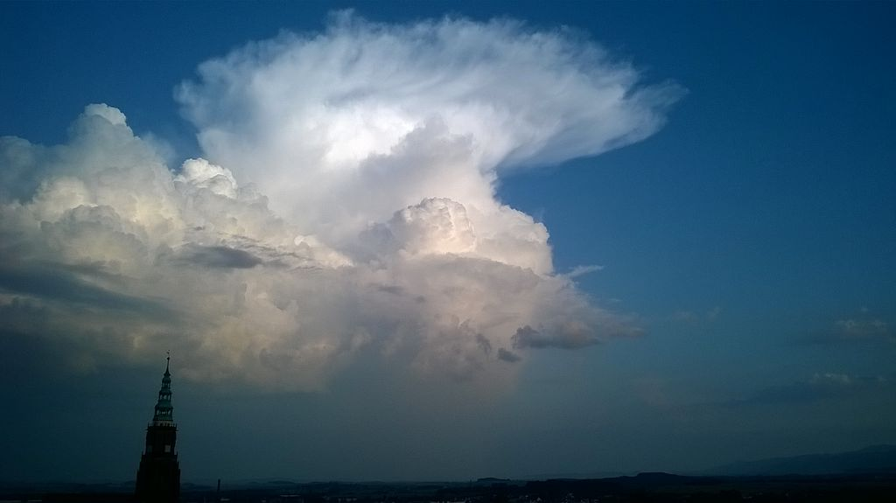
3.

Slide 22
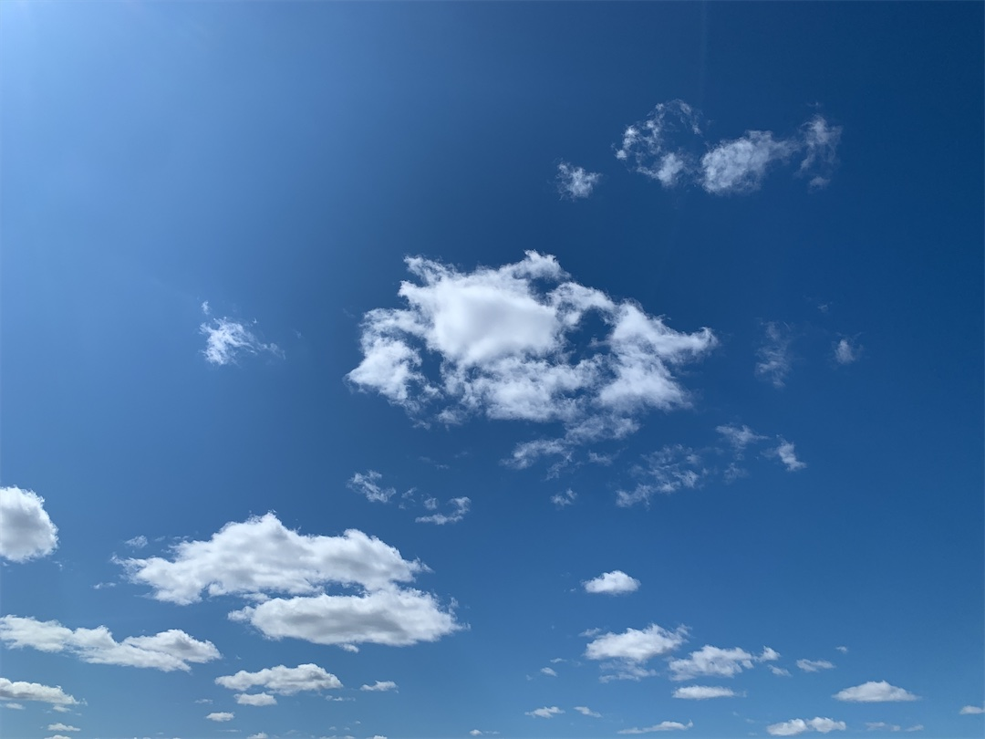
4.

Slide 23
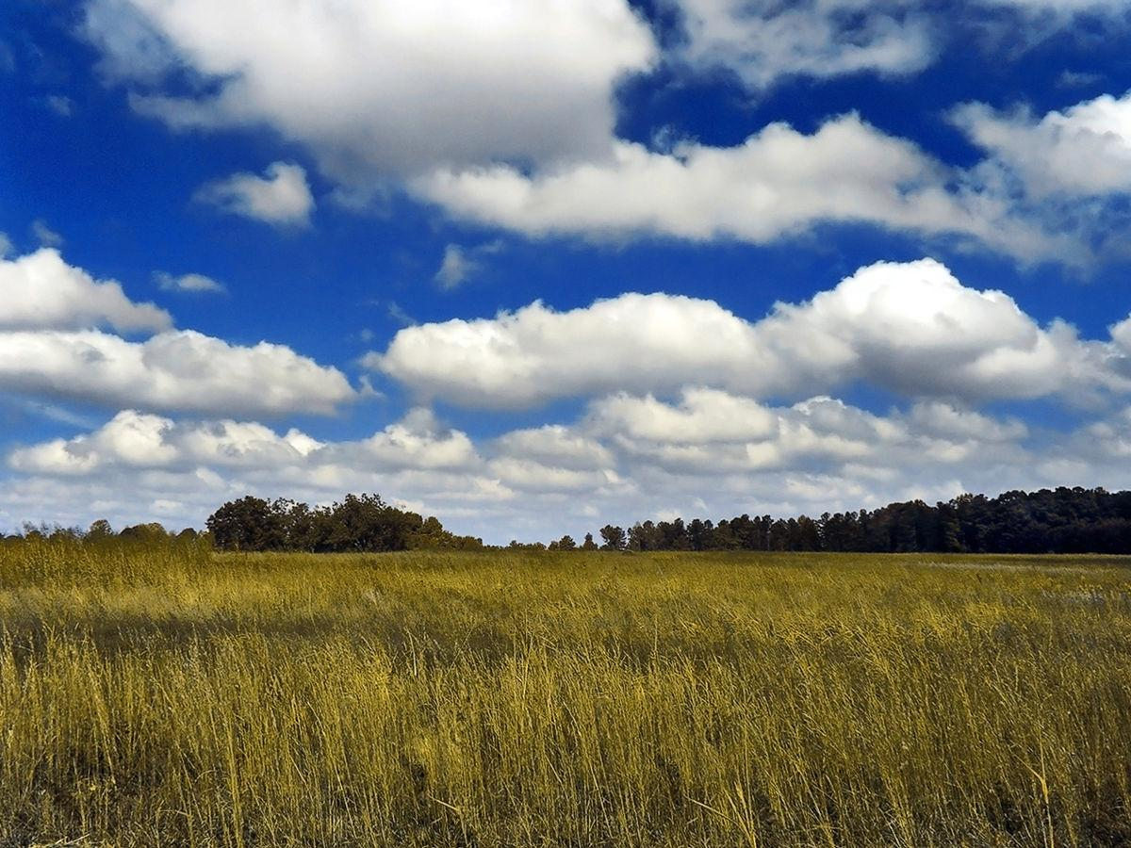
5.

Slide 24
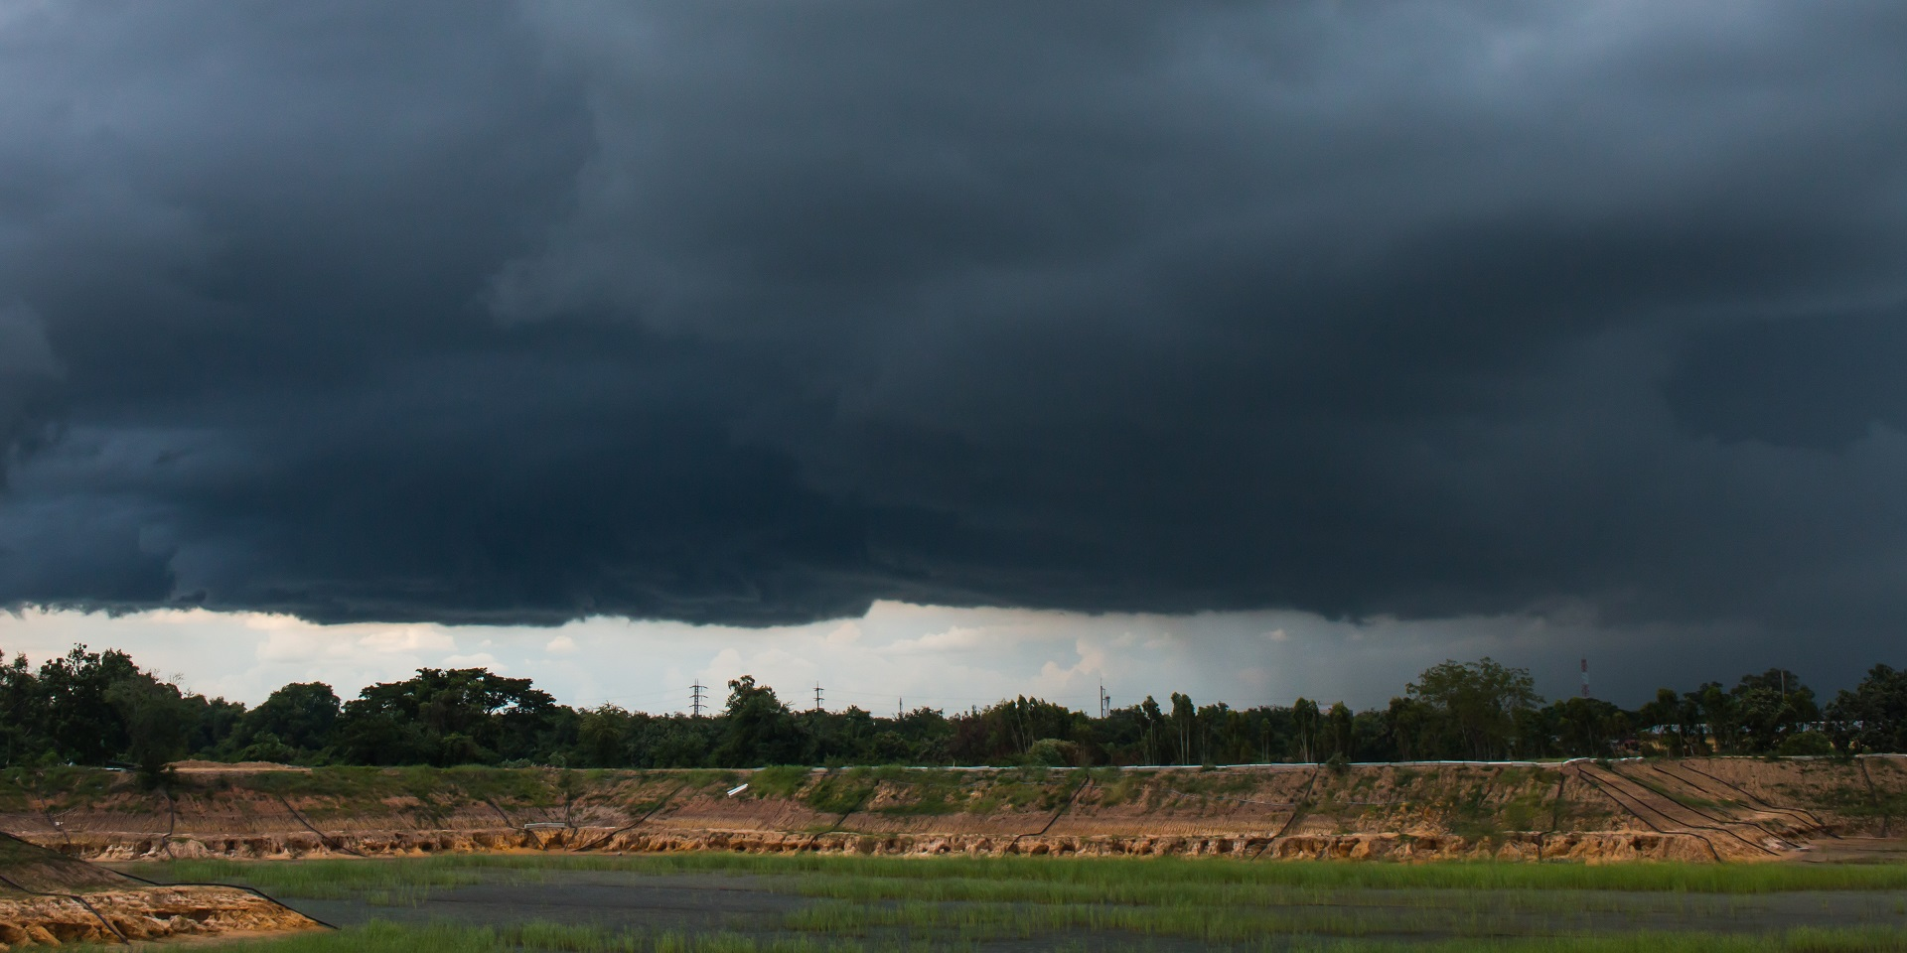
6.

Slide 25
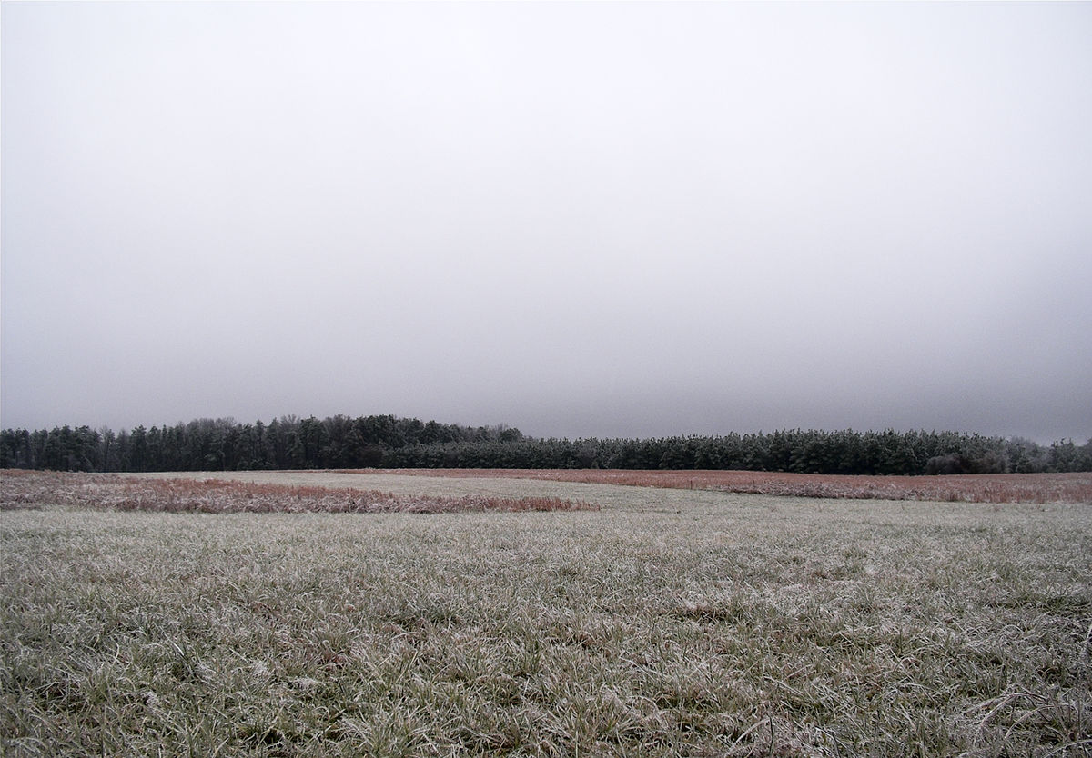
7.

Slide 26
8.

Slide 27
GLOBE Observer Cloud Classification Challenge Answers
And the ANSWERS are...
Notes:
And the answers are…

Slide 28
1. Answer
Notes:
1. Cirrocumulus

Slide 29
2. Answer
Notes:
2. Cirrus

Slide 30
3. Answer
Notes:
3. Cumulonimbus

Slide 31
4. Answer
Notes:
4. Cumulus or Altocumulus (It’s hard to tell how high these clouds are from the picture)

Slide 32
5. Answer
Notes:
5. Cumulus

Slide 33
6. Answer
Notes:
6. Nimbostratus

Slide 34
7. Answer
Notes:
7. Stratus

Slide 35
8. Answer
No clouds! Clear Skies!
Notes:
8. Clear
How did you do?

Slide 36
GLOBE Observer Cloud Classification Challenge Complete
CONGRATULATIONS!
Thanks for playing the
Clouds Classification Challenge!
Notes:
Congratulations and thanks for playing the Clouds Classification Challenge.

Slide 37
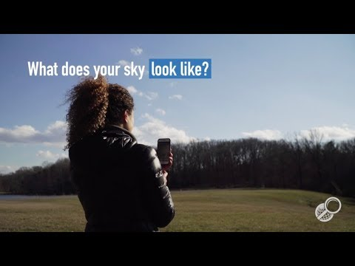
How to use the Clouds Tool
https://youtu.be/CNZGfeVaCHU
Notes:
Now that you are familiar with how to classify clouds, let’s learn how to use the GLOBE Observer Clouds tool.
“GLOBE Observer Clouds: Getting Started” video: youtu.be/cZM3PO5hoHU [2:36]

Slide 38
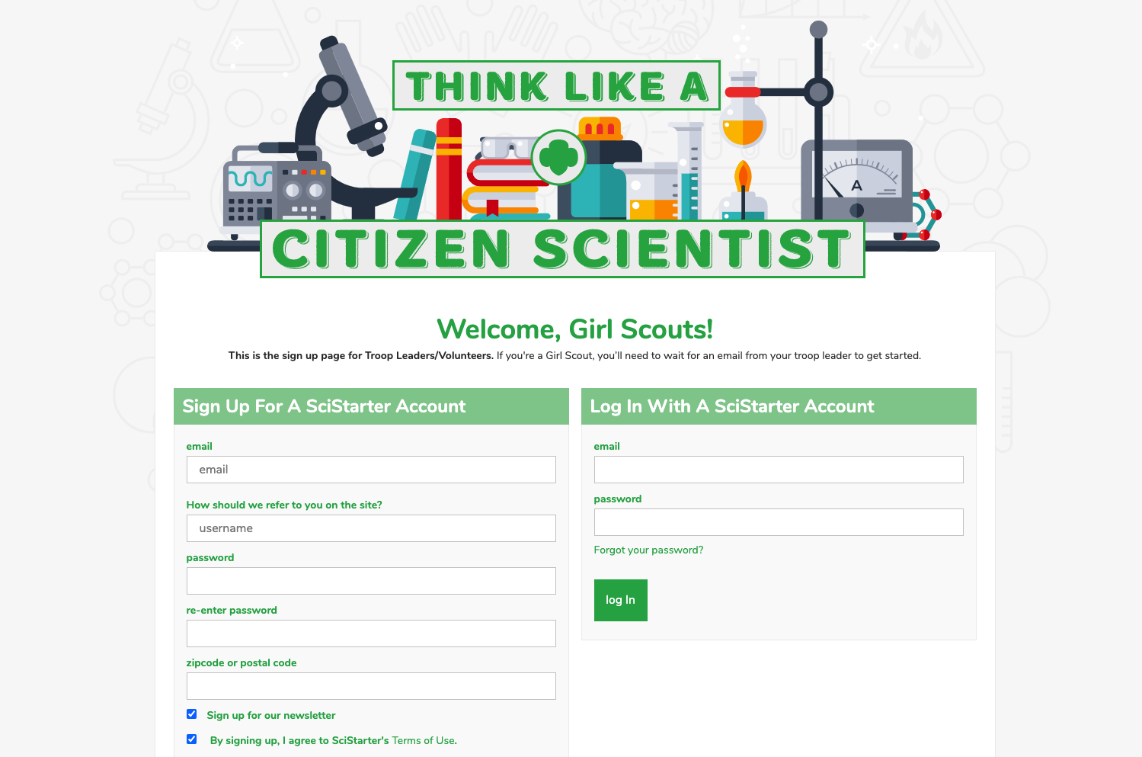
Register your Troop on SciStarter
https://scistarter.com/girlscouts/volunteer/landing
Notes:
If you want to get started as a GLOBE Observer, ask your troop leader to register your troop through SciStarter, then send you the link to set up your accounts.
URL to set up SciStarter account: scistarter.com/girlscouts/volunteer/landing

Slide 39
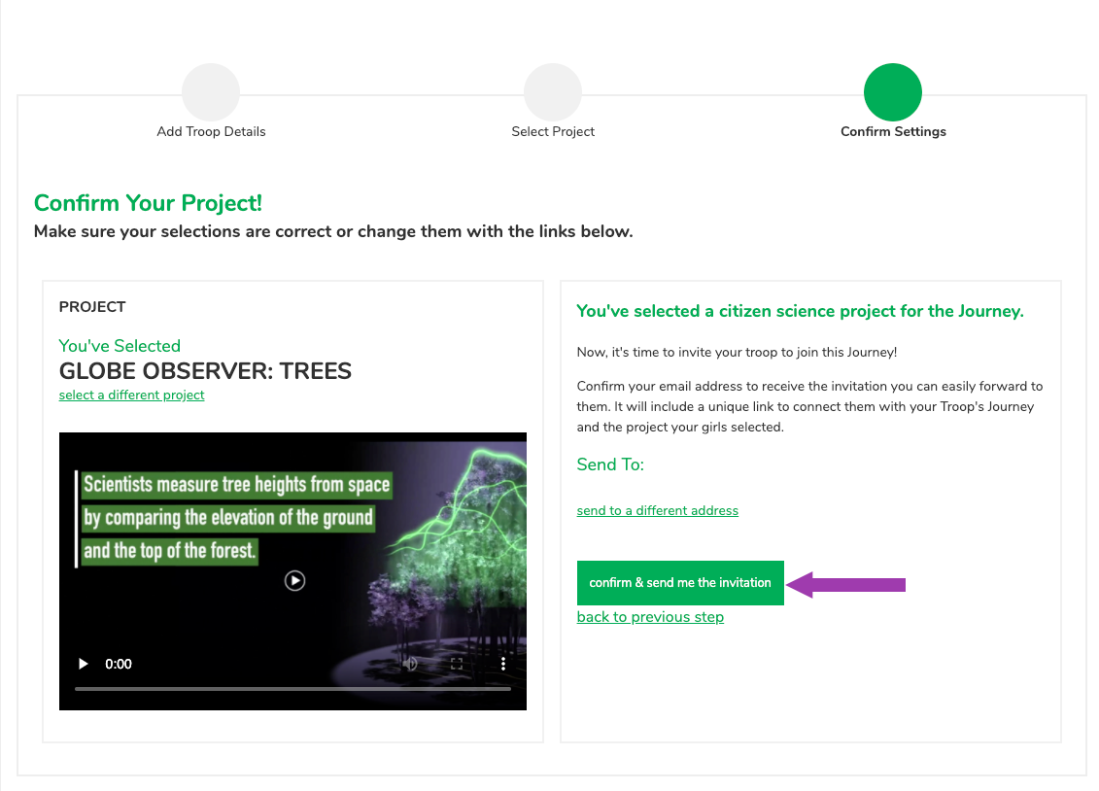
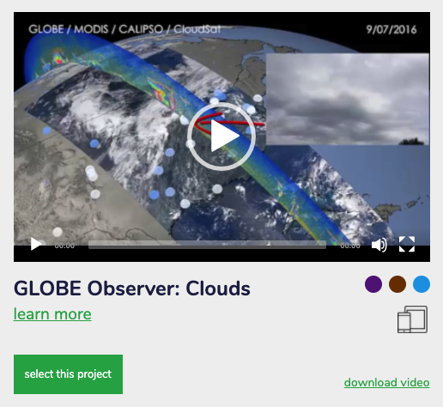
Choose GLOBE Observer: Clouds
Notes:
Once you have a troop SciStarter account, you will choose which citizen science opportunity interests you. There are a lot of different citizen science projects (including others with NASA) and others with GLOBE Observer, including: Trees, Land Cover, and Mosquito Habitat Mapper, in addition to clouds.

Slide 40
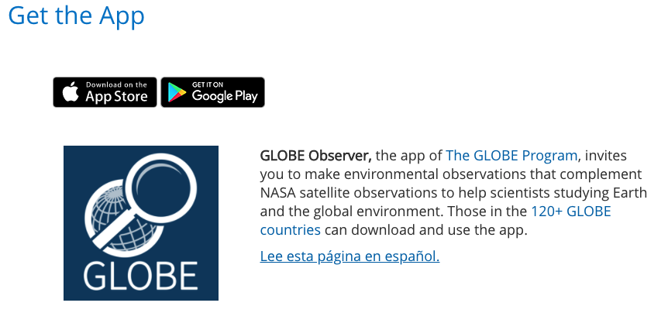
Download the App
https://observer.globe.gov/get-the-app
Notes:
Then you need to download the app (observer.globe.gov/get-the-app)
Register as a GLOBE Observer. Then collect your data.
The nice part about clouds is that they change and can be observed almost anywhere (except inside if there aren't any windows).
So now you’ve learned to Think Like a Citizen Scientist by observing and collecting and analyzing data. The next step is to collect and analyze your own data by using the app.

Slide 41
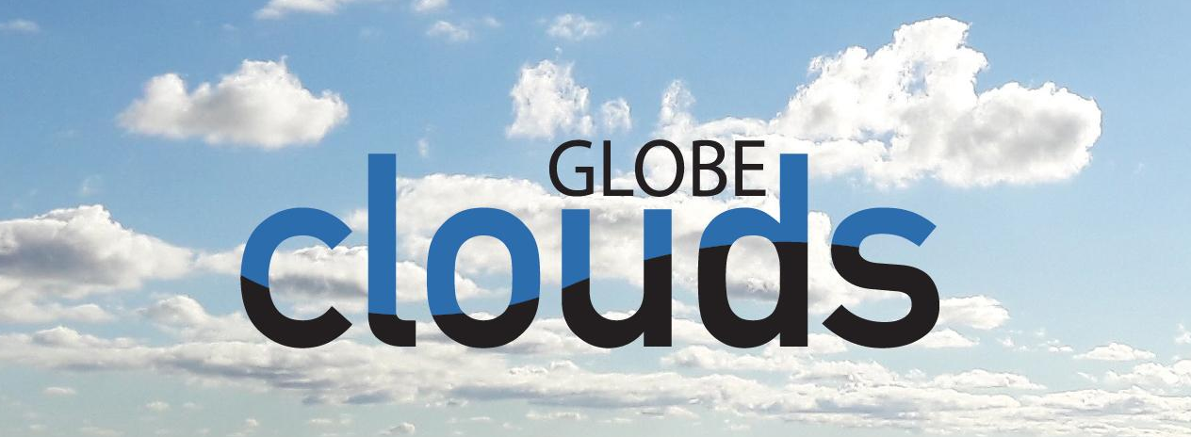
Take Action
What can you do?
Educate other Girl Scouts or people in your community about air quality and teach them what is in our air. Visibility can tell us a lot about how clean our air is.
Track frequent storms and help neighbors know what kind of weather to expect and to prepare.
Create a storm kit to help when severe storms hit or work to create these kits and distribute them to people in your community.
Create a team for your troop, council, or service unit (www.globe.gov/globe-community/globe-teams) and take observations together.
Notes:
Then, consider how you might use your data to take action.
What kind of take-action projects can you think of doing?
Visibility can tell us a lot about how clean our air is. You could educate some other Girl Scouts or people in your community about air quality and teach them what is in our air.
Tracking frequent storms could help neighbors know what kind of weather to expect and prepare.
You could create a storm kit to help when severe storms hit or work to create these kits and distribute them to people in your community.
Create a team of your troop, council, service unit, and take observations together. (www.globe.gov/globe-community/globe-teams)

Slide 42
Questions? Share your projects.
@TheGLOBEProgram
@GLOBEProgram
Notes:
If you have any questions for me about NASA, GLOBE Observer please feel free to contact us or follow us on social media. We love seeing your Take Action projects, so please don’t forget to share!
What I love about Girl Scouts is that you all leave the world a better place. I for one am really excited that you are leading the future for us.

