Slide 1
Mosquito Habitats and Hideouts Bingo Call Slides

Slide 2
Before playing game,
mix up the order of the slides!

Slide 3
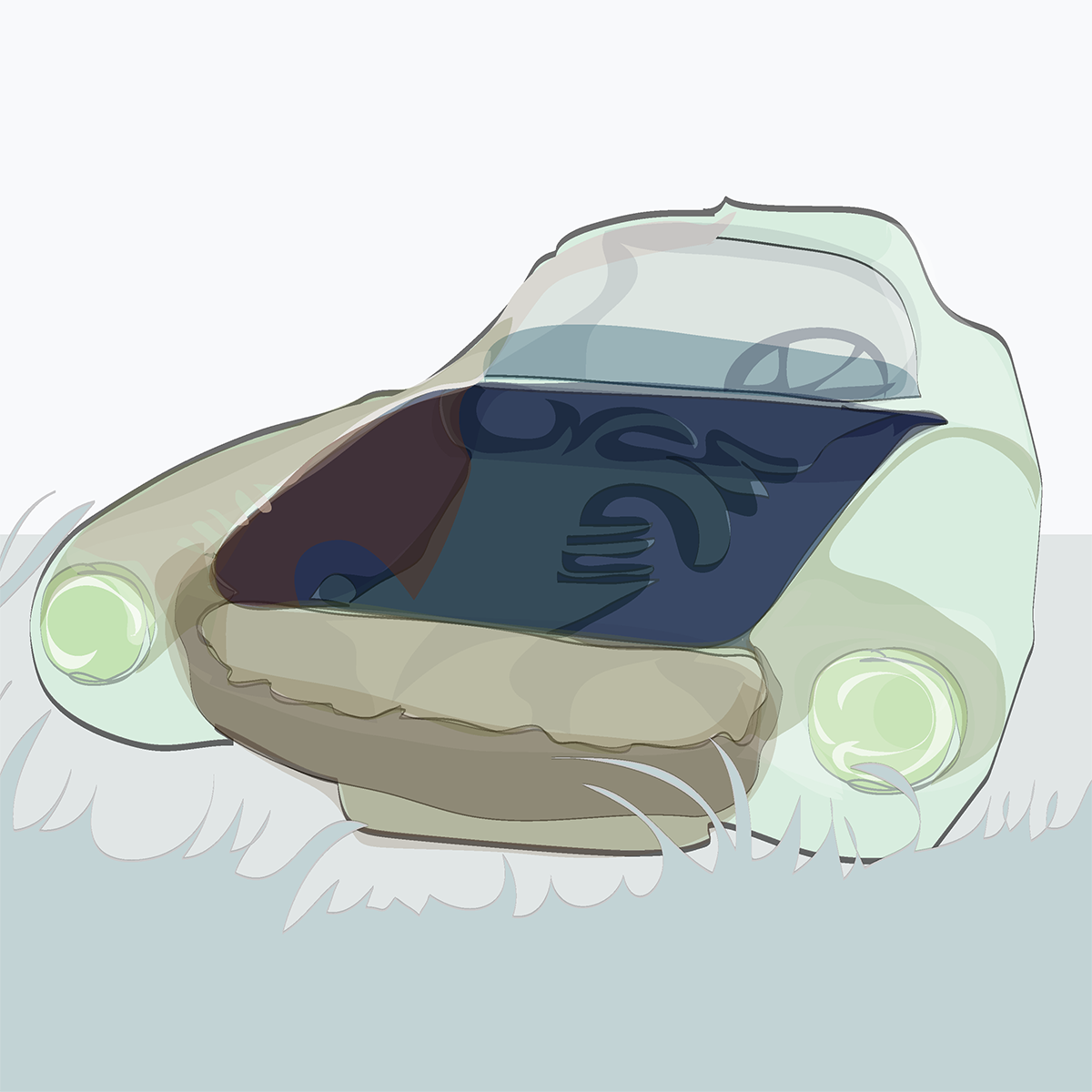
Abandoned car

Slide 4
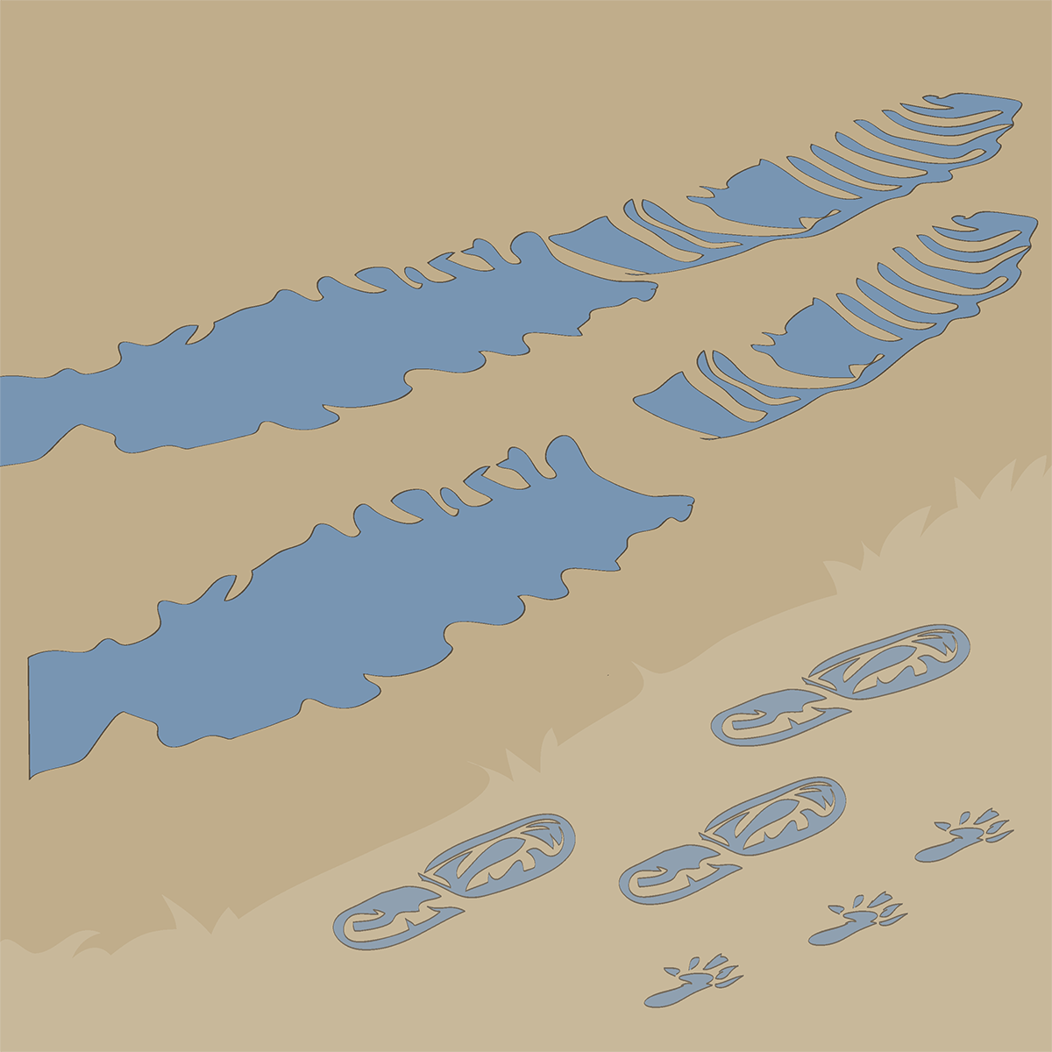
Tracks:
animal, people or tire

Slide 5
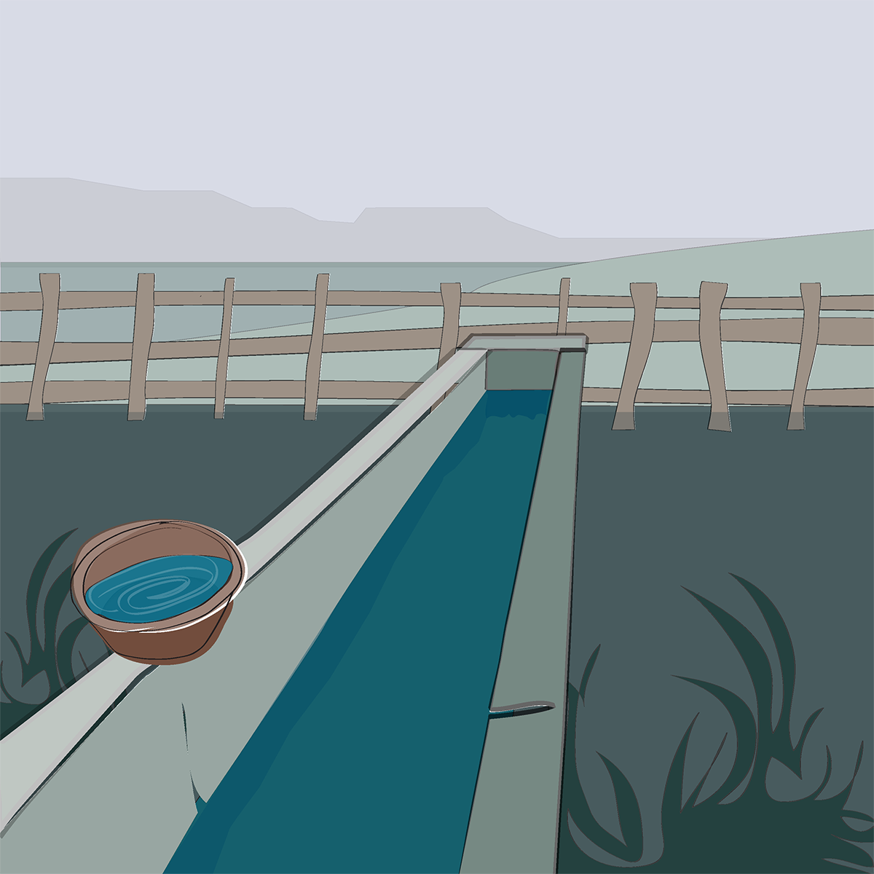
Animal trough or water bowl

Slide 6
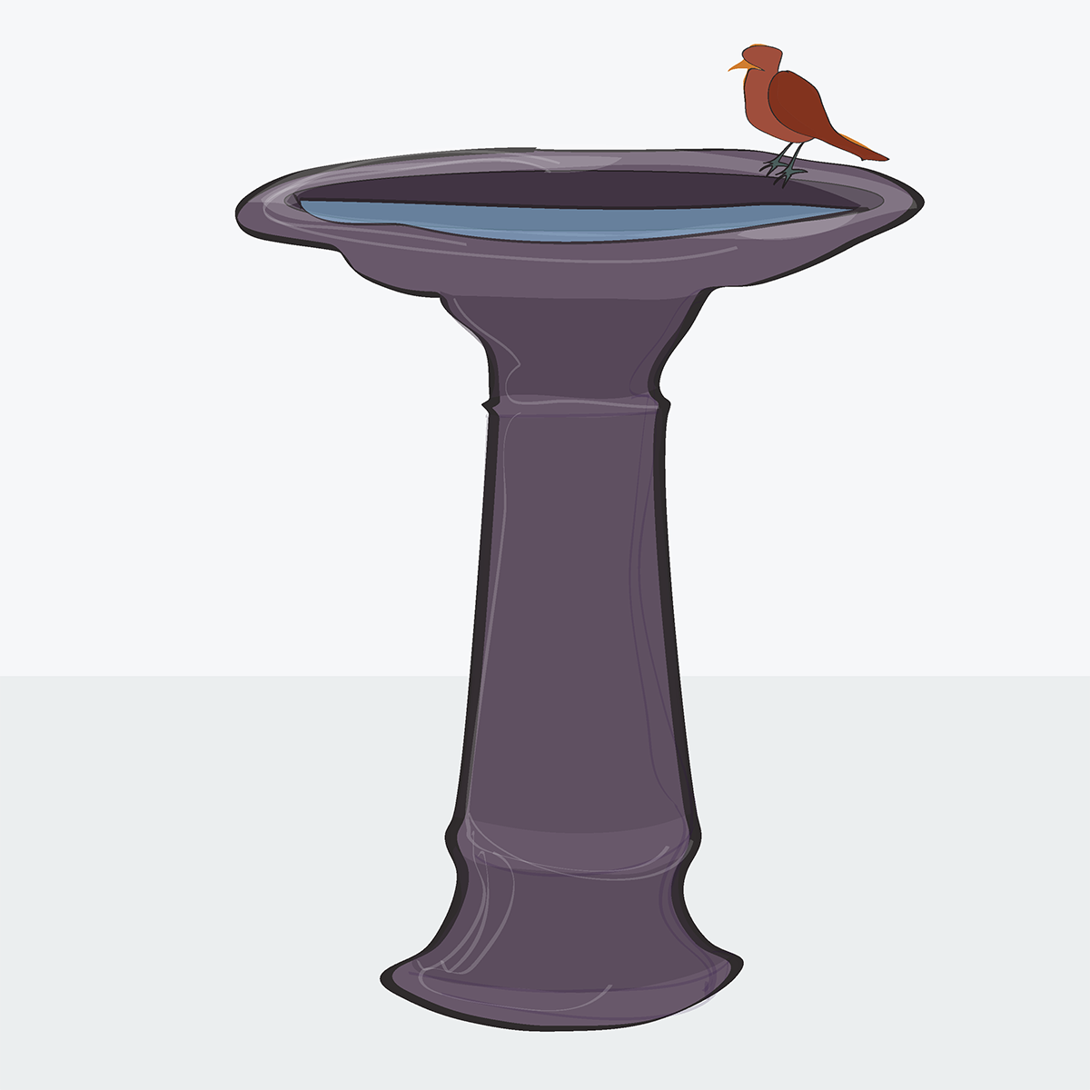
Birdbath

Slide 7
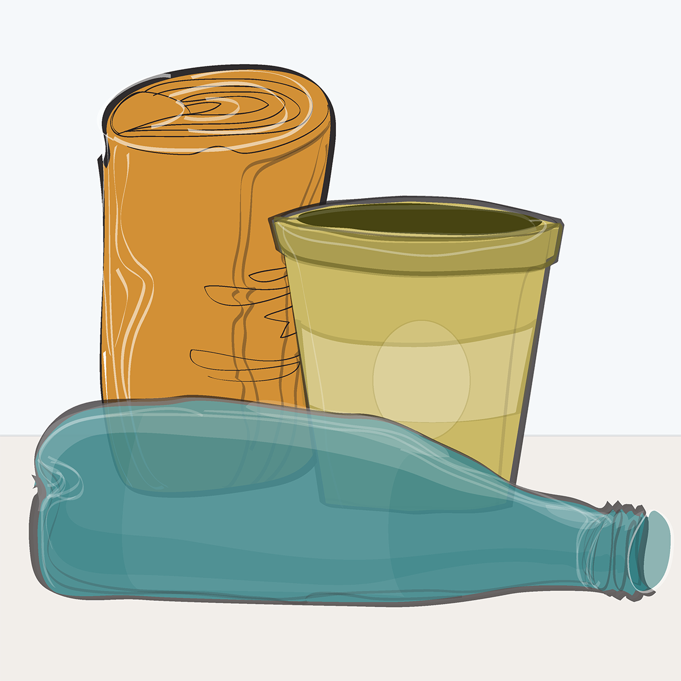
Can, bottle or cup

Slide 8
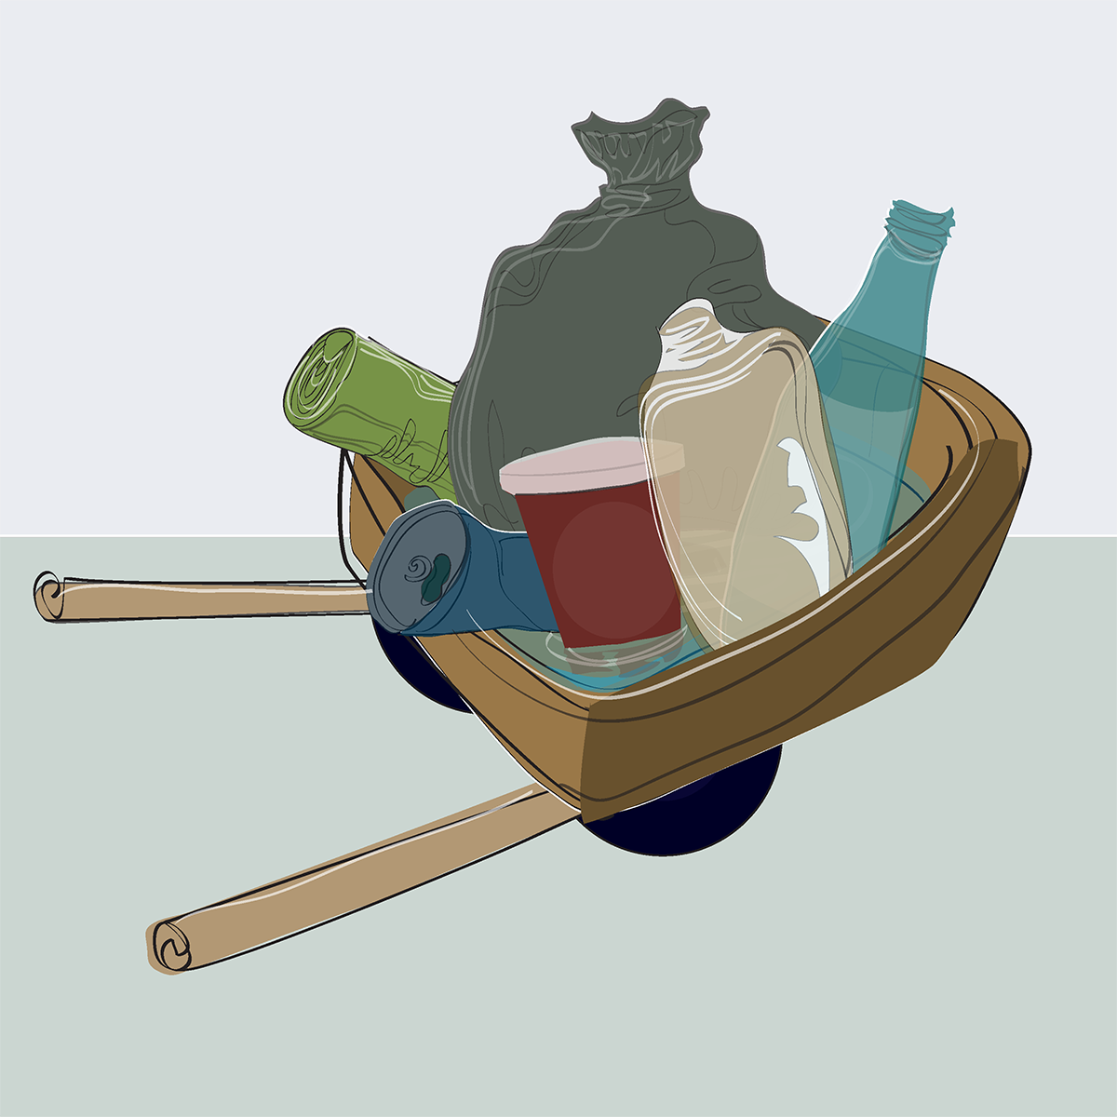
Discarded objects or trash

Slide 9
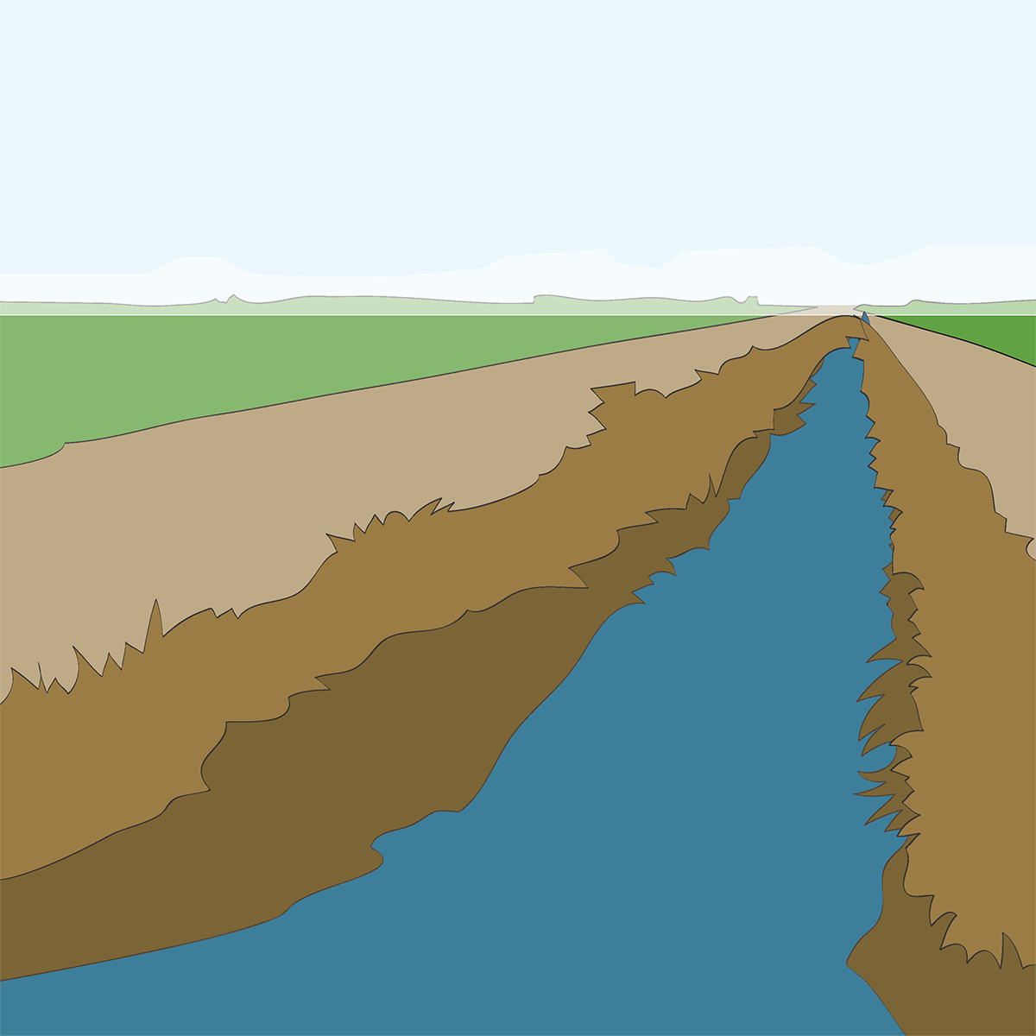
Ditch

Slide 10
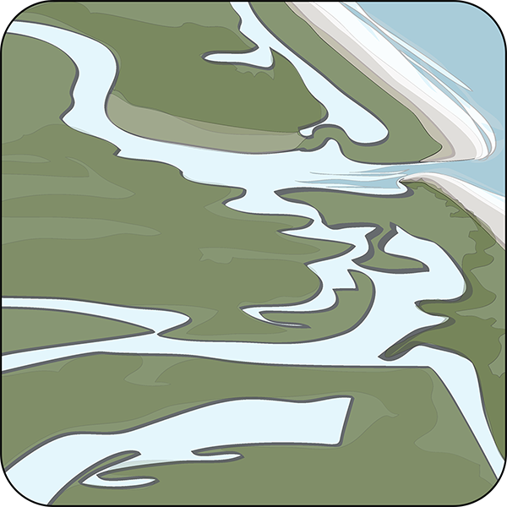
Estuary

Slide 11
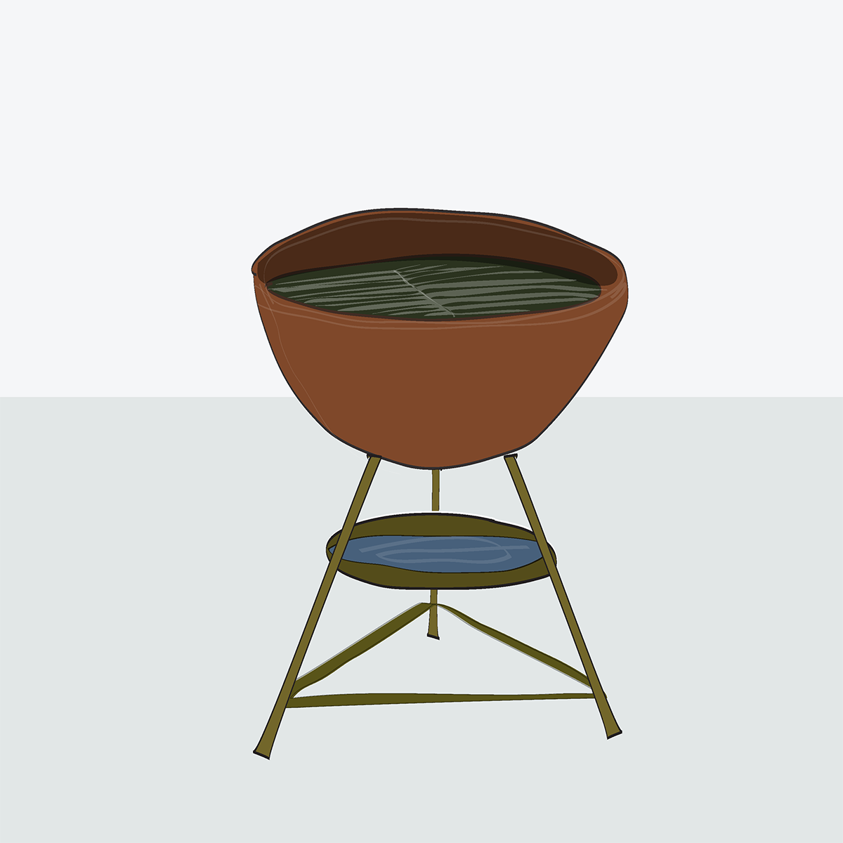
Grill

Slide 12
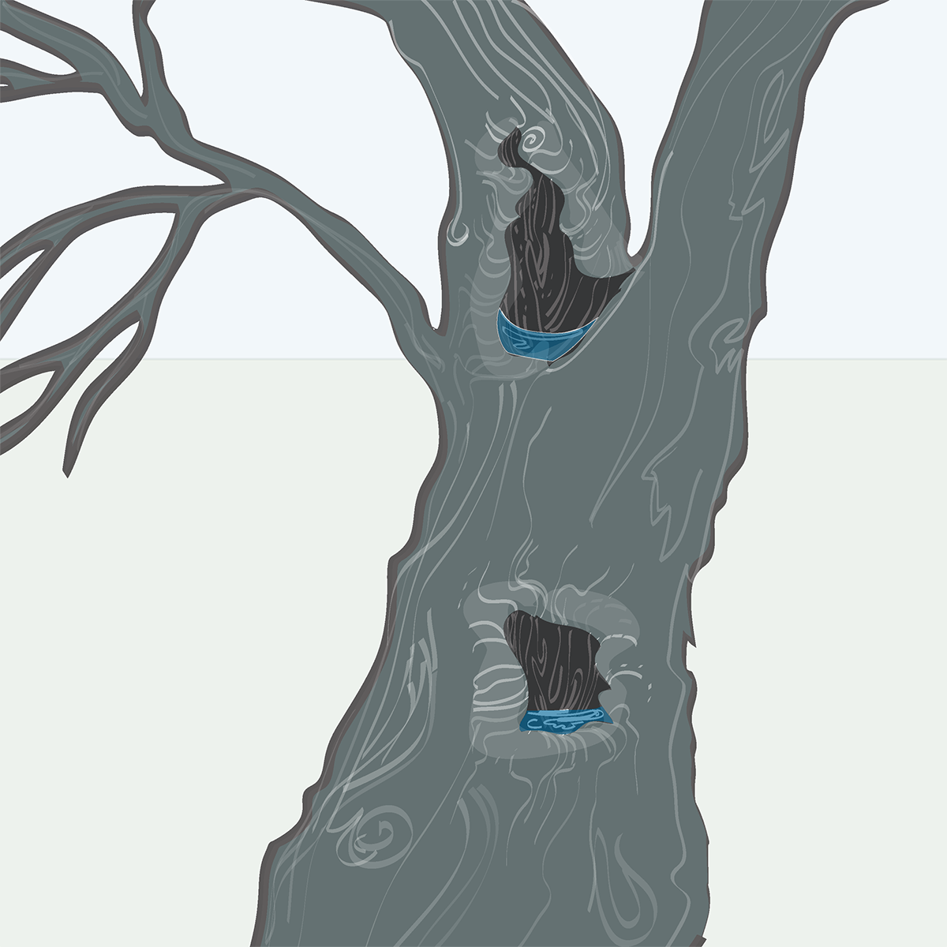
Hollows in trees

Slide 13
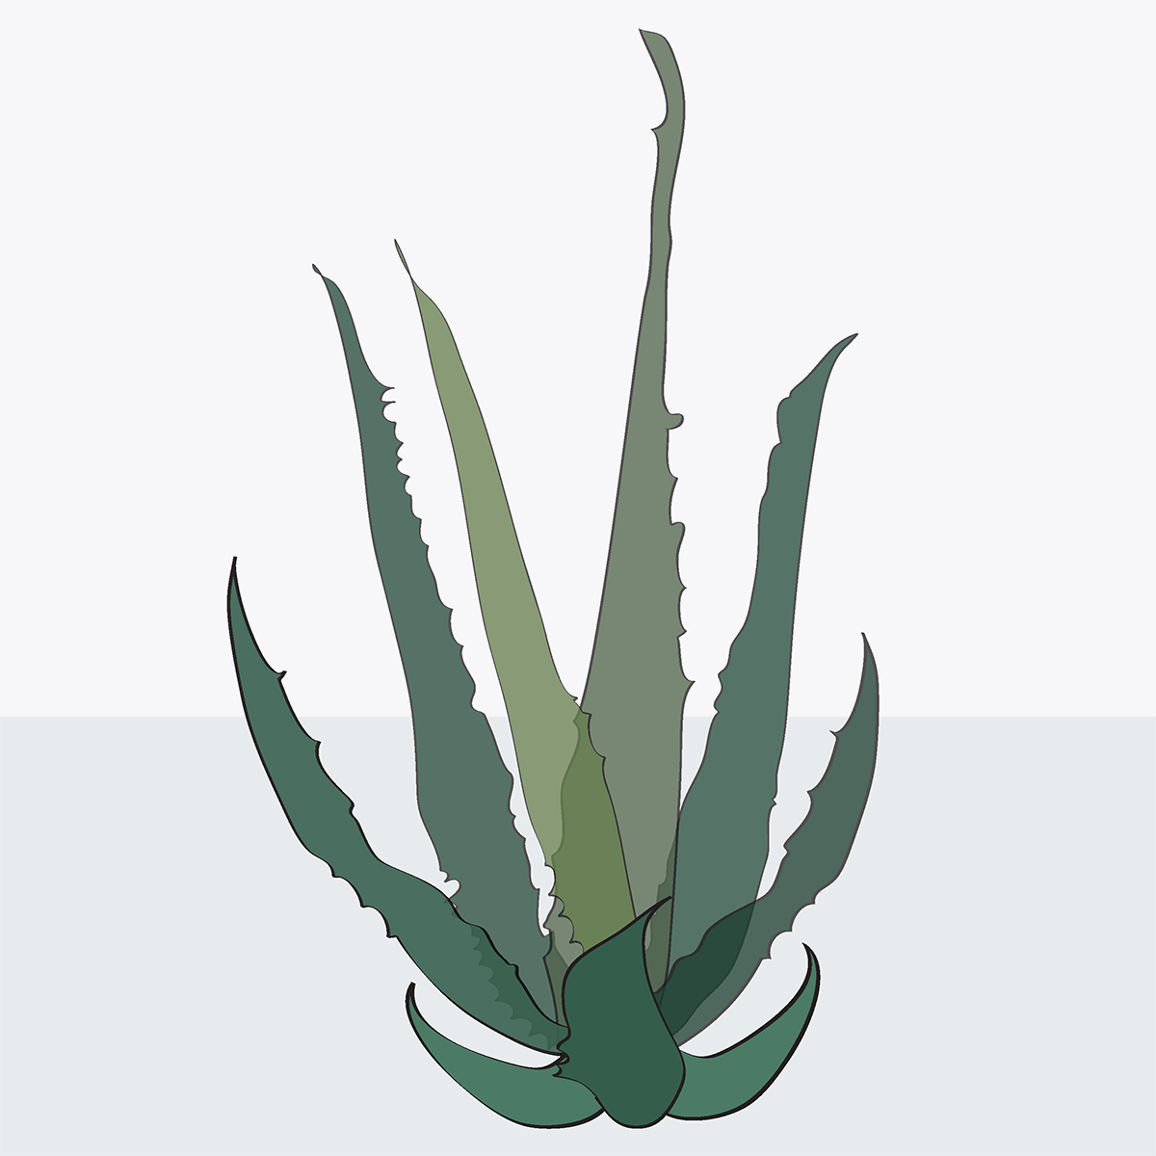
Hollows in plants
(for example,
puddle on leaf,
Bamboo)

Slide 14
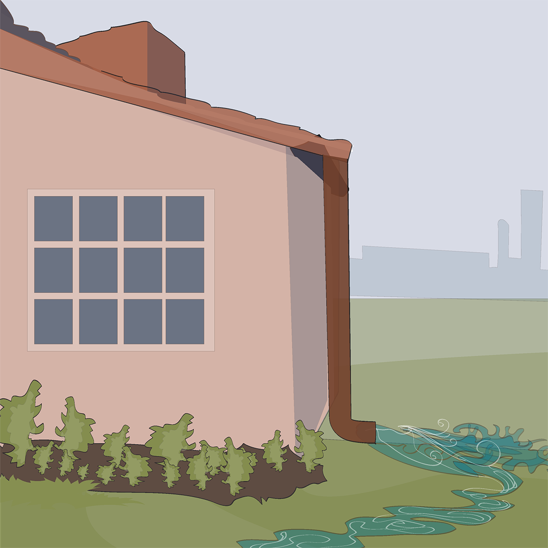
House structure (gutters, downspouts)

Slide 15
Mosquito eggs

Slide 16
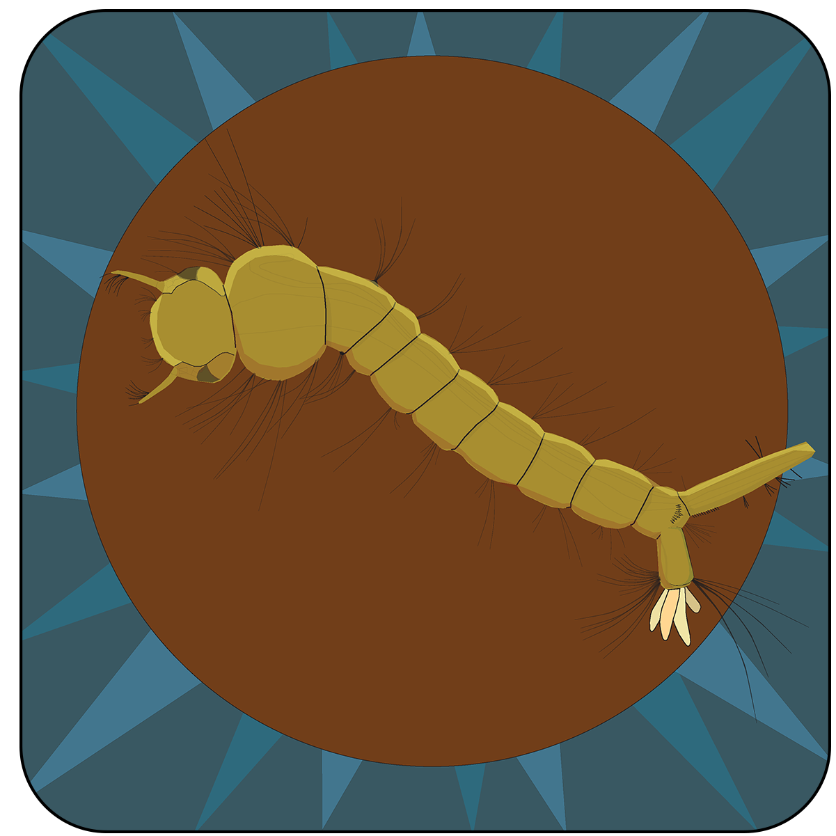
Mosquito larva

Slide 17
Mosquito pupa

Slide 18
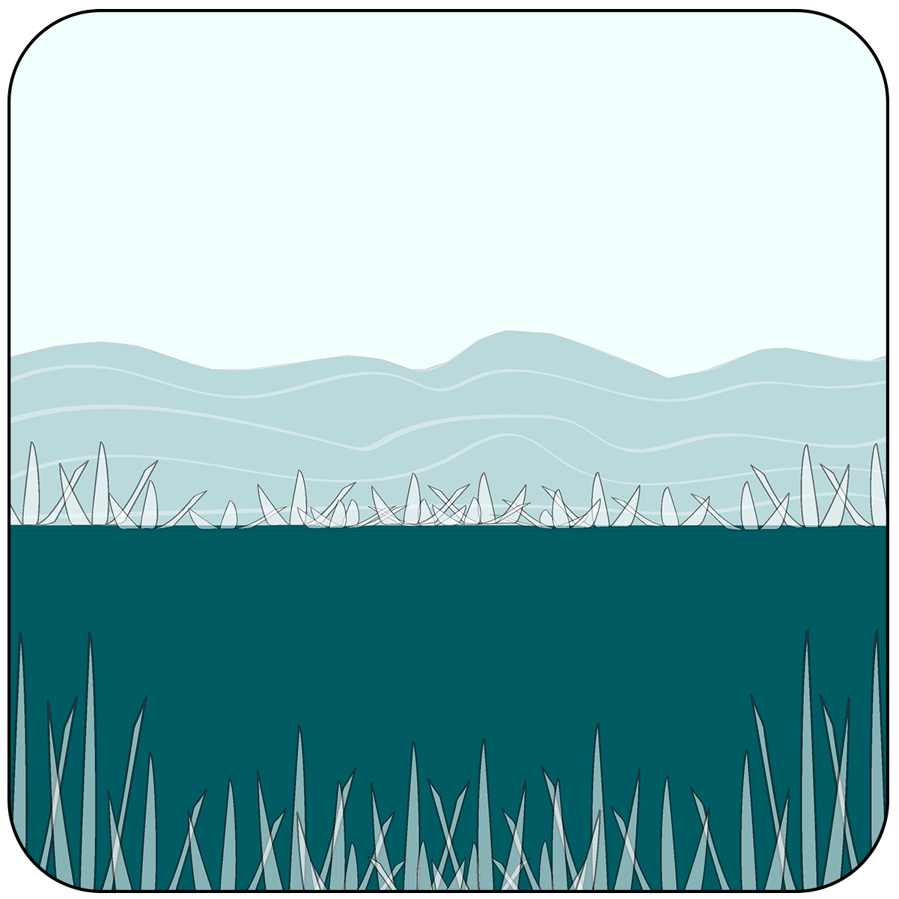
Lake or pond

Slide 19
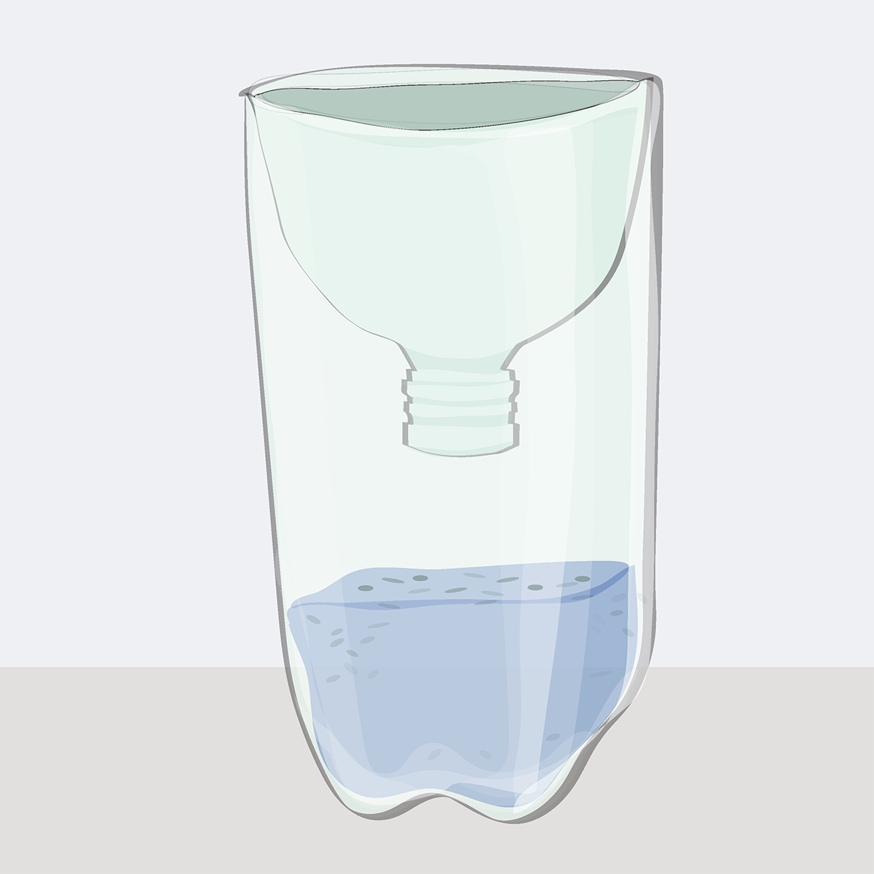
Mosquito trap

Slide 20
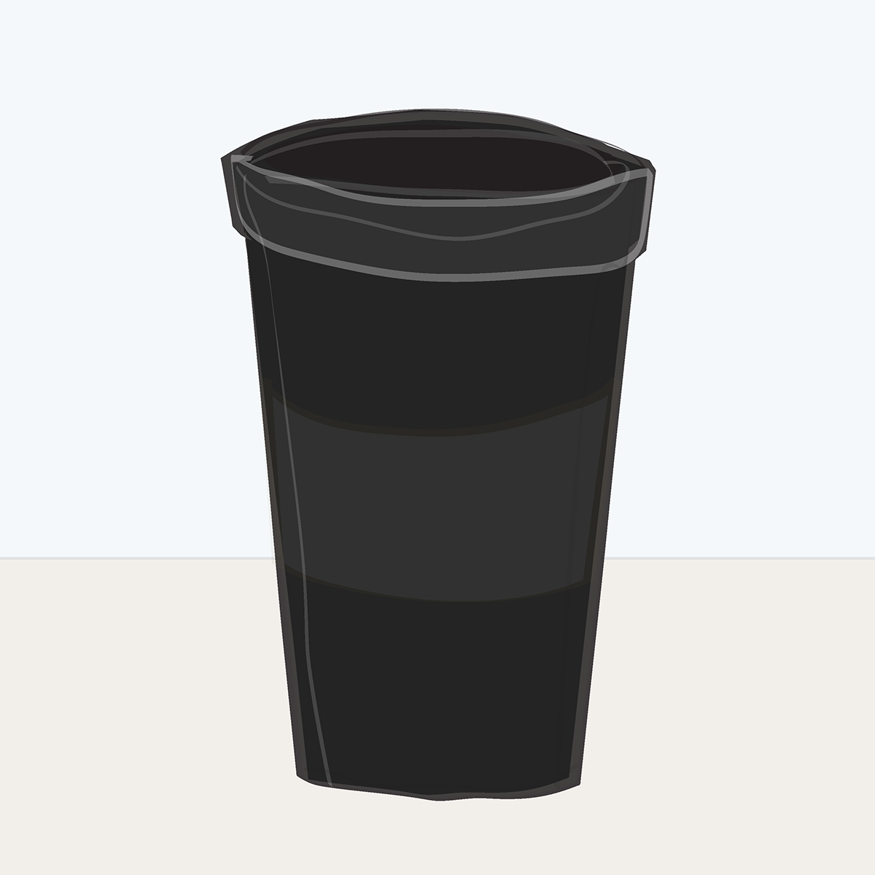
Ovitrap

Slide 21
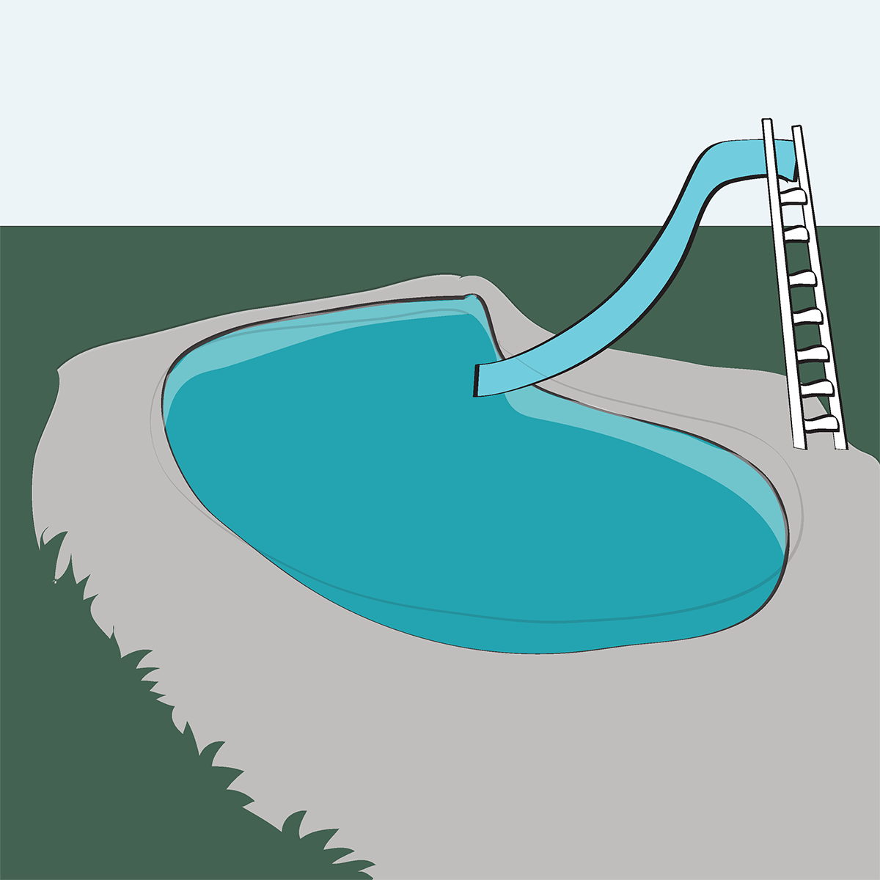
Pool

Slide 22
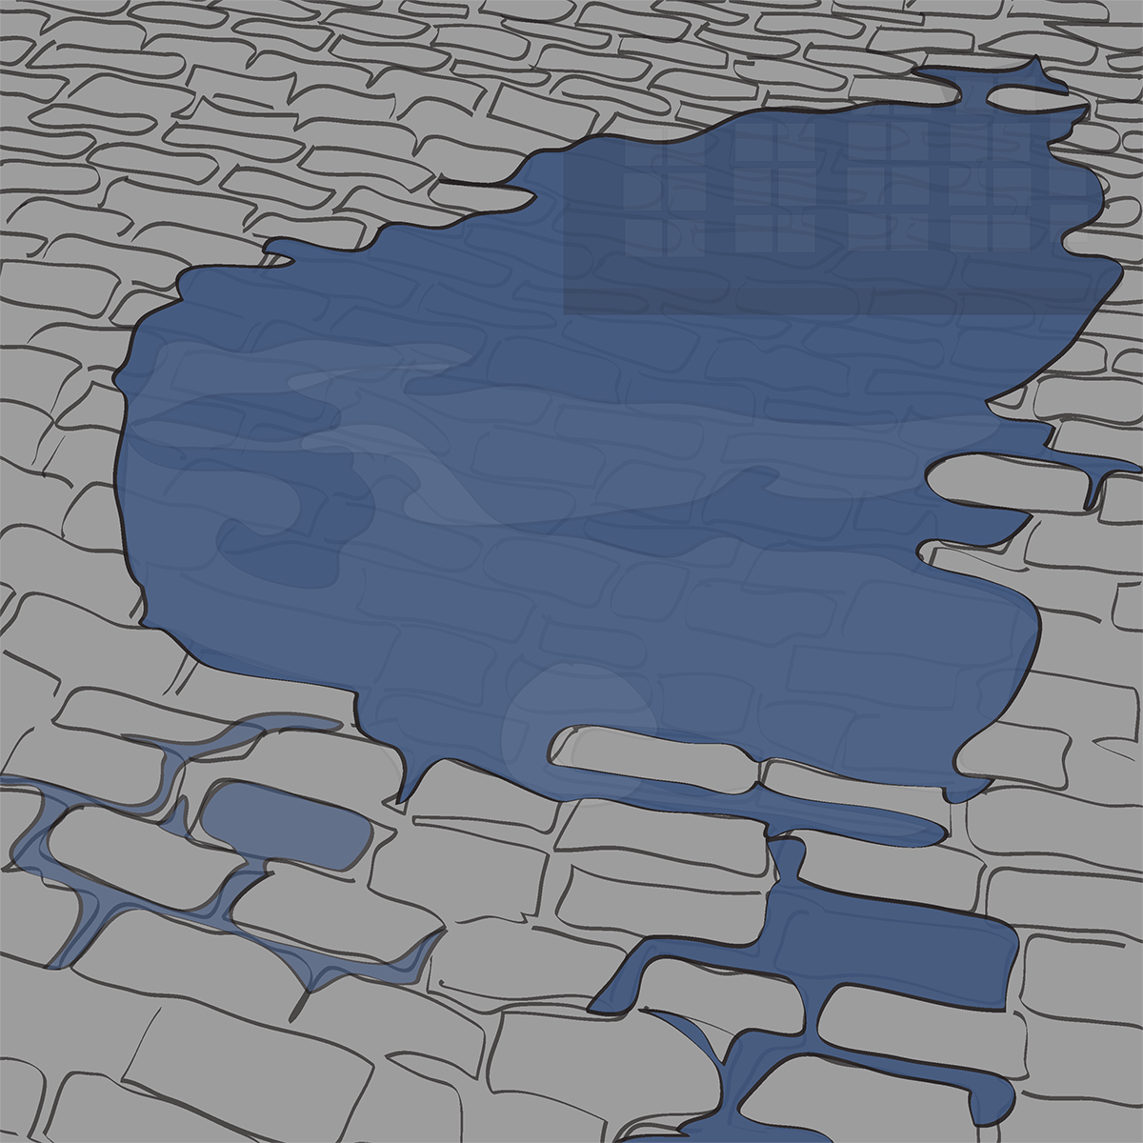
Puddle

Slide 23
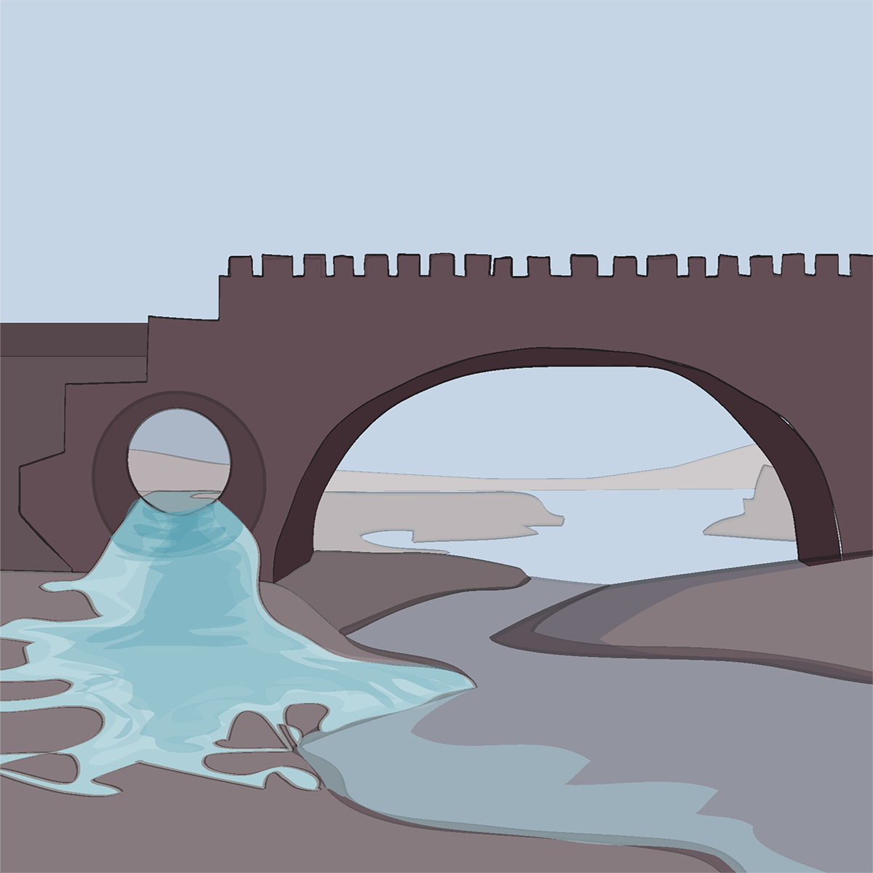
Public works
(bridges, culverts, and other structures)

Slide 24
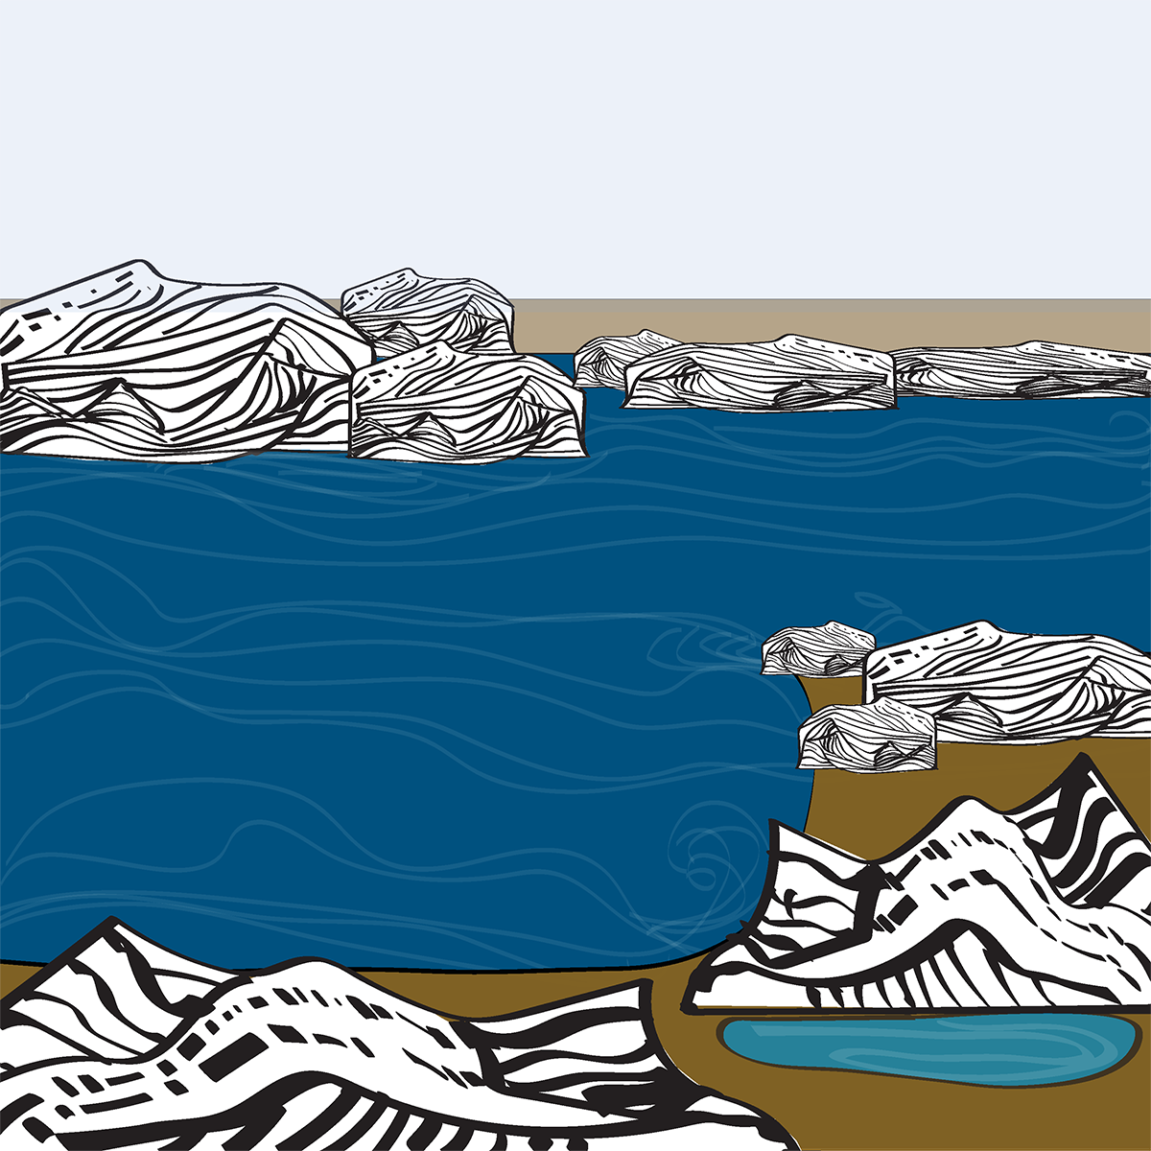
River or stream edge (pooled water)

Slide 25
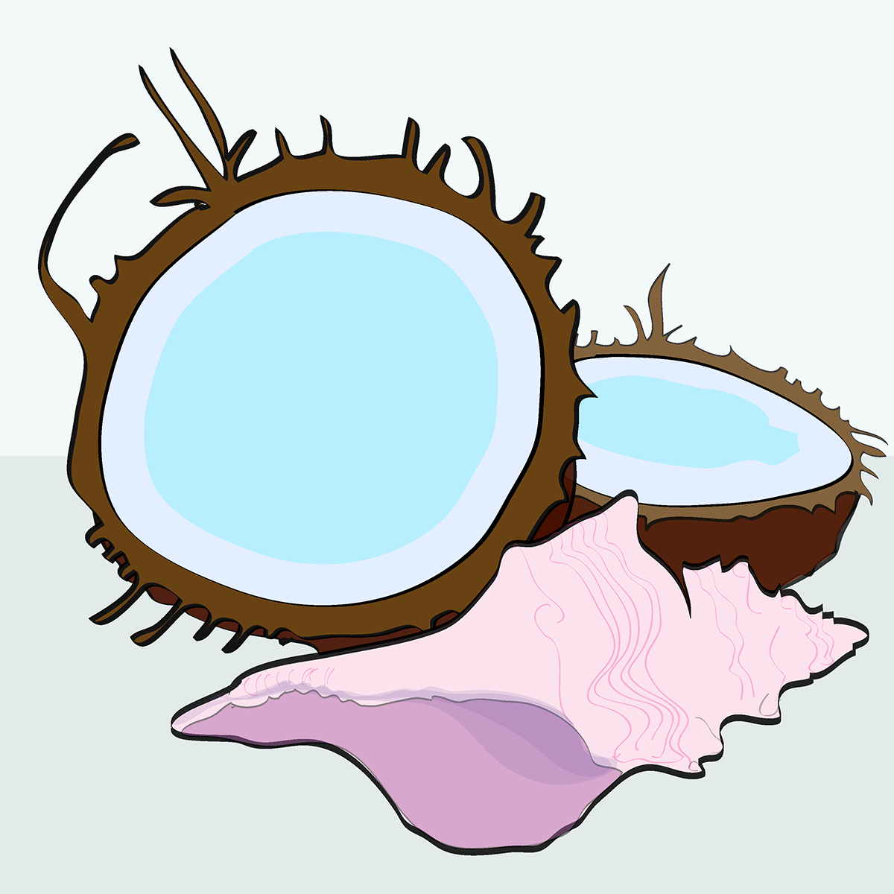
Shells
(animal or plant)

Slide 26
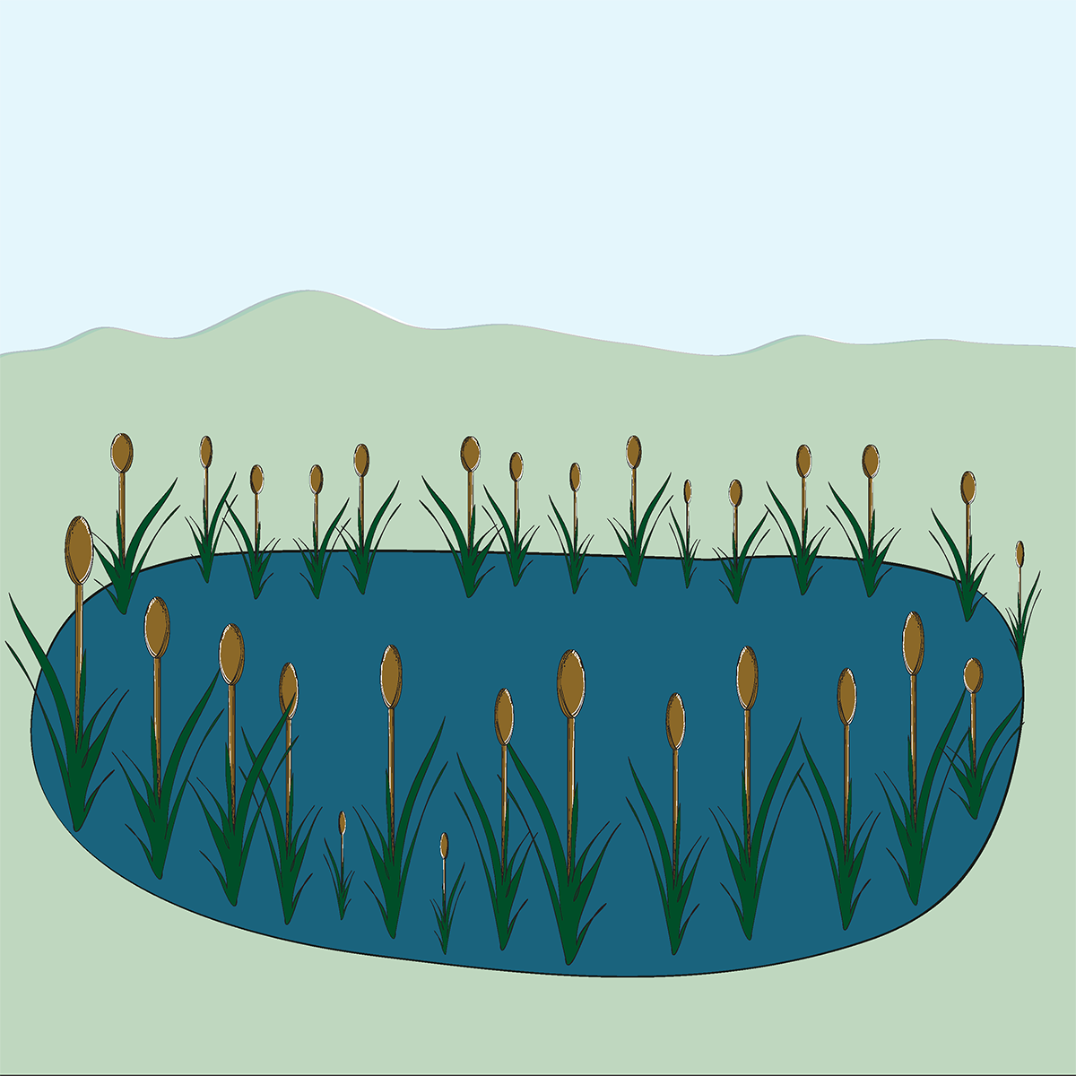
Swamp

Slide 27
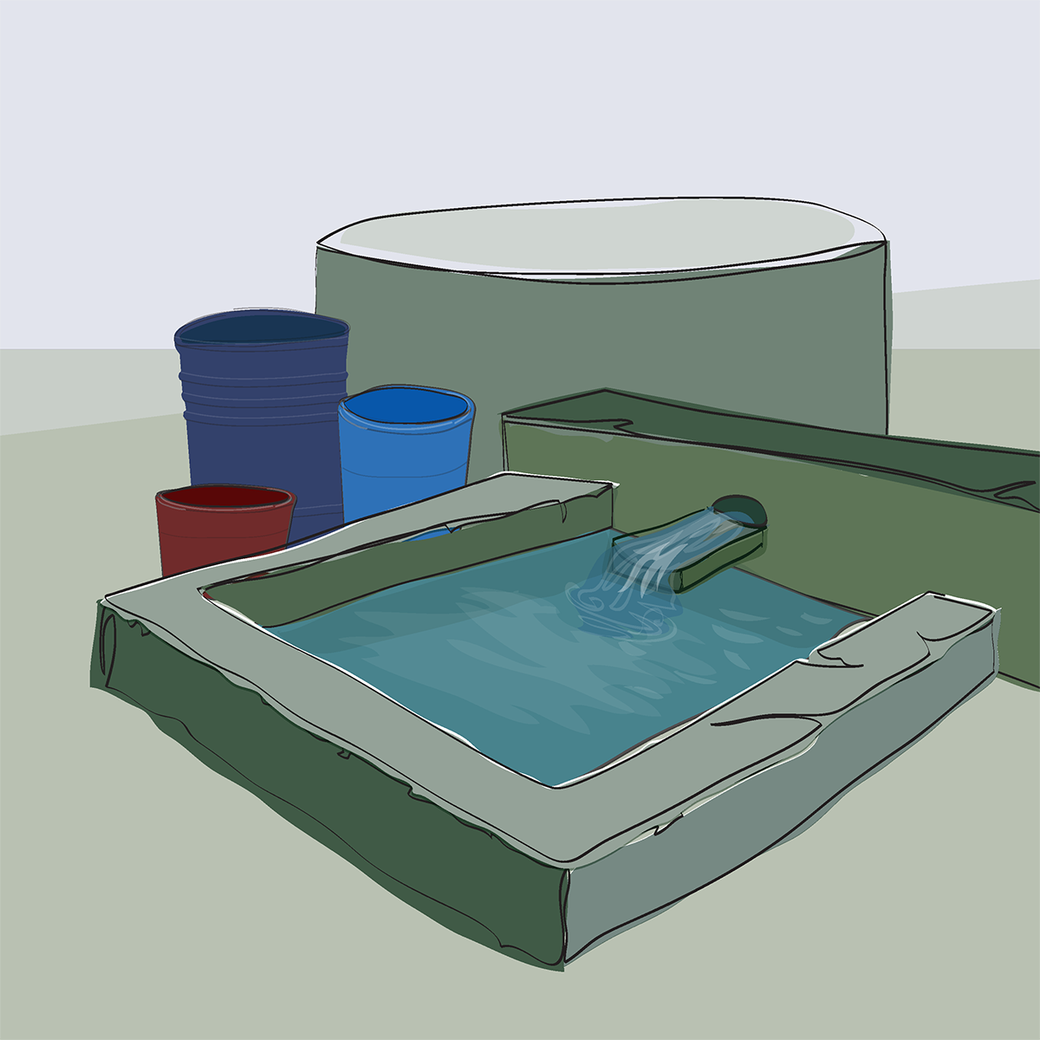
Tank
(water storage)

Slide 28
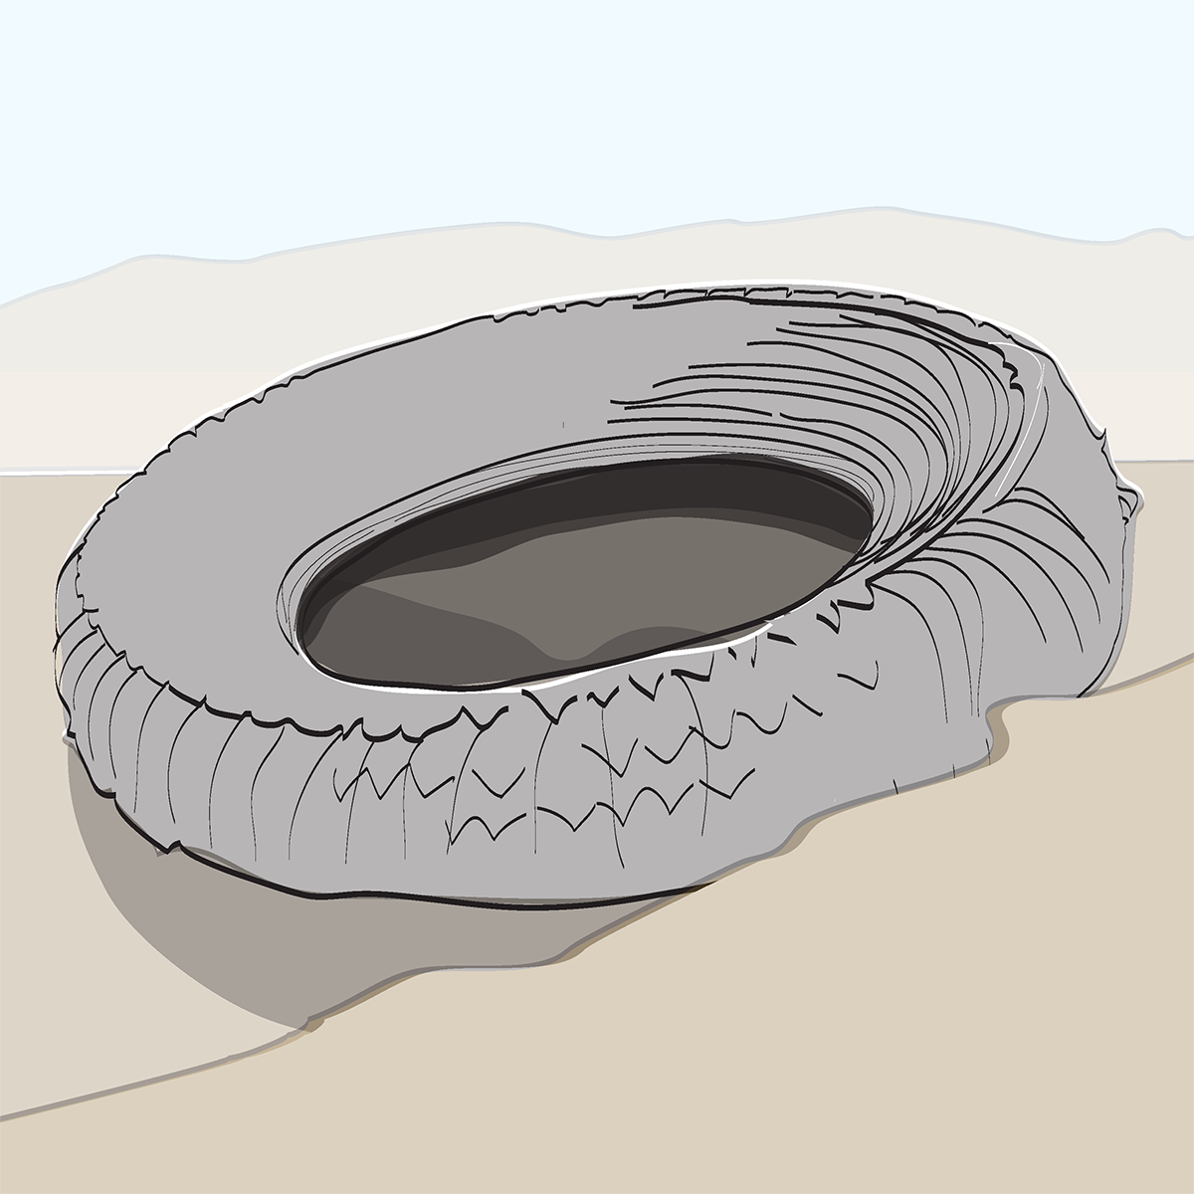
Tire

Slide 29
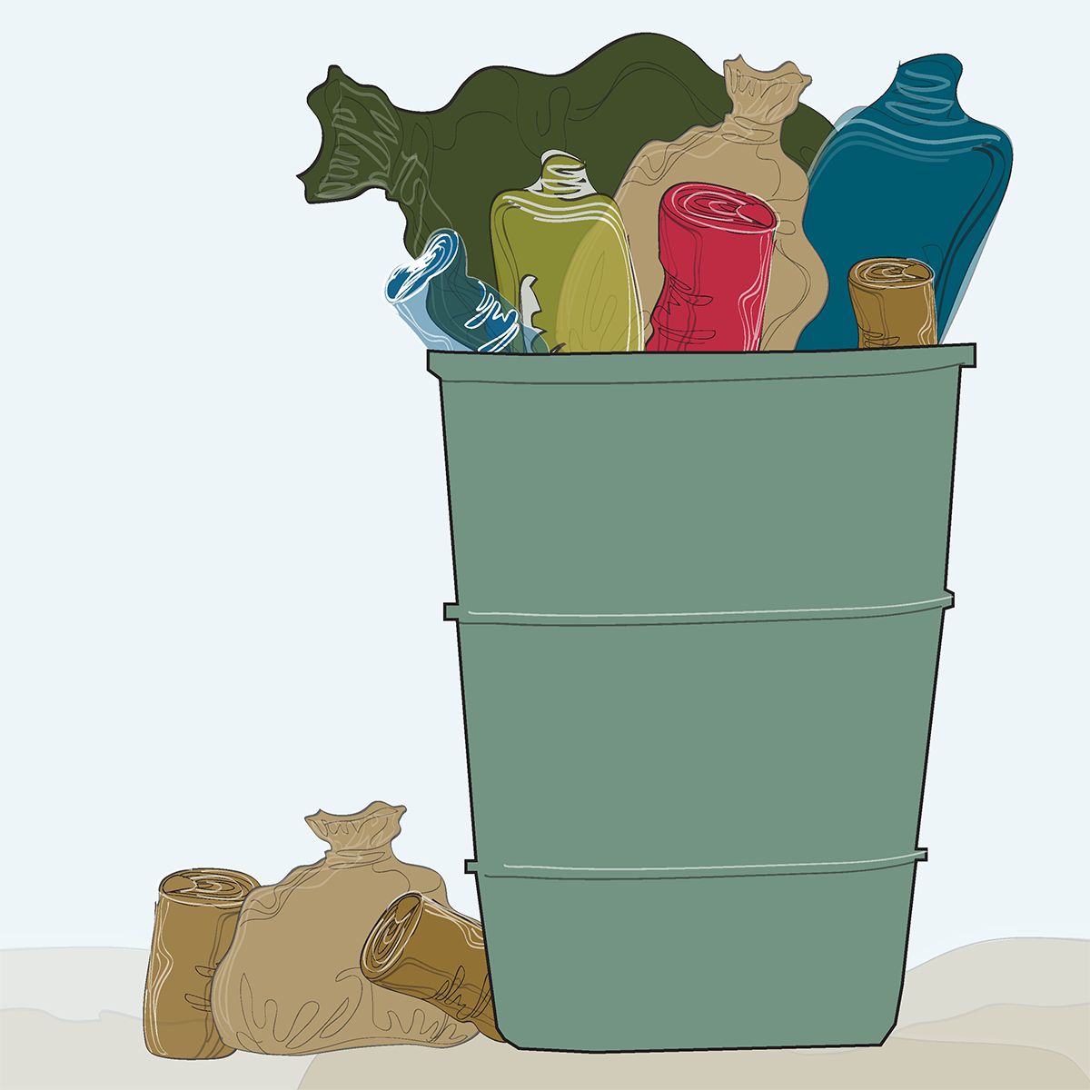
Trash container

Slide 30
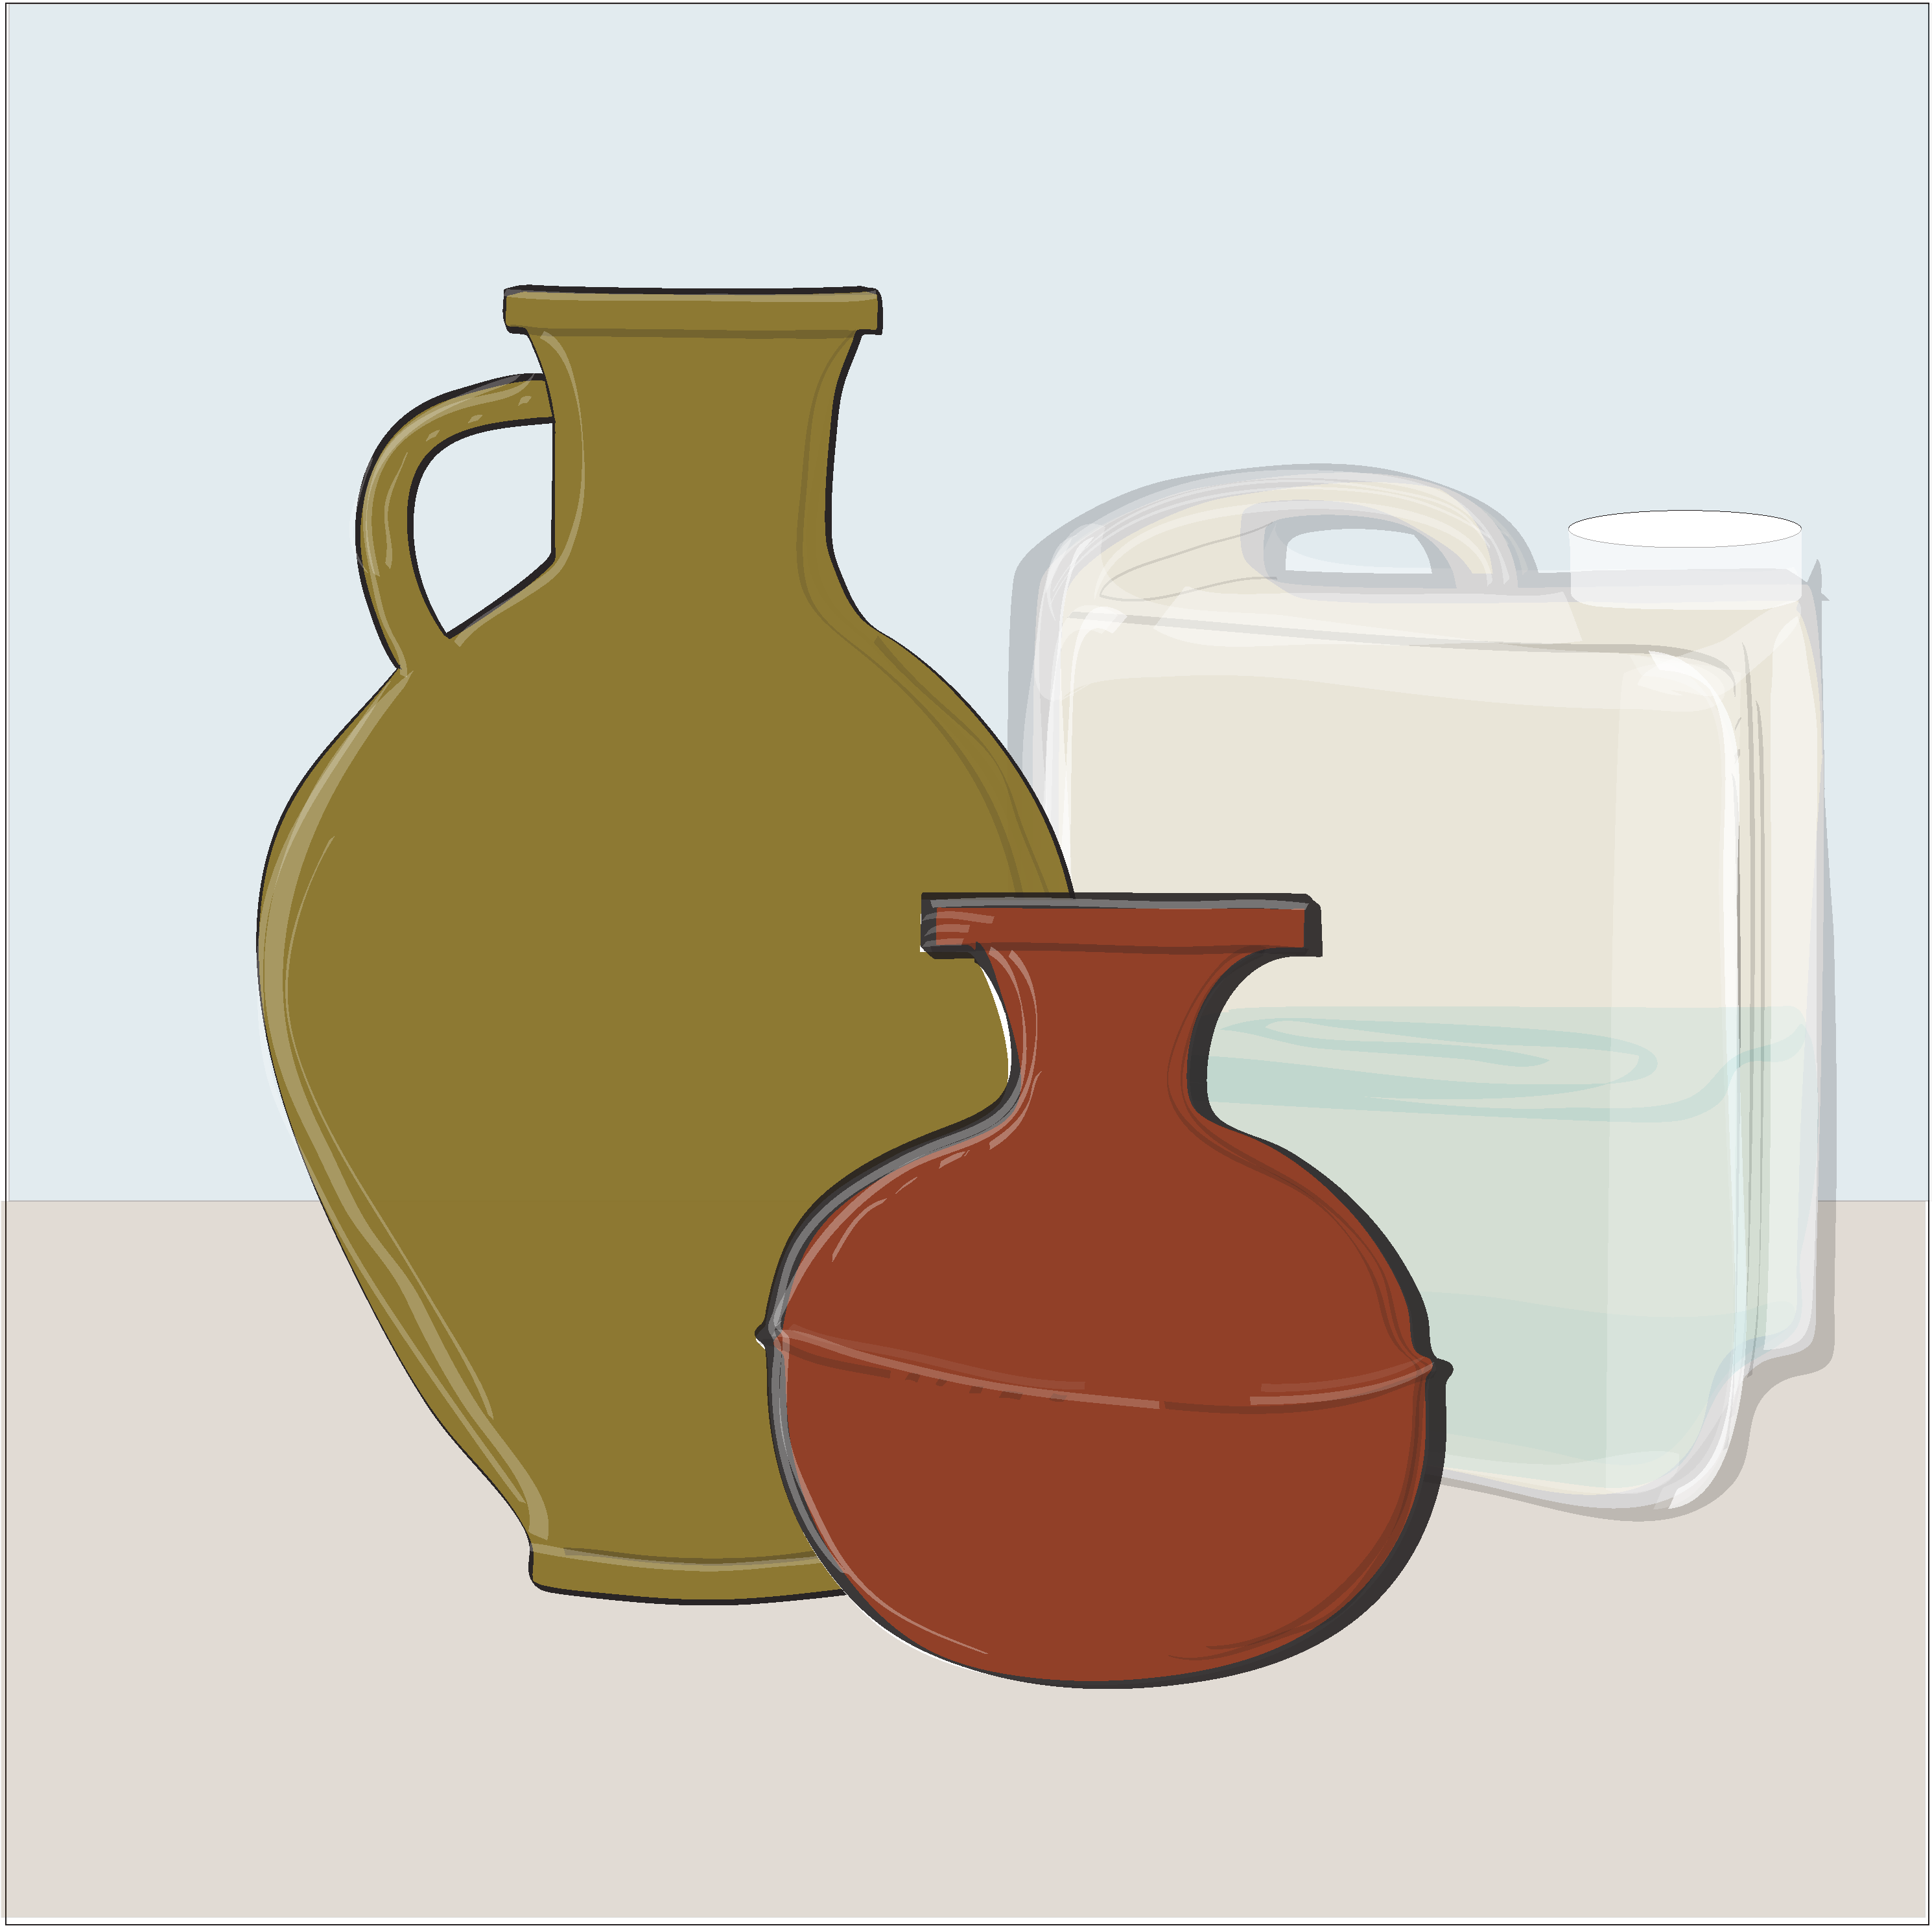
Water storage
jars

Slide 31
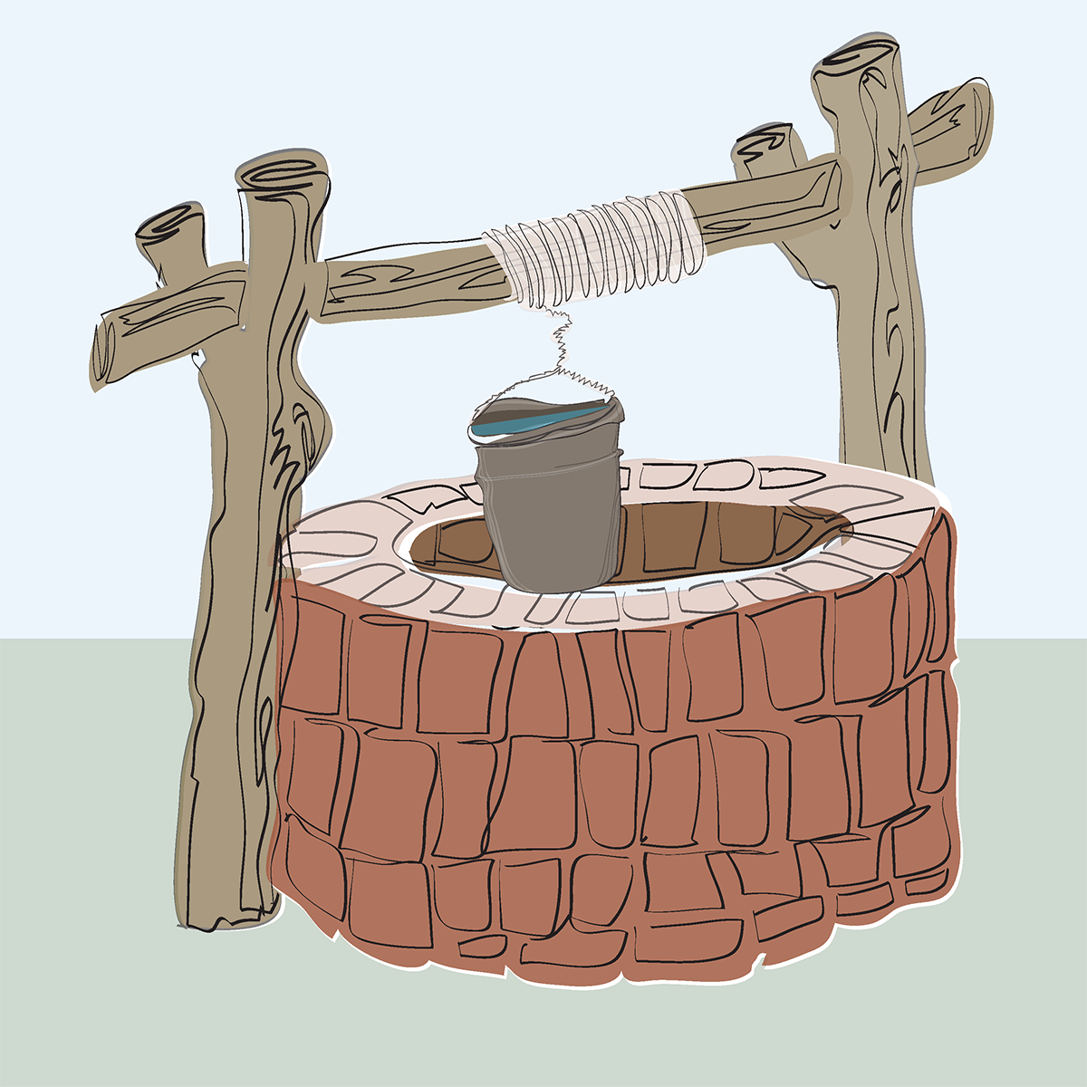
Well or cistern

Slide 32
Plant pot

