Slide 1
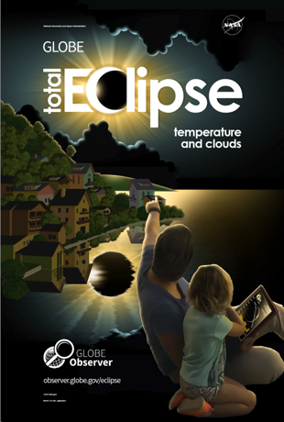

Introduction & Safety
GLOBE Eclipse:
Preparing for 2023 & 2024
GLOBE Eclipse poster, available in the Resource Library.
Last updated 15 September 2023

Slide 2
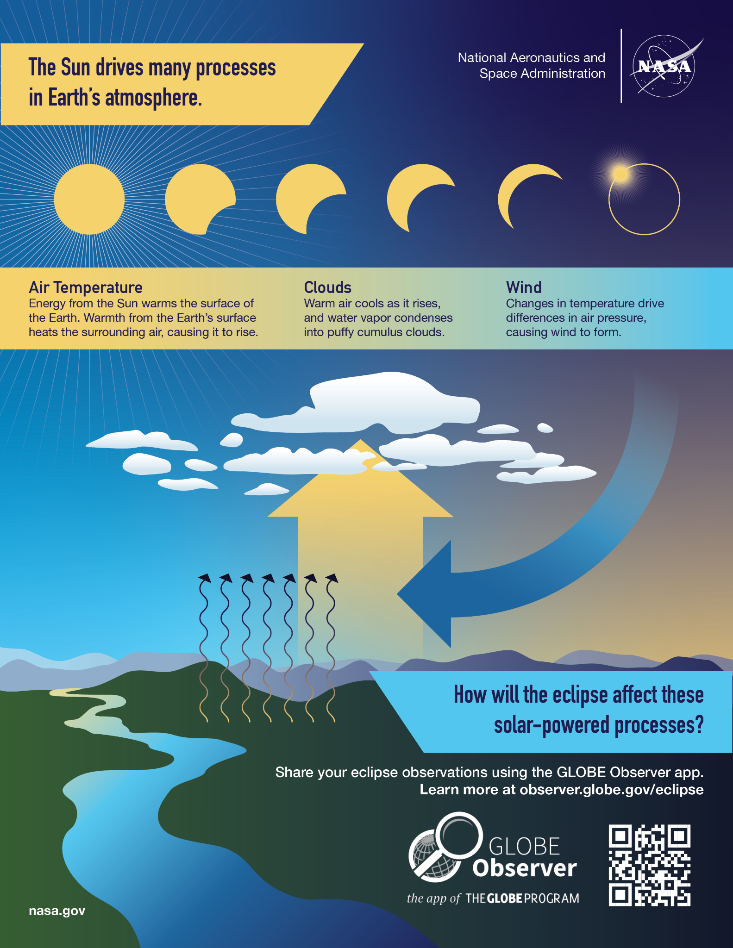
The Earth Science Angle: Study eclipses as a volunteer observer with GLOBE
Energy from the Sun warms our planet, and changes in sunlight can also cause changes in temperature, clouds, and wind. What happens when the Sun is blocked by the Moon during an eclipse? How will the eclipse affect these solar-powered processes?
Diagram from the front side of a one-page document outlining the changes that might be observed during a solar eclipse, which is available on the GLOBE Observer Eclipse website.

Slide 3
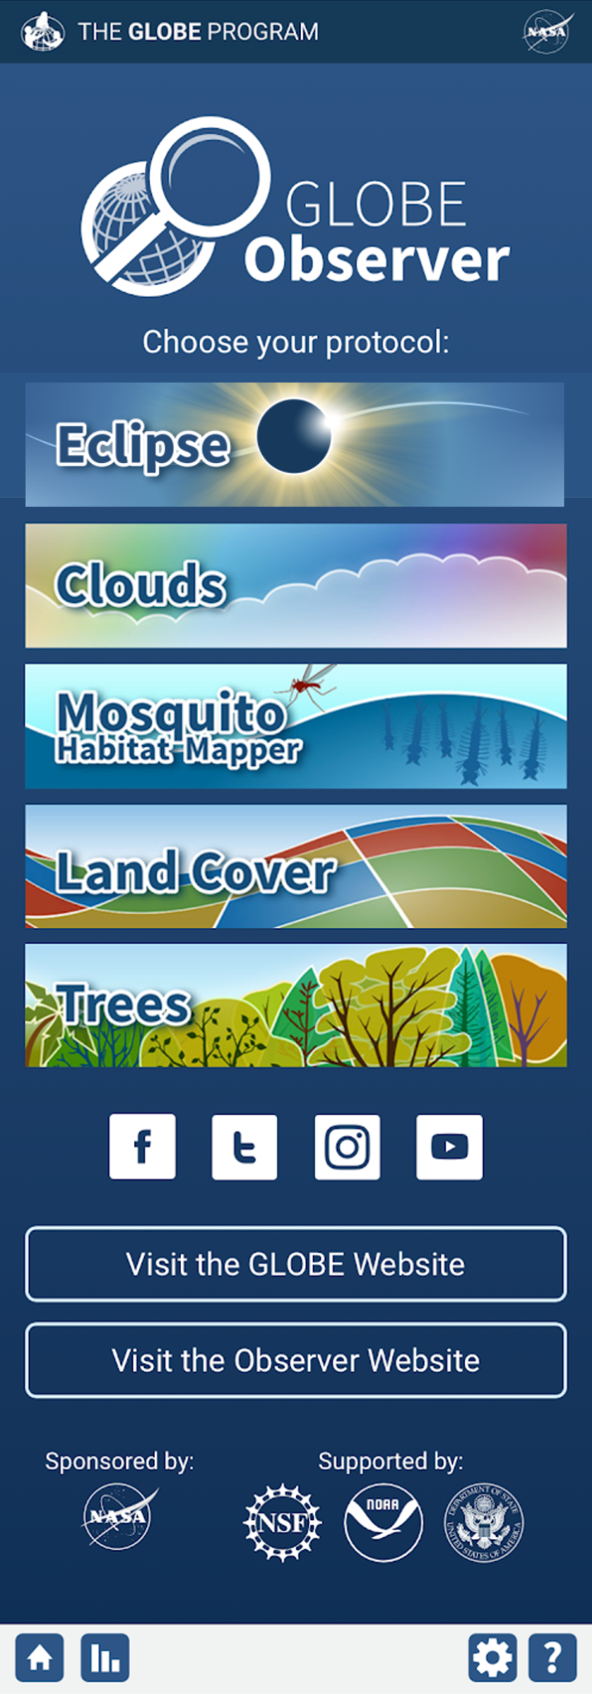
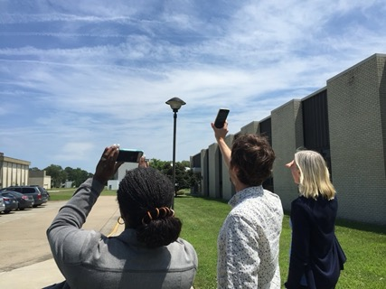
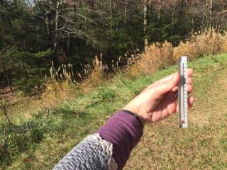
Using the GLOBE Eclipse tool, volunteer scientists are able to:
Observe how the eclipse changes atmospheric conditions near you by reporting on clouds and air temperature
Taking clouds observations using the Clouds tool is always available in the GLOBE Observer app, and is incorporated into the observation prompts for the Eclipse tool. Credit: GLOBE Clouds Team, NASA LaRC
Above: A simple thermometer that can be used to take air temperature measurements. Credit: GLOBE Right: An example of what the home screen of the GLOBE Observer app will look like when the Eclipse tool is available. Credits: GLOBE

Slide 4
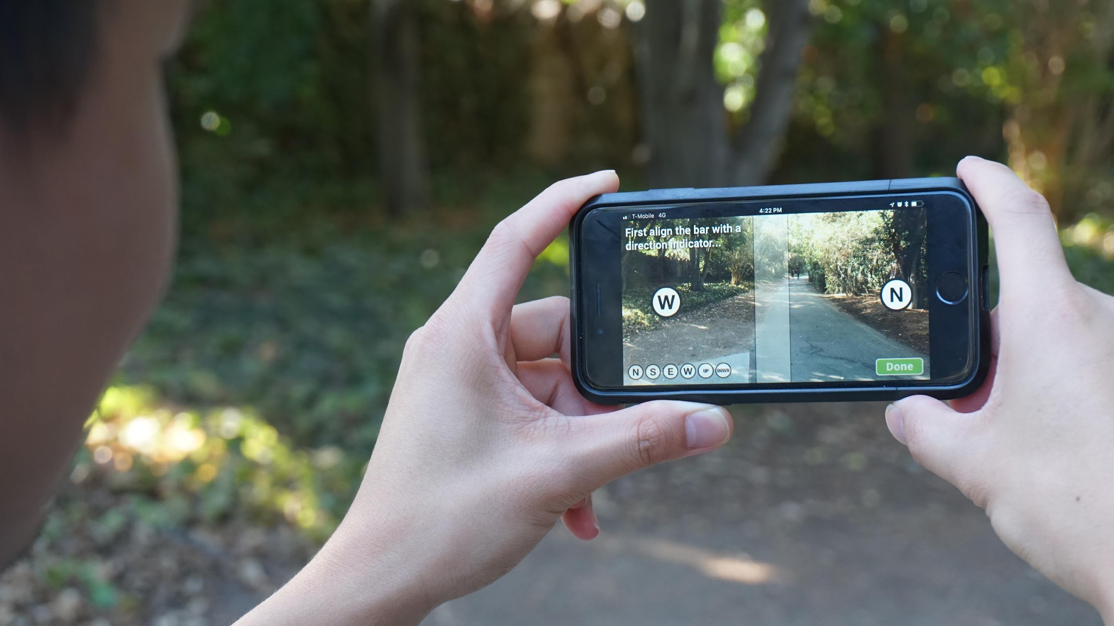
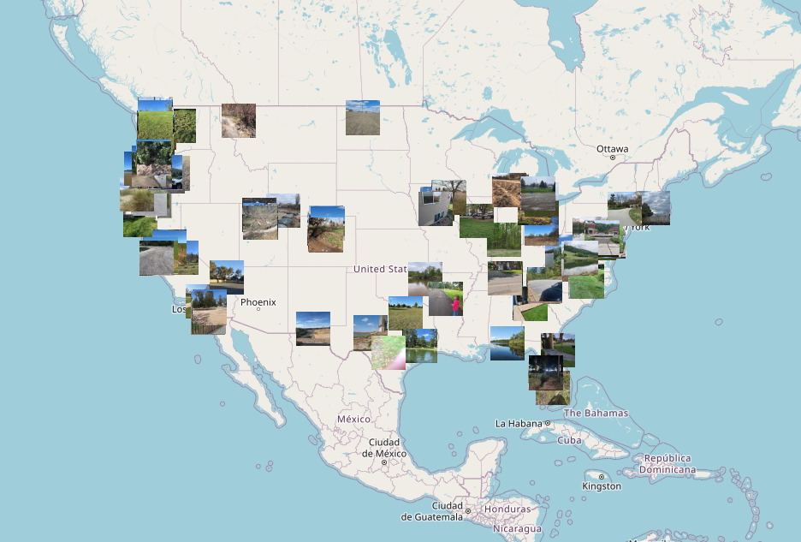
Report surface conditions (photograph and describe the landscape) that may have an impact on differences in the atmospheric effects in varying locations
A participant using the GLOBE Observer app Land Cover tool to take photos of the surrounding landscape. Credit: GLOBE
A screenshot from the GLOBE Visualization System, https://vis.globe.gov, showing images of land cover taken around the United States. Credit: GLOBE
Notes:
Left: Right

Slide 5
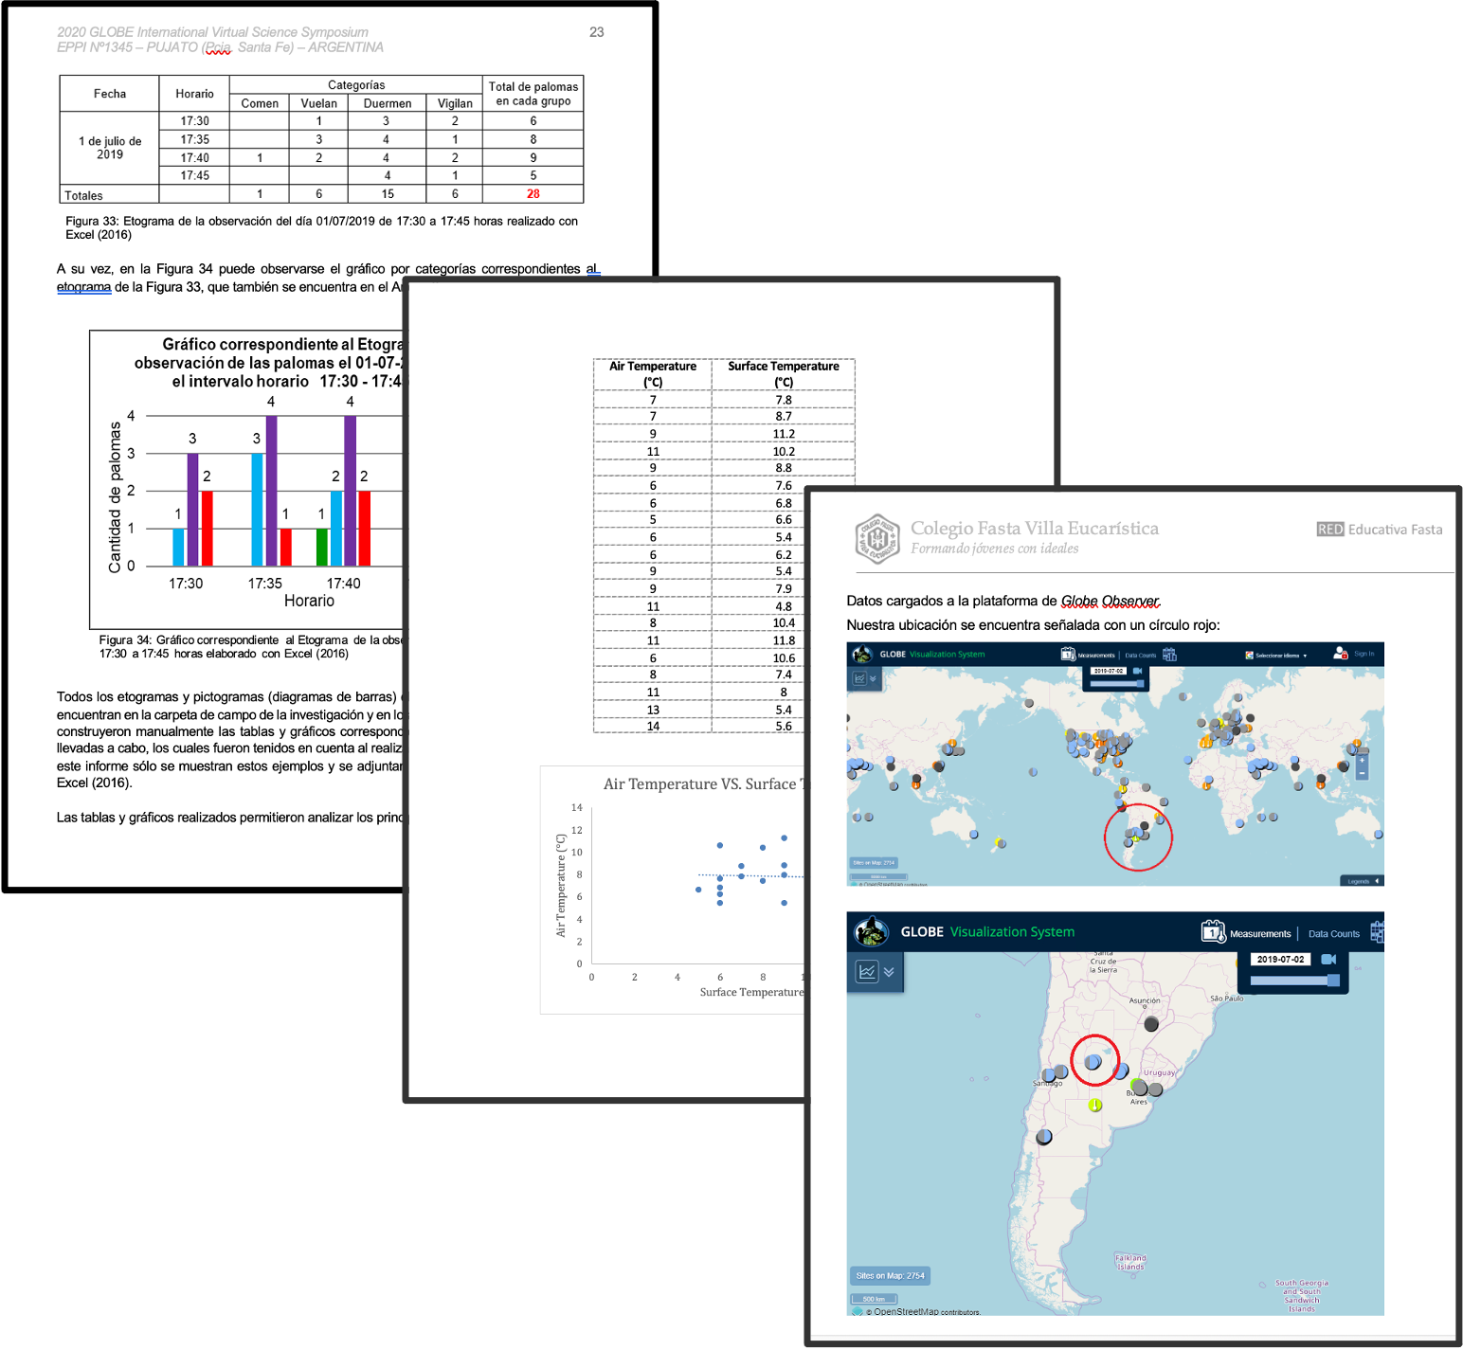
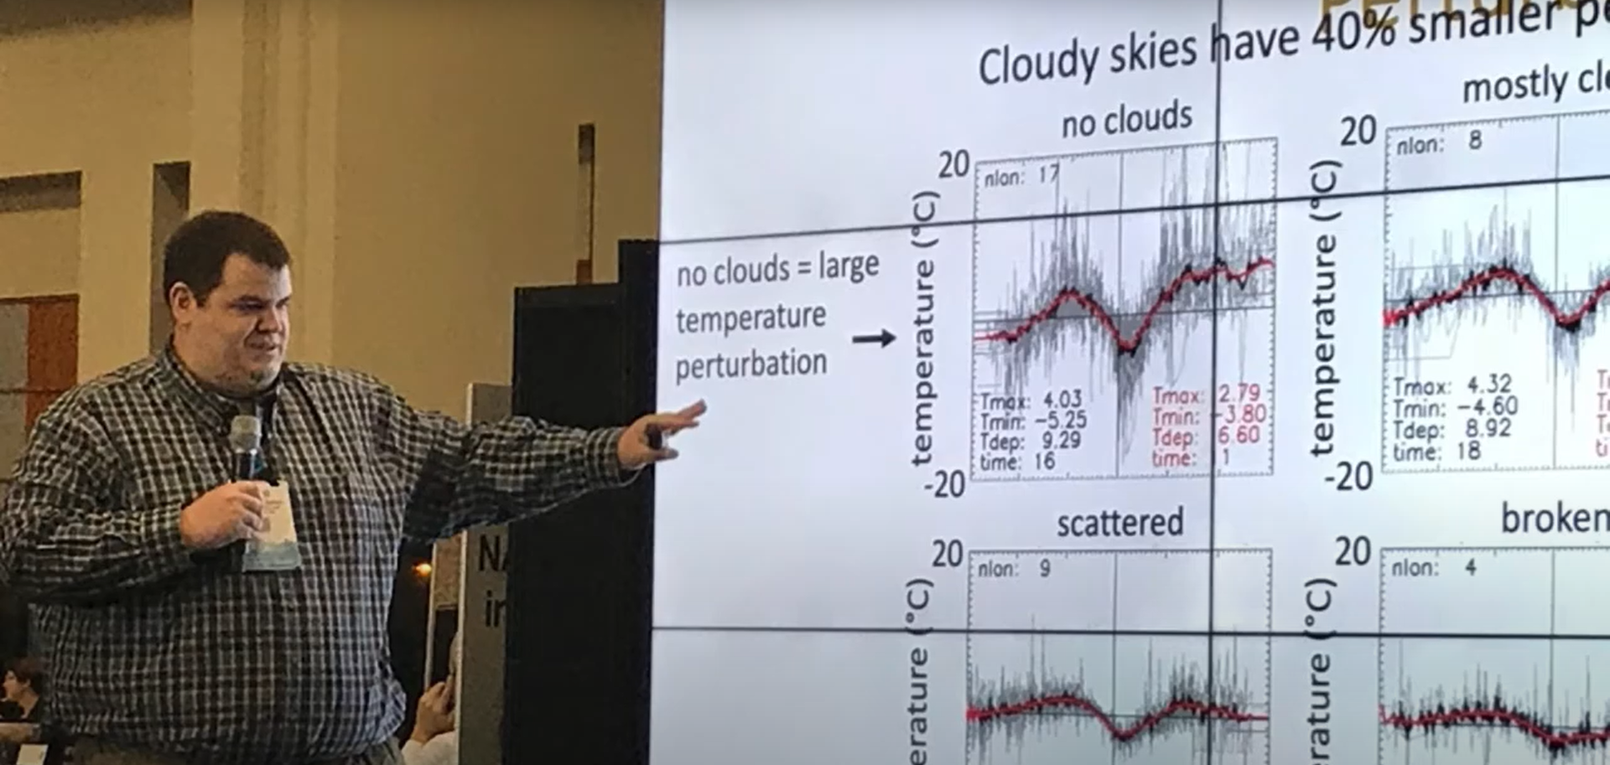
Contribute to a citizen science database used by scientists and students to study the effects of eclipses on the atmosphere
Left: Dr. Brant Dodson (NASA Langley Research Center) presents his paper comparing the citizen science temperature data at different reported levels of cloud cover, doi.org/10.1175/JAMC-D-18-0297.1
Right: Pages from several of the research reports submitted by students to the GLOBE International Virtual Science Symposia after the 2017, 2019 and 2020 eclipses, observer.globe.gov/eclipses#studentresearch

Slide 6
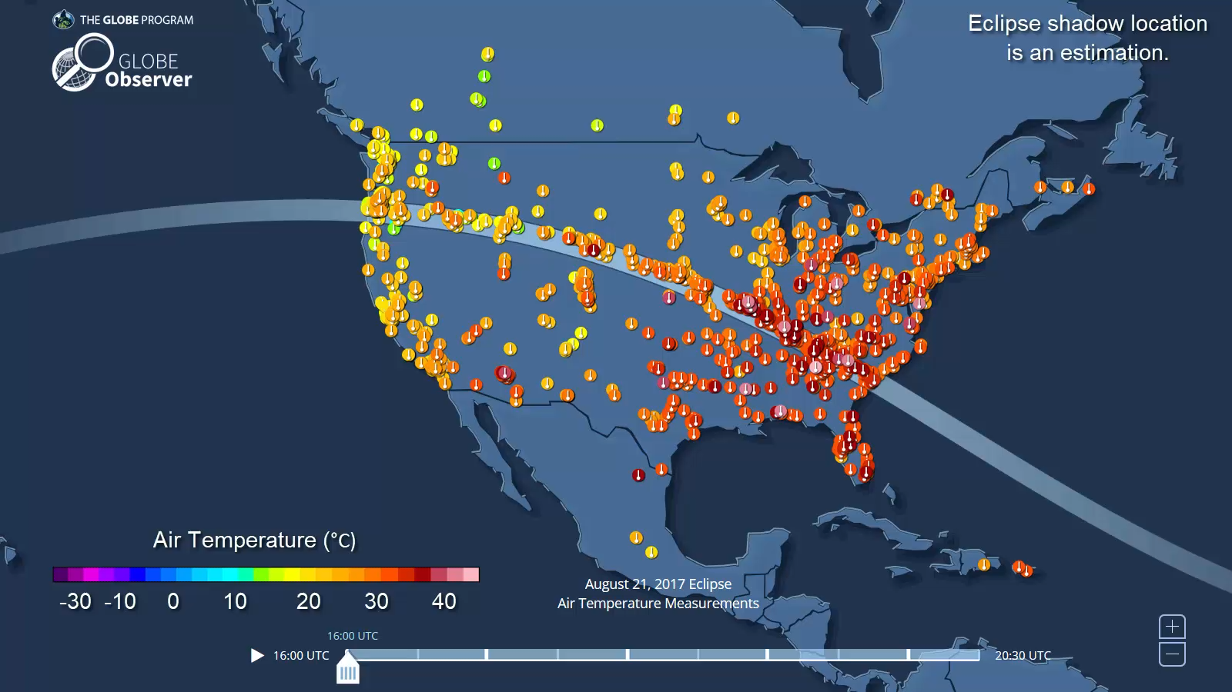
Provide comparison data even if not on the path of maximum eclipse
Notes:
Air temperature data collected by GLOBE participants during the total solar eclipse on 21 August 2017. https://youtu.be/yiNF1PEV5f8

Slide 7
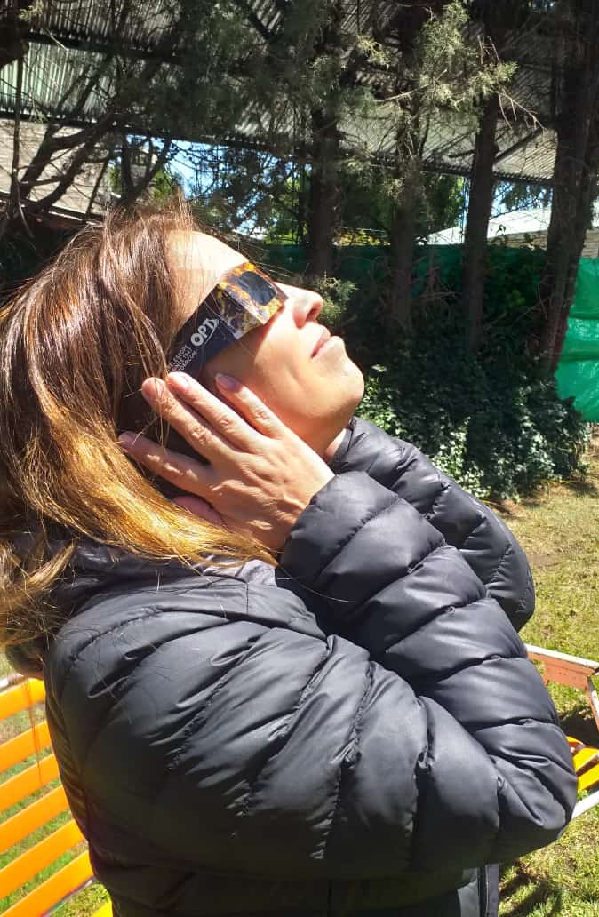
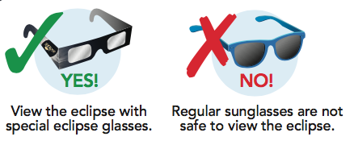
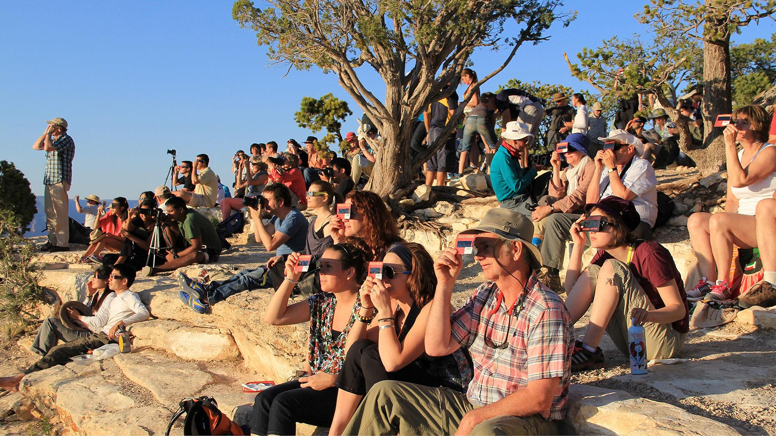
Eye Safety During an Annular Eclipse
The Sun is never completely blocked by the Moon during an annular solar eclipse. Therefore, during an annular eclipse, it is never safe to look directly at the Sun without specialized eye protection designed for solar viewing.
View the eclipse with special solar viewing glasses
A solar eclipse watcher in Argentina in December 2020. Credit: Marta Kingsland
Regular sunglasses are not safe to view the eclipse
A crowd uses handheld solar viewers and solar eclipse glasses to safely view a solar eclipse. Credit: National Park Service

Slide 8
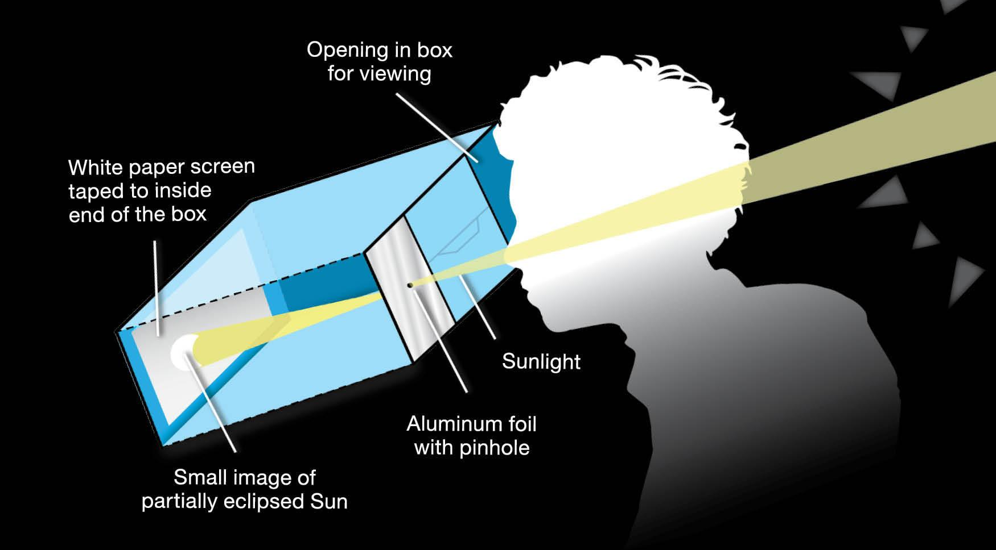
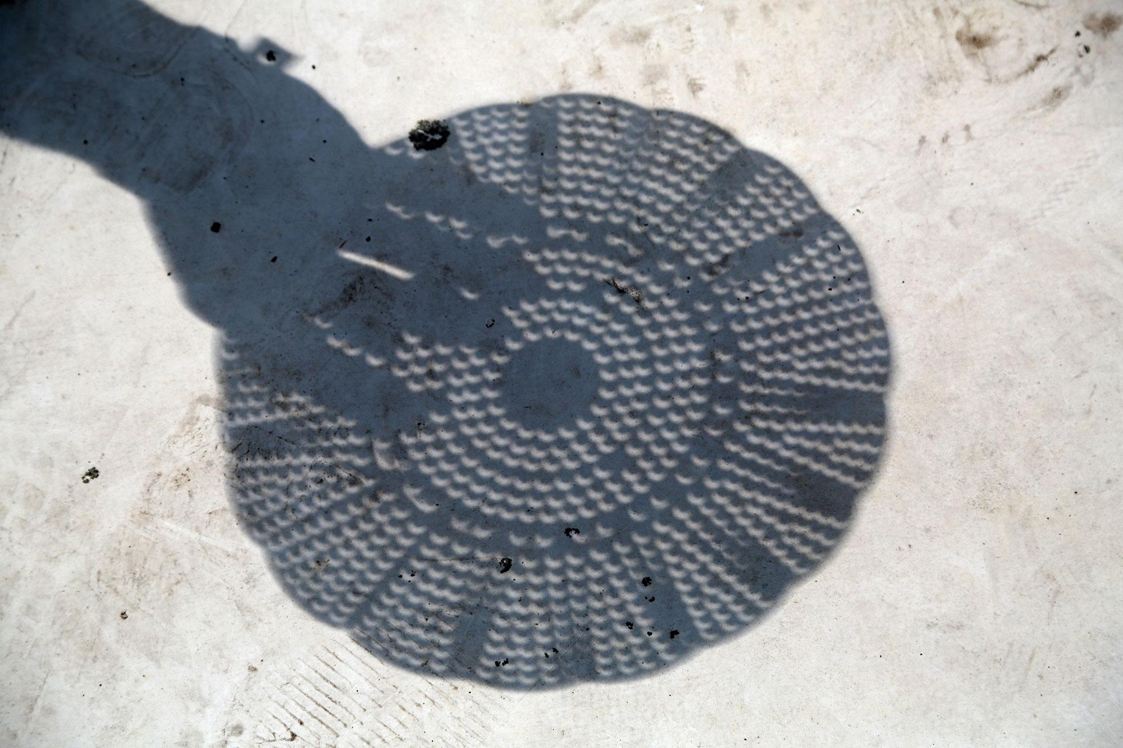
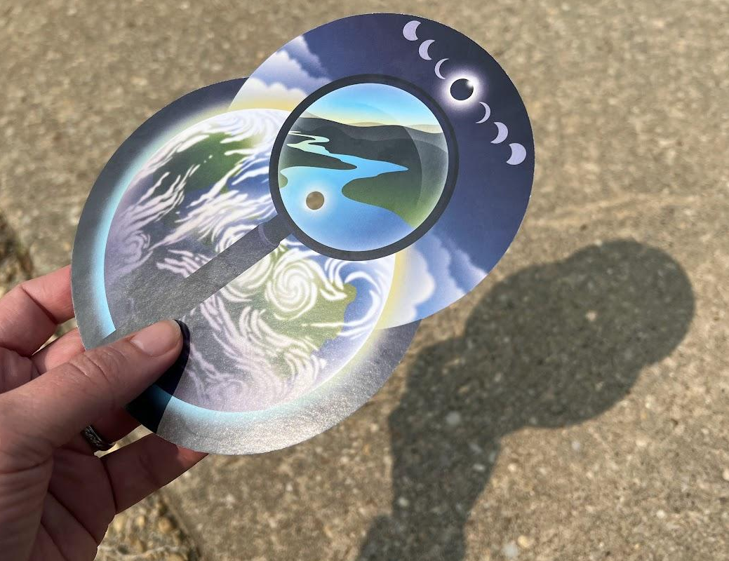
Indirect viewing methods
If you don’t have eclipse glasses or a handheld solar viewer, you can use an indirect viewing method, which does not involve looking directly at the Sun. For example, a pinhole projector or a colander or other object with circular holes. The GLOBE Eclipse cards also have a place where a hole can be punched to serve as an indirect viewer.
You can make your own eclipse projector using a cardboard box, a white sheet of paper, tape, scissors, and aluminum foil. Credit: NASA
Read more on NASA’s Eclipse Safety page.
Left: A GLOBE Eclipse card used to project the Sun onto the ground. Credit: GLOBE Above: The circular holes of a colander project crescent shapes onto the ground during the partial phases of a solar eclipse. Credit: Joy Ng

Slide 9
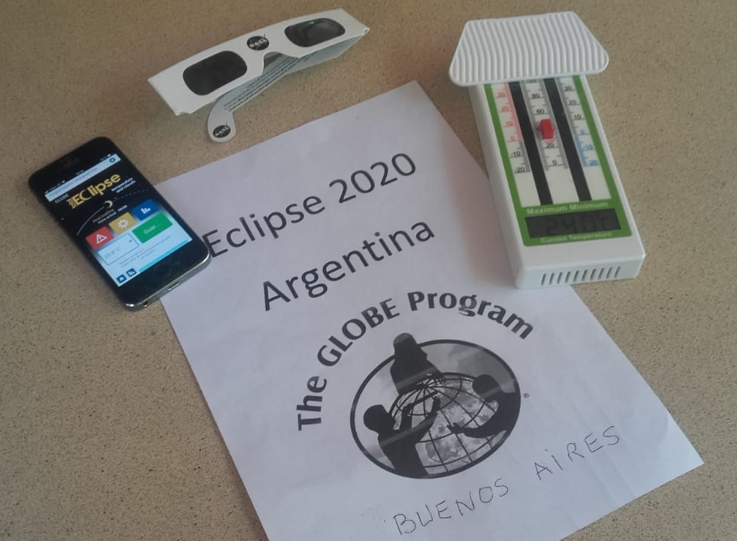

App Basics
GLOBE Eclipse:
Preparing for 2023 & 2024
Materials laid out and ready to observe the eclipse in December 2020: the Eclipse tool in the app, solar viewing glasses, and a thermometer. Credit: Marta Kingsland

Slide 10
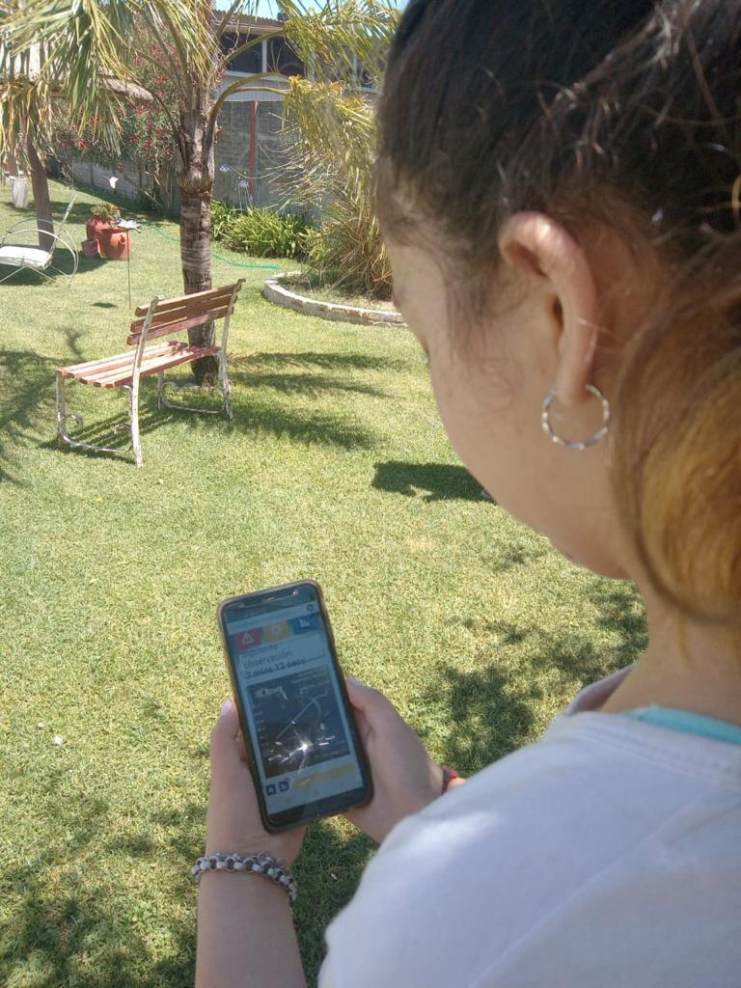
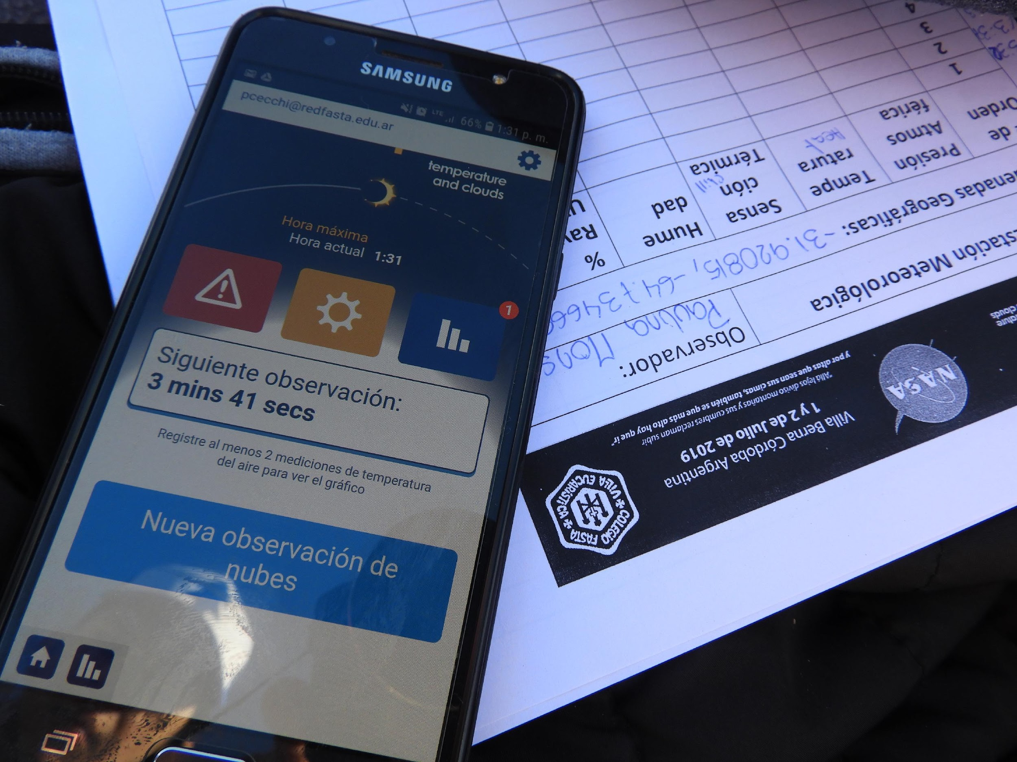
Using the GLOBE Eclipse tool
Observer using the GLOBE Eclipse tool during the total eclipse in Argentina on 14 Dec 2020. Credit: Marta Kingsland
The app screen showing the countdown to the next observation, as well as an (optional) paper data sheet. Credit: Pablo Cecchi

Slide 11
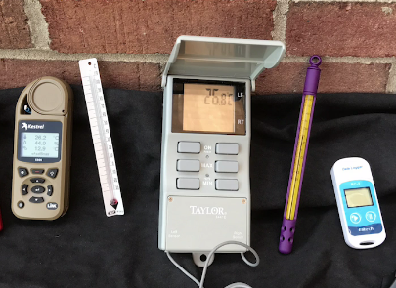
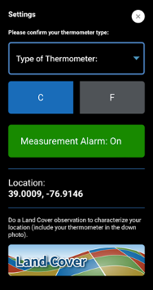
Using the App: Configuration
Set the type of thermometer to be used (liquid filled, digital, weather station, other)
Example thermometers. Credit: GLOBE NOTE: A weather app does not count as “other” - you should have a separate physical thermometer.
Choose Celsius or Fahrenheit to display the temperature in the app (all data is stored in Celsius in the GLOBE database)
Activate reminders for taking measurements
Current location (automatically set)
Take a Land Cover observation to tell us about the landscape where the observations are being collected

Slide 12
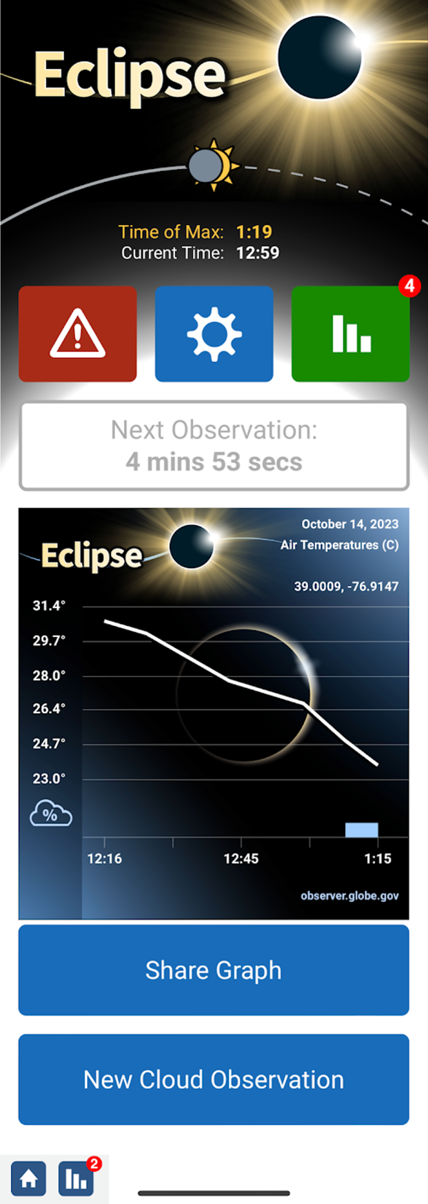
Using the App: Data Collection Screen
Top portion shows the time of maximum eclipse based on the current location
Buttons navigate to safety/intro pages, configuration/ settings (see previous slide), and a listing of the already collected data, respectively

Slide 13
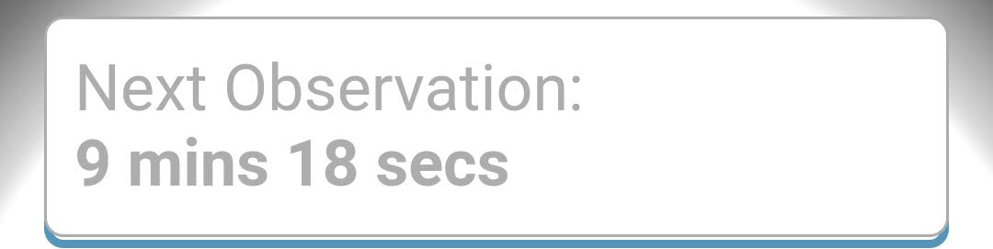
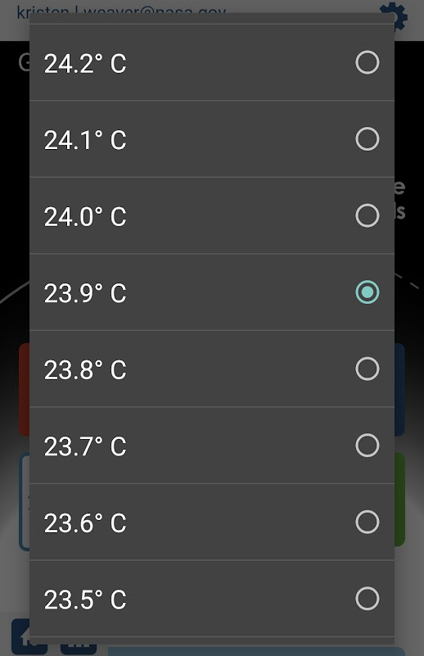
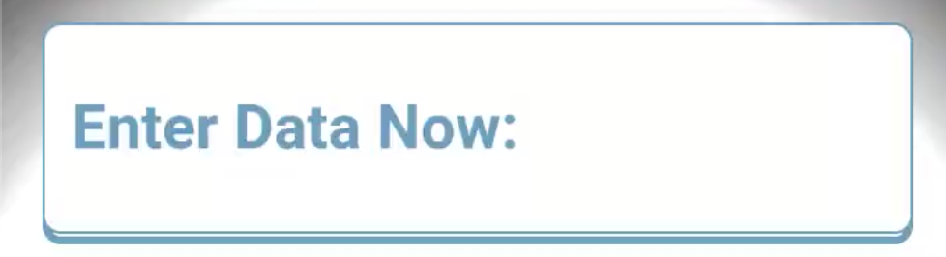
Using the App: Entering Temperature Data
Display shows a countdown to the time for the next observation, or “Enter Data Now” when it’s time to collect another air temperature measurement. Tapping “Enter Data Now” brings up a selection menu for temperature values (right).

Slide 14
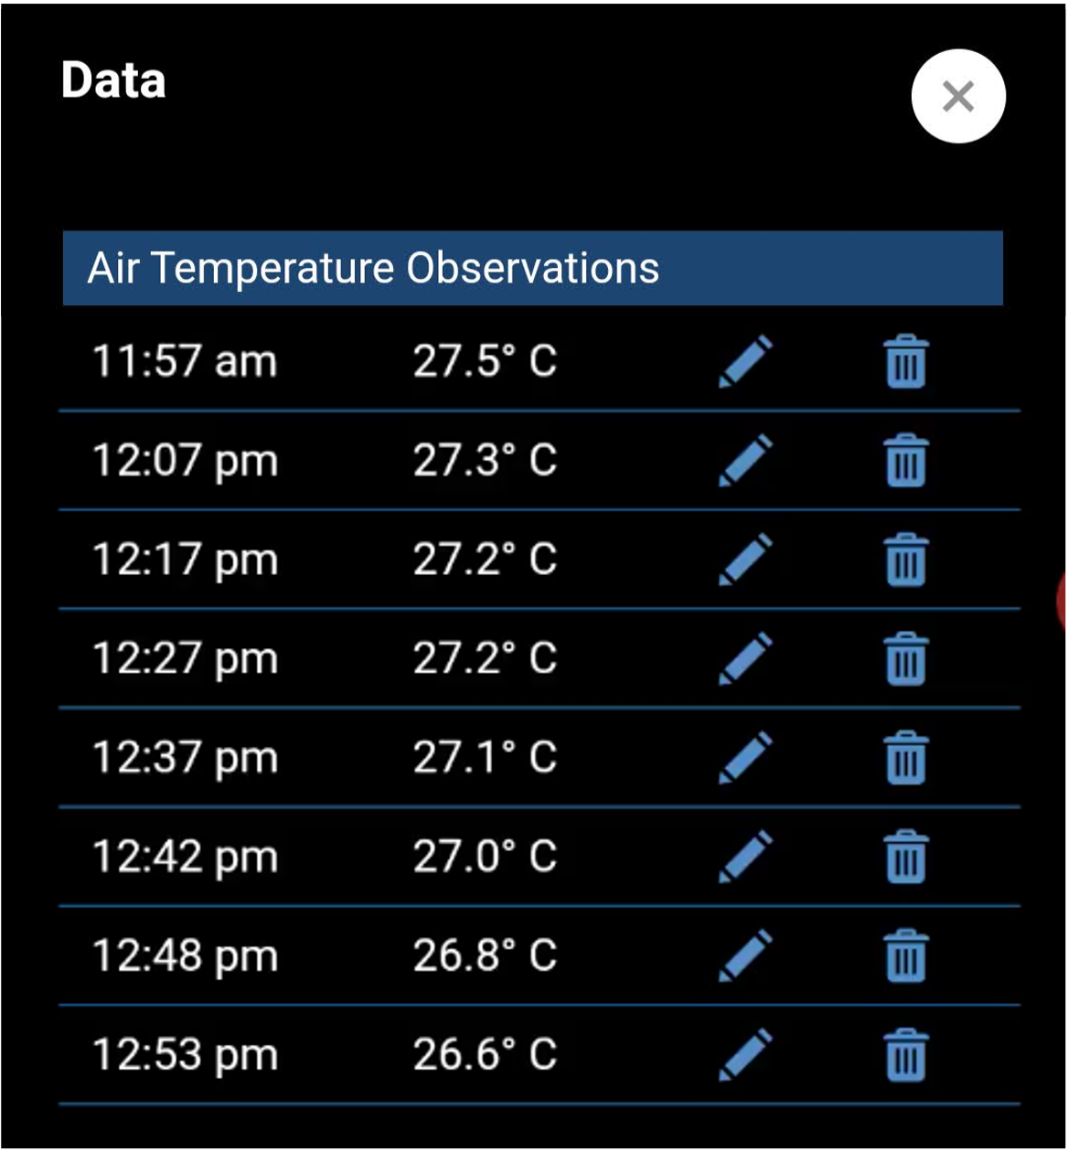
Using the App: Review/Edit Data
The graph icon goes to a listing of previously collected air temperature data, with options to edit or delete data points if needed.

Slide 15
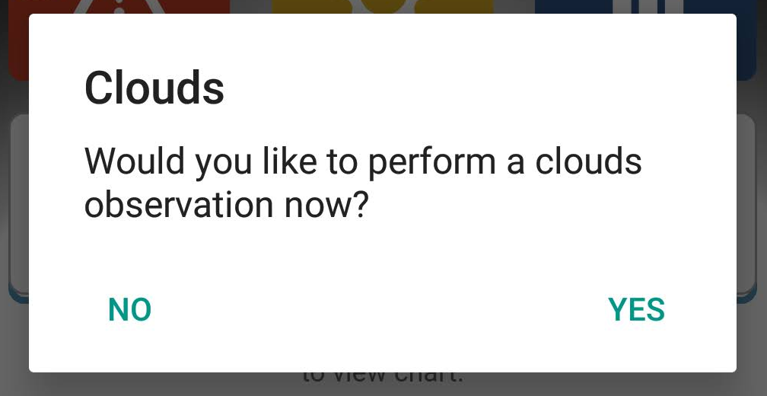
Using the App: Clouds Data
Periodically, the app will also pop up a reminder to take an observation of clouds, although users are also encouraged to take an observation at any time if they notice something changing in the cloud conditions (New Cloud Observation button).

Slide 16
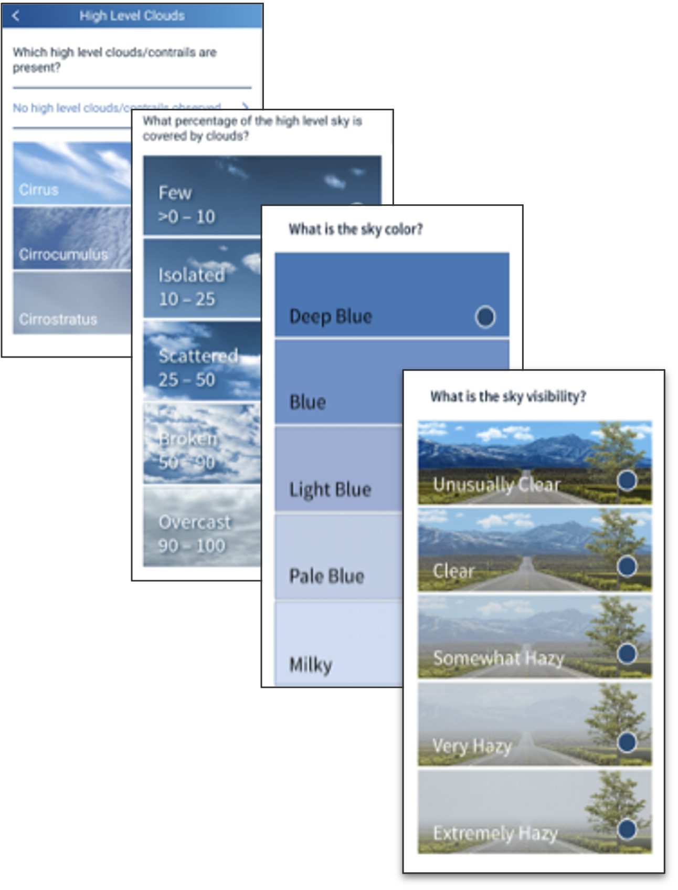
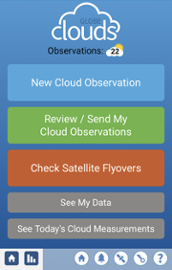
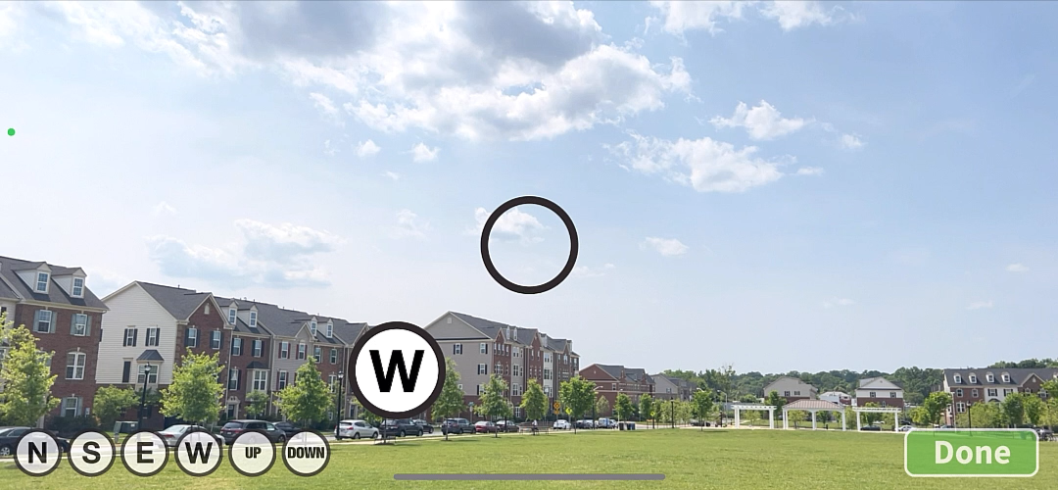
Taking a Clouds Observation
Steps to observe:
Overall cloud cover
Sky conditions
Cloud types, cloud cover, and opacity by height
Take photos

Slide 17
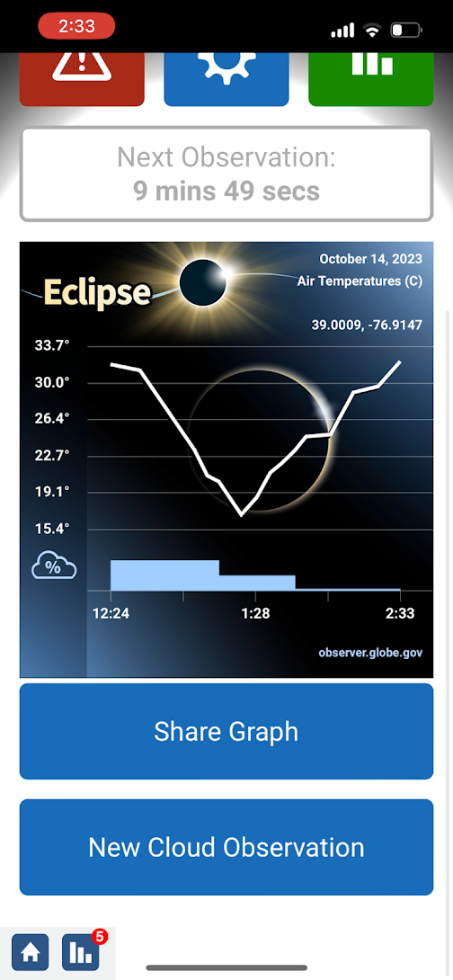
Using the App: Graphing the Data
The graph will update as new data points are added, both for air temperature and overall cloud coverage.
The ”Share Graph” button allows easy sharing to social media.

Slide 18
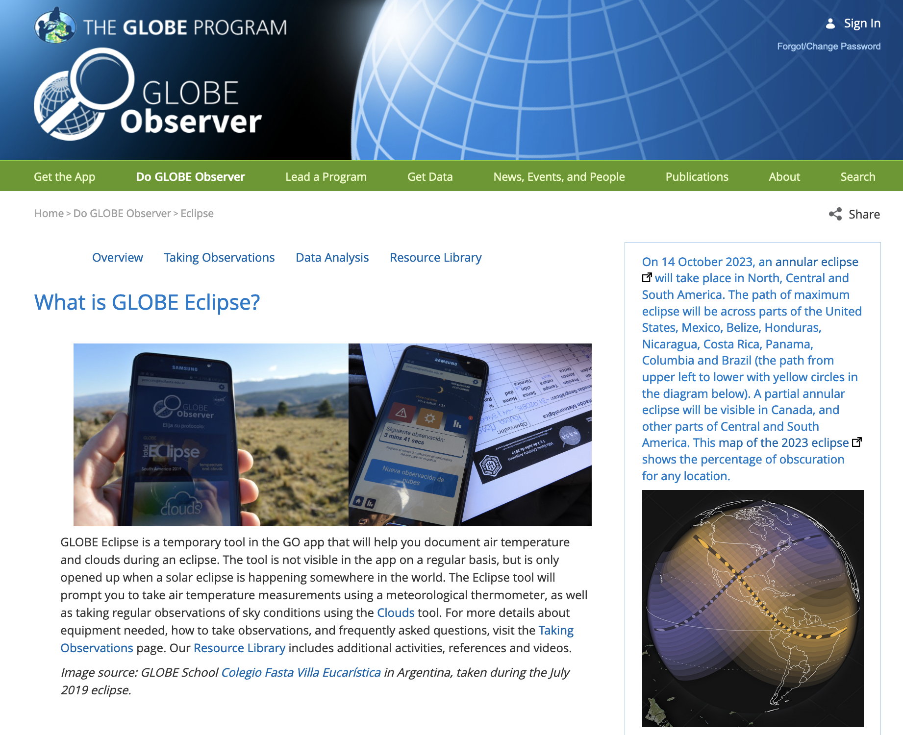
Learn More
Find more details, including activity guides and extended opportunities for data collection, on the Eclipse page of the GLOBE Observer website,
observer.globe.gov/eclipse

Slide 19
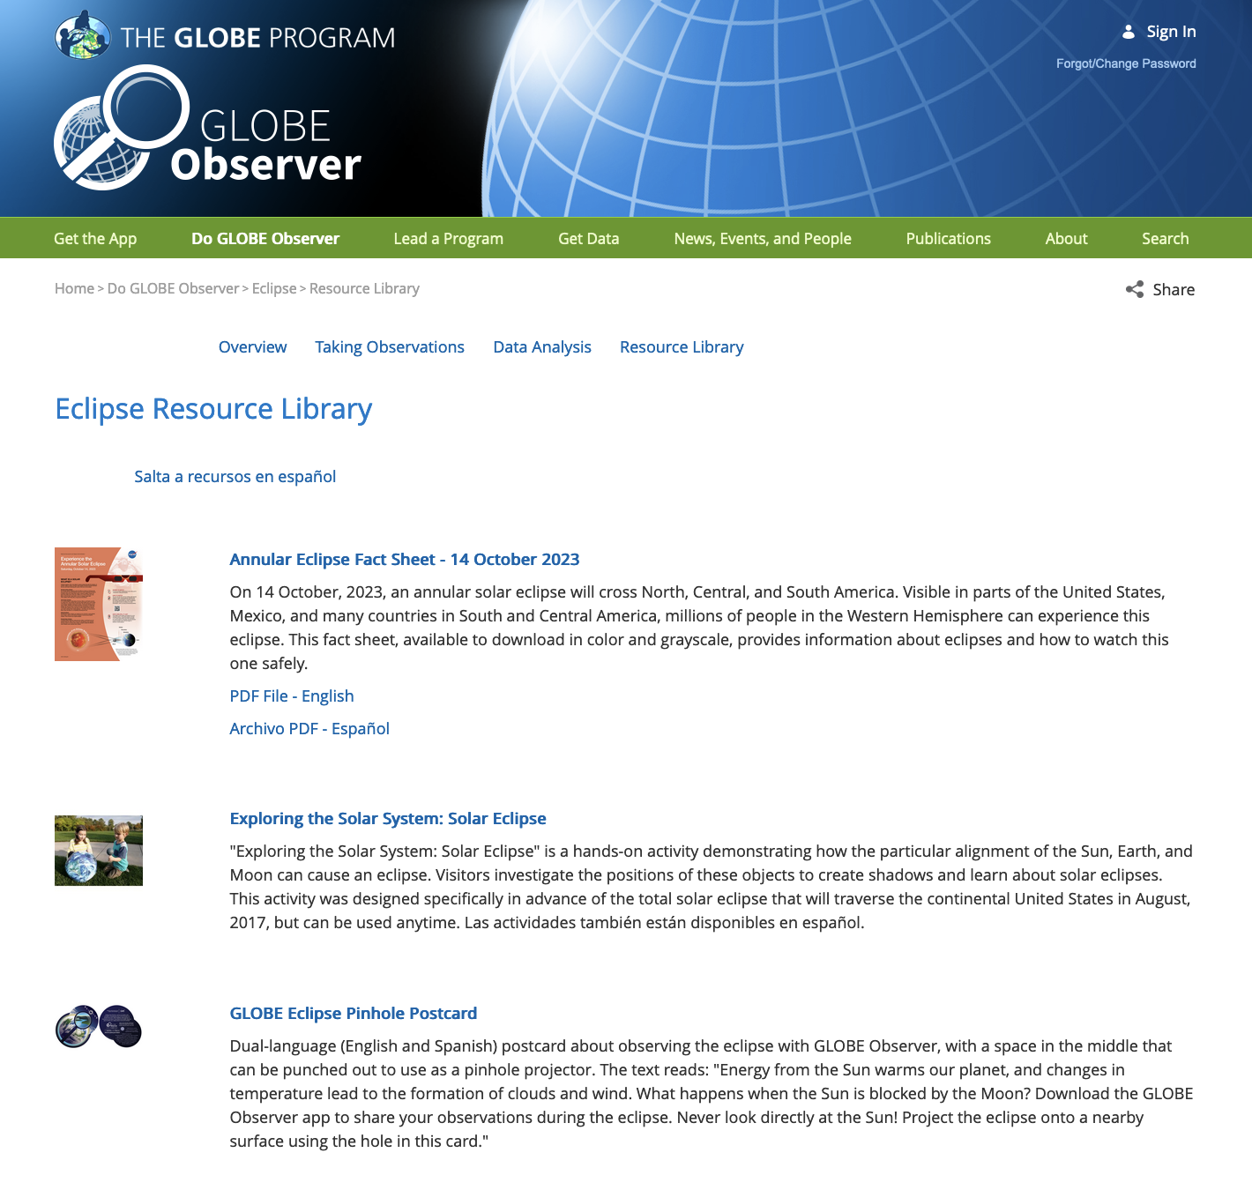
Additional Resources
The Eclipse Resource Library has a number of useful resources aimed at individual observers, and we will add more as they are developed.
También hay una sección de recursos en español.

Slide 20
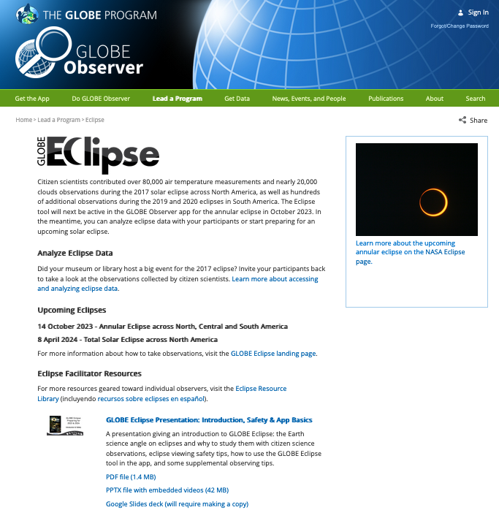
Lead a Program
The Eclipse Toolkit for Informal Educators has resources specifically for facilitators, and more are coming.

Slide 21


Download the app from the Apple App Store or Google Play.
Get the latest information as the eclipses approach by following us on social media:
facebook.com/TheGLOBEProgram
twitter.com/GLOBEProgram
instagram.com/globeprogram
Contact the GLOBE Observer team with any questions.

Slide 22
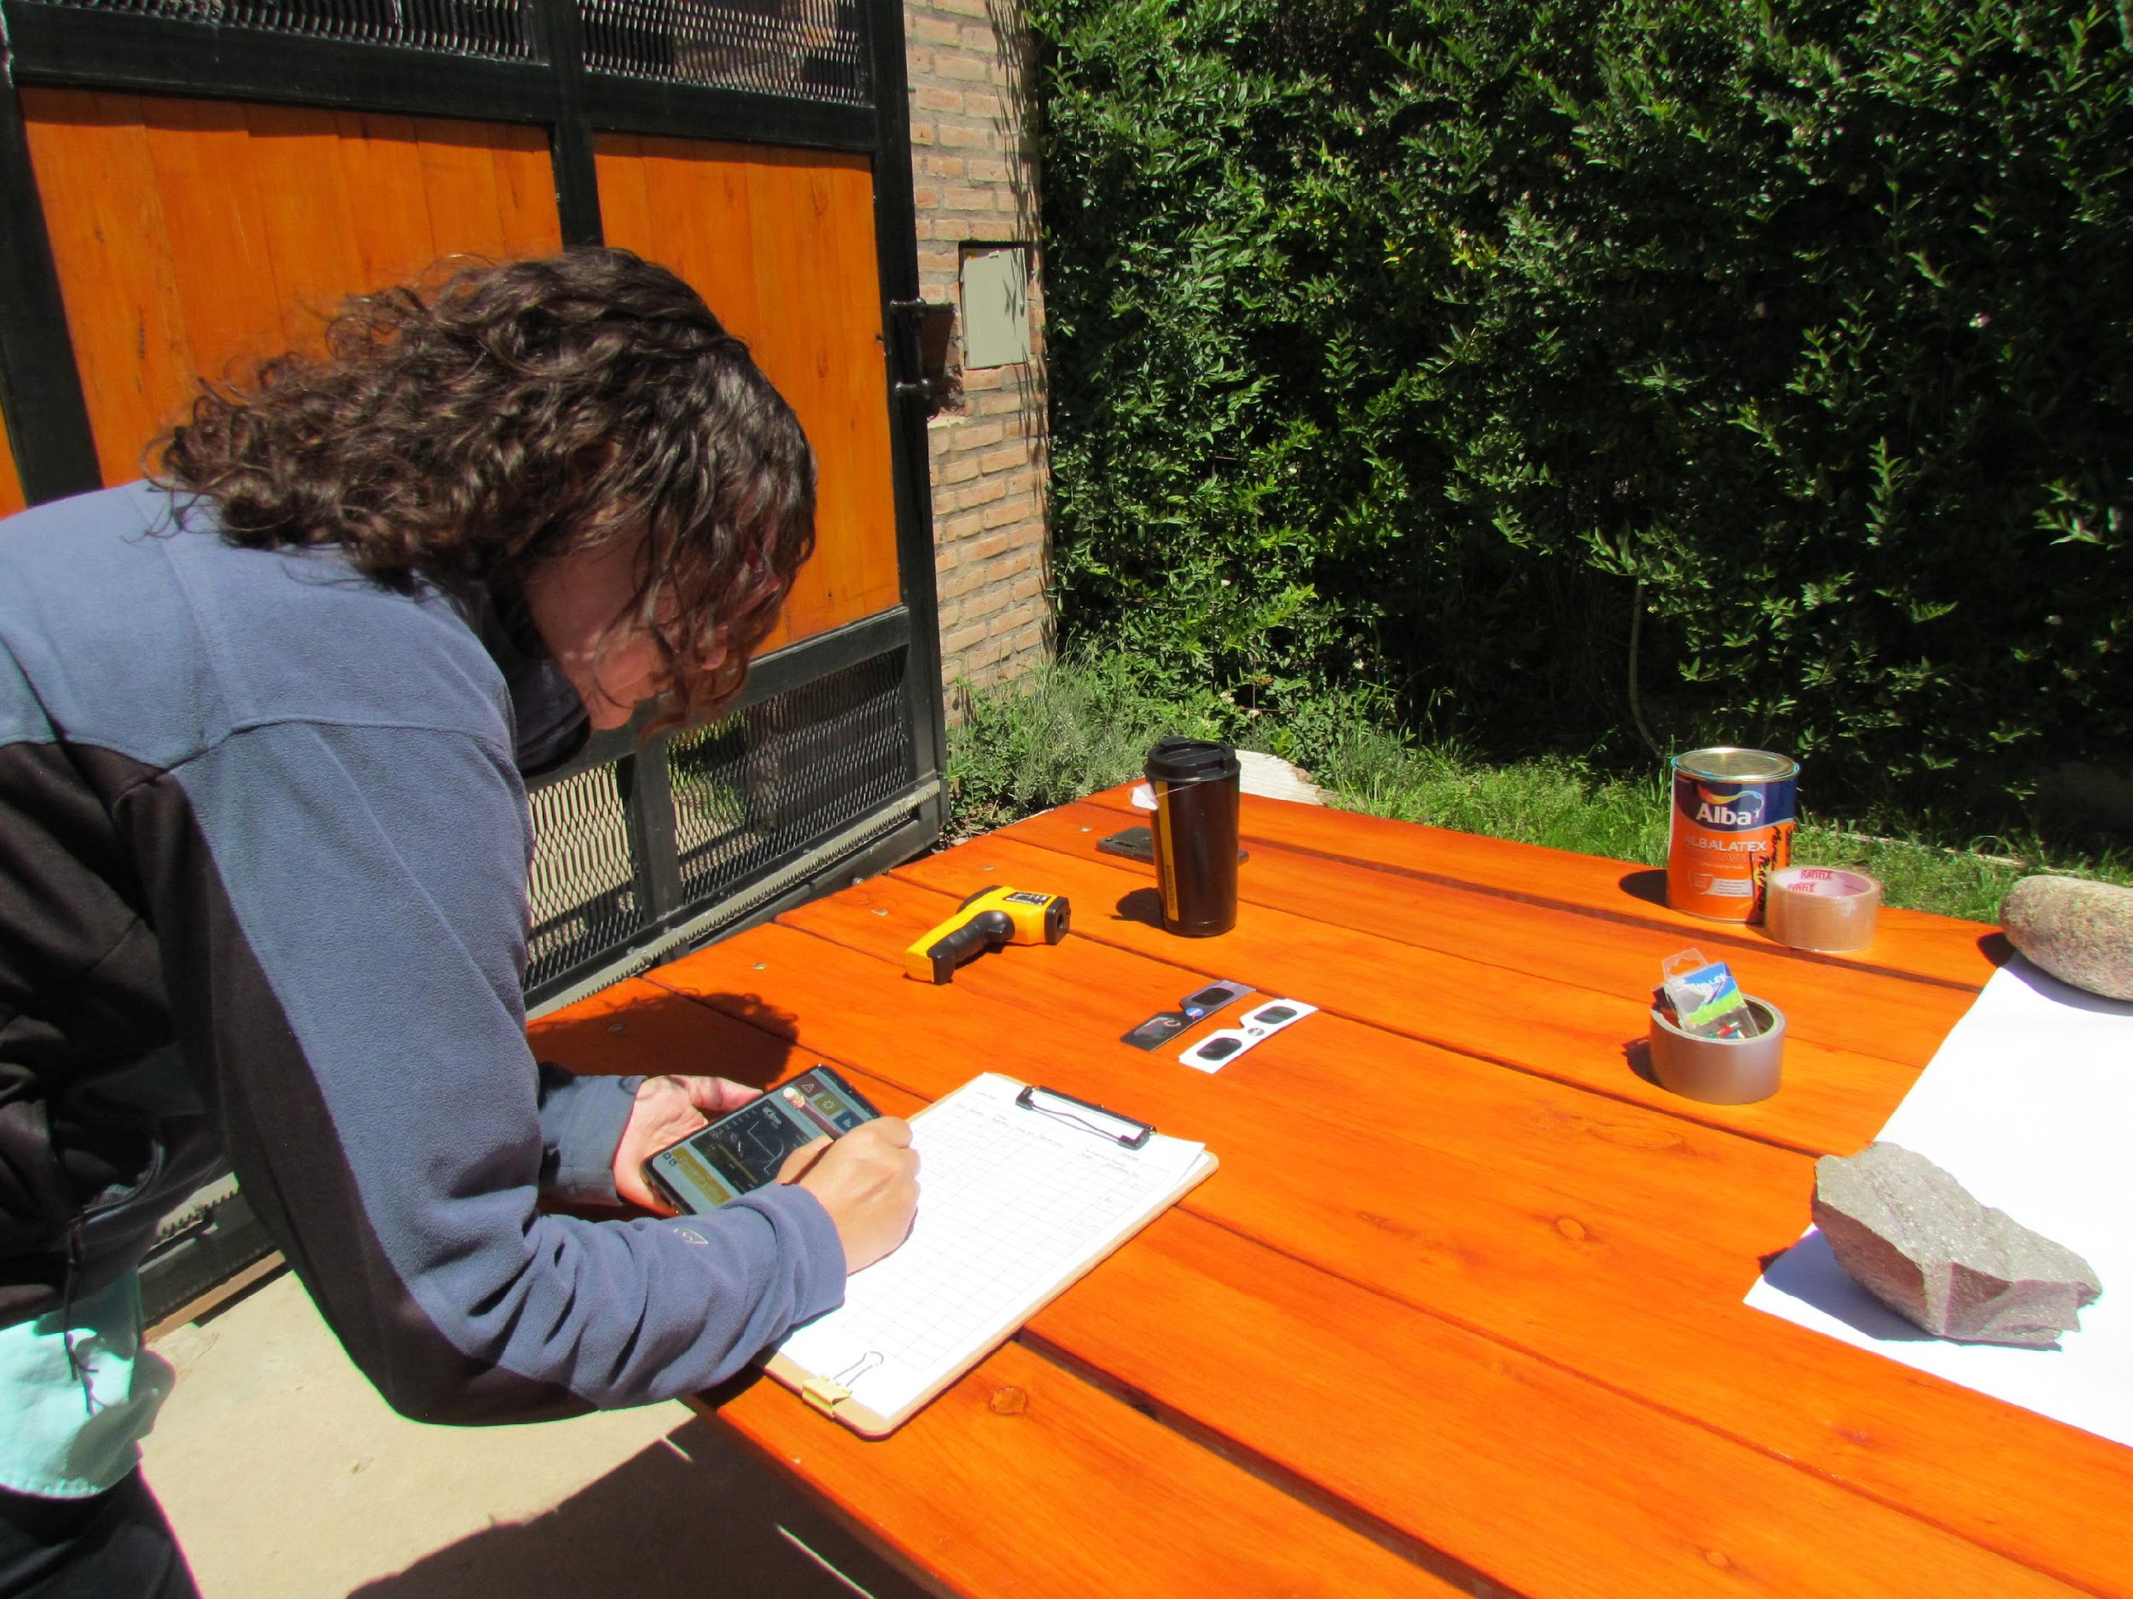
Supplemental Observation Tips
GLOBE Eclipse:
Preparing for 2023 & 2024
Making notes during the December 2020 eclipse in Argentina. Credit: Ana Prieto

Slide 23
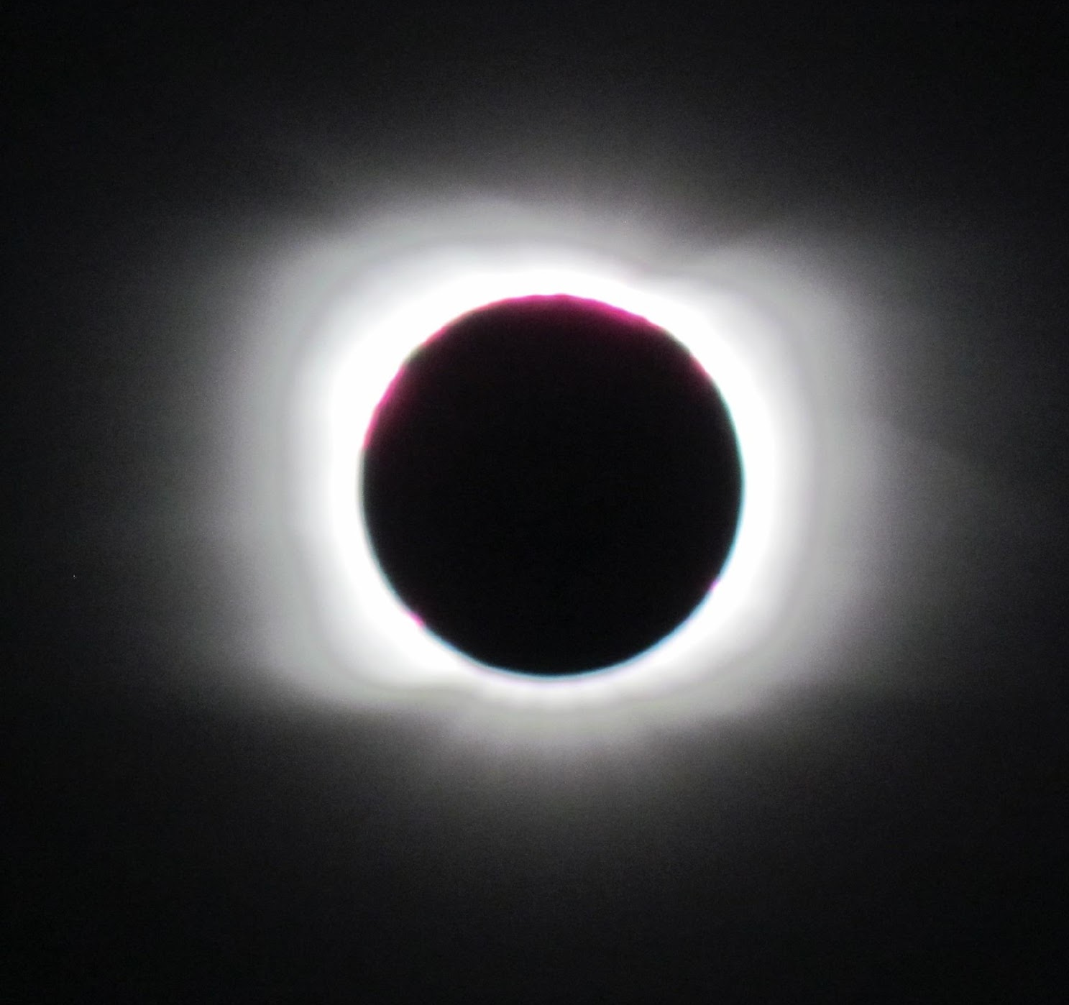
Air Temperature Tips: Timing
Ideally, take a measurement at least every ten minutes for two hours before and after maximum eclipse
If you can, increase that to every five minutes for the half hour before and after totality or the maximum eclipse at your location.
Image of the solar corona taken in Argentina on 14 December 2020. Credit: Science Club Huechulafquen, Junín de los Andes, Argentina
Stop taking measurements during the maximum eclipse/totality to enjoy the experience!
If you want the full temperature curve to appear in your graph, make sure you keep taking observations after the point of maximum eclipse.

Slide 24
Air Temperature Tips: Choosing a Thermometer
Make sure you have a separate thermometer of some sort, whether digital or liquid-filled. Don’t rely on a weather app on your phone, as that could be pulling data from a weather station some distance away.
GLOBE has a list of equipment suppliers for North America, but many available thermometers are acceptable. Look for one with with an accuracy of +/- 0.5 ºC (and 0.5 ºC divisions for liquid filled models).
Example thermometers. Credit: GLOBE

Slide 25
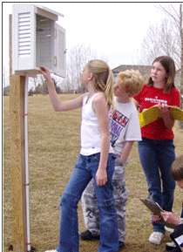
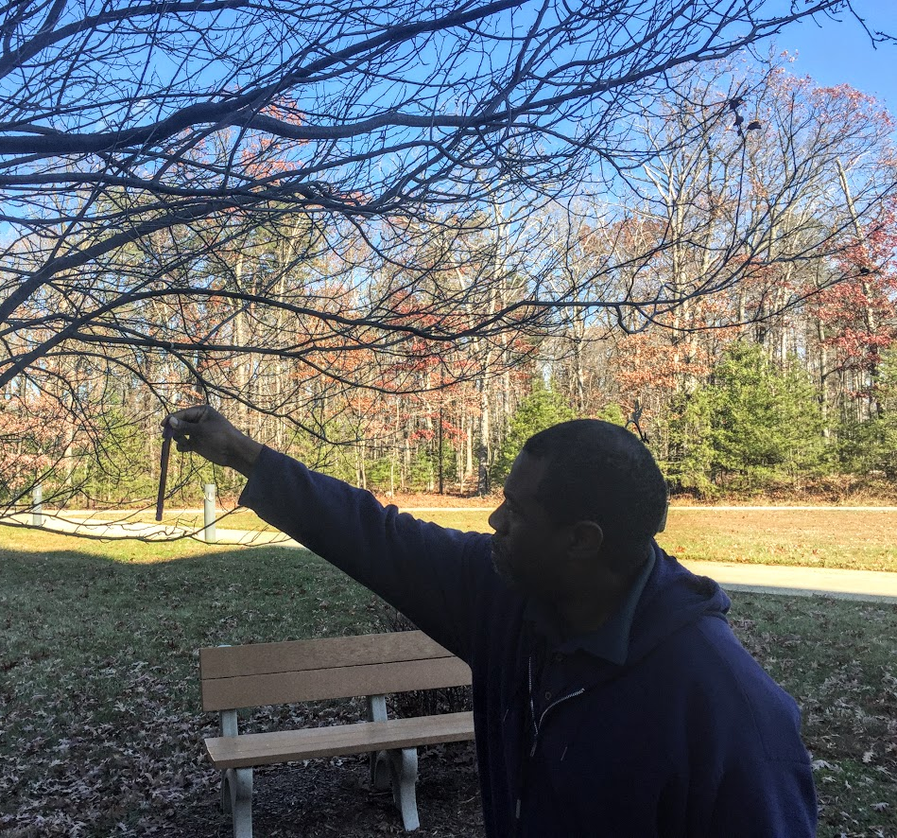
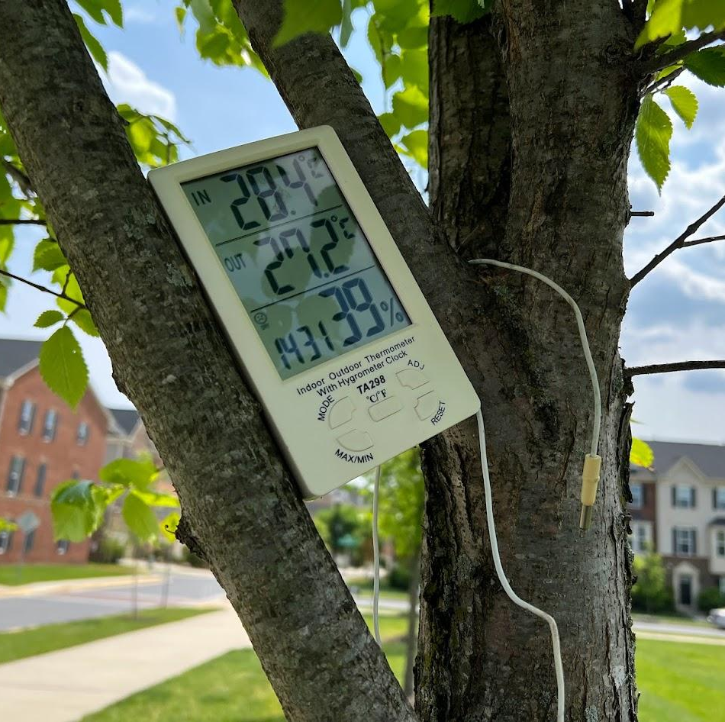
Air Temperature Tips: Accuracy of Measurements
Using an instrument box is ideal, but if that isn’t possible, make measurements in the shade (even your own shadow will help)
A mounted instrument box being checked by GLOBE students. Credit: GLOBE
Examples of taking the current temperature in the shade: Holding a simple liquid-filled thermometer in your shadow (left) or propping up a digital thermometer in a tree (right). Credit: GLOBE

Slide 26
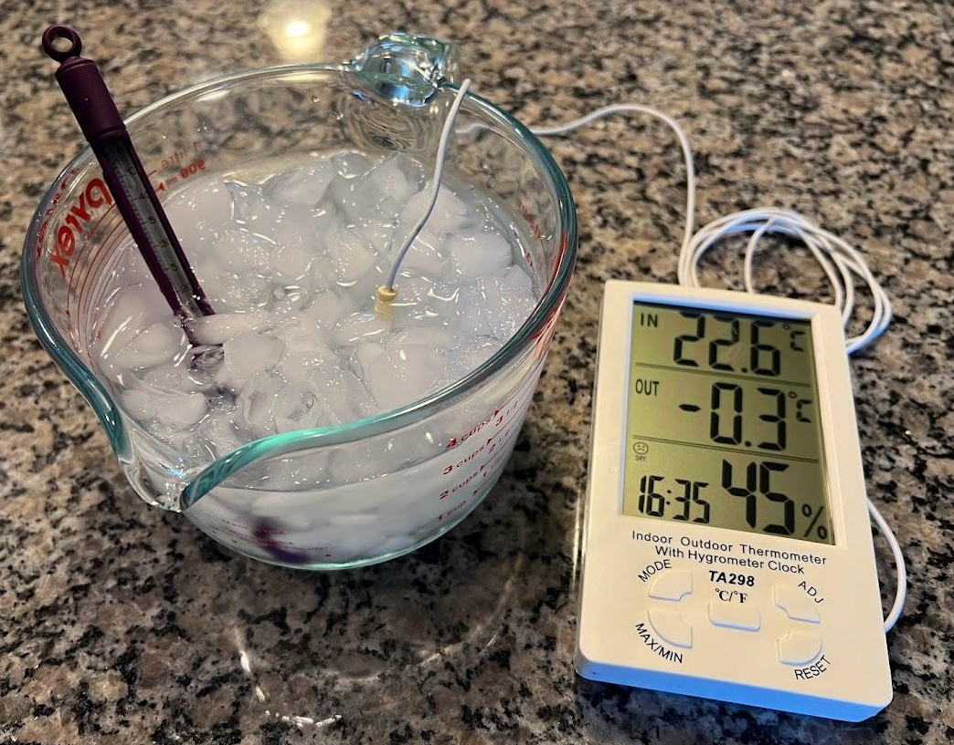
Air Temperature Tips: Thermometer Calibration
For maximum accuracy, check the calibration of your thermometer.
Prepare a mixture of fresh water and crushed ice with more ice than water in a container.
Put the thermometer in the ice-water bath and let sit for about 10 minutes.
Read the thermometer. If it reads between -0.5˚ C and +0.5˚ C, the thermometer is fine.
Testing the calibration of a liquid filled thermometer and a digital thermometer at the same time. Credit: GLOBE

Slide 27
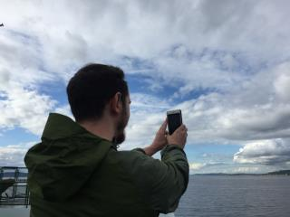
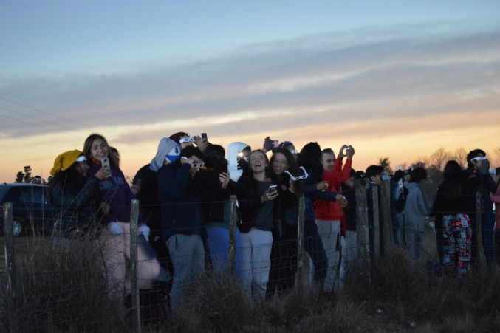
Clouds Observations for the Eclipse
Make observations about every 15-30 minutes, more often if you wish, especially any time you notice something changing.
If you are also measuring air temperature, the eclipse tool will remind you with notifications to make your measurements about every third air temperature measurement.
Feel free to add narrative comments to your photos about anything interesting you see happening.
Taking a Clouds observation with a mobile device. Credit: Lindsey Weaver
Students from Colegio Fasta Villa Eucarística, Córdoba, Argentina observing the July 2019 eclipse. Credit: Pablo Cecchi

Slide 28
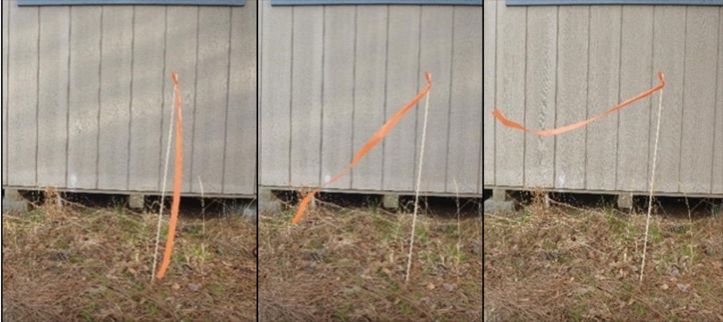
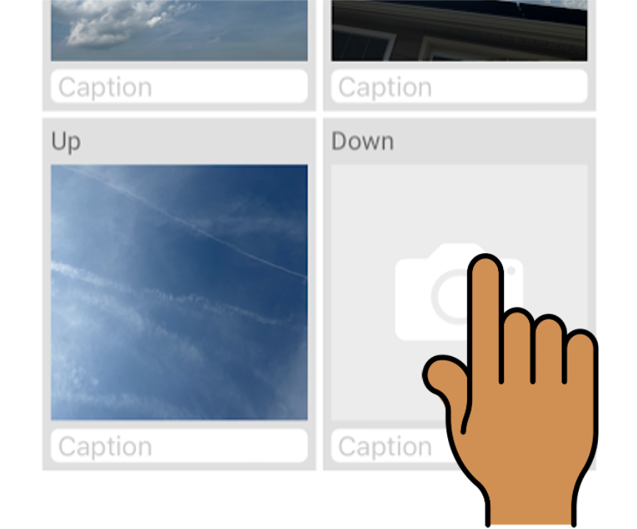
Basic Wind Observations
A simple rod and a ribbon (a wind stick) can be a way to visually estimate if the wind is increasing or decreasing, or changing direction
Include your stick in the down photo of any clouds observations you take to document the changes during the period of the eclipse.
Tip: Using the manual photo option for your down photo may make it easier to capture the wind stick fully.
Images of a wind stick showing progressively stronger wind from left to right. Credit: AREN Project

Slide 29
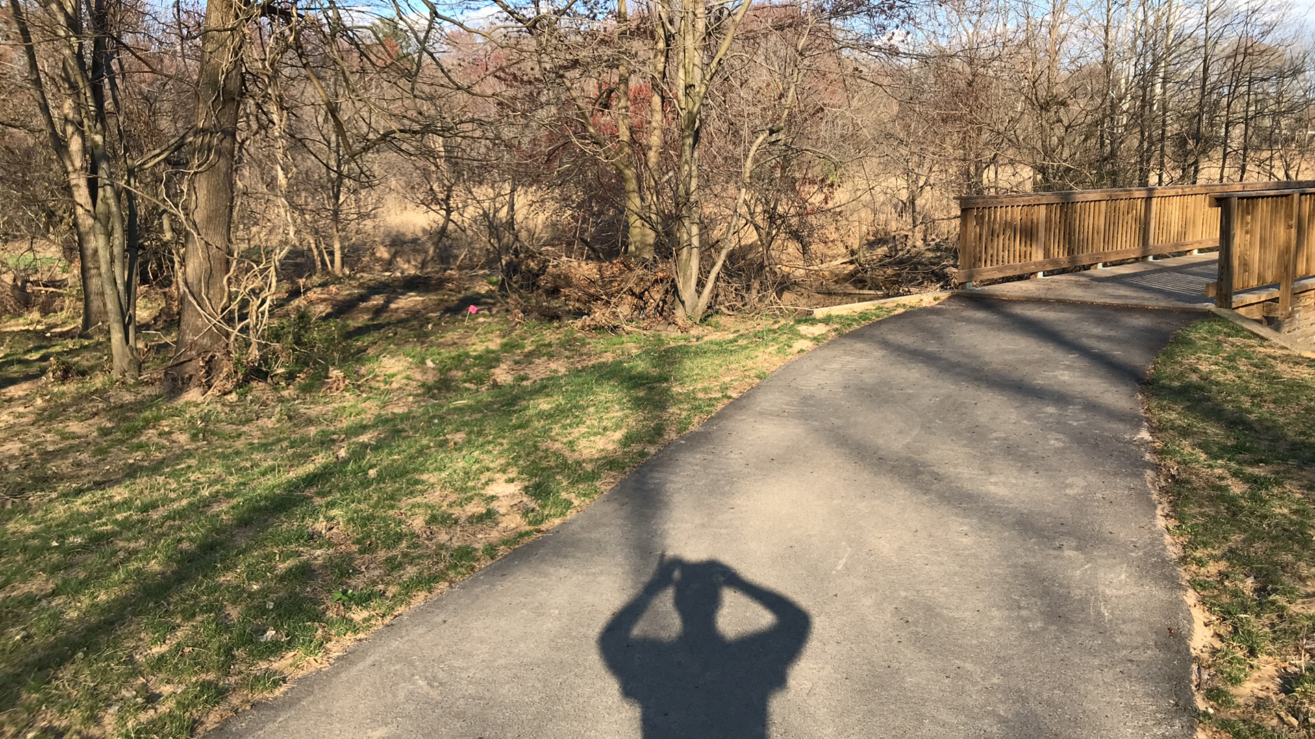
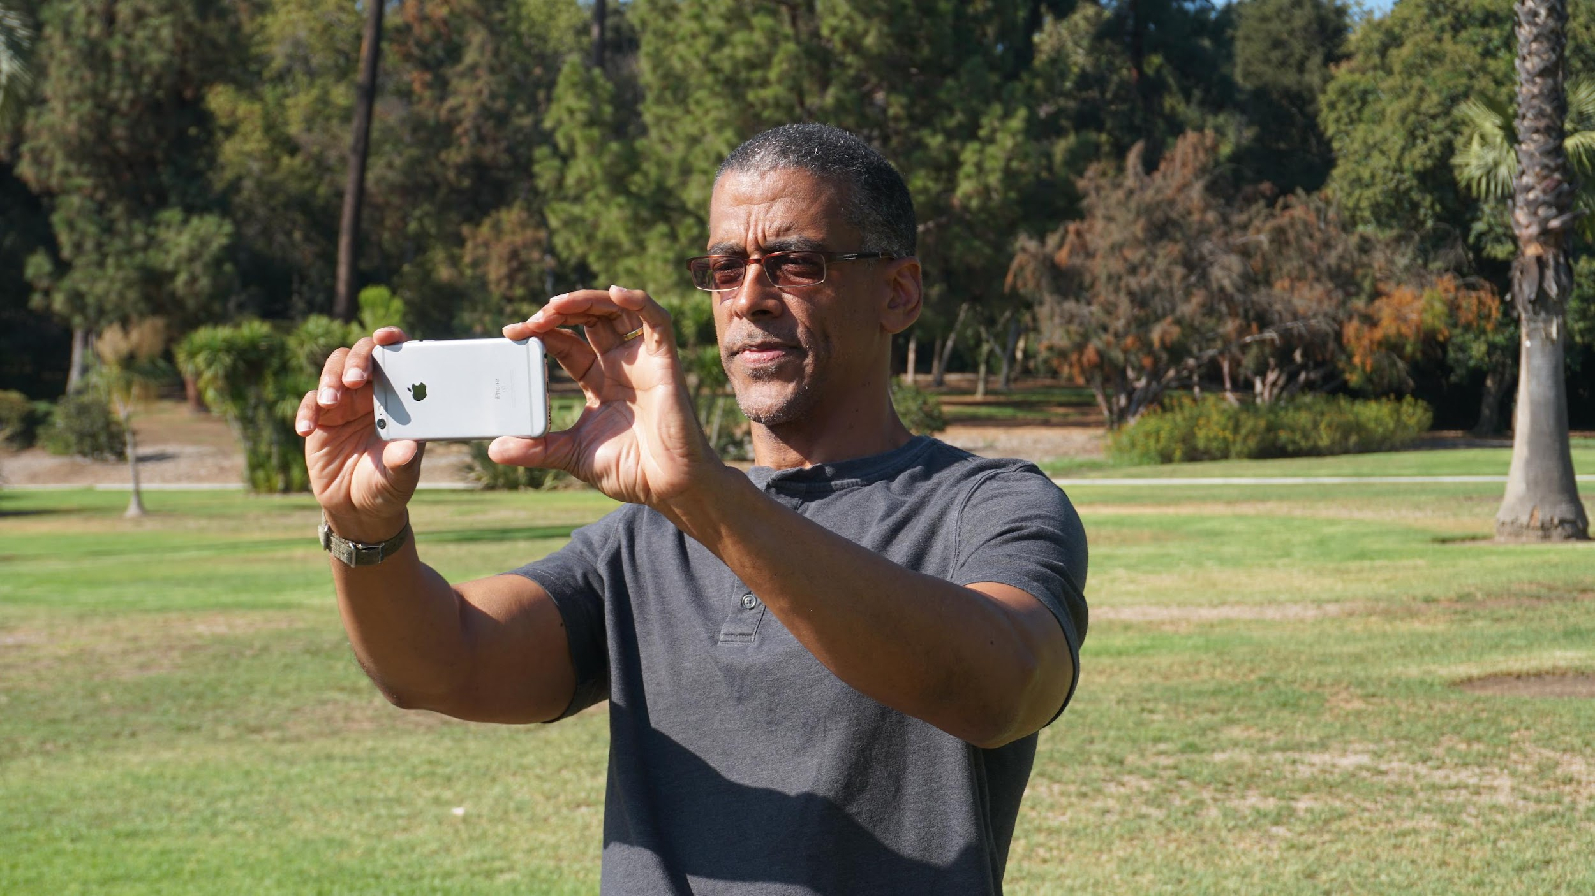
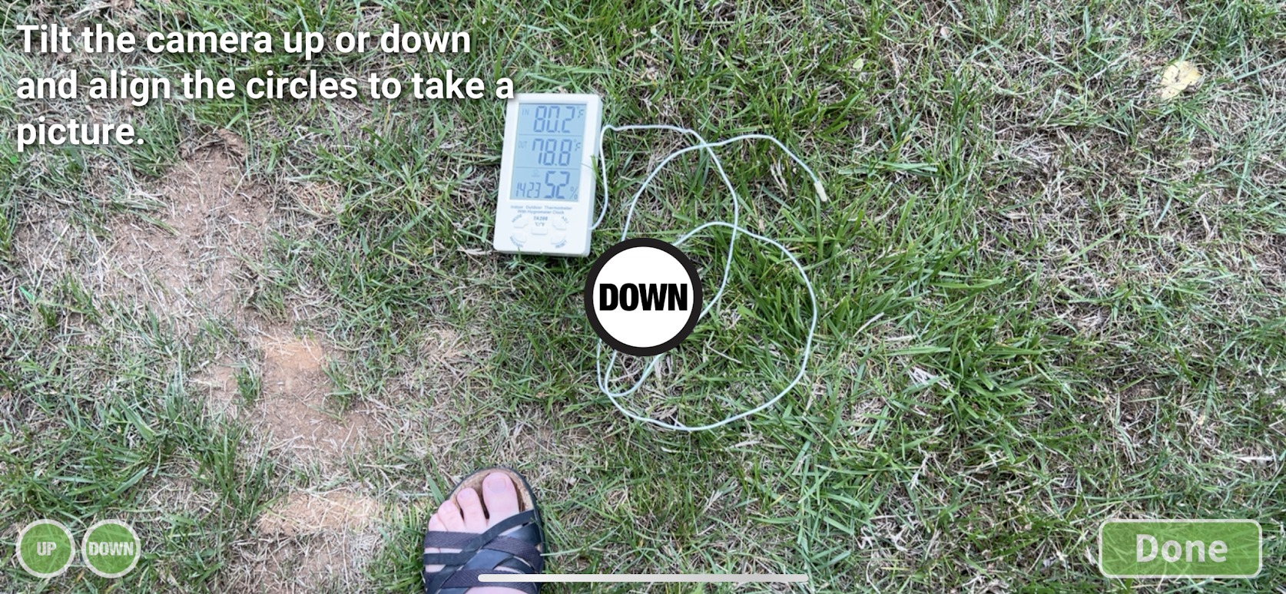
Land Cover Observations
We ask you do to a Land Cover observation as part of the initial setup when you open the Eclipse tool to help with research questions that may look at the effect of different types of surface cover on temperature changes during the eclipse.
As part of that site setup, please include your thermometer in one of your photos, which will allow us to confirm the type you are using for air temperature measurements.
A photo from a land cover observation. Credit: GLOBE
A person taking a land cover observation. Credit: GLOBE
A digital thermometer included in the down photo of a land cover observation. Credit GLOBE

Slide 30
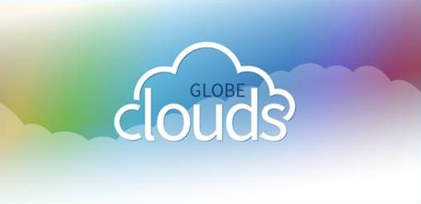
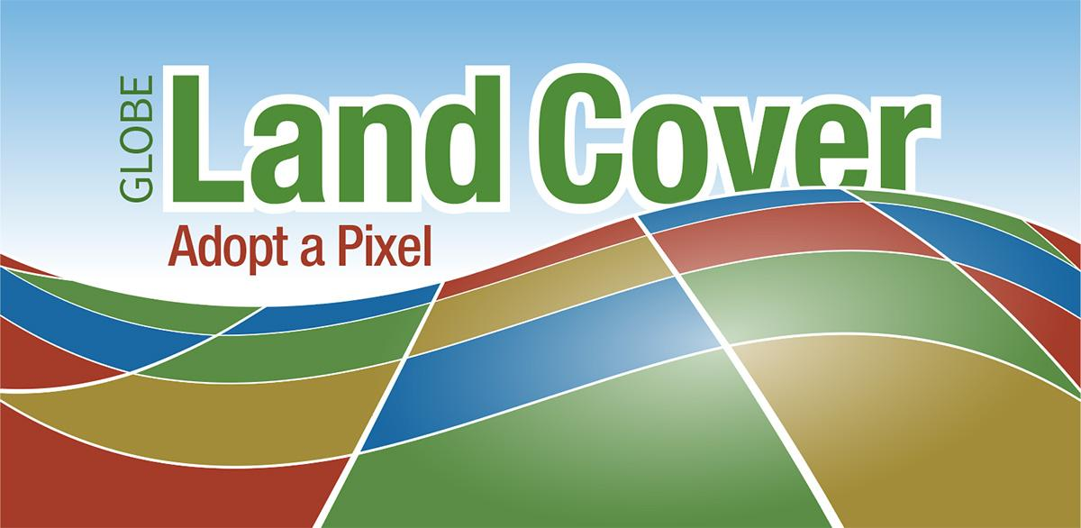
General Notes
You should download the app and set up your account ahead of time, but you don’t need to have wifi or cellular signal to collect data (can collect and send later).
Cloud and land cover observations are always available in the GLOBE Observer app, so you can practice those types of observations ahead of time. For basic app users, air temperature will become available closer to each eclipse.

Slide 31
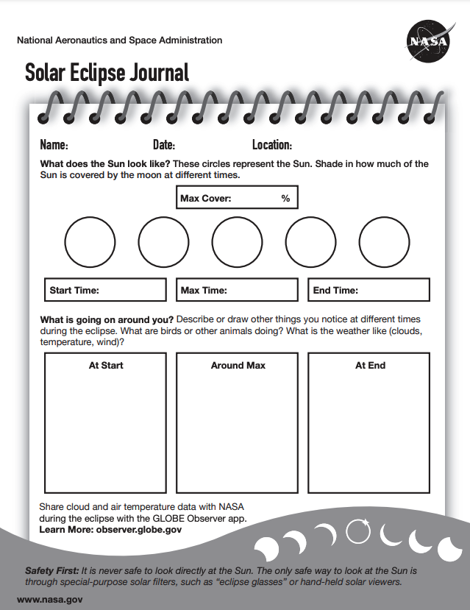
Qualitative Observations
In addition to adding narrative comments to the photo captions in a Clouds observation, or to the field notes in a Land Cover observation, we also have a paper Solar Eclipse Journal page available in the Eclipse Resource Library on the GLOBE Observer website.
This can serve as an organizer for your thoughts or simply inspiration for creating your own style of eclipse journal page.

